Slide 1
Warm Up
Classify each polygon.
1. a polygon with three congruent sides
2. a polygon with six congruent sides and six congruent angles
3. a polygon with four sides and with opposite sides parallel and congruent
equilateral triangle
regular hexagon
parallelogram

Slide 2
10-1
Solid Geometry
Warm Up
Lesson Presentation
Lesson Quiz
Holt McDougal Geometry
Holt Geometry

Slide 3
Objectives
Classify three-dimensional figures according to their properties.
Use nets and cross sections to analyze three-dimensional figures.

Slide 4
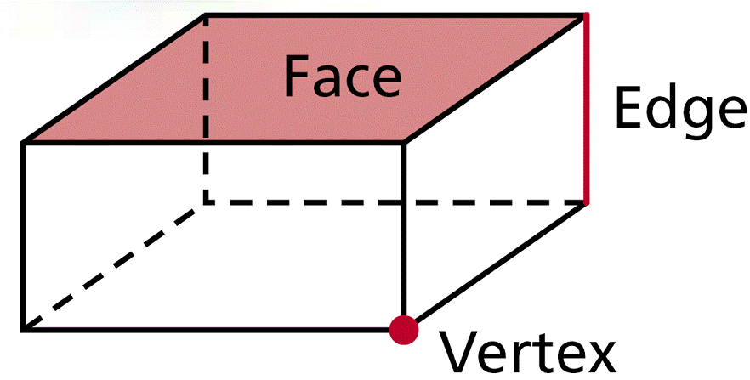
Three-dimensional figures, or solids, can be made up of flat or curved surfaces. Each flat surface is called a face. An edge is the segment that is the intersection of two faces. A vertex is the point that is the intersection of three or more faces.

Slide 6
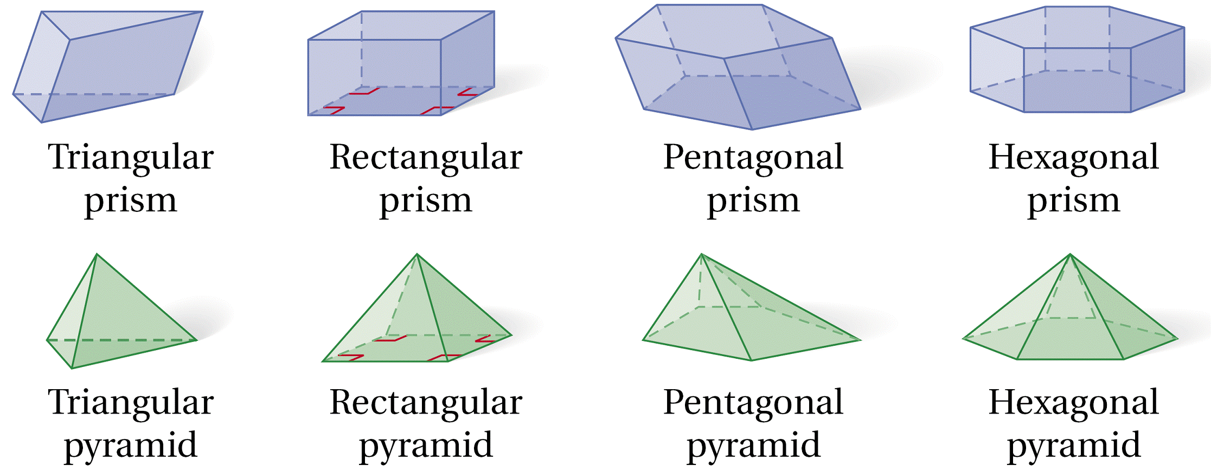
A cube is a prism with six square faces. Other prisms and pyramids are named for the shape of their bases.

Slide 7
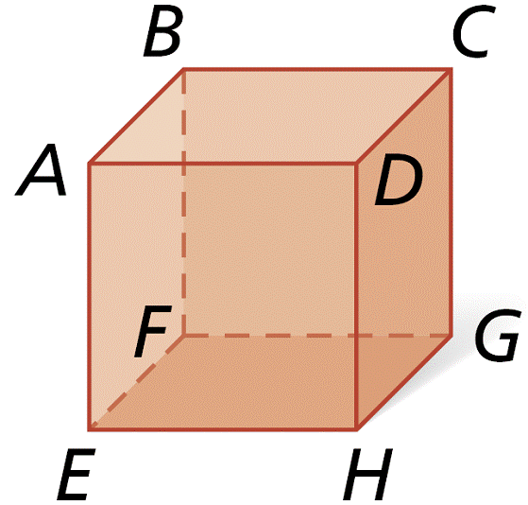
Example 1A: Classifying Three-Dimensional Figures
Classify the figure.
Rectangular Prism, or a
cube if all faces are squares

Slide 8
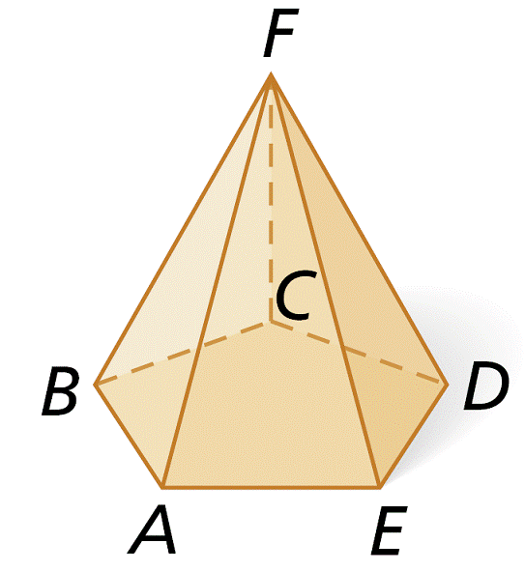
Example 1B: Classifying Three-Dimensional Figures
Classify the figure and name the base.
pentagonal pyramid
base: ABCDE

Slide 9
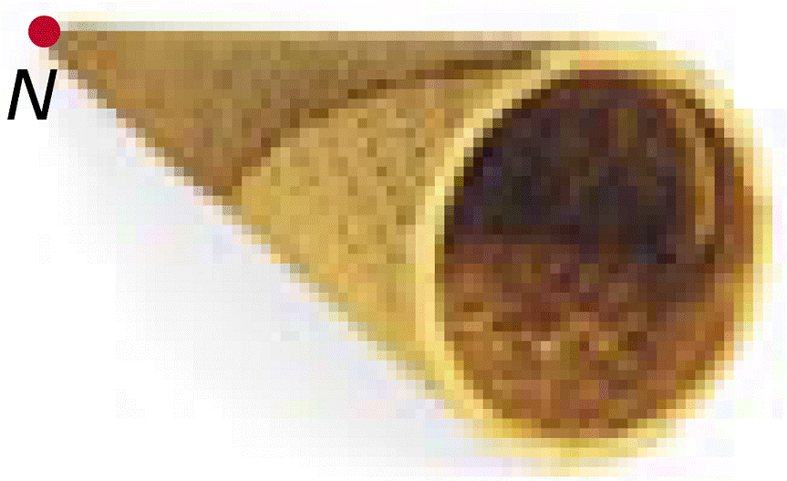
Check It Out! Example 1a
Classify the figure.
cone

Slide 10
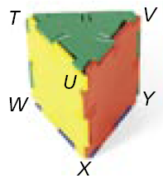
Check It Out! Example 1b
Classify the figure.
triangular prism

Slide 11
A net is a diagram of the surfaces of a three-dimensional figure that can be folded to form the three-dimensional figure. To identify a three-dimensional figure from a net, look at the number of faces and the shape of each face.

Slide 12
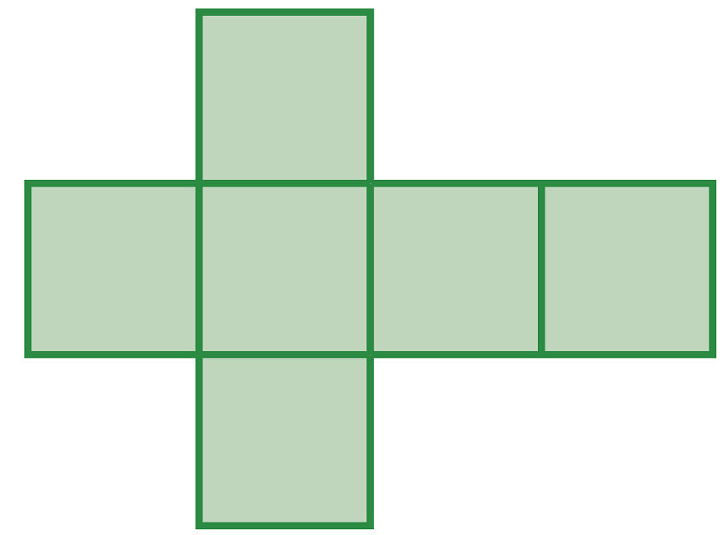
Example 2A: Identifying a Three-Dimensional Figure From a Net
Describe the three-dimensional figure that can be made from the given net.
The net has six congruent square faces. So the net forms a cube.

Slide 13
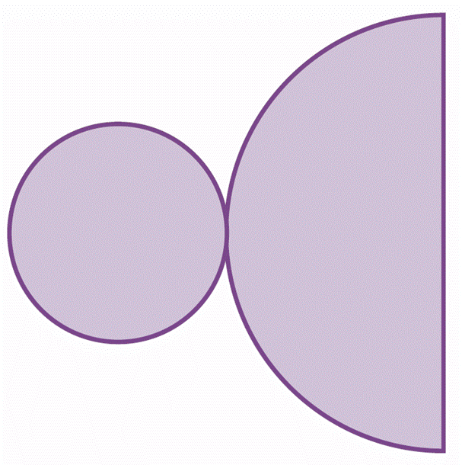
Example 2B: Identifying a Three-Dimensional Figure From a Net
Describe the three-dimensional figure that can be made from the given net.
The net has one circular face and one semicircular face. These are the base and sloping face of a cone. So the net forms a cone.

Slide 14
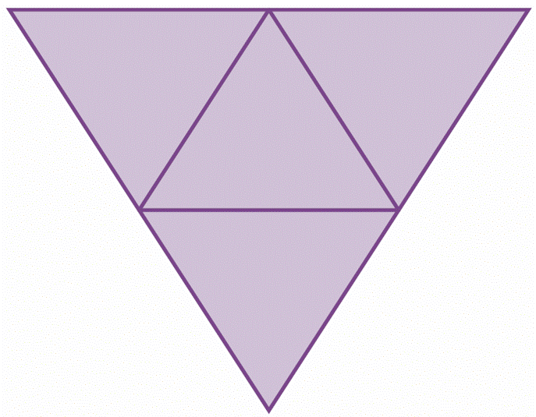
Check It Out! Example 2a
Describe the three-dimensional figure that can be made from the given net.
The net has four congruent triangular faces. So the net forms a triangular pyramid.

Slide 15
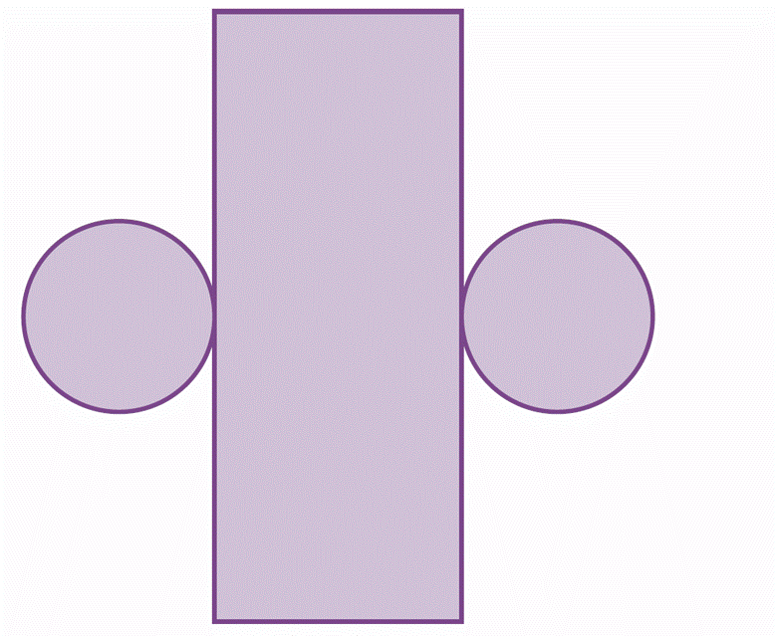
Check It Out! Example 2b
Describe the three-dimensional figure that can be made from the given net.
The net has two circular faces and one rectangular face. These are the bases and curved surface of a cylinder. So the net forms a cylinder.

Slide 16
Closer look at NETS!
A cross section is the intersection of a three-dimensional figure and a plane.

Slide 17
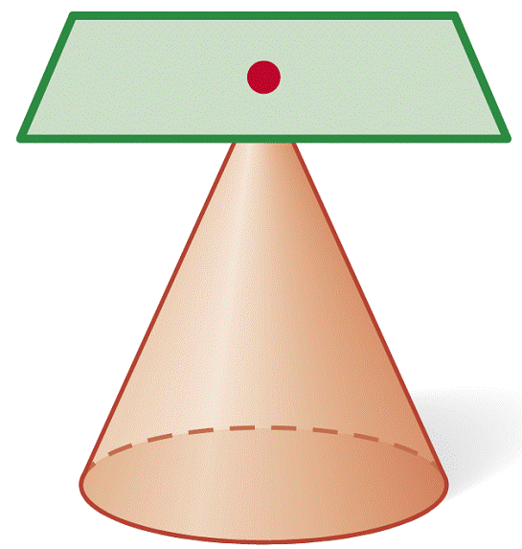
Example 3A: Describing Cross Sections of Three-Dimensional Figures
Describe the cross section.
The cross section is a point.

Slide 18
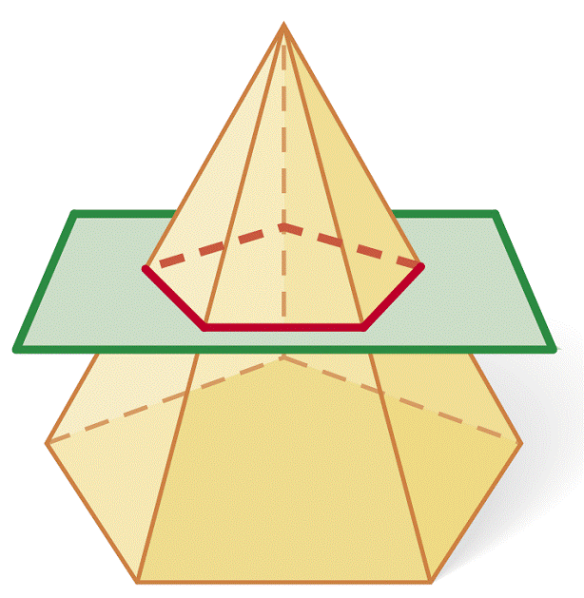
Example 3B: Describing Cross Sections of Three-Dimensional Figures
Describe the cross section.
The cross section is a pentagon.

Slide 19
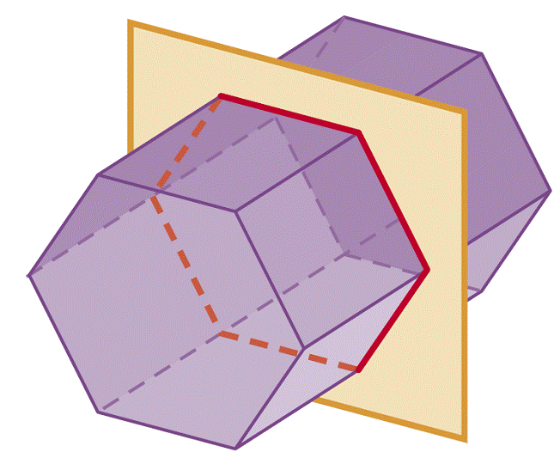
Check It Out! Example 3a
Describe the cross section.
The cross section is a hexagon.

Slide 20
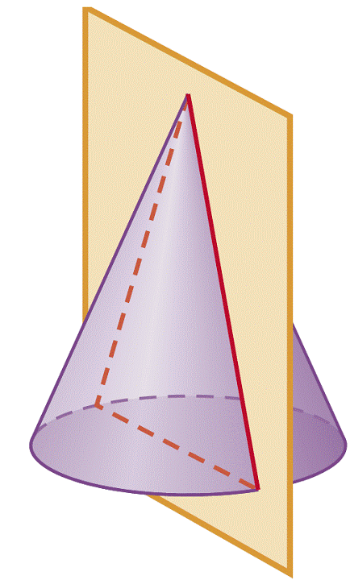
Check It Out! Example 3b
Describe the cross section.
The cross section is a triangle.

Slide 21
Warm Up
Find the unknown lengths.
1. the diagonal of a square with side length 5 cm
2. the base of a rectangle with diagonal 15 m and height 13 m
3. the height of a trapezoid with area 18 ft² and bases 3 ft and 9 ft
≈ 7.5 m
3 ft

Slide 22
10-3
Formulas in Three Dimensions
Warm Up
Lesson Presentation
Lesson Quiz
Holt McDougal Geometry
Holt Geometry

Slide 23
Objectives
Apply Euler’s formula to find the number of vertices, edges, and faces of a polyhedron.
Develop and apply the distance and midpoint formulas in three dimensions.

Slide 24
A polyhedron is formed by four or more polygons that intersect only at their edges. Prisms and pyramids are polyhedrons, but cylinders and cones are not.

Slide 25
In the lab before this lesson, you made a conjecture about the relationship between the vertices, edges, and faces of a polyhedron. One way to state this relationship is given below.
Reading Math
Euler is pronounced “Oiler.”

Slide 26
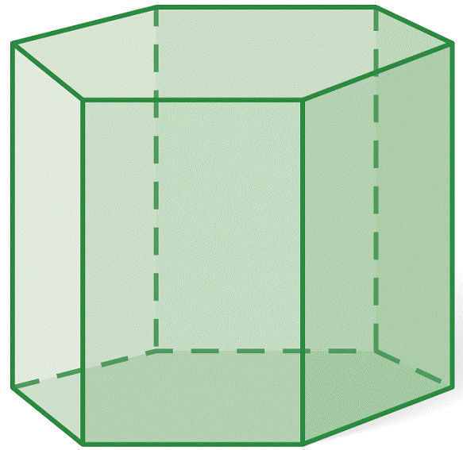
Example 1A: Using Euler’s Formula
Find the number of vertices, edges, and faces of the polyhedron. Use your results to verify Euler’s formula.
V = 12, E = 18, F = 8
?
12 – 18 + 8 = 2
Use Euler’s Formula.
2 = 2
Simplify.

Slide 27
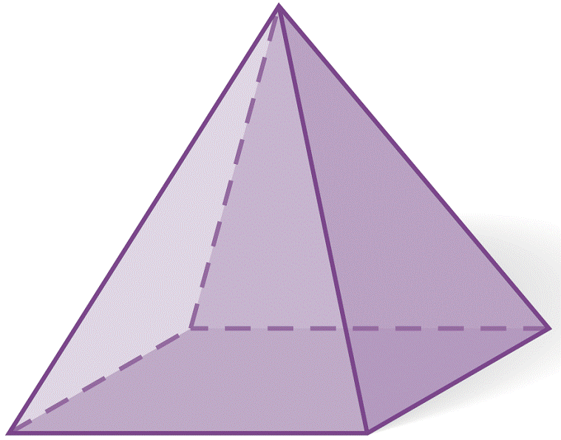
Example 1B: Using Euler’s Formula
Find the number of vertices, edges, and faces of the polyhedron. Use your results to verify Euler’s formula.
V = 5, E = 8, F = 5
?
Use Euler’s
Formula.
5 – 8 + 5 = 2
2 = 2
Simplify.

Slide 28
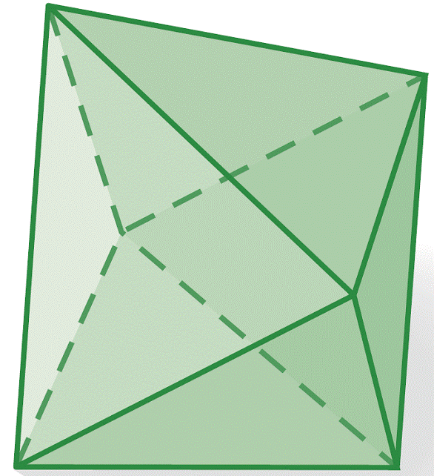
Check It Out! Example 1a
Find the number of vertices, edges, and faces of the polyhedron. Use your results to verify Euler’s formula.
V = 6, E = 12, F = 8
?
6 – 12 + 8 = 2
Use Euler’s Formula.
2 = 2
Simplify.

Slide 29
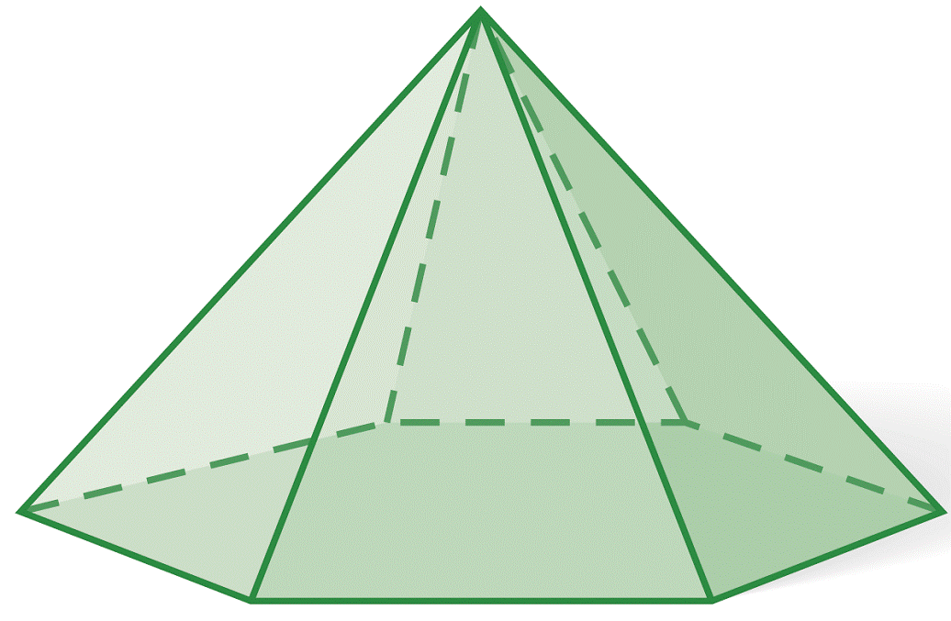
Check It Out! Example 1b
Find the number of vertices, edges, and faces of the polyhedron. Use your results to verify Euler’s formula.
V = 7, E = 12, F = 7
?
Use Euler’s
Formula.
7 – 12 + 7 = 2
2 = 2
Simplify.

Slide 30
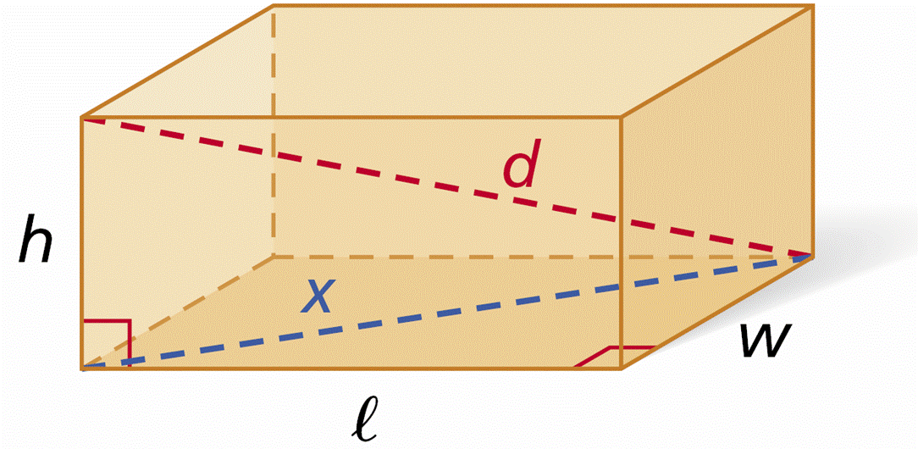
A diagonal of a three-dimensional figure connects
two vertices of two different faces. Diagonal d
of a rectangular prism is shown in the diagram.
By the Pythagorean Theorem, l² + w² = x², and
x² + h² = d². Using substitution, l² + w² + h² = d².

Slide 32
Example 2A: Using the Pythagorean Theorem in Three Dimensions
Find the unknown dimension in the figure.
the length of the diagonal of a 6 cm by 8 cm by 10 cm rectangular prism
Substitute 6 for l, 8 for w, and 10 for h.
Simplify.

Slide 33
Example 2B: Using the Pythagorean Theorem in Three Dimensions
Find the unknown dimension in the figure.
the height of a rectangular prism with a 12 in. by 7 in. base and a 15 in. diagonal
Substitute 15 for d, 12 for l, and 7 for w.
Square both sides of the equation.
225 = 144 + 49 + h²
Simplify.
h² = 32
Solve for h².
Take the square root of both sides.

Slide 34
Check It Out! Example 2
Find the length of the diagonal of a cube with edge length 5 cm.
Substitute 5 for each side.
Square both sides of the equation.
d² = 25 + 25 + 25
Simplify.
d² = 75
Solve for d².
Take the square root of both sides.

Slide 35
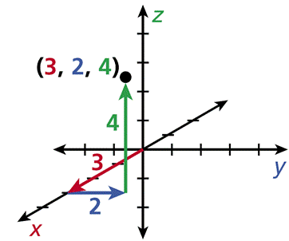
Space is the set of all points in three dimensions.
Three coordinates are needed to locate a point in
space. A three-dimensional coordinate system has 3 perpendicular axes: the x-axis, the y-axis, and the
z-axis. An ordered triple (x, y, z) is used to locate a
point. To locate the point (3, 2, 4) , start at (0, 0, 0). From there move 3 units forward, 2 units right, and then 4 units up.

Slide 36
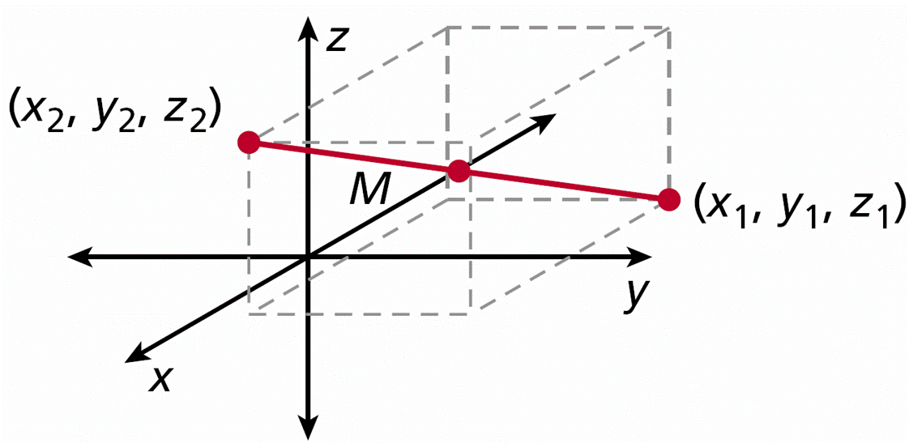
You can find the distance between the two points (x₁, y₁, z₁) and (x₂, y₂, z₂) by drawing a rectangular prism with the given points as endpoints of a diagonal. Then use the formula for the length of the diagonal. You can also use a formula related to the Distance Formula. (See Lesson 1-6.) The formula for the midpoint between (x₁, y₁, z₁) and (x₂, y₂, z₂) is related to the Midpoint Formula. (See Lesson 1-6.)

Slide 38
Example 4A: Finding Distances and Midpoints in Three Dimensions
Find the distance between the given points. Find the midpoint of the segment with the given endpoints. Round to the nearest tenth, if necessary.
(0, 0, 0) and (2, 8, 5)
distance:

Slide 39
Example 4A Continued
Find the distance between the given points. Find the midpoint of the segment with the given endpoints. Round to the nearest tenth, if necessary.
(0, 0, 0) and (2, 8, 5)
midpoint:
M(1, 4, 2.5)

Slide 40
Example 4B: Finding Distances and Midpoints in Three Dimensions
Find the distance between the given points. Find the midpoint of the segment with the given endpoints. Round to the nearest tenth, if necessary.
(6, 11, 3) and (4, 6, 12)
distance:

Slide 41
Example 4B Continued
Find the distance between the given points. Find the midpoint of the segment with the given endpoints. Round to the nearest tenth, if necessary.
(6, 11, 3) and (4, 6, 12)
midpoint:
M(5, 8.5, 7.5)

Slide 42
Check It Out! Example 4a
Find the distance between the given points. Find the midpoint of the segment with the given endpoints. Round to the nearest tenth, if necessary.
(0, 9, 5) and (6, 0, 12)
distance:

Slide 43
Check It Out! Example 4a Continued
Find the distance between the given points. Find the midpoint of the segment with the given endpoints. Round to the nearest tenth, if necessary.
(0, 9, 5) and (6, 0, 12)
midpoint:
M(3, 4.5, 8.5)

Slide 44
Check It Out! Example 4b
Find the distance between the given points. Find the midpoint of the segment with the given endpoints. Round to the nearest tenth, if necessary.
(5, 8, 16) and (12, 16, 20)
distance:

Slide 45
Check It Out! Example 4b
Find the distance between the given points. Find the midpoint of the segment with the given endpoints. Round to the nearest tenth, if necessary.
(5, 8, 16) and (12, 16, 20)
midpoint:
M(8.5, 12, 18)

Slide 46
Example 5: Recreation Application
Trevor drove 12 miles east and 25 miles south from a cabin while gaining 0.1 mile in elevation. Samira drove 8 miles west and 17 miles north from the cabin while gaining 0.15 mile in elevation. How far apart were the drivers?
The location of the cabin can be represented by the ordered triple (0, 0, 0), and the locations of the drivers can be represented by the ordered triples (12, –25, 0.1) and (–8, 17, 0.15).

Slide 47
Example 5 Continued
Use the Distance Formula to find the distance between the drivers.

Slide 48
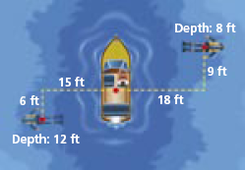
Check It Out! Example 5
What if…? If both divers swam straight up to the surface, how far apart would they be?
Use the Distance Formula to find the distance between the divers.

Slide 49
Lesson Quiz: Part I
1. Find the number of vertices, edges, and faces of the polyhedron. Use your results to verify Euler’s formula.
V = 8; E = 12; F = 6;
8 – 12 + 6 = 2

Slide 50
Lesson Quiz: Part II
Find the unknown dimension in each figure. Round to the nearest tenth, if necessary.
2. the length of the diagonal of a cube with edge length 25 cm
3. the height of a rectangular prism with a 20 cm by 12 cm base and a 30 cm diagonal
4. Find the distance between the points (4, 5, 8) and (0, 14, 15) . Find the midpoint of the segment with the given endpoints. Round to the nearest tenth, if necessary.
43.3 cm
18.9 cm
d ≈ 12.1 units; M (2, 9.5, 11.5)

