Slide 1
Lesson 4.4 – Graphing Lines
Concept: Graphing Lines
EQ: How do we graph linear equations?
Vocabulary:
Coordinate Plane, Slope, Slope intercept form, Table, Intercepts

Slide 2
Do you remember…
Linear equations have a constant rate of change.
The slope of a linear graph is a measure of the rate of change of y with respect to x. (Rise over Run)
The y-intercept of the equation is the point at which the graph crosses the y-axis and the value of x is zero.
Linear equations in two variables can be written in slope-intercept form y = mx + b, where m is the slope and b is the y-intercept.

Slide 3
Let’s see if we can graph the line below…
Example 1
Graph the line y = 2x - 3

Slide 4
Graphing using a Table of Values
1. Draw a table
x | y
2. Choose three inputs (x values)
x | y
-1
0
2
Notes:
Notice I chose 1 negative, 0 and 1 positive input

Slide 5
3. Substitute the inputs into the equation to
find the outputs or y-values
x | y= 2x - 3 | y
-1 | 2(-1) – 3 | -5
0 | 2(0) – 3 | -3
2 | 2(2) – 3 | 1

Slide 6
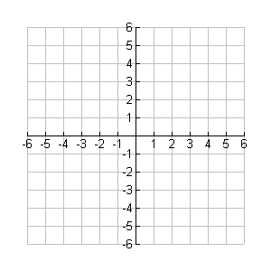
4. Draw a coordinate plane. Be sure to label the x and y
axis and write in an appropriate scale.
x | y
-1 | -5
0 | -3
2 | 1
y
x

Slide 7
5. Plot the points and connect.
y
x | y
-1 | -5
0 | -3
2 | 1
.
x
.
.

Slide 8
Example 2: Graph the line y = -3x + 1
y
x | y
x

Slide 9
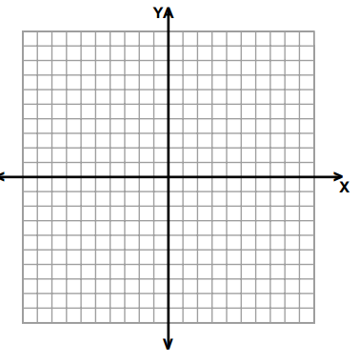
Example 3: Graph the line y = 10x + 20
*you will need to choose a scale for this problem
x | y
Notes:
You may need to walk your classes through this step…

Slide 10
Next we will graph lines using slope-intercept form
(y = mx + b)
Example 4: Graph the line y =
1. Make sure the equation is in y = mx + b form. You may have to solve the equation for y.
Our equation is already in y = mx + b form, so on to step 2….

Slide 11
2. Identify the slope of the line (this is the coefficient of x)
and the y-intercept (b).
m = ½
b = -3

Slide 12
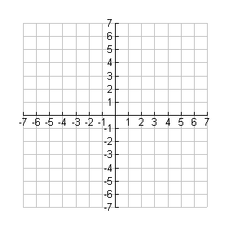
3. Plot the y-intercept on a coordinate plane.
.

Slide 13
4. Use the slope to find the next point.
Rise the numerator
Run the denominator
.
.

Slide 14
5. Connect the points.
.
.

Slide 15
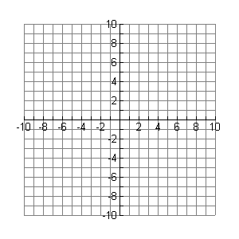
Example 5: Graph the line
Fall 2 (negative)
m =
Run 1
.
.
b = 5

Slide 16
Example 6: Graph the line 3x + 5y = 10.
We will need to solve this equation for y….
3x + 5y = 10
-3x -3x
5y = -3x + 10

Slide 17
Next we will identify the slope and y-intercept so that we can graph the line.
b = 2
.
.

Slide 18
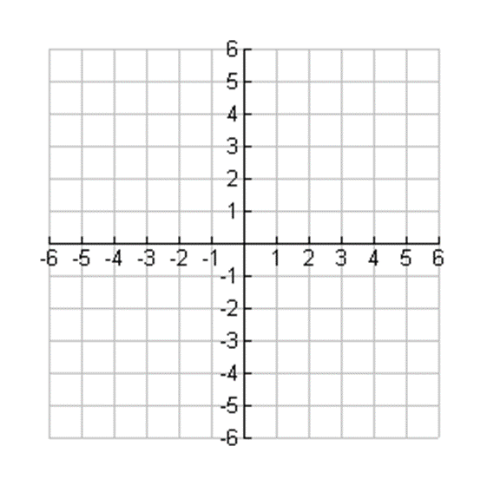
Your turn….
Graph the line y = 4x – 3 using a table of values.

Slide 19
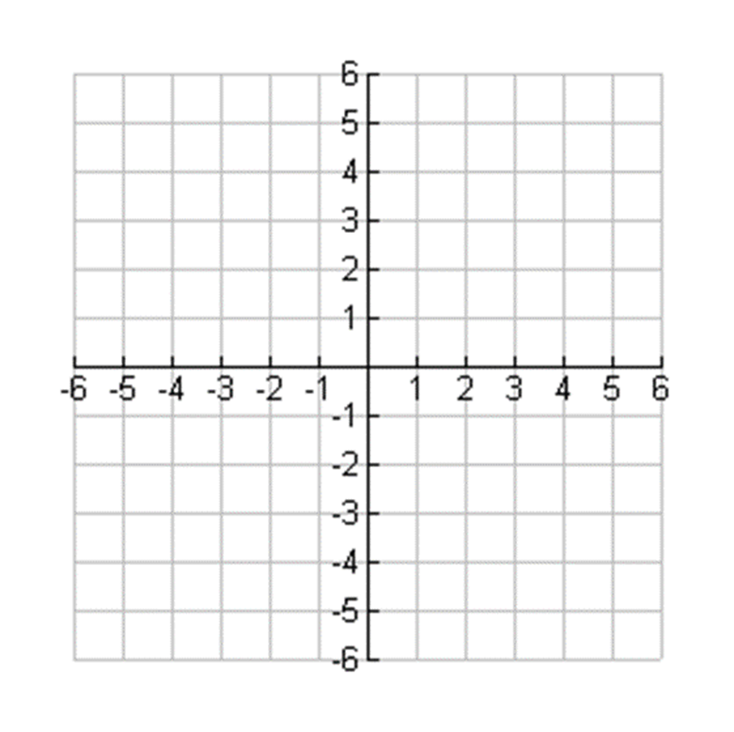
Your turn…
2. Graph the line y = 3x – 5 using slope-intercept form.

