Slide 1
Drill: Monday, 10/25
Determine if the conditional “If x is a number then |x| > 0” is true. If false, give a counterexample.
Write the contrapositive of the statement, “If it rains, then the ground gets wet”.
OBJ: SWBAT analyze conditional statements and apply the Law of Detachment and the Law of Syllogism in logical reasoning.

Slide 2
Unit C Deductive Reasoning
Geometry

Slide 3
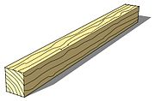
Monty Python Logic
SHE’S A WITCH!!!

Slide 4
Vocabulary
Deductive reasoning is the process of using logic to draw conclusions from given facts, definitions, and properties.
Deductive Reasoning vs. Inductive Reasoning

Slide 5
Laws of Detachment and Syllogism
Law of Detachment
If p → q is a true statement and p is true, then q is true.
Law of Syllogism
If p → q and q → r are true statements, then p → r is a true statement.

Slide 6
Direct TV Law of Syllogism

Slide 7
Inductive VS Deductive

Slide 8
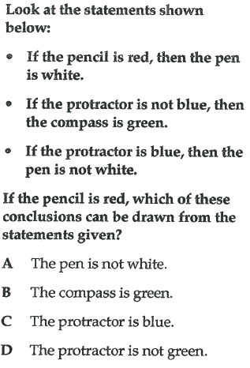
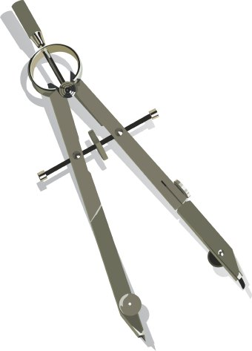
Example

Slide 9
Example 1: Verifying Conjectures by Using the Law of Detachment
Determine if the conjecture is valid by the Law of Detachment.
Given: In the World Series, if a team wins four games, then the team wins the series. The Philadelphia Phillies won four games in the 2008 World Series.
Conjecture: The Phillies won the 2008 World Series.

Slide 10
Check It Out! Example 2
Determine if the conjecture is valid by the Law of Detachment.
Given: If a student passes his classes, the student is eligible to play sports. Ramon passed his classes.
Conjecture: Ramon is eligible to play sports.

Slide 11
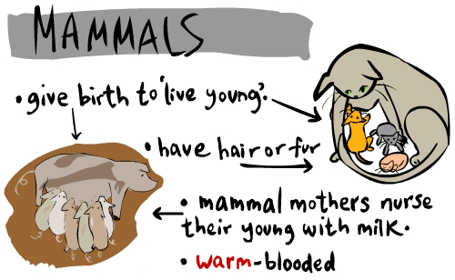
Check It Out! Example 3
Determine if the conjecture is valid by the Law of Syllogism.
Given: If an animal is a dog, then it is a mammal. If an animal is a mammal, then it has hair.
Conjecture: If an animal is a dog, then it has hair.

Slide 12
Check It Out! Example 3 Continued
Let p, q, and r represent the following.
p: An animal is a dog.
q: An animal is a mammal.
r: An animal has hair.
You are given that p → q and q → r.
Since q is the conclusion of the first conditional and the hypothesis of the first conditional, you can conclude that p → r. The conjecture is valid by Law of Syllogism.

Slide 13
Check It Out! Example 4
Draw a conclusion from the given information.
Given: If a polygon is a triangle, then it has three sides.
If a polygon has three sides, then it is not a quadrilateral. Polygon P is a triangle.
Conclusion: Polygon P is not a quadrilateral.

Slide 14
Lesson Quiz: Part I
Is the conclusion a result of inductive or deductive reasoning?
At Owings Mills High School, students must pass Geometry before they can graduate. Emily graduated, so she must have passed Geometry.
deductive reasoning

Slide 15
Lesson Quiz: Part II
Determine the conjecture is valid.
2. Given: If an American citizen is at least 18 years old, then he or she is eligible to vote. Anna is a 20-year-old American citizen.
Conjecture: Anna is eligible to vote.
valid

