Slide 1
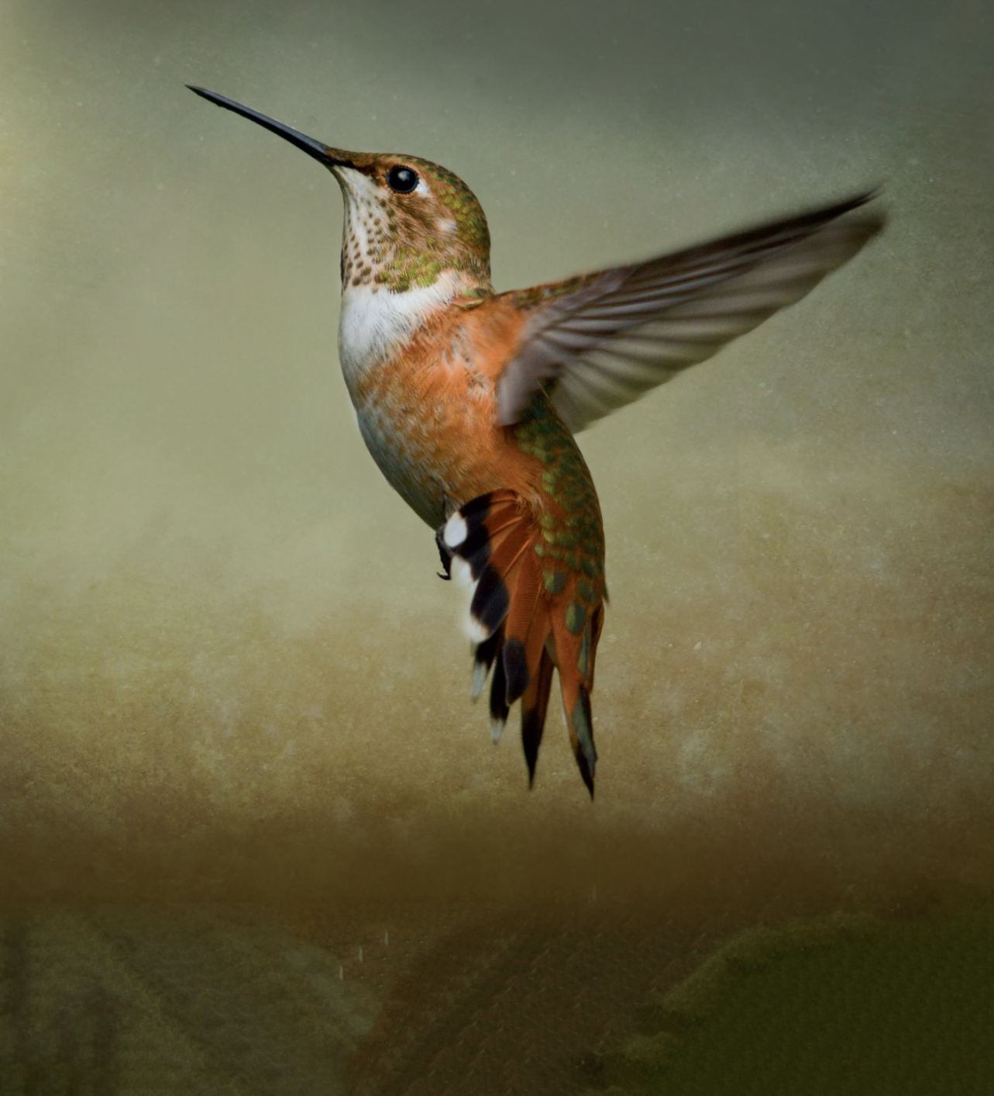
Chapter 2: The Derivative and Its Properties
Section 2.2
The derivative as a function; differentiability

Slide 2
2.2 The Derivative as a Function; Differentiability
Objectives:
Define the derivative function
Graph the derivative function
Identify where a function is not differentiable

Slide 3
2.2 The Derivative as a Function; Differentiability

Slide 4
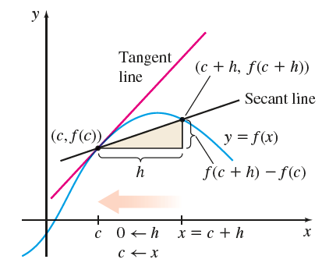
2.2 The Derivative as a Function; Differentiability

Slide 5
2.2 The Derivative as a Function; Differentiability

Slide 6
2.2 The Derivative as a Function; Differentiability

Slide 7
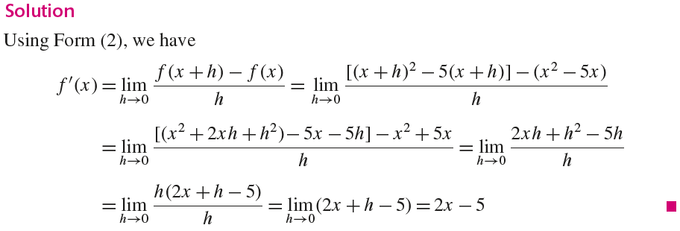
2.2 The Derivative as a Function; Differentiability

Slide 8
2.2 The Derivative as a Function; Differentiability

Slide 9
2.2 The Derivative as a Function; Differentiability

Slide 10
2.2 The Derivative as a Function; Differentiability

Slide 11
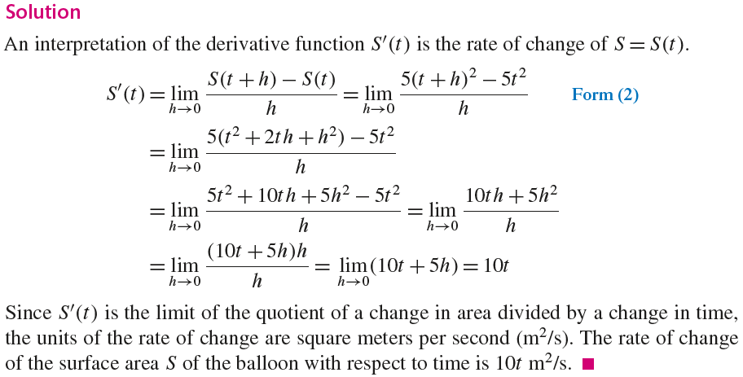
2.2 The Derivative as a Function; Differentiability

Slide 12
2.2 The Derivative as a Function; Differentiability

Slide 13
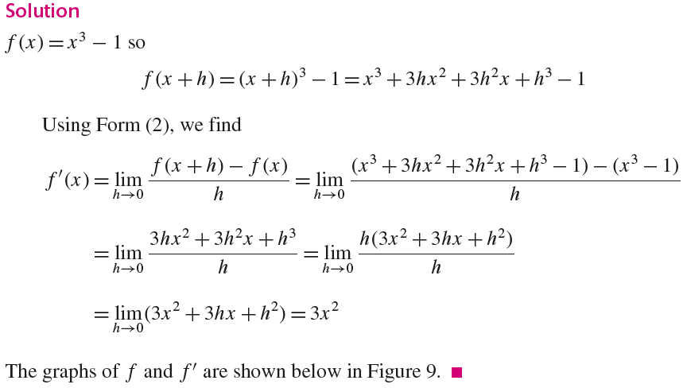
2.2 The Derivative as a Function; Differentiability

Slide 14
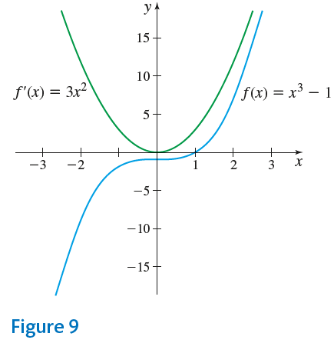
2.2 The Derivative as a Function; Differentiability

Slide 15
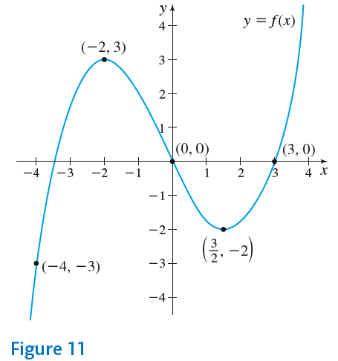
2.2 The Derivative as a Function; Differentiability

Slide 16
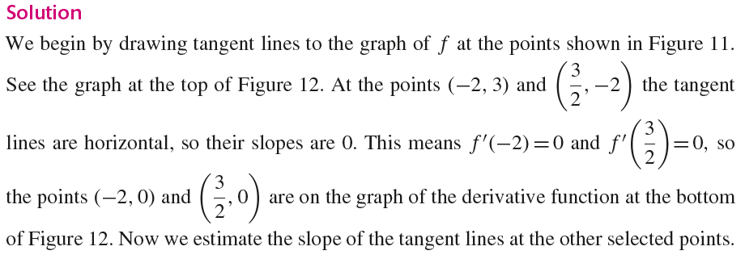
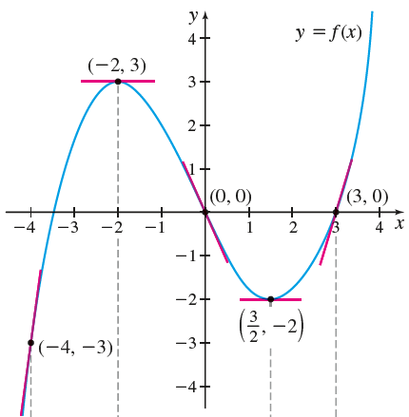
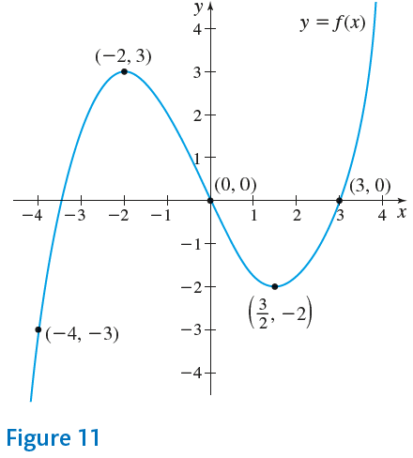
2.2 The Derivative as a Function; Differentiability

Slide 17
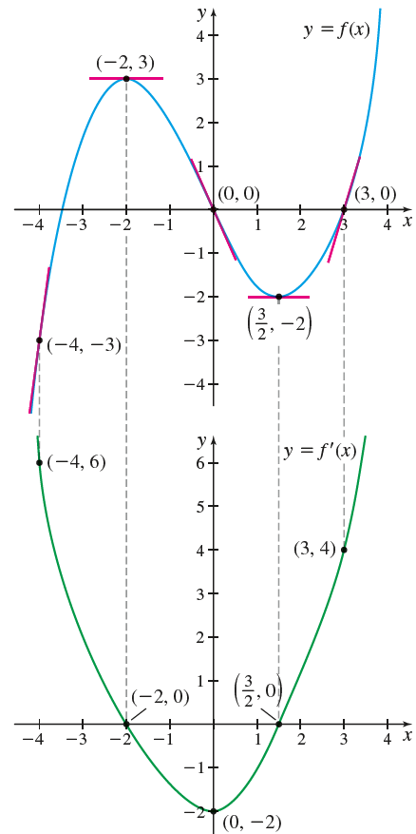
2.2 The Derivative as a Function; Differentiability

Slide 18
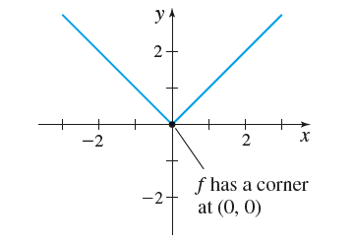
2.2 The Derivative as a Function; Differentiability

Slide 19
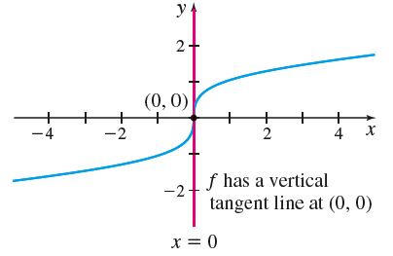
2.2 The Derivative as a Function; Differentiability

Slide 20
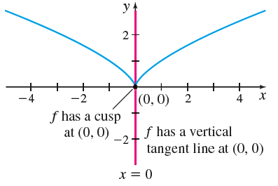
2.2 The Derivative as a Function; Differentiability

Slide 21
2.2 The Derivative as a Function; Differentiability

Slide 22
2.2 The Derivative as a Function; Differentiability

Slide 23
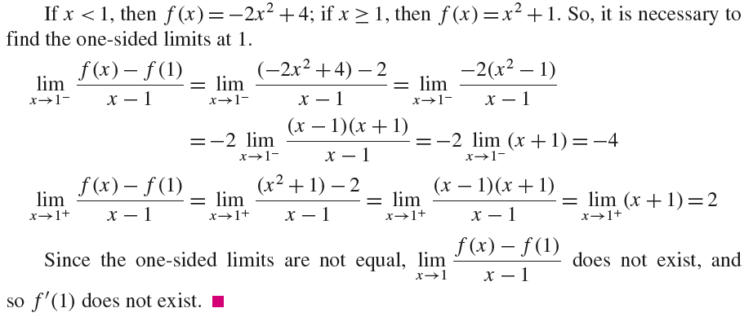
2.2 The Derivative as a Function; Differentiability

Slide 24
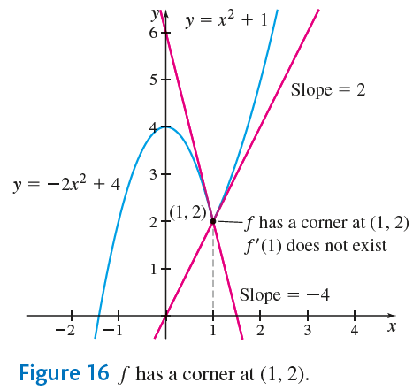
2.2 The Derivative as a Function; Differentiability

Slide 25
2.2 The Derivative as a Function; Differentiability

Slide 26
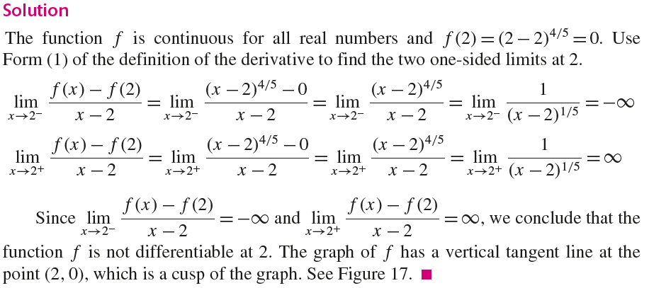
2.2 The Derivative as a Function; Differentiability

Slide 27
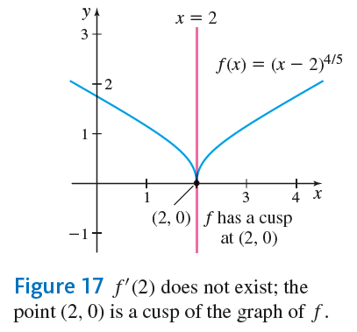
2.2 The Derivative as a Function; Differentiability

Slide 28
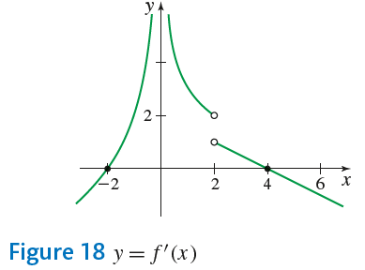
2.2 The Derivative as a Function; Differentiability

Slide 29
2.2 The Derivative as a Function; Differentiability

Slide 30
2.2 The Derivative as a Function; Differentiability

Slide 31
2.2 The Derivative as a Function; Differentiability

Slide 32
2.2 The Derivative as a Function; Differentiability

Slide 33
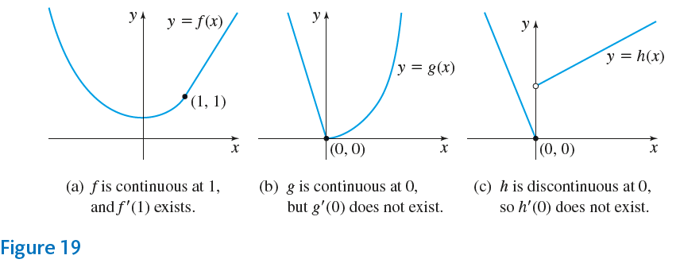
2.2 The Derivative as a Function; Differentiability

Slide 34
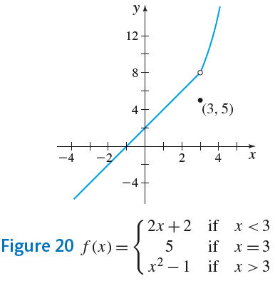
2.2 The Derivative as a Function; Differentiability

Slide 35
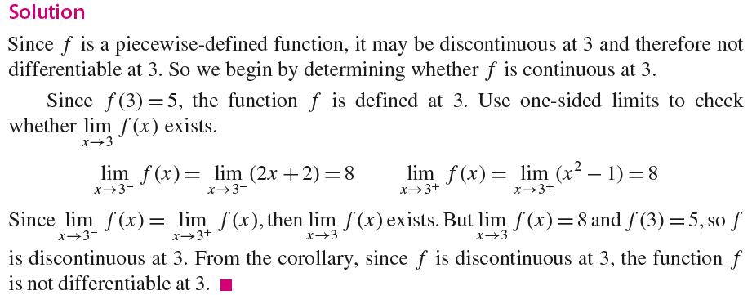
2.2 The Derivative as a Function; Differentiability

Slide 36
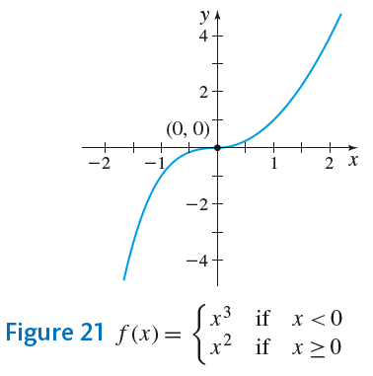
2.2 The Derivative as a Function; Differentiability

Slide 37
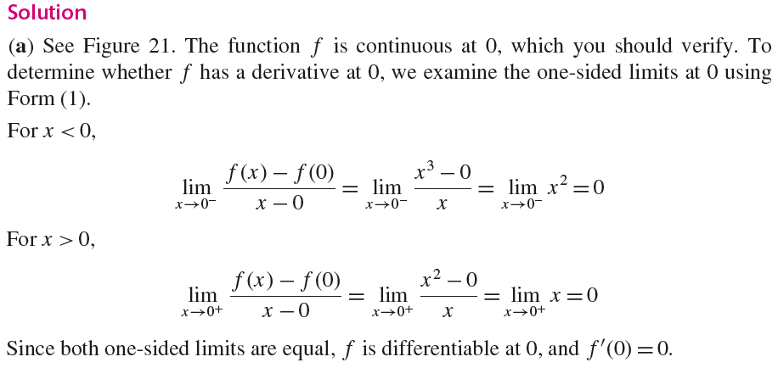
2.2 The Derivative as a Function; Differentiability

Slide 38
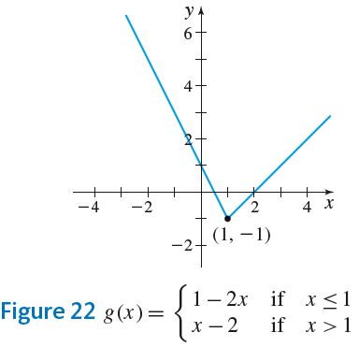
2.2 The Derivative as a Function; Differentiability

Slide 39
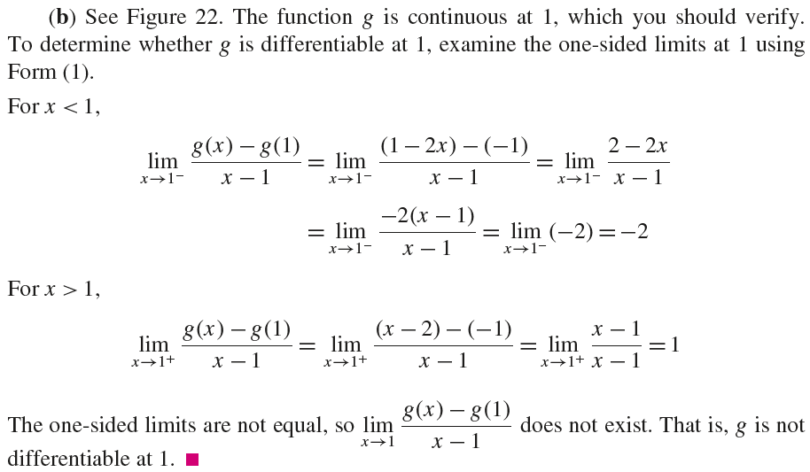
2.2 The Derivative as a Function; Differentiability

