Slide 1
Chapter 2: The Derivative and Its Properties
Section 2.3
The derivative of a polynomial function; the derivative of $y$=$ex$

Slide 2
2.3 The Derivative of a Polynomial Function; The Derivative of $y$ = $ex$
Objectives:
Differentiate a constant function
Differentiate a power function
Differentiate the sum and difference of two functions
Differentiate the exponential function $y$ = $ex$

Slide 3
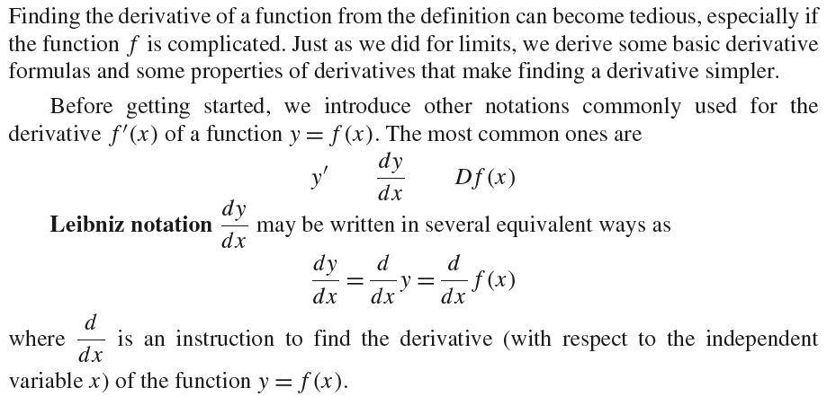
2.3 The Derivative of a Polynomial Function; The Derivative of $y$ = $ex$

Slide 4
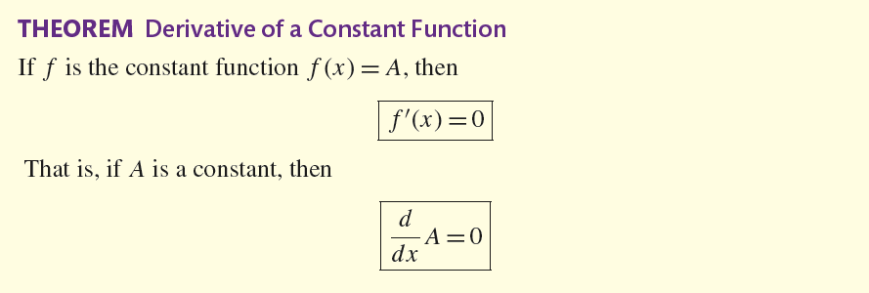
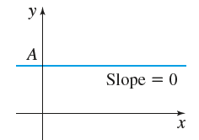
2.3 The Derivative of a Polynomial Function; The Derivative of $y$ = $ex$

Slide 5
2.3 The Derivative of a Polynomial Function; The Derivative of $y$ = $ex$

Slide 6
2.3 The Derivative of a Polynomial Function; The Derivative of $y$ = $ex$

Slide 7
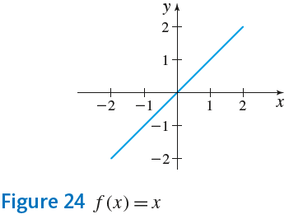
2.3 The Derivative of a Polynomial Function; The Derivative of $y$ = $ex$

Slide 8
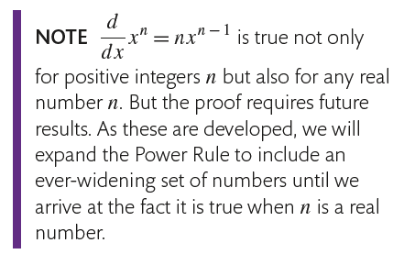
2.3 The Derivative of a Polynomial Function; The Derivative of $y$ = $ex$

Slide 9
2.3 The Derivative of a Polynomial Function; The Derivative of $y$ = $ex$

Slide 10
2.3 The Derivative of a Polynomial Function; The Derivative of $y$ = $ex$

Slide 11
2.3 The Derivative of a Polynomial Function; The Derivative of $y$ = $ex$

Slide 12
2.3 The Derivative of a Polynomial Function; The Derivative of $y$ = $ex$

Slide 13
2.3 The Derivative of a Polynomial Function; The Derivative of $y$ = $ex$

Slide 14
2.3 The Derivative of a Polynomial Function; The Derivative of $y$ = $ex$

Slide 15
2.3 The Derivative of a Polynomial Function; The Derivative of $y$ = $ex$

Slide 16
2.3 The Derivative of a Polynomial Function; The Derivative of $y$ = $ex$

Slide 17
2.3 The Derivative of a Polynomial Function; The Derivative of $y$ = $ex$

Slide 18
2.3 The Derivative of a Polynomial Function; The Derivative of $y$ = $ex$

Slide 19
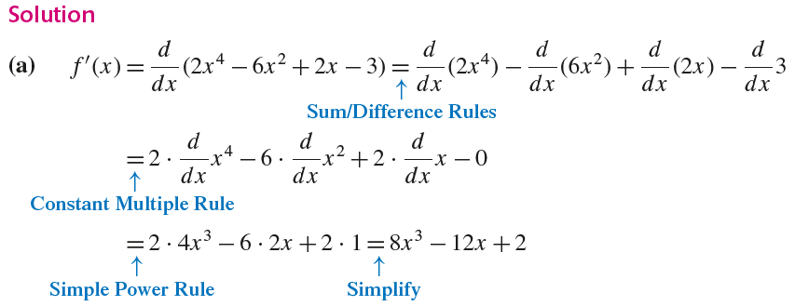
2.3 The Derivative of a Polynomial Function; The Derivative of $y$ = $ex$

Slide 20
2.3 The Derivative of a Polynomial Function; The Derivative of $y$ = $ex$

Slide 21
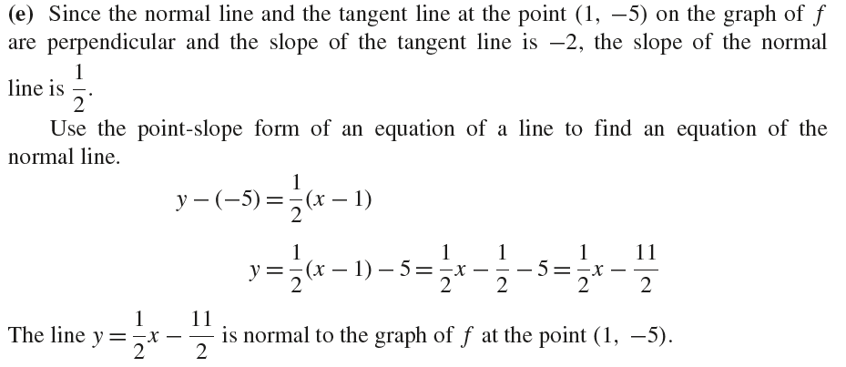
2.3 The Derivative of a Polynomial Function; The Derivative of $y$ = $ex$

Slide 22
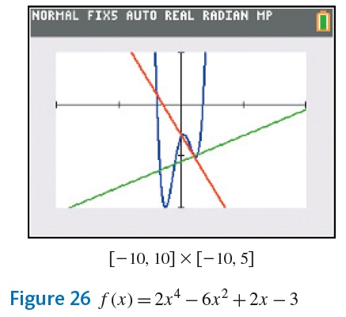
2.3 The Derivative of a Polynomial Function; The Derivative of $y$ = $ex$

Slide 23
2.3 The Derivative of a Polynomial Function; The Derivative of $y$ = $ex$

Slide 24
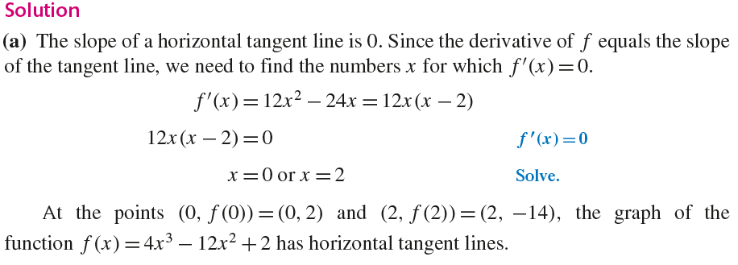
2.3 The Derivative of a Polynomial Function; The Derivative of $y$ = $ex$

Slide 25
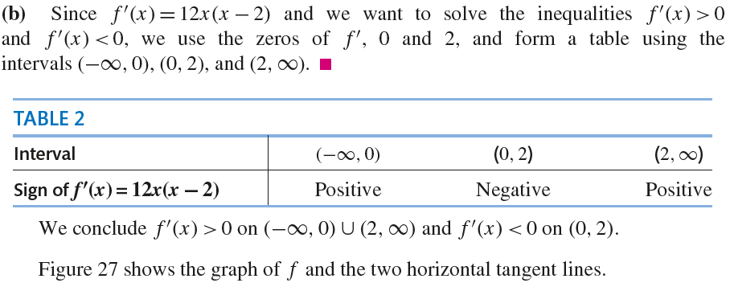
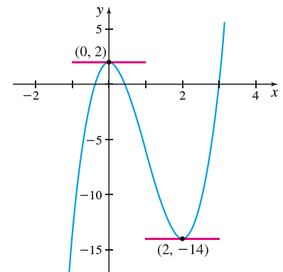
2.3 The Derivative of a Polynomial Function; The Derivative of $y$ = $ex$

Slide 26
2.3 The Derivative of a Polynomial Function; The Derivative of $y$ = $ex$

Slide 27
2.3 The Derivative of a Polynomial Function; The Derivative of $y$ = $ex$

Slide 28
2.3 The Derivative of a Polynomial Function; The Derivative of $y$ = $ex$

