Slide 1
Chapter 2: The Derivative and Its Properties
Section 2.5
The derivative of the trigonometric functions

Slide 2
2.5 The Derivative of Trigonometric Functions
Objectives:
Differentiate trigonometric functions

Slide 3
Derivatives of Trigonometric Functions

Slide 4
2.5 The Derivative of Trigonometric Functions

Slide 5
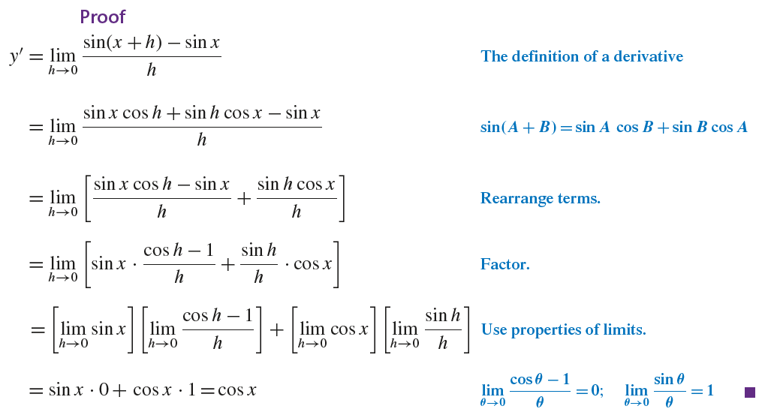
2.5 The Derivative of Trigonometric Functions

Slide 6
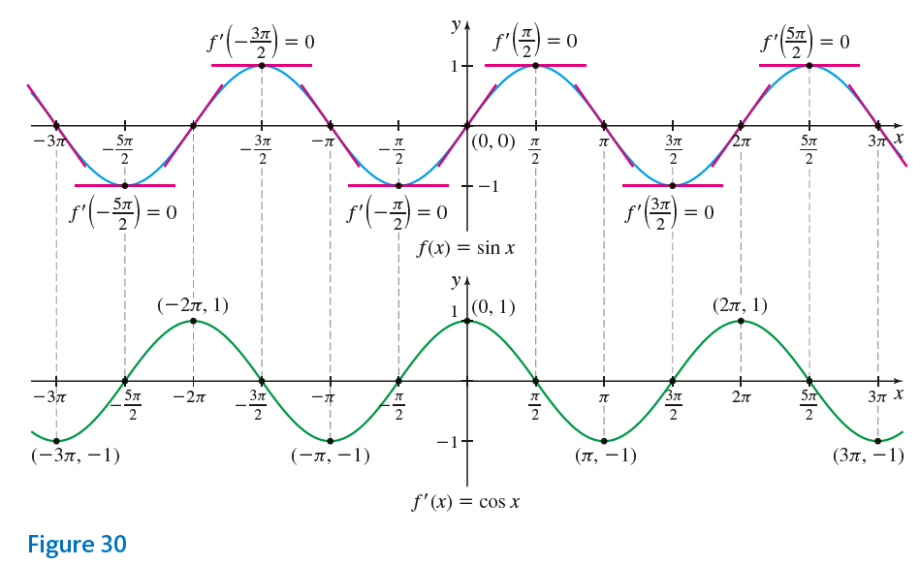
2.5 The Derivative of Trigonometric Functions

Slide 7
2.5 The Derivative of Trigonometric Functions

Slide 8
2.5 The Derivative of Trigonometric Functions

Slide 9
2.5 The Derivative of Trigonometric Functions

Slide 10
2.5 The Derivative of Trigonometric Functions

Slide 11
2.5 The Derivative of Trigonometric Functions

Slide 12
2.5 The Derivative of Trigonometric Functions

Slide 13
2.5 The Derivative of Trigonometric Functions

Slide 14
2.5 The Derivative of Trigonometric Functions

Slide 15
2.5 The Derivative of Trigonometric Functions

Slide 16
2.5 The Derivative of Trigonometric Functions

Slide 17
2.5 The Derivative of Trigonometric Functions

Slide 18
2.5 The Derivative of Trigonometric Functions

Slide 19
2.5 The Derivative of Trigonometric Functions

Slide 20
2.5 The Derivative of Trigonometric Functions

Slide 21
2.5 The Derivative of Trigonometric Functions

Slide 22
2.5 The Derivative of Trigonometric Functions

Slide 23
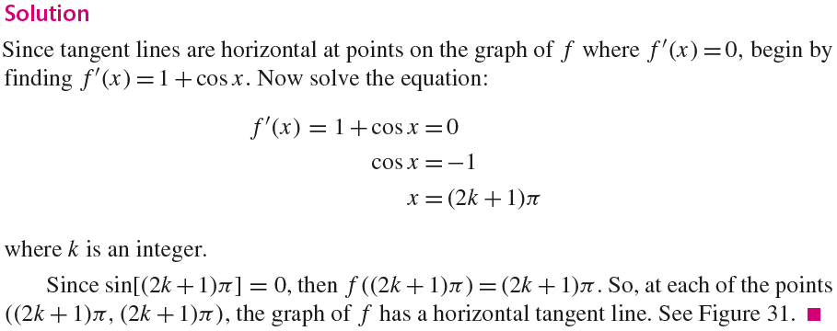
2.5 The Derivative of Trigonometric Functions

Slide 24
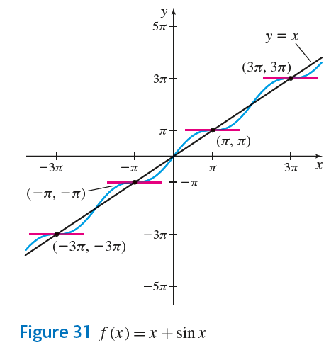
2.5 The Derivative of Trigonometric Functions

Slide 25
2.5 The Derivative of Trigonometric Functions

Slide 26
2.5 The Derivative of Trigonometric Functions

Slide 27
2.5 The Derivative of Trigonometric Functions

Slide 28
2.5 The Derivative of Trigonometric Functions

Slide 29
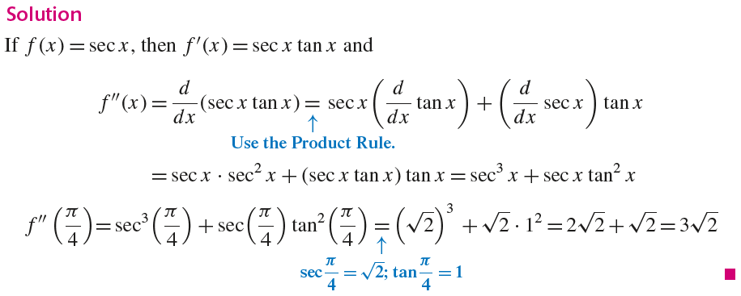
2.5 The Derivative of Trigonometric Functions

Slide 30
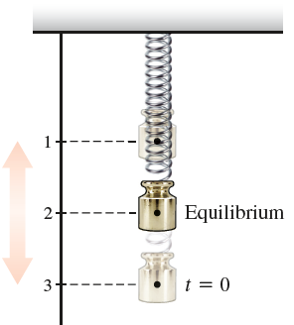
2.5 The Derivative of Trigonometric Functions

Slide 31
2.5 The Derivative of Trigonometric Functions

Slide 32
2.5 The Derivative of Trigonometric Functions

Slide 33
2.5 The Derivative of Trigonometric Functions

Slide 34
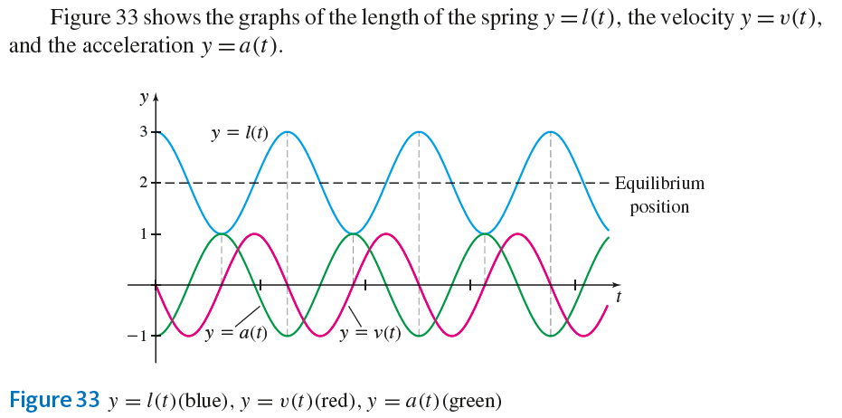
2.5 The Derivative of Trigonometric Functions

