Slide 1
Chapter 3: The Derivative of Composite, Implicit, and Inverse Functions
Section 3.1
The chain rule

Slide 2
3.1 The Chain Rule
Objectives:
Differentiate a composite function
Differentiate $y=ax$, $a>0$, $a ≠1$
Use the Power Rule for functions to find a derivative
Use the Chain Rule for multiple composite functions

Slide 3
3.1 The Chain Rule

Slide 4
3.1 The Chain Rule

Slide 5
3.1 The Chain Rule

Slide 6
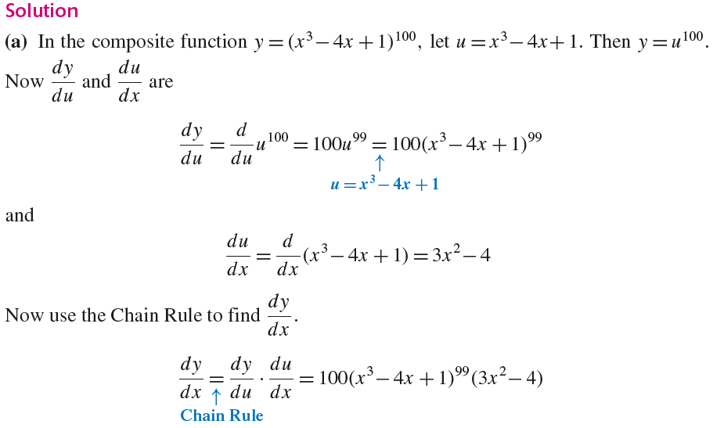
3.1 The Chain Rule

Slide 7
3.1 The Chain Rule

Slide 8
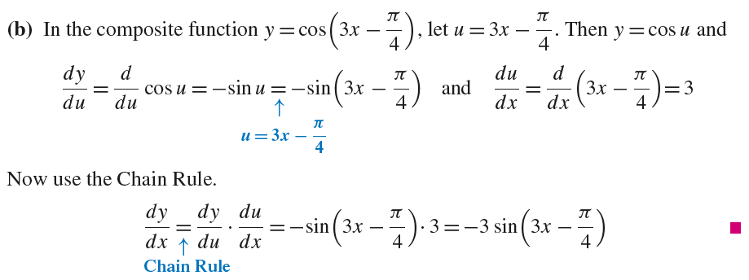
3.1 The Chain Rule

Slide 9
3.1 The Chain Rule

Slide 10
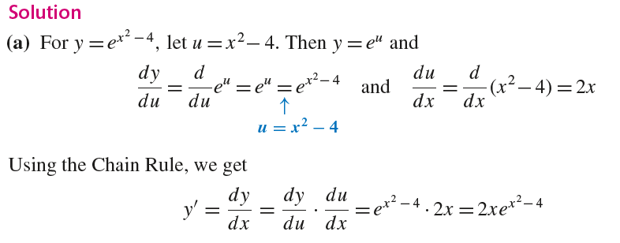
3.1 The Chain Rule

Slide 11
3.1 The Chain Rule

Slide 12
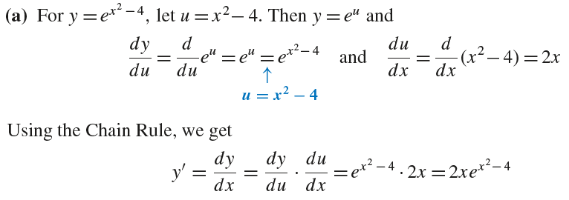
3.1 The Chain Rule

Slide 13
3.1 The Chain Rule

Slide 14
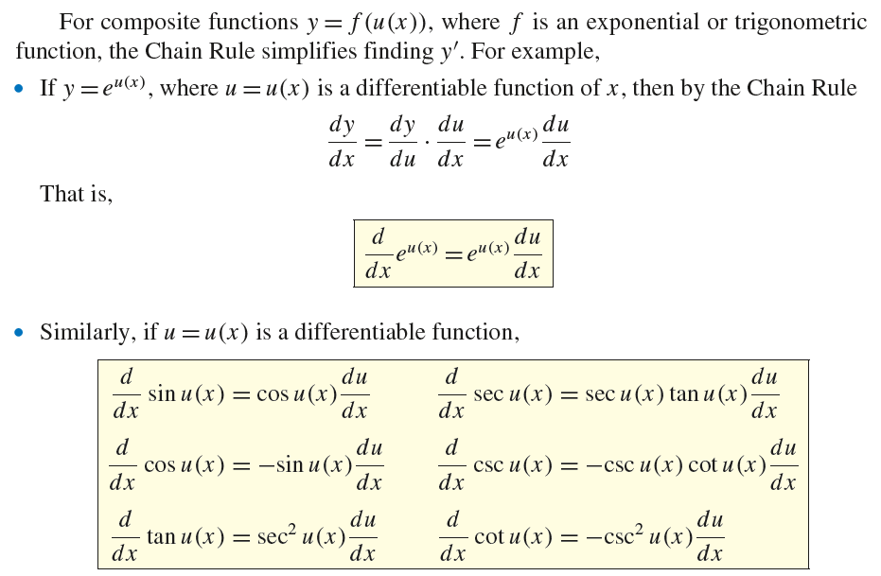
3.1 The Chain Rule

Slide 15
3.1 The Chain Rule

Slide 16
3.1 The Chain Rule

Slide 17
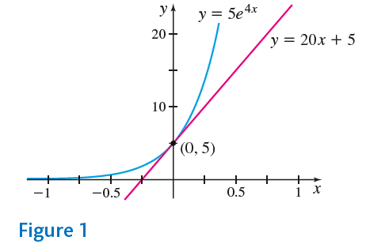
3.1 The Chain Rule

Slide 18
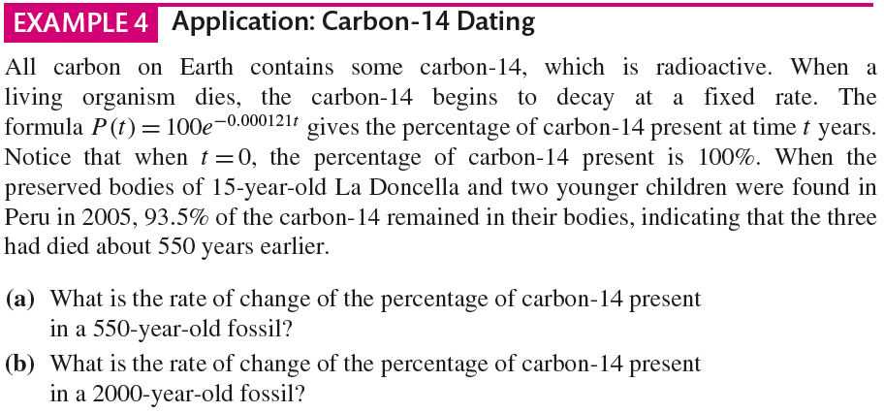
3.1 The Chain Rule

Slide 19
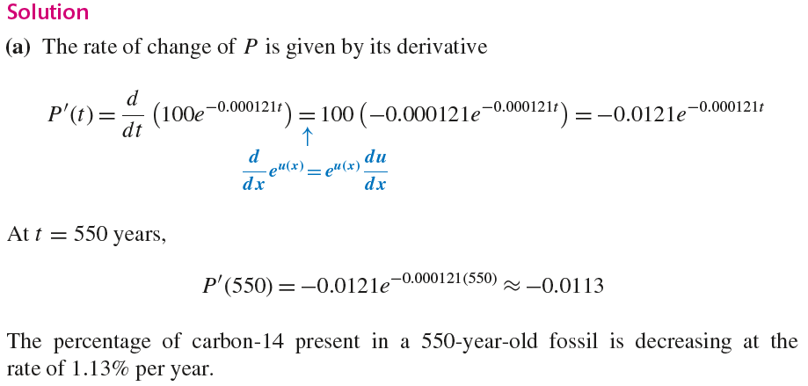
3.1 The Chain Rule

Slide 20
3.1 The Chain Rule

Slide 21
3.1 The Chain Rule

Slide 22
3.1 The Chain Rule

Slide 23
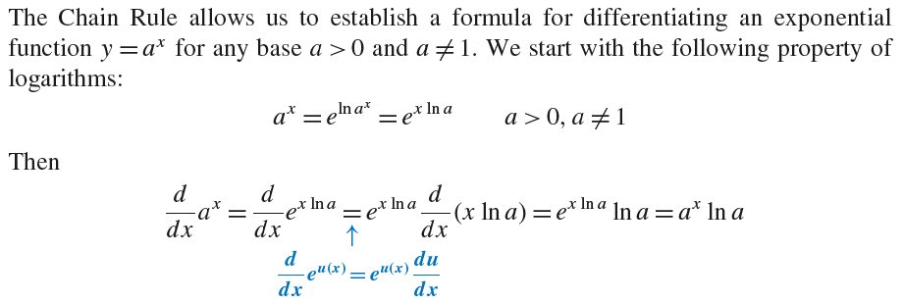
3.1 The Chain Rule

Slide 24
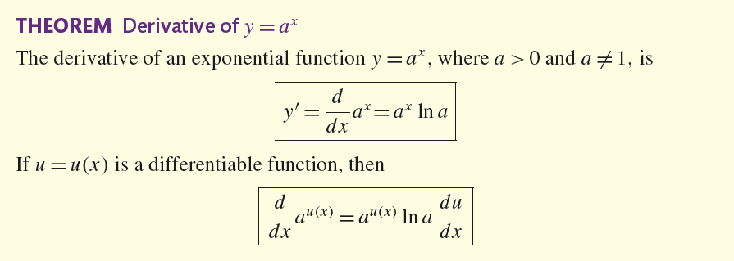
3.1 The Chain Rule

Slide 25
3.1 The Chain Rule

Slide 26
3.1 The Chain Rule

Slide 27
3.1 The Chain Rule

Slide 28
3.1 The Chain Rule

Slide 29
3.1 The Chain Rule

Slide 30
3.1 The Chain Rule

Slide 31
3.1 The Chain Rule

Slide 32
3.1 The Chain Rule

Slide 33
3.1 The Chain Rule

Slide 34
3.1 The Chain Rule

Slide 35
3.1 The Chain Rule

Slide 36
3.1 The Chain Rule

Slide 37
3.1 The Chain Rule

Slide 38
3.1 The Chain Rule

Slide 39
3.1 The Chain Rule

Slide 40
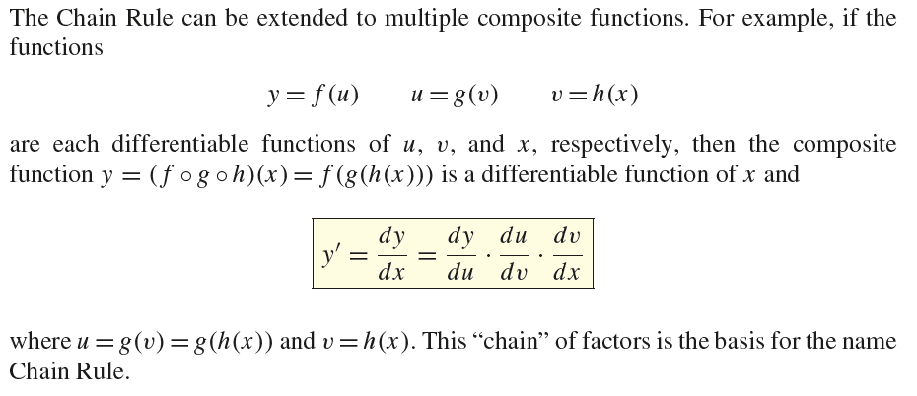
3.1 The Chain Rule

Slide 41
3.1 The Chain Rule

Slide 42
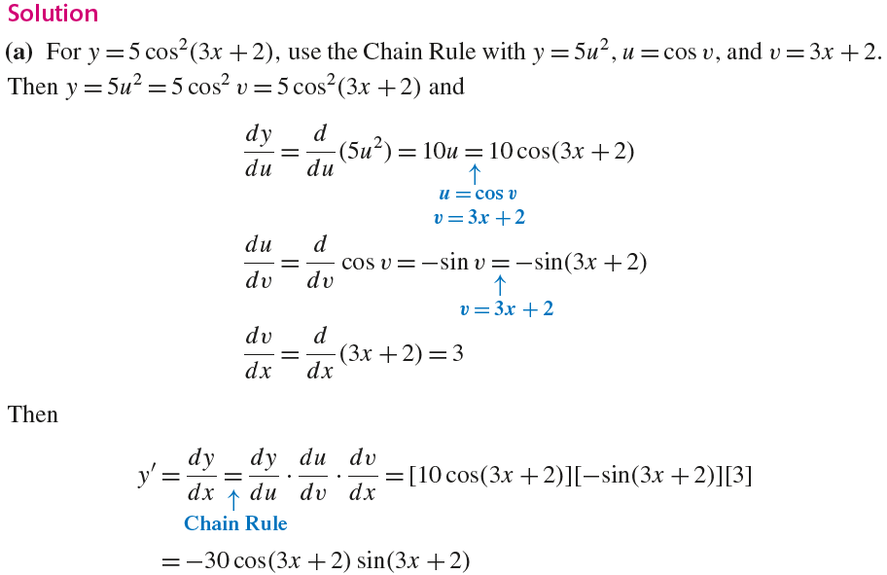
3.1 The Chain Rule

Slide 43
3.1 The Chain Rule

Slide 44
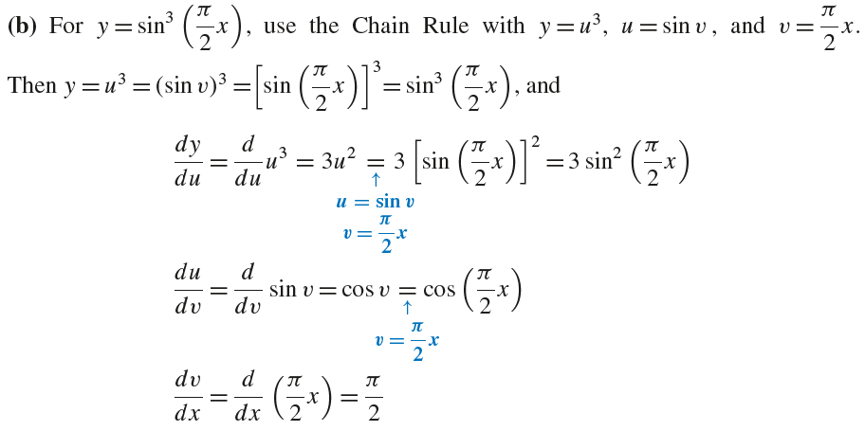
3.1 The Chain Rule

Slide 45
3.1 The Chain Rule

