Slide 1
3.2 Implicit Differentiation
Objectives:
Find a derivative using implicit differentiation
Find higher-order derivatives using implicit differentiation
Differentiate functions with rational exponents

Slide 2
3.2 Implicit Differentiation
To find the derivative of a function defined implicitly, we use the technique of implicit differentiation.

Slide 3
3.2 Implicit Differentiation
Implicit differentiation does not require rewriting the function explicitly, but it does require that the dependent variable y is a differentiable function of the independent variable x.

Slide 4
3.2 Implicit Differentiation

Slide 5
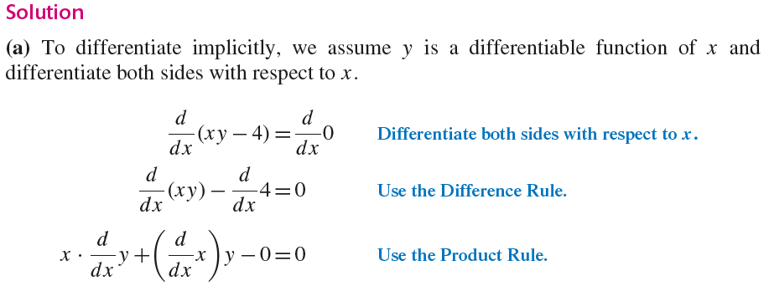
3.2 Implicit Differentiation

Slide 6
3.2 Implicit Differentiation

Slide 7
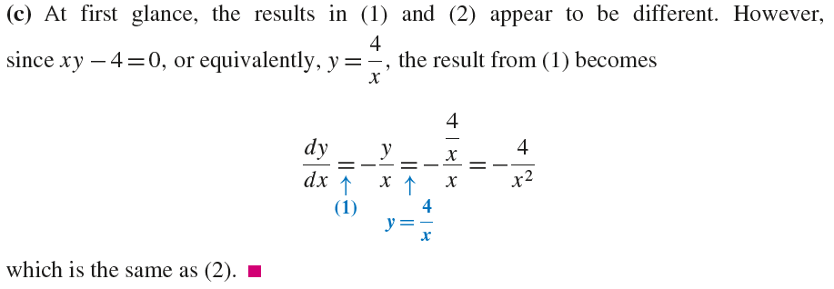
3.2 Implicit Differentiation

Slide 8
3.2 Implicit Differentiation

Slide 9
3.2 Implicit Differentiation

Slide 10
3.2 Implicit Differentiation

Slide 11
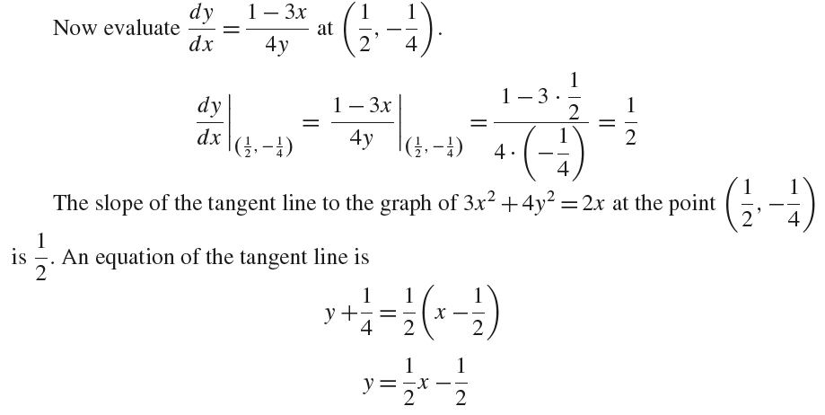
3.2 Implicit Differentiation

Slide 12
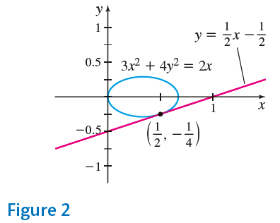
3.2 Implicit Differentiation

Slide 13
3.2 Implicit Differentiation

Slide 14
3.2 Implicit Differentiation

Slide 15
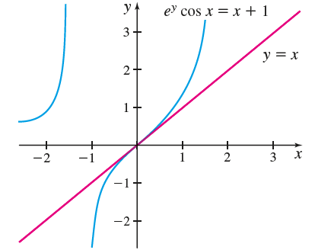
3.2 Implicit Differentiation

Slide 16
3.2 Implicit Differentiation

Slide 17
3.2 Implicit Differentiation

Slide 18
3.2 Implicit Differentiation

Slide 19
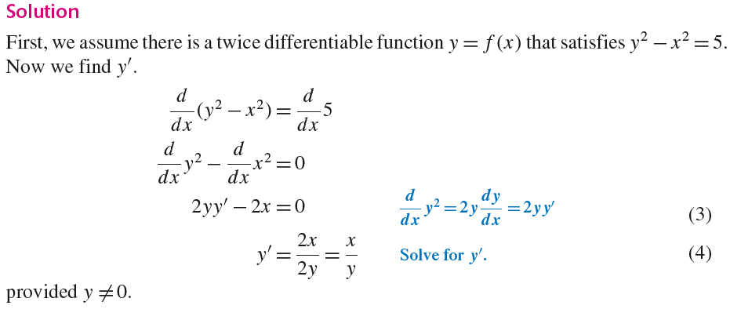
3.2 Implicit Differentiation

Slide 20
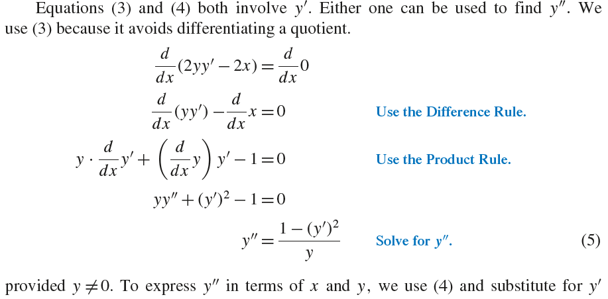
3.2 Implicit Differentiation

Slide 21
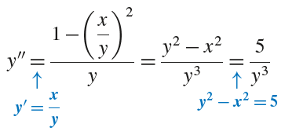
3.2 Implicit Differentiation

Slide 22
3.2 Implicit Differentiation

Slide 23
3.2 Implicit Differentiation

Slide 24
3.2 Implicit Differentiation

Slide 25
3.2 Implicit Differentiation

Slide 26
3.2 Implicit Differentiation

Slide 27
3.2 Implicit Differentiation

