Slide 1


Chapter 4
Collecting Data
Section 4.2
Experiments

Slide 2
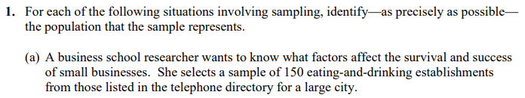

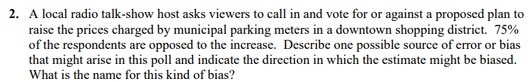
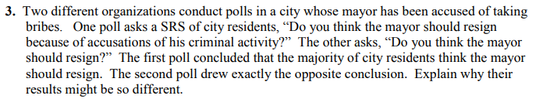

Slide 3
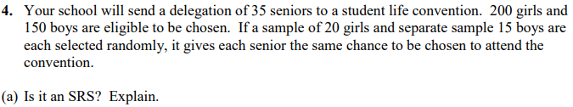
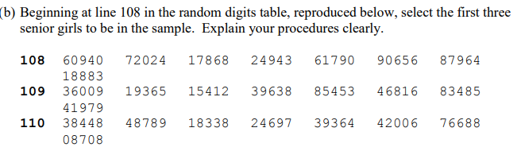

Slide 4
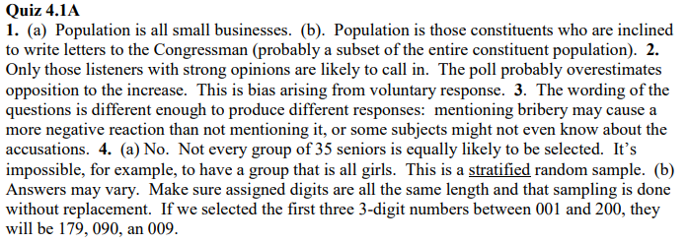

Slide 5
Experiments
Explain the concept of confounding and how it limits the ability to make cause-and-effect conclusions.
Distinguish between an observational study and an experiment, and identify the explanatory and response variables in each type of study.
Identify the experimental units and treatments in an experiment.
Describe the placebo effect and the purpose of blinding in an experiment.

Slide 6
Experiments
Describe how to randomly assign treatments in an experiment using slips of paper, technology, or a table of random digits.
Explain the purpose of comparison, random assignment, control, and replication in an experiment.
Describe a completely randomized design for an experiment.
Describe a randomized block design and a matched pairs design for an experiment and explain the purpose of blocking in an experiment.

Slide 7
Observational Studies Versus Experiments
Sample surveys are one kind of observational study.
Observational studies that examine existing data for a sample of individuals are called retrospective.
Observational studies that track individuals into the future are called prospective.

Slide 8
Observational Studies Versus Experiments
Is taking a vitamin D supplement good for you? Hundreds of observational studies have looked at the relationship between vitamin D concentration in a person’s blood and various health outcomes.
An observational study observes individuals and measures variables of interest but does not attempt to influence the responses.
A response variable measures an outcome of a study.
An explanatory variable may help explain or predict changes in a response variable.
Unfortunately, it is very difficult to show that taking vitamin D causes a lower risk of diabetes using an observational study.

Slide 9
Observational Studies Versus Experiments
Is taking a vitamin D supplement good for you? Hundreds of observational studies have looked at the relationship between vitamin D concentration in a person’s blood and various health outcomes.
Tatiana Popova/Shutterstock.com

Slide 10
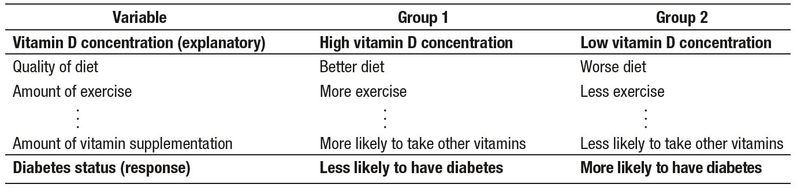
Observational Studies Versus Experiments
Is taking a vitamin D supplement good for you? Hundreds of observational
studies have looked at the relationship between vitamin D concentration in a person’s blood and various health outcomes.
Confounding occurs when two variables are associated in such a way that their effects on a response variable cannot be distinguished from each other.

Slide 11
Observational Studies Versus Experiments
To determine if taking vitamin D actually causes a reduction in diabetes risk, researchers in Norway performed an experiment. The researchers randomly assigned 500 people with pre-diabetes to either take a high dose of vitamin D or to take a placebo—a pill that looked exactly like the vitamin D supplement but contained no active ingredient. After 5 years, about 40% of the people in each group were diagnosed with diabetes.
Tatiana Popova/Shutterstock.com

Slide 12
Observational Studies Versus Experiments
To determine if taking vitamin D actually causes a reduction in diabetes risk, researchers in Norway performed an experiment. The researchers randomly assigned 500 people with pre-diabetes to either take a high dose of vitamin D or to take a placebo—a pill that looked exactly like the vitamin D supplement but contained no active ingredient. After 5 years, about 40% of the people in each group were diagnosed with diabetes.
An experiment deliberately imposes some treatment on individuals to measure their responses.
A placebo is a treatment that has no active ingredient, but is otherwise like other treatments.

Slide 13
The Language of Experiments
An experiment is a statistical study in which we actually do something (a treatment) to people, animals, or objects (the experimental units or subjects) to observe the response.
A specific condition applied to the individuals in an experiment is called a treatment. If an experiment has several explanatory variables, a treatment is a combination of specific values of these variables.
An experimental unit is the object to which a treatment is randomly assigned. When the experimental units are human beings, they are often called subjects.

Slide 14
The Language of Experiments
Malaria causes hundreds of thousands of deaths each year, with many of the victims being children. Will regularly screening children for the malaria parasite and treating those who test positive reduce the proportion of children who develop the disease? Researchers worked with children in 101 schools in Kenya, randomly assigning half of the schools to receive regular screenings and follow-up treatments and the remaining schools to receive no regular screening. Children at all 101 schools were tested for malaria at the end of the study.
Identify the treatments and the experimental units in this experiment.
Alexander Joe/Getty Images

Slide 15
The Language of Experiments
Malaria causes hundreds of thousands of deaths each year, with many of the victims being children. Will regularly screening children for the malaria parasite and treating those who test positive reduce the proportion of children who develop the disease? Researchers worked with children in 101 schools in Kenya, randomly assigning half of the schools to receive regular screenings and follow-up treatments and the remaining schools to receive no regular screening. Children at all 101 schools were tested for malaria at the end of the study.
Identify the treatments and the experimental units in this experiment.
Experimental units:
The 101 schools in Kenya
Treatments:
Regular screenings and follow-up treatments
No regular screening

Slide 16
The Language of Experiments
Researchers from Rutgers University put the five-second rule to the
test. They used four different types of food: watermelon, bread, bread
with butter, and gummy candy. They dropped the food onto four different surfaces: stainless steel, ceramic tile, wood, and carpet. And they waited for four different lengths of time: less than 1 second, 5 seconds, 30
seconds, and 300 seconds. Finally, they used bacteria prepared two different ways: in a tryptic soy broth or peptone buffer. Once the bacteria were ready, the researchers spread them out on the different surfaces and
started dropping food.
List the factors in this experiment and the number of levels for each factor..
In an experiment, a factor is a variable that is manipulated and may cause a change in the response variable. The different values of a factor are called levels.
Zaia Snively

Slide 17
The Language of Experiments
Researchers from Rutgers University put the five-second rule to the
test. They used four different types of food: watermelon, bread, bread
with butter, and gummy candy. They dropped the food onto four different surfaces: stainless steel, ceramic tile, wood, and carpet. And they waited for four different lengths of time: less than 1 second, 5 seconds, 30
seconds, and 300 seconds. Finally, they used bacteria prepared two different ways: in a tryptic soy broth or peptone buffer. Once the bacteria were ready, the researchers spread them out on the different surfaces and
started dropping food.
List the factors in this experiment and the number of levels for each factor..
Type of food (4 levels)
Type of surface (4 levels)
Amount of time (4 levels)
Method of bacterial prep (2 levels)
Zaia Snively

Slide 18
Designing Experiments: Comparison
Good designs are essential for effective experiments, just as they are for sampling. To see why, let’s start with an example of a bad experimental design.
Experimental Units
Treatment
Measure Response
In this design, there are many other variables (besides the treatment) that are potentially confounded with taking caffeine.
The remedy for potential confounding is to do a comparative experiment with two or more groups.

Slide 19
Designing Experiments: Comparison
In an experiment, a control group is used to provide a baseline for comparing the effects of other treatments. Depending on the purpose of the experiment, a control group may be given an inactive treatment (placebo), an active treatment, or no treatment at all.
Eric O’Connell/Getty Images

Slide 20
Designing Experiments: Comparison
In an experiment, a control group is used to provide a baseline for comparing the effects of other treatments. Depending on the purpose of the experiment, a control group may be given an inactive treatment (placebo), an active treatment, or no treatment at all.
In all other aspects, the treatment groups should be treated exactly the same so that the only difference is the treatments.
This way, if there is convincing evidence of a difference in the average response, we can safely conclude it was caused by the treatments.

Slide 21
Designing Experiments:
Blinding and the Placebo Effect
The placebo effect describes the fact that some subjects in an experiment will respond favorably to any treatment, even an inactive treatment.
In a double-blind experiment, neither the subjects nor those who interact with them and measure the response variable know which treatment a subject received.
In a single-blind experiment, either the subjects don’t know which treatment they are receiving or the people who interact with them and measure the response variable don’t know which subjects are receiving which treatment.

Slide 22
Designing Experiments: Random Assignment
To create roughly equivalent groups at the beginning of an experiment, we use random assignment to determine which experimental units get which treatment.
In an experiment, random assignment means that experimental units are assigned to treatments using a chance process.

Slide 23
Designing Experiments: Random Assignment
A total of 20 students have agreed to participate in an experiment comparing the effects of caffeinated cola and caffeine-free cola on pulse rates. Describe how you would randomly assign 10 students to each of the two treatments:
(a) Using 20 identical slips of paper
(b) Using technology
(c) Using Table D.
Zaia Snively

Slide 24
Designing Experiments: Random Assignment
A total of 20 students have agreed to participate in an experiment comparing the effects of caffeinated cola and caffeine-free cola on pulse rates. Describe how you would randomly assign 10 students to each of the two treatments:
(a) Using 20 identical slips of paper
(b) Using technology
(c) Using Table D.
(a) On 10 slips of paper, write the letter “A”; on the remaining 10 slips, write the letter “B.” Shuffle the slips of paper and hand out one slip of paper to each volunteer. Students who get an “A” slip receive the cola with caffeine and students who get a “B” slip receive the cola without caffeine.

Slide 25
Designing Experiments: Random Assignment
A total of 20 students have agreed to participate in an experiment comparing the effects of caffeinated cola and caffeine-free cola on pulse rates. Describe how you would randomly assign 10 students to each of the two treatments:
(a) Using 20 identical slips of paper
(b) Using technology
(c) Using Table D.
(b) Label each student with a different integer from 1 to 20. Then randomly generate 10 different integers from 1 to 20. The students with these labels receive the cola with caffeine. The remaining 10 students receive the cola without caffeine.

Slide 26
Designing Experiments: Random Assignment
A total of 20 students have agreed to participate in an experiment comparing the effects of caffeinated cola and caffeine-free cola on pulse rates. Describe how you would randomly assign 10 students to each of the two treatments:
(a) Using 20 identical slips of paper
(b) Using technology
(c) Using Table D.
(c) Label each student with a different integer from 01 to 20. Go to a line of Table D and read two-digit groups moving from left to right. The first 10 different labels between 01 and 20 identify the 10 students who receive cola with caffeine. The remaining 10 students receive the caffeine-free cola. Ignore groups of digits from 21 to 00.

Slide 27
Designing Experiments: Control
In an experiment, control means keeping other variables constant for all experimental units.
After randomly assigning treatments and controlling other variables, treatment groups should be about the same, except for the treatments. Then a difference in the average response must be due either to the treatments themselves or to the random assignment.
We can’t say that any difference in average response between treatment groups must be caused by the treatments because there would likely be some difference just because the random assignment is unlikely to produce two groups that are exactly equivalent.

Slide 28

Designing Experiments: Replication
In an experiment, replication means using enough experimental units to
distinguish a difference in the effects of the treatments from chance variation due to the random assignment.
CAUTION:
In statistics, replication means “use enough subjects.” In other fields, the term replication has a different meaning.

Slide 29
Experiments: Putting It All Together
Principles of Experimental Design
The basic principles for designing experiments are as follows:
Comparison. Use a design that compares two or more treatments.
Random assignment. Use chance to assign experimental units to treatments. Doing so helps create roughly equivalent groups of experimental units by balancing the effects of other variables among the treatment groups.
Control. Keep other variables the same for all groups, especially variables that are likely to affect the response variable. Control helps avoid confounding and reduces variability in the response variable.
Replication. Use enough experimental units in each group so that any differences in the effects of the treatments can be distinguished from chance differences between the groups.

Slide 30
Completely Randomized Designs
In a completely randomized design, the experimental units are assigned to the treatments completely by chance.
Group 1
Treatment 1
Compare response variable
Experimental units
Random assignment
Group 2
Treatment 2

Slide 31
Randomized Block Designs
A block is a group of experimental units that are known before the experiment to be similar in some way that is expected to affect the response to the treatments.
In a randomized block design, the random assignment of experimental units to treatments is carried out separately within each block.
Using a randomized block design allows us to account for the variation in the response that is due to the blocking variable. This makes it easier to determine if one treatment is really more effective than the other.
When blocks are formed wisely, it is easier to find convincing evidence that one treatment is more effective than another.

Slide 32
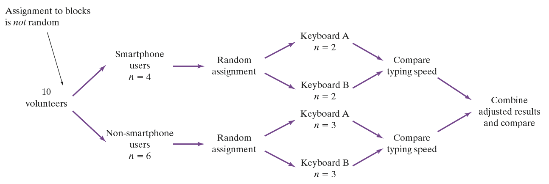
Randomized Block Designs

Slide 33
Randomized Block Designs
A matched pairs design is a common experimental design for comparing two treatments that uses blocks of size 2. In some matched pairs designs, two very similar experimental units are paired and the two treatments are randomly assigned within each pair. In others, each experimental unit receives both treatments in a random order.
The idea is to create blocks by matching pairs of similar experimental units. Just as with other forms of blocking, matching helps account for the variation due to the variable(s) used to form the pairs.

Slide 34
Section Summary
Explain the concept of confounding and how it limits the ability to make cause-and-effect conclusions.
Distinguish between an observational study and an experiment, and identify the explanatory and response variables in each type of study.
Identify the experimental units and treatments in an experiment.
Describe the placebo effect and the purpose of blinding in an experiment.

Slide 35
Section Summary
Describe how to randomly assign treatments in an experiment using slips of paper, technology, or a table of random digits.
Explain the purpose of comparison, random assignment, control, and replication in an experiment.
Describe a completely randomized design for an experiment.
Describe a randomized block design and a matched pairs design for an experiment and explain the purpose of blocking in an experiment.

Slide 36
Chapter 4
Collecting Data
Section 4.3
Using Studies Wisely

Slide 37
Using Studies Wisely
Explain the concept of sampling variability when making an inference about a population and how sample size affects sampling variability.
Explain the meaning of statistically significant in the context of an experiment and use simulation to determine if the results of an experiment are statistically significant.
Identify when it is appropriate to make an inference about a population and when it is appropriate to make an inference about cause and effect.
Evaluate if a statistical study has been carried out in an ethical manner.*

Slide 38
Inference for Sampling
When the members of a sample are selected at random from a population, we can use the sample results to make inferences about the population.
Even when making an inference from a random sample, it would be surprising if the estimate from the sample was exactly equal to the truth about the population.
Sampling variability refers to the fact that different random samples of the same size from the same population produce different estimates.

Slide 39
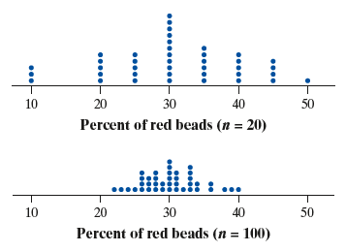
Inference for Sampling
Sampling Variability and Sample Size
Larger random samples tend to produce estimates that are closer to the true population value than smaller random samples. In other words, estimates from larger samples are more precise.

Slide 40
Inference for Sampling
How much do National Football League (NFL) players weigh, on average? In a random sample of 50 NFL players, the average weight is 244.4 pounds.
Do you think that 244.4 pounds is the true average weight of all NFL players? Explain your answer.
No. Different samples of size 50 would produce different average weights. So it would be surprising if this estimate is equal to the true average weight of all NFL players.
Diamond Images/Getty Images

Slide 41
Inference for Sampling
How much do National Football League (NFL) players weigh, on average? In a random sample of 50 NFL players, the average weight is 244.4 pounds.
Do you think that 244.4 pounds is the true average weight of all NFL players? Explain your answer.
Which would be more likely to give an estimate close to the true average weight of all NFL players: a random sample of 50 players or a random sample of 100 players? Explain your answer.
(b) A random sample of 100 players, because estimates tend to be closer to the truth when the sample size is larger.
Diamond Images/Getty Images

Slide 42
Inference for Experiments
Well-designed experiments allow for inferences about cause and effect.
In an experiment, there are two ways to explain why the average response for one group is different than the average response for another group:
The treatment does not have a different effect for the groups, and the difference in the response happened because of chance variation in the random assignment.
The treatment causes a difference in the average response of the groups.
When the observed results of a study are too unusual to be explained by chance alone, the results are called statistically significant.

Slide 43
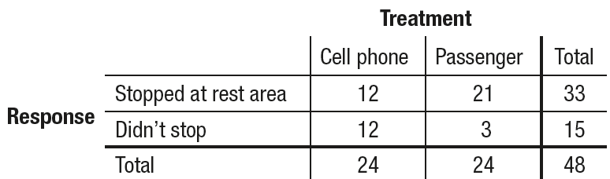
Inference for Experiments
Is talking on a cell phone while driving more distracting than talking to a passenger? David Strayer and his colleagues at the University of Utah designed an experiment to help answer this question. They used 48 undergraduate students as subjects. The researchers randomly assigned half of the subjects to drive in a simulator while talking on a cell phone, and the other half to drive in the simulator while talking to a passenger. One response variable was whether or not the driver stopped at a rest area that was specified by researchers before the simulation started. The table shows the results.
Sean Locke Photography/
Shutterstock.com

Slide 44
Inference for Experiments
(a) Calculate the difference (Passenger –
Cell phone) in the proportion of
students who stopped at the rest
area in the two groups.
Sean Locke Photography/
Shutterstock.com
Difference in proportions = 21/24 – 12/24
= 0.875 – 0.500
= 0.375

Slide 45
Inference for Experiments
One hundred trials of a simulation were performed to see what differences in proportions would occur due only to chance variation in
the random assignment, assuming that the type of distraction did not affect whether a subject stopped at the rest area. That is, 33 “stoppers” and 15 “non-stoppers” were randomly assigned to two groups
of 24.
(b) There are three dots at 0.29. Explain
what these dots mean in this context.
Sean Locke Photography/
Shutterstock.com
(b) When we assumed that the type of distraction doesn’t matter, there were three simulated random assignments where the difference in the proportion of students who stopped at the rest area was 0.29.

Slide 46
Inference for Experiments
One hundred trials of a simulation were performed to see what differences in proportions would occur due only to chance variation in
the random assignment, assuming that the type of distraction did not affect whether a subject stopped at the rest area. That is, 33 “stoppers” and 15 “non-stoppers” were randomly assigned to two groups
of 24.
(c) Use the results of the simulation to
determine if the difference in proportions
from part (a) is statistically significant.
Explain your reasoning.
Sean Locke Photography/
Shutterstock.com
(c) Because a difference of 0.375 or greater never occurred in the simulation, the difference is statistically significant. It is extremely unlikely to get a difference this big simply due to chance variation in the random assignment..

Slide 47
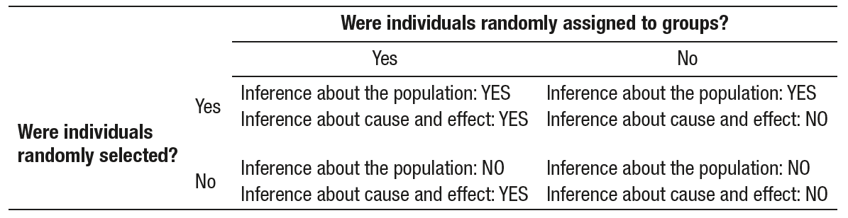
The Scope of Inference: Putting it All Together
The Scope of Inference
Random selection of individuals allows inference about the population from which the individuals were chosen.
Random assignment of individuals to groups allows inference about cause and effect.

Slide 48
The Challenges of Establishing Causation
There are several criteria for establishing causation when we can’t do an experiment:
The association is strong.
The association is consistent.
Larger values of the explanatory variable are associated with stronger responses.
The alleged cause precedes the effect in time.
The alleged cause is plausible.
archives/Getty Images

Slide 49
Data Ethics*
*This is an important topic, but it is not required for the AP® Statistics exam.
Basic Data Ethics
All planned studies must be reviewed in advance by an institutional review board charged with protecting the safety and well-being of the subjects.
All individuals who are subjects in a study must give their informed consent before data are collected.
All individual data must be kept confidential. Only statistical summaries for groups of subjects may be made public.

Slide 50
Section Summary
Explain the concept of sampling variability when making an inference about a population and how sample size affects sampling variability.
Explain the meaning of statistically significant in the context of an experiment and use simulation to determine if the results of an experiment are statistically significant.
Identify when it is appropriate to make an inference about a population and when it is appropriate to make an inference about cause and effect.
Evaluate if a statistical study has been carried out in an ethical manner.*

