Slide 1


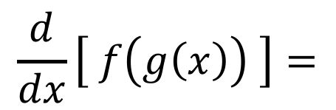

3.4 The Chain Rule:
Suppose you are asked to differentiate the function $f\left(x\right)={\left(2x+1\right)}^{3}$
TOO MUCH WORK!
The Chain Rule:
$$\frac{d}{dx}\left[ f\left(g\left(x\right)\right) \right]=$$
* used to differentiate compositions
* Alternate form:
$$\frac{dy}{dx}= \frac{dy}{du}∙\frac{du}{dx}$$

Slide 2
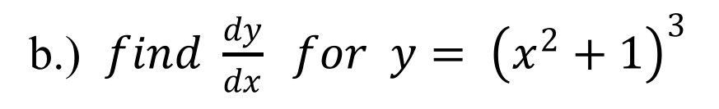
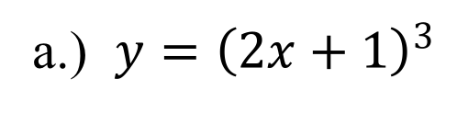
EX #1: Find the derivative.
a.) $y={\left(2x+1\right)}^{3}$
b.) $find \frac{dy}{dx} for y= {\left(x^{2}+1\right)}^{3}$
Inner Function
Outer Function
Inner Function
Outer Function
Always put ( )’s around the x of the outer function derivative.

Slide 3
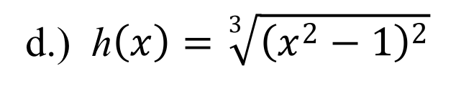
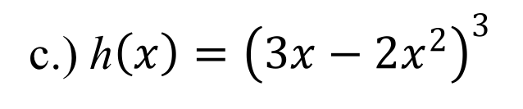
c.) h$\left(x\right)={\left(3x−2x^{2}\right)}^{3}$
d.) h$\left(x\right)=\sqrt[3]{{\left(x^{2}−1\right)}^{2}}$
Inner Function
Outer Function
Inner Function
Outer Function

Slide 4
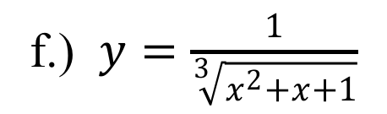
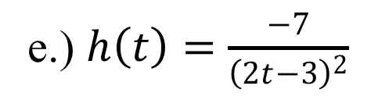
e.) $h\left(t\right)=\frac{−7}{{\left(2t−3\right)}^{2}}$
f.) $y=\frac{1}{\sqrt[3]{x^{2}+x+1}}$
Outer Function
Inner Function
Outer Function
Inner Function

Slide 5
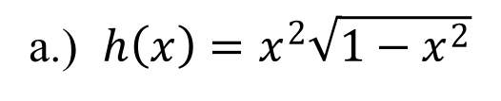
DRILL: Differentiate.
a.) $h\left(x\right)=x^{2}\sqrt{1−x^{2}}$
Product Rule w/ Chain Rule
Inner Function
Outer Function

Slide 6
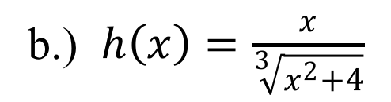
EX #2: Differentiate.
b.) $h\left(x\right)=\frac{x}{\sqrt[3]{x^{2}+4}}$
Quotient Rule w/ Chain Rule
Inner Function
Outer Function

Slide 7
EX #2: Differentiate.
b.) $h\left(x\right)=\frac{x}{\sqrt[3]{x^{2}+4}}$

Slide 8
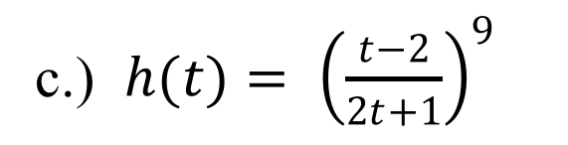
EX #2: Differentiate.
c.) $h(t)= {\left(\frac{t−2}{2t+1}\right)}^{9}$
Chain Rule w/ Quotient Rule
Inner Function
Outer Function

Slide 9
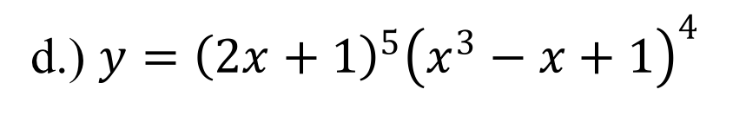
EX #2: Differentiate.
d.) $y={\left(2x+1\right)}^{5}{\left(x^{3}−x+1\right)}^{4}$
Product Rules w/ Chain Rules
Out
Out
In
In

Slide 10
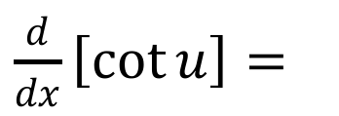
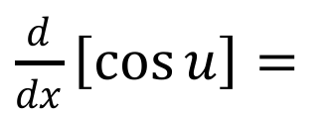
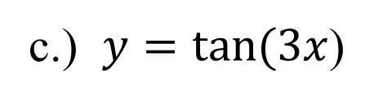
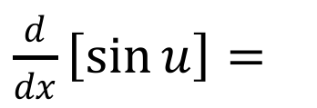
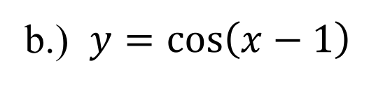
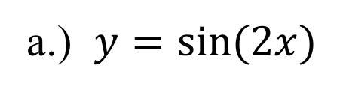
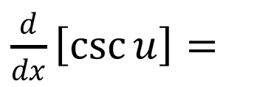
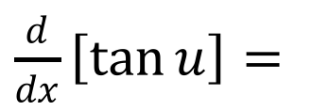
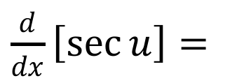
The Chain Rule can be applied to other derivative rules as well…
Take the derivative of the inside of the trig function.
Trig. Functions and the Chain Rule:
$\frac{d}{dx}\left[\sin{u}\right]=$
$\frac{d}{dx}\left[\tan{u}\right]=$
$\frac{d}{dx}\left[\sec{u}\right]=$
$\frac{d}{dx}\left[\cos{u}\right]=$
$\frac{d}{dx}\left[\cot{u}\right]=$
$\frac{d}{dx}\left[\csc{u}\right]=$
EX #3: Differentiate.
a.) $y=\sin{(2x)}$
b.) $y=\cos\left(x−1\right)$
c.) $y=\tan{(3x}$)

Slide 11
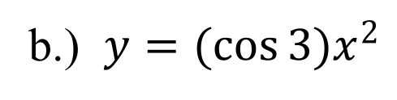
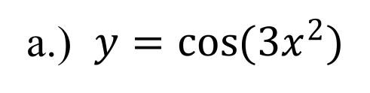


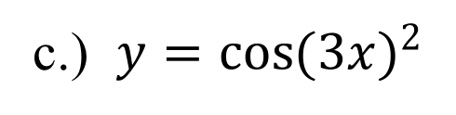
Parenthesis:
EX #4: Differentiate.
$y=\cos{(9x^{2})}$
Constant
a.) $y=\cos{(3x^{2})}$
b.) $y=(\cos{3)x^{2}}$
c.) $y=\cos{(3{x)}^{2}}$
$y=\cos{((3{x)}^{2})}$
Chain Rule
Inner Function Outer Function
Double Angle Identity

Slide 12
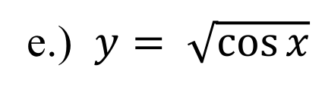
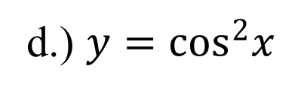
EX #4: Differentiate.
d.) $y=\cos^{2}x$
e.) $y= \sqrt{\cos{x}}$
Chain Rule
Inner Function Outer Function
Chain Rule
Inner Function Outer Function

Slide 13
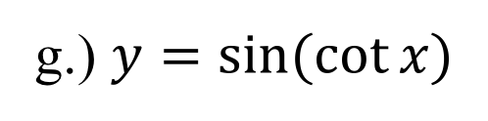
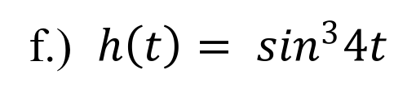
EX #4: Differentiate.
Harder…☺
f.) $h\left(t\right)= \sin^{3}4t$
g.) $y=\sin{(\cot{x)}}$
Chain Rule
Inner Function Outer Function
Chain Rule
Inner Function Outer Function

Slide 14
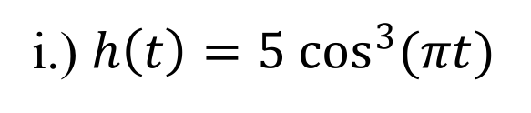
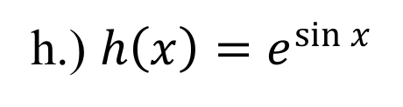
EX #4: Differentiate.
h.) $h\left(x\right)=e^{\sin{x}}$
i.) $h\left(t\right)=5 \cos^{3}(πt)$
Chain Rule
Inner Function Outer Function
Chain Rule
Inner Function Outer Function

Slide 15
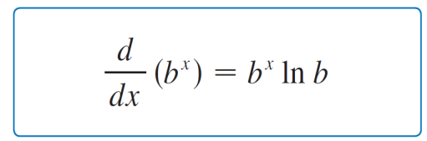
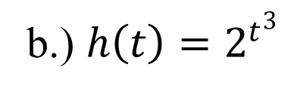
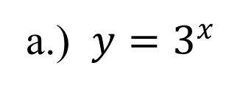
Another derivative rule:
EX #5: Differentiate.
a.) $y=3^{x}$
b.) $h\left(t\right)=2^{t^{3}}$
Chain Rule
Inner Function Outer Function

Slide 18
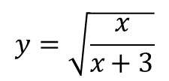

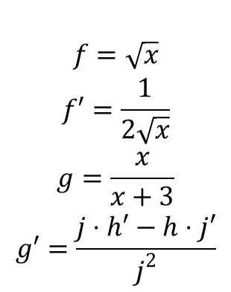
$$y=\sqrt{\frac{x}{x+3}}$$
Chain rule and quotient rule
$$\begin{matrix} \\ f=\sqrt{x} \\ f′=\frac{1}{2\sqrt{x}} \\ g=\frac{x}{x+3} \\ g′=\frac{j⋅h′−h⋅j′}{j^{2}}\end{matrix}$$
$$\begin{matrix}j=x+3 \\ j′=1 \\ h=x \\ h′=1\end{matrix}$$

