Slide 1
Cyber Addiction

Slide 2
What is Cyber Addiction?
How do you know if you have an addiction?
How much screen time do you have on a weekday vs. Weekend?
Which devices count as screen time?
How much is too much?

Slide 3
When should you be tuned in and tuned out?
School
Home
Restaurants
Movie theater
Sporting events
Other?

Slide 4
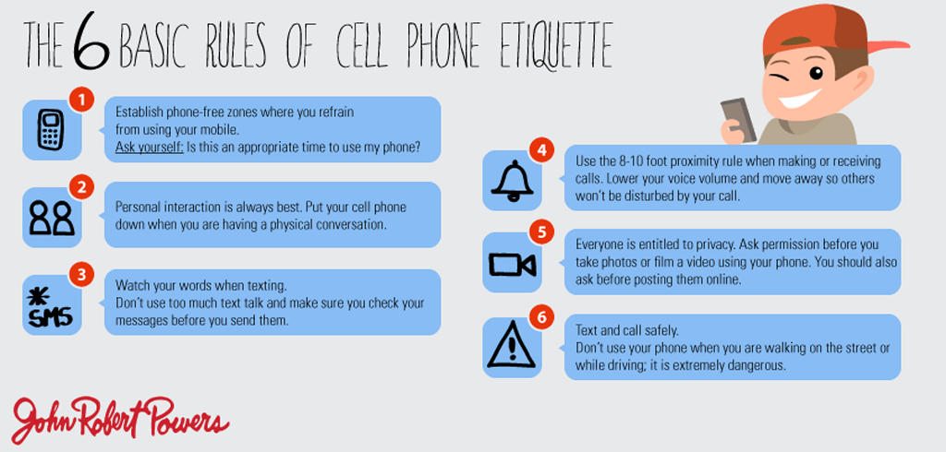

Slide 5
Signs of Cyber Addiction... sound familiar?
Preoccupation – Thinking about previous ,difficulty completing tasks at work or home
Increased use
Inability to stop – can't cut back
Withdrawal symptoms – defensive
Loss sense of time- spending more time than you realize
Risky behaviors-
Lies – to conceal the extent of your involvement
Escape - Isolating yourself from friends or family to be online
Euphoric feelings when involved with internet activities

Slide 6
Symptoms of too much screen time... do you suffer?
Backache
Carpal tunnel – thumb joint
Headache
Insomnia – sleep disturbances
Poor nutrition
Poor personal hygiene
Neck pain
Dry eyes or other vision problems
Weight gain or loss

Slide 7
Do you know these tech terms?
Keep it confidential, between friends
Something is going to happen; promise
Let's meet in real life
An offer to meet face to face or video chat
A crime where predators convince people to send naked pics, and threaten negative attention if they don't
Low Key
Bet
LMIRL
F2F?
Sextortion

Slide 8
True story – Amanda Todd
What do you already know about her story?
Video - Amanda Todd
What are your thoughts?
How did cyber addiction play a role in her life?
There must be so many similar untold stories...
If you want more of the original story...
Amanda's original video

Slide 9
Tech – Etiquette
Phone up vs phone down vs phone away
Vibrate vs flashing lights vs ding
Headphones in vs around your neck vs away

Slide 10
Black Mirror What if your worth was valued in “likes”
https://www.youtube.com/watch?v=epI5r0_T_lE
https://www.youtube.com/watch?v=tyUi6-Opzzw

Slide 11
Lady Gaga – statement about addiction
https://www.buzzfeednews.com/article/adambvary/lady-gaga-addiction-a-star-is-born
Quickly skim the article
Thoughts?

Slide 12
Take Aways
Screen Free zone/time
Let your actions speak louder than words, lead by example
Indulge in the real world
Get outside, put your feet in the grass and experience the world
Live your REAL life – not a SCREEN life
Live in the moment

Slide 13
FRANCE – banned all cell phones from schools
Thoughts?
Good idea?
Pros?
Cons?

