Slide 1
Section 6.2
Adding and
Subtracting
Rational
Expressions

Slide 2
Objective 1
Add rational expressions with the same denominator.

Slide 3
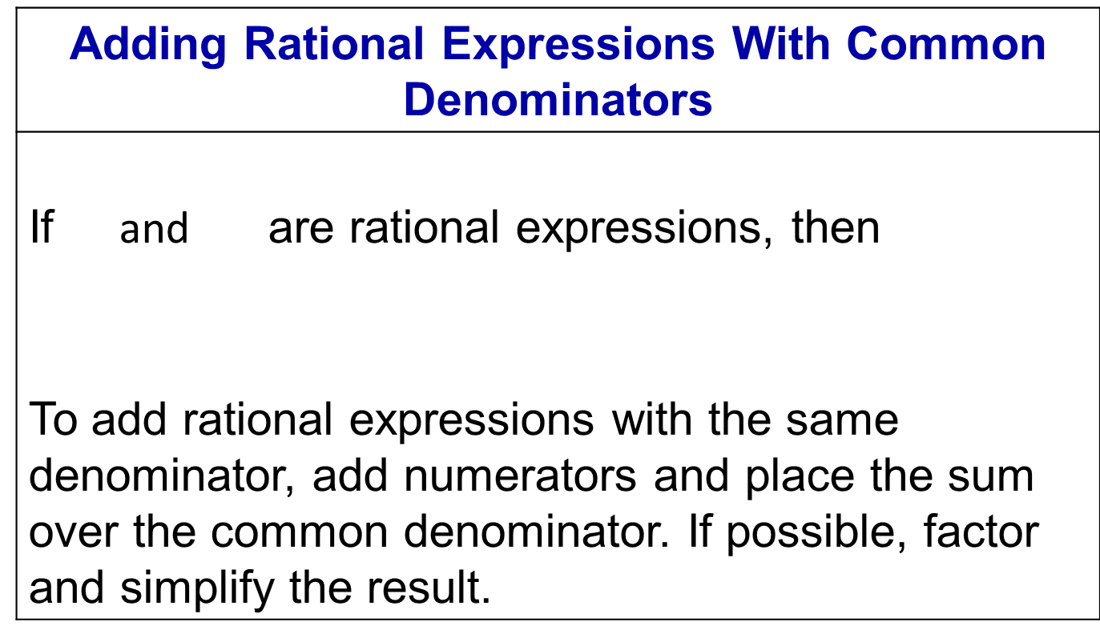
Adding Rational Expressions
Adding Rational Expressions With Common Denominators
If $\text{and}$ are rational expressions, then To add rational expressions with the same denominator, add numerators and place the sum over the common denominator. If possible, factor and simplify the result.

Slide 4
Example
Add:
This is the original expression.
Add numerators. Place this sum over the common denominator.
Combine like terms.

Slide 5
Example (cont)
Factor.
Factor and simplify by dividing out the common factor, x.
Simplify.

Slide 6
Objective 1: Example
1. Add:

Slide 7
Objective 2
Subtract rational expressions with the same denominator.

Slide 8
Subtracting Rational Expressions
Subtracting Rational Expressions With Common Denominators
If and are rational expressions, then To subtract rational expressions with the same denominator, subtract numerators and place the difference over the common denominator. If possible, factor and simplify the result.

Slide 9
Example
Subtract:
This is the original expression.
Subtract numerators. Place this difference over the common denominator.
Remove the parentheses and distribute.

Slide 10
Example (cont)
Combine like terms.
Factor.
Factor and simplify by dividing out the common factor,
Simplify.

Slide 11
Objective 2: Example
2. Subtract:

Slide 12
Objective 3
Find the least common denominator.

Slide 13
Least Common Denominators
Finding the Least Common Denominator (LCD)
Factor each denominator completely.
List the factors of the first denominator.
Add to the list in step 2 any factors of the second denominator that do not appear in the list.
Form the product of each different factor from the list in step 3. This product is the least common denominator.

Slide 14
Example
Find the LCD of:
1. Factor each denominator completely.
2. List the factors of the first denominator.

Slide 15
Example (cont)
3. Add any unlisted factors from the second denominator. The second denominator is One factor of is already in our list, but the factor is not. We add the factor to our list.
4. The least common denominator is the product of all factors in the final list. Thus,
is the least common denominator.

Slide 16
Objective 3: Example
3a. Find the LCD of
Factor each denominator:
List the factors of the first denominator:
Add any unlisted factors from the second denominator:

Slide 17
Objective 3: Example (cont)
The LCD is the product of all the factors in the final list:
The LCD is

Slide 18
Objective 3: Example
3b. Find the LCD of and
Factor each denominator:
List the factors of the first denominator:
Add any unlisted factors from the second denominator:

Slide 19
Objective 3: Example (cont)
The LCD is the product of all the factors in the final list:
The LCD is or

Slide 20
Objective 4
Add and subtract rational expressions with different denominators.

Slide 21
Add & Subtract Fractions
Adding and Subtracting Rational Expressions That Have Different Denominators
Find the LCD of the rational expressions.
Rewrite each rational expression as an equivalent expression whose denominator is the LCD. To do so, multiply the numerator and denominator of each rational expression by any factor(s) needed to convert the denominator into the LCD.

Slide 22
Add & Subtract Fractions (cont)
Adding and Subtracting Rational Expressions That Have Different Denominators
Add or subtract numerators, placing the resulting expression over the LCD.
If possible, simplify the resulting rational expressions.

Slide 23
Example
Add:
1. Find the least common denominator. Begin by factoring the denominators.
The factors of the first denominator are and The only factor from the second denominator that is unlisted is Thus, the least common denominator is,

Slide 24
Example (cont)
2. Write equivalent expressions with the LCD as denominators.
This is the original expression.
Factored denominators.
Multiply each numerator and denominator by the extra factor required to form the LCD.

Slide 25
Example (cont)
3. & 4. Add numerators, putting this sum over the LCD. Simplify, if possible.
Add numerators.
Perform the multiplications using the distributive property.
Combine like terms.

Slide 26
Example (cont)
Since the numerator does not factor, there are clearly no common factors in the numerator and the denominator. Therefore, the final solution is,

Slide 27
Example
Subtract:
1. Find the least common denominator. Begin by factoring the denominators.
The factors of the first denominator are and The only factor from the second denominator that is unlisted is Thus, the least common denominator is,

Slide 28
Example (cont)
2. Write equivalent expressions with the LCD as denominators.
This is the original expression.
Factored denominators.
Multiply each numerator and denominator by the extra factor required to form the LCD.

Slide 29
Example (cont)
3 & 4. Add numerators, putting this sum over the LCD. Simplify, if possible.
Subtract numerators.
Perform the multiplications using the distributive property and FOIL.

Slide 30
Example (cont)
Remove parentheses.
Combine like terms in the numerator.
Since the numerator does not factor, there are clearly no common factors betwixt the numerator and the denominator. Therefore, the final
solution is,

Slide 31
Example
Perform the indicated operations:
1. Find the least common denominator. Begin by factoring the denominators.

Slide 32
Example (cont)
The factors of the first denominator are 1 and The only factor from the second denominator that is unlisted is We have already listed all factors from the third denominator. Thus, the least common denominator is,
or
2. Write equivalent expressions with the LCD as denominators.

Slide 33
Example (cont)
This is the original expression.
Factor the second denominators.
Multiply each numerator and denominator by the extra factor required to form the LCD.

Slide 34
Example (cont)
3 & 4. Add numerators, putting this sum over the LCD. Simplify, if possible.
Add and subtract numerators.
Perform the multiplications using the distributive property.
Combine like terms in the numerator.

Slide 35
Example (cont)
Since the numerator does not factor, there are clearly no common factors in the numerator and the denominator. Therefore, the final solution is,

Slide 36
Objective 4: Example
4a. Add:
The LCD is
Rewrite each rational expression with the LCD as the denominator.

Slide 37
Objective 4: Example
4b. Add:
The LCD is
Rewrite each rational expression with the LCD as the denominator.

Slide 38
Objective 4: Example
4c. Subtract:
The LCD is
Rewrite each rational expression with the LCD as the denominator.

Slide 39
Objective 4: Example (cont)

Slide 40
Objective 4: Example
4d. Perform the indicated operations:
The LCD is
Rewrite each rational expression with the LCD as the denominator.

Slide 41
Objective 4: Example (cont)

Slide 42
Objective 5
Add and subtract rational expressions with opposite denominators.

Slide 43
Example
Add:
This is the original expression.
Factor the first denominator.
Multiply the numerator and the denominator of the second rational expression by

Slide 44
Example (cont)
Multiply by
Rewrite as
Notice the LCD is
Multiply the second numerator and denominator by the extra factor required to form the LCD.

Slide 45
Example (cont)
Perform the multiplications using the distributive property.
Add and subtract numerators.
Remove parentheses and distribute.

Slide 46
Example (cont)
Combine like terms in the numerator.
Since the numerator does not factor, there are clearly no common factors betwixt the numerator and the denominator. Therefore, the final solution is,

Slide 47
Objective 5: Example
5. Add:
Since the denominators are opposites, multiply the numerator and denominator of the second rational expression by

Slide 48
Section 6.6
Rational
Equations

Slide 49
Solving a Rational Equation
A rational equation, also called a fractional equation, is an equation containing one or more rational expressions. The following is an example of a rational equation:
Do you see that there is a variable in the denominator? This is a characteristic of many rational equations.

Slide 50
Objective 1
Solve rational equations.

Slide 51
Solving a Rational Equation
When adding or subtracting rational expressions, we find the LCD and convert fractions to equivalent fractions that have the common denominator.
By contrast, when we solve rational equations, the LCD is used as a multiplier that clears an equation of fractions.

Slide 52
Example
Solve:
Notice that the variable x appears in two of the denominators. We must avoid any values of the variable that make a denominator zero.
Therefore, we see that x cannot equal zero.
This denominator would equal zero if
This denominator would equal zero if

Slide 53
Example (cont)
The denominators are 5x, 5, and x. The least common denominator is 5x. We begin by multiplying both sides of the equation by 5x. We will also write the restriction that x cannot equal zero to the right of the equation.
This is the given equation.
Multiply both sides by 5x, the LCD.

Slide 54
Example (cont)
Use the distributive property.
Divide out common factors in the multiplications.
Multiply.
Subtract.
Add.
Divide.

Slide 55
Example (cont)
The proposed solution, 8, is not part of the restriction It should check in the original equation.
Check 8:

Slide 56
Example (cont)
true
This true statement verifies that the solution is 8 and the solution set is

Slide 57
Solving a Rational Equation
Solving Rational Equations
List restrictions on the variable. Avoid any values of the variable that make a denominator zero.
Clear the equation of fractions by multiplying both sides by the LCD of all rational expressions in the equation.
Solve the resulting equation.
Reject any proposed solution that is in the list of restrictions on the variable. Check other proposed solutions in the original equation.

Slide 58
Example
Solve:
List restrictions on the variable.
The restrictions are and
This denominator would equal zero if
This denominator would equal zero if

Slide 59
Example (cont)
Multiply both sides by the LCD. The denominators are and Thus, the LCD is
This is the given equation.
Multiply both sides by the LCD.
Simplify.

Slide 60
Example (cont)
Solve the resulting equation.
This is the equation cleared of fractions.
Use FOIL on each side.
Subtract from both sides.
Subtract 19x from both sides.

Slide 61
Example (cont)
Check the proposed solution in the original equation.
Notice, there is no proposed solution. And of course, is not a true statement. Therefore, there is no solution to the original rational equation. We say the solution set is , the empty set.

Slide 62
Example
Solve:
List restrictions on the variable. By factoring denominators, it makes it easier to see values that make the denominators zero.
This denominator is zero if or
This denominator would equal zero if
This denominator would equal zero if

Slide 63
Example (cont)
The restrictions are and
Multiply both sides by the LCD. The factors of the LCD are and Thus, the LCD is
This is the given equation.
Multiply both sides by the LCD.

Slide 64
Example (cont)
Use the distributive property.
Simplify.

Slide 65
Example (cont)
Solve the resulting equation.
This is the equation with cleared fractions.
Use the distributive property.
Combine like terms.
Subtract x from both sides.
Add 5 to both sides.
Divide both sides by 3.

Slide 66
Example (cont)
Check the proposed solutions in the original equation. The proposed solution, 3, is not part of the restriction that and Substitute 3 for x, in the given (original) equation. The resulting true statement verifies that 3 is a solution and that is the solution set.

Slide 67
Objective 1: Example
1a. Solve:
The restriction is

Slide 68
Objective 1: Example (cont)
The proposed result makes the original equation true.
The solution set is

Slide 69
Objective 1: Example
1b. Solve:
The restriction is and

Slide 70
Objective 1: Example (cont)
The proposed result makes the original equation true.
The solution set is

Slide 71
Objective 1: Example
1c. Solve:
The restriction is

Slide 72
Objective 1: Example (cont)
The proposed result is restricted because
The solution set is

Slide 73
Objective 1: Example
1d. Solve:
The restriction is

Slide 74
Objective 1: Example (cont)
The solution set is

Slide 75
Objective 1: Example
1e. Solve:
The restriction is and

Slide 76
Objective 1: Example (cont)
The solution set is

Slide 77
Objective 2
Solve problems involving rational functions that model applied situations.

Slide 78
Example
Rational functions can be used to model learning. Many of these functions model the proportion of correct responses as a function of the number of trials of a particular task. One such model, called a learning curve, is
where is the proportion of correct responses after x trials. If , there are no correct responses. If , all responses are correct. The graph of the rational function is shown on the next slide. Use the function to solve the following problem.

Slide 79
Example (cont)

Slide 80
Example (cont)
How many learning trials are necessary for 0.5 of the responses to be correct? Identify your solution as a point on the graph.
Substitute 0.5, the proportion of correct responses, for and solve the resulting rational equation for x.
The LCD is
Multiply both sides by the LCD.

Slide 81
Example (cont)
Simplify.
Use the distributive property on the left side.
Subtract 0.9x from both sides.
Subtract 0.05 from both sides.
Divide both sides by

Slide 82
Example (cont)
The number of learning trials necessary for 0.5 of the responses to be correct is 1.
The solution is identified as a point on the graph at the beginning of the problem.

Slide 83
Objective 2: Example
2. The function models the cost, in thousands of dollars, to remove x% of a lake’s pollutants. If voters in the city commit $120 thousand for the project, what percentage of the lake’s pollutants can be removed?

Slide 84
Objective 2: Example (cont)
If voters commit $120 thousand, 50% of the lake’s pollutants can be removed.

