Slide 1




Math 153
Stats Starts Here

Slide 2



Stats Starts Here
According to 100% of people surveyed, this is the greatest class ever offered in college.
List of people surveyed: ME

Slide 3
What Is (Are?) Statistics?
Statistics (the discipline) is a way of reasoning, a collection of tools and methods, designed to help us understand the world.
Statistics (plural) are particular calculations made from a sample of data.
Data are values with a context.
What is Statistics About?
Statistics is about variation.
All measurements are imperfect, since there is variation that we cannot see.
Statistics helps us to understand the real, imperfect world in which we live.

Slide 4



Think, Show, Tell
There are three simple steps to doing Statistics right:
  first. Know where you’re headed and why.
  is about the mechanics of calculating statistics and graphical displays, which are important (but are not the most important part of Statistics).
  what you’ve learned. You must explain your results so that someone else can understand your conclusions.

Slide 5
What Are Data?
Data can be numbers, record names, or other labels.
Not all data represented by numbers are numerical data (e.g., 1=male, 2=female).
Data are useless without their context…

Slide 6

The Exam (FICTIONAL DATA)
The class average last semester was a 94 on the final exam.
It was out of 500 points!!!!
A group of individuals averaged a 78% on an algebra exam……
The group of individuals were 7 year olds…
Or…the group of individuals were Algebra teachers!

Slide 7

Dream Job
The average salary at a company that has 25 employees is $8,500,000 per year.
Would you like to be hired by this company?
The CEO makes
$212,400,000 per year…
The other 24 employees
Average $4,166.67 per/year

Slide 8

The “W’s”
To provide context we need the W’s
  Who
  What (and in what units)
  When
  Where
  Why (if possible)
  and How
  of the data.
Note: the answers to “who” and “what” are essential.

Slide 9
Who
The Who of the data tells us the individual cases about which (or whom) we have collected data.
  Individuals who answer a survey are called respondents.
  People on whom we experiment are called subjects or participants.
  Animals, plants, and inanimate subjects are called experimental units.

Slide 10
What and Why
Variables are characteristics recorded about each individual.
The variables should have a name that identify What has been measured.
To understand variables, you must Think about what you want to know.

Slide 11
What and Why (cont.)
A categorical (or qualitative) variable names categories and answers questions about how cases fall into those categories.
  Categorical examples: sex, race, ethnicity
A quantitative variable is a measured variable (with units) that answers questions about the quantity of what is being measured.
  Quantitative examples: income ($), height (inches), weight (pounds)

Slide 12
What and Why (cont.)
Example: In a student evaluation of instruction at a large university, one question asks students to evaluate the statement “The instructor was generally interested in teaching” on the following scale: 1 = Disagree Strongly; 2 = Disagree; 3 = Neutral; 4 = Agree; 5 = Agree Strongly.
Question: Is interest in teaching categorical or quantitative?

Slide 13
Examples
Time it takes to get to school in minutes
Height in inches
Number of shoes owned
Gender
Hair color
Age of Oscar winners in years
Temperature of a cup of coffee in Cº
Type of pain medication
Jellybean flavors
Hours spent on Social Media
Q
Q
Q
C
C
Q
Q
C
C
Q

Slide 14
What Can Go Wrong?
Don’t label a variable as categorical or quantitative without thinking about the question you want it to answer.
Just because your variable’s values are numbers, don’t assume that it’s quantitative.
Always be skeptical—don’t take data for granted.

Slide 15
What have we learned? (cont.)
We treat variables as categorical or quantitative.
  Categorical variables identify a category for each case.
  Quantitative variables record measurements or amounts of something and must have units.
  Some variables can be treated as categorical or quantitative depending on what we want to learn from them.

Slide 16
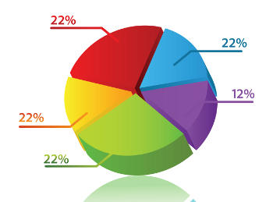
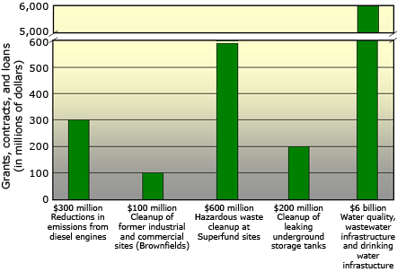
Displaying and Describing
Categorical Data

Slide 17
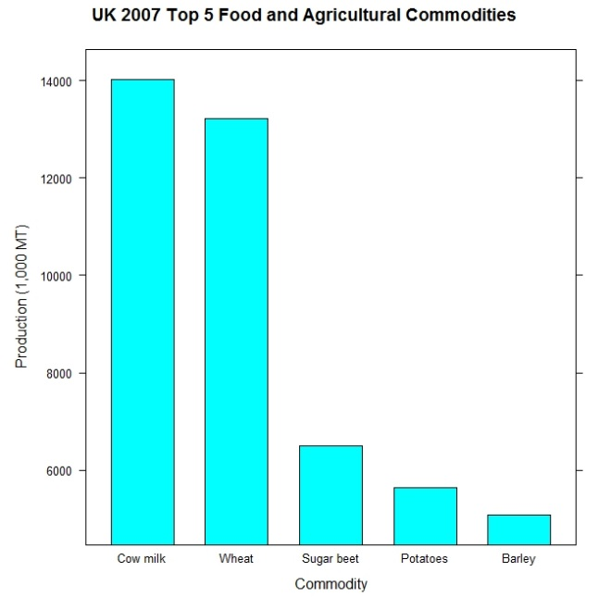
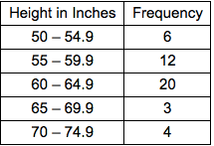
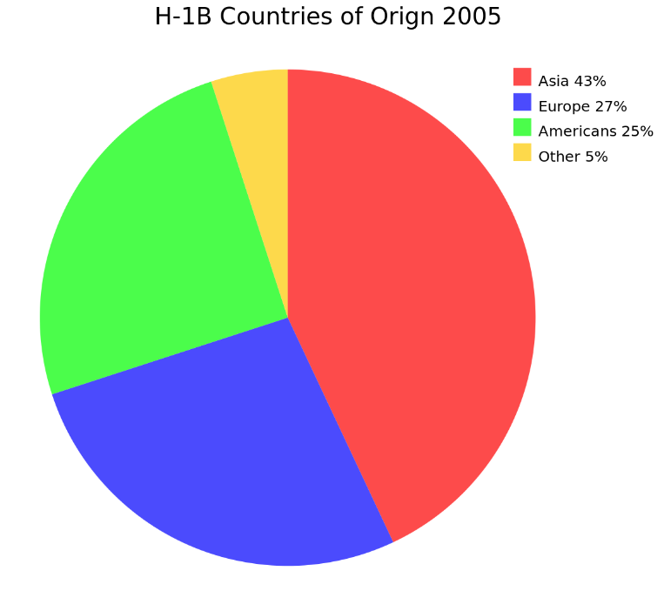
Types of Graphs for Categorical Data
Bar Charts
Pie Charts
Frequency Table (Two-Way Table)

Slide 18
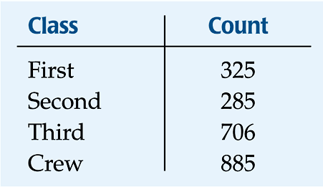
Frequency Tables: Making Piles
We can “pile” the data by counting the number of data values in each category of interest.
We can organize these counts into a frequency table, which records the totals and the category names.

Slide 19
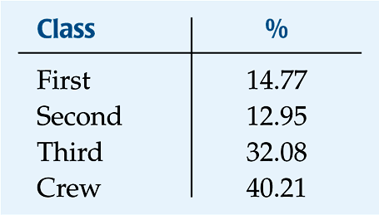
Frequency Tables: Making Piles (cont.)
A relative frequency table is similar, but gives the percentages (instead of counts) for each category.

Slide 20
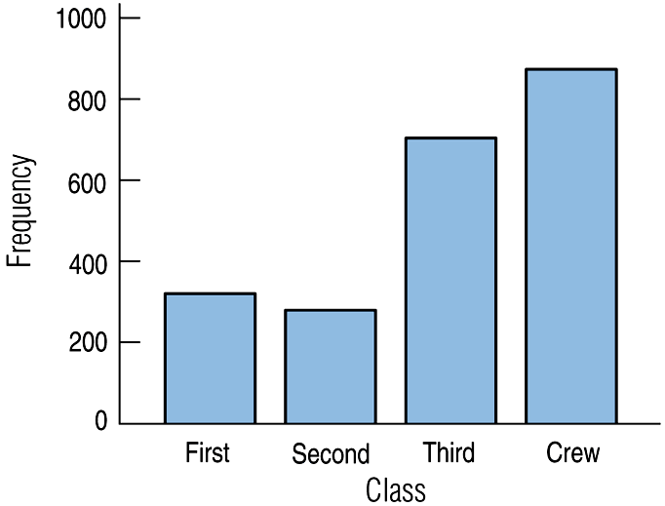
Bar Charts
A bar chart displays the distribution of a categorical variable, showing the counts for each category next to each other for easy comparison.
A bar chart stays true to the area principle.
Thus, a better display for the ship data is:

Slide 21
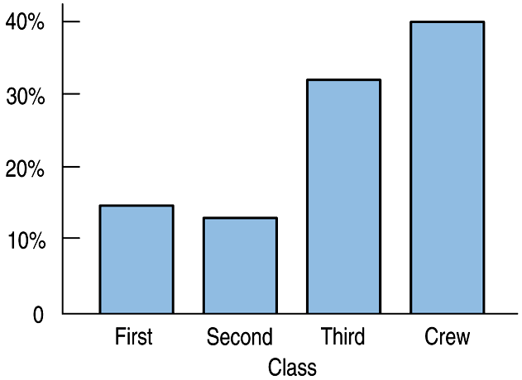
Bar Charts (cont.)
A relative frequency bar chart displays the relative proportion of counts for each category.
A relative frequency bar chart also stays true to the area principle.
Replacing counts with percentages in the ship data:

Slide 22
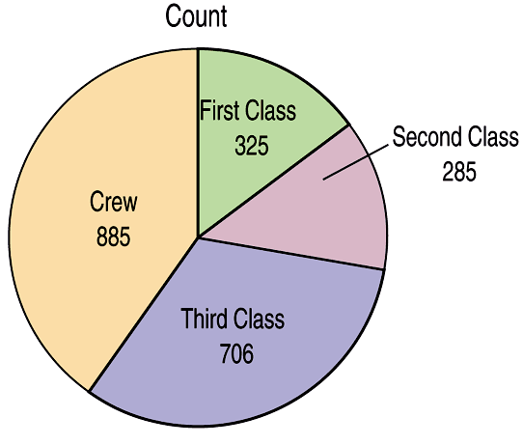
Pie Charts
When you are interested in parts of the whole, a pie chart might be your display of choice.
Pie charts show the whole group of cases as a circle.
They slice the circle into pieces whose size is proportional to the fraction of the whole in each category.

Slide 23
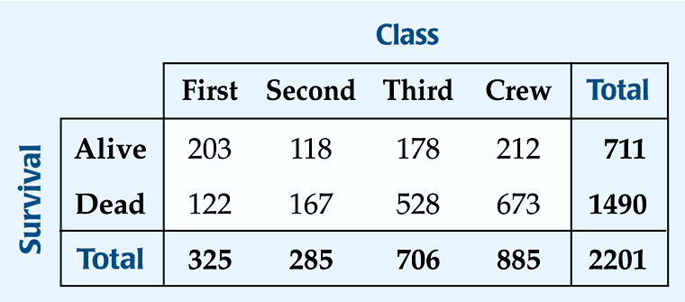
Contingency Tables
A contingency table allows us to look at two categorical variables together.
It shows how individuals are distributed along each variable, contingent on the value of the other variable.
  Example: we can examine the class of ticket and whether a person survived the Titanic:

Slide 24
Contingency Tables (cont.)
The margins of the table, both on the right and on the bottom, give totals and the frequency distributions for each of the variables.
Each frequency distribution is called a marginal distribution of its respective variable.
  The marginal distribution of Survival is:

Slide 25
Contingency Tables (cont.)
Each cell of the table gives the count for a combination of values of the two values.
  For example, the second cell in the crew column tells us that 673 crew members died when the Titanic sunk.

Slide 26
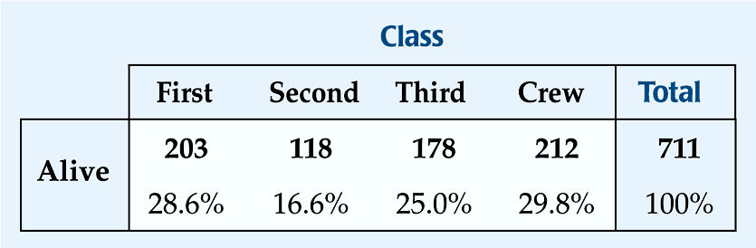
Conditional Distributions
A conditional distribution shows the distribution of one variable for just the individuals who satisfy some condition on another variable.
  The following is the conditional distribution of ticket Class, conditional on having survived:

Slide 27
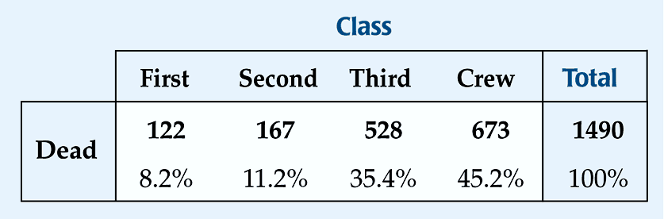
Conditional Distributions (cont.)
  The following is the conditional distribution of ticket Class, conditional on having perished:

Slide 28
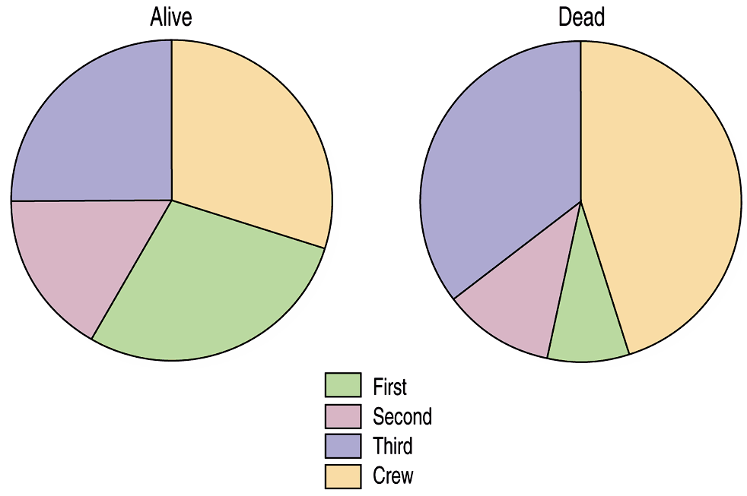
Conditional Distributions (cont.)
The conditional distributions tell us that there is a difference in class for those who survived and those who perished.
This is better shown with pie charts of the two distributions:

Slide 29
Conditional Distributions (cont.)
We see that the distribution of Class for the survivors is different from that of the nonsurvivors.
This leads us to believe that Class and Survival are associated, that they are not independent.
The variables would be considered independent when the distribution of one variable in a contingency table is the same for all categories of the other variable.

Slide 30
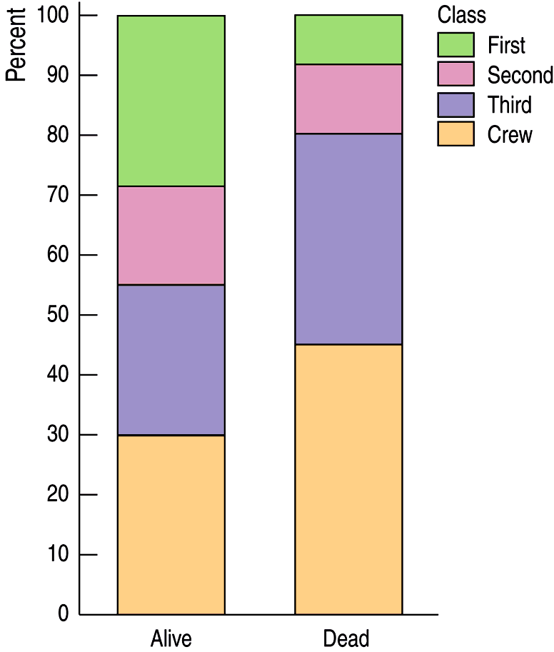
Segmented Bar Charts
A segmented bar chart displays the same information as a pie chart, but in the form of bars instead of circles.
Here is the segmented bar chart for ticket Class by Survival status:

Slide 31
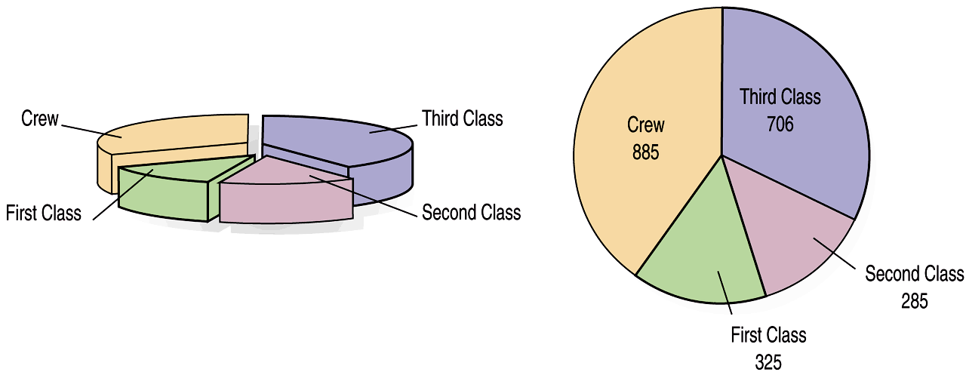
What Can Go Wrong?
Don’t violate the area principle.
  While some people might like the pie chart on the left better, it is harder to compare fractions of the whole, which a well-done pie chart does.

Slide 32
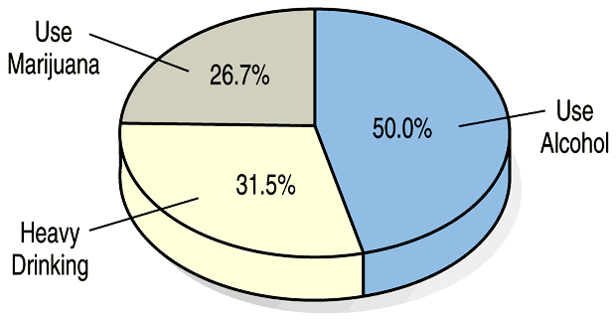

What Can Go Wrong? (cont.)
Keep it honest—make sure your display shows what it says it shows.
  This plot of the percentage of high-school students who engage in specified dangerous behaviors has a problem. Can you see it?

Slide 33
What Can Go Wrong? (cont.)
Don’t confuse similar-sounding percentages—pay particular attention to the wording of the context.
Don’t forget to look at the variables separately too—examine the marginal distributions, since it is important to know how many cases are in each category.
Example: 20% of 100 (20) is a big difference from 21% of 10000 (2100)

Slide 34
What Can Go Wrong? (cont.)
Be sure to use enough individuals!
  Do not make a report like “We found that 66.67% of the rats improved their performance with training. The other rat died.”

Slide 35
What have we learned?
We can summarize categorical data by counting the number of cases in each category (expressing these as counts or percents).
We can display the distribution in a bar chart or pie chart.
And, we can examine two-way tables called contingency tables, examining marginal and/or conditional distributions of the variables.
If conditional distributions of one variable are the same for every category of the other, the variables are independent.

