Slide 1
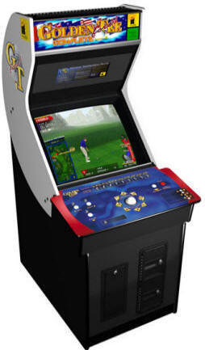
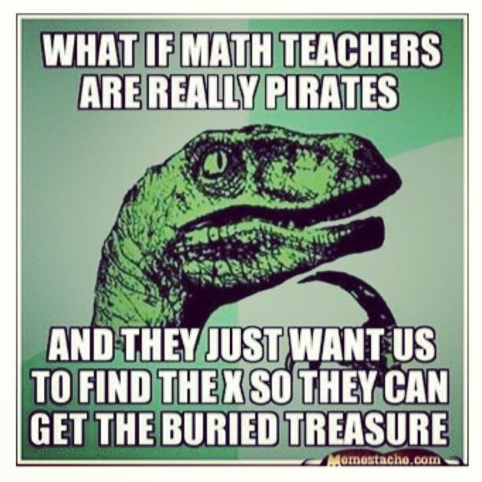
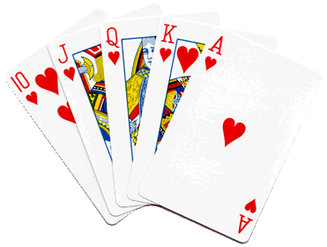
Mr. Calise
Welcome !!
Hope you had a good 1st semester
I have been teaching High School for 20 years
I love ALL TYPES of SPORTS and ALL TYPES of MUSIC
I also teach Math and Statistics at Johns Hopkins University and CCBC
I have two children ages 9 and 13.

Slide 2
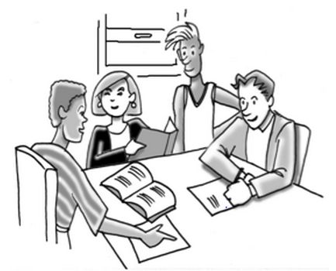
Opening Question
Write down a few times you may have used math or can think of why someone might use math in the real world. What jobs do you think require a lot of math?

Slide 3
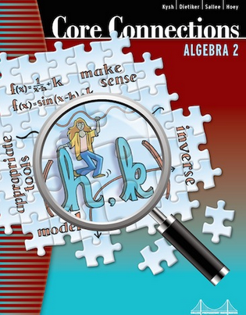
Syllabus and Textbook
www.mrcalise.com

Slide 4
What Function Is That?
Algebra 2, Unit 1A

Slide 6
