Slide 1
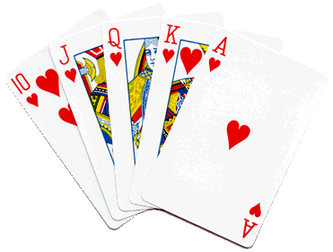
Mr. Calise
Welcome Back!
Hope you had a
Great summer!
I have been teaching High School for 22 years
I love ALL TYPES of SPORTS and ALL TYPES of MUSIC
I also teach Math and Statistics at Johns Hopkins University, CCBC, AACC and Loyola University
I have two children ages 11 and 15.

Slide 2
Unit 1
Build It
Constructions and Rigid Transformations
Lesson 1
Notes:
For quick access to the presentation from your own drive, go to File > Add shortcut to Drive.
To customize for your students, go to File > Make a copy to make a copy of the slide deck in your Google Drive that you can edit.
Report a Typo

Slide 3
Let’s use tools to create shapes precisely.
Unit 1 ● Lesson 1

Slide 4
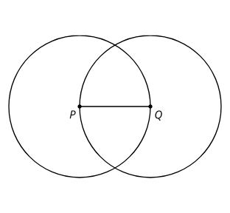
The Right Tool
Copy this figure using only a pencil and no other tools.
Familiarize yourself with your straightedge and compass by drawing a few circles of different sizes, a few line segments of different lengths, and extending some of those line segments in both directions.
Complete these steps with a straightedge and compass:
Draw a point and label it A.
Draw a circle centered at point A with a radius of length PQ.
Mark a point on the circle and label it B.
Draw another circle centered at point B that goes through point A.
Draw a line segment between points A and B.
Unit 1 ● Lesson 1 ● Activity 1

Slide 5
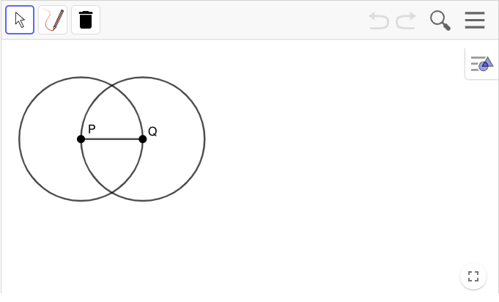
The Right Tool
Warm-up
Unit 1 ● Lesson 1 ● Activity 1

Slide 6
Illegal Construction Moves
Create a circle centered at A with radius AB.
Estimate the midpoint of segment AB and label it C.
Create a circle centered at B with radius BC. This creates 2 intersection points. Label the one toward the top of the page as D and the one toward the bottom as E.
Use your straightedge to connect points A, D, and E to make triangle ADE and lightly shade it in with your pencil.
Unit 1 ● Lesson 1 ● Activity 2

Slide 7
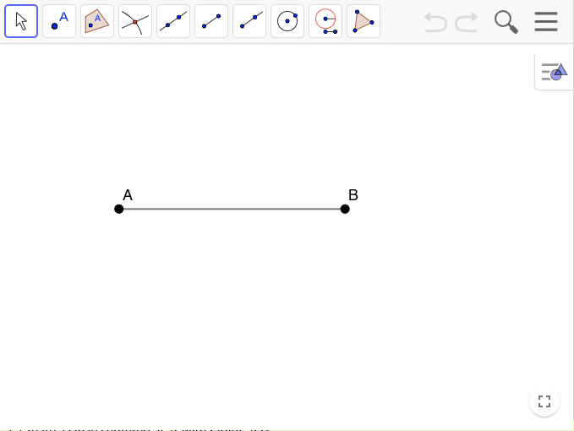
Illegal Construction Moves
Unit 1 ● Lesson 1 ● Activity 2

Slide 8
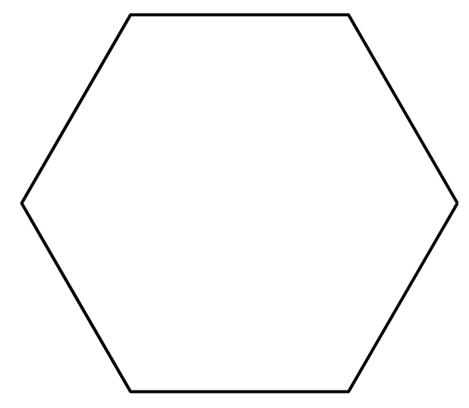
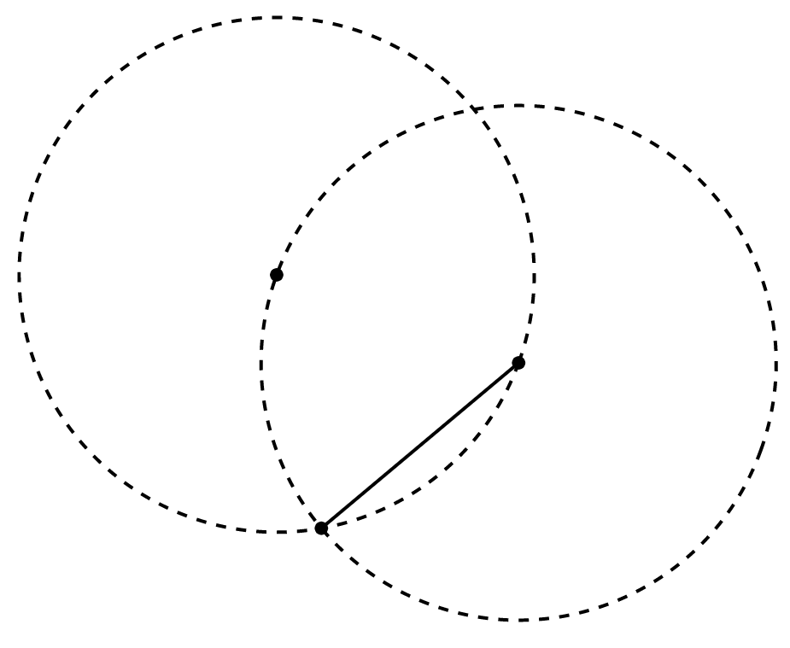
Can You Make a Perfect Copy?
Here is a hexagon with all congruent angles and all congruent sides (called a regular hexagon).
Draw a copy of the regular hexagon using only your pencil and no other tools. Trace your copy onto tracing paper. Try to fold it in half. What happened?
Here is a figure that shows the first few steps to constructing the regular hexagon. Use straightedge and compass moves to finish constructing the regular hexagon. Trace it onto tracing paper and confirm that when you fold it in half, the edges line up.
How do you know each of the sides of the shape are the same length? Show or explain your reasoning.
Unit 1 ● Lesson 1 ● Activity 3

Slide 9
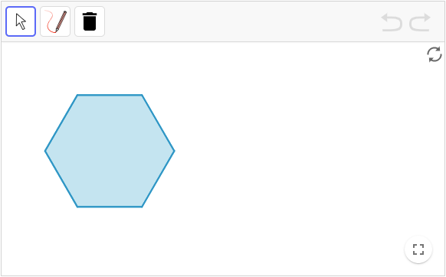
Can You Make a Perfect Copy?
Unit 1 ● Lesson 1 ● Activity 3

Slide 10
Build It
Using a straightedge and compass:
If starting from a blank space, start by marking 2 points.
Create a line or line segment between 2 marked points.
Create a circle centered at a marked point going through another marked point.
Set your compass to the length between 2 marked points and create a circle with that radius centered at any marked point.
Mark intersection points.
Mark a point on a circle.
Mark a point on a line or line segment.
Unit 1 ● Lesson 1

Slide 11
Build It
Point, line, and distance (or length) are undefined terms. We use these undefined to define other terms.
points are infinitesimally small
lines are infinitely long, extending in both directions
part of a line with one endpoint is called a ray, and it extends in one direction
part of a line with two endpoints is called a segment, and it has a measurable length
a circle is made up of all the points a set distance from a point
the point is called the center, and the set distance is called the radius
Unit 1 ● Lesson 1

Slide 12
Unit 1 ● Lesson 1
I can create diagrams using a straightedge.
I know to use a compass to construct a circle.

Slide 13
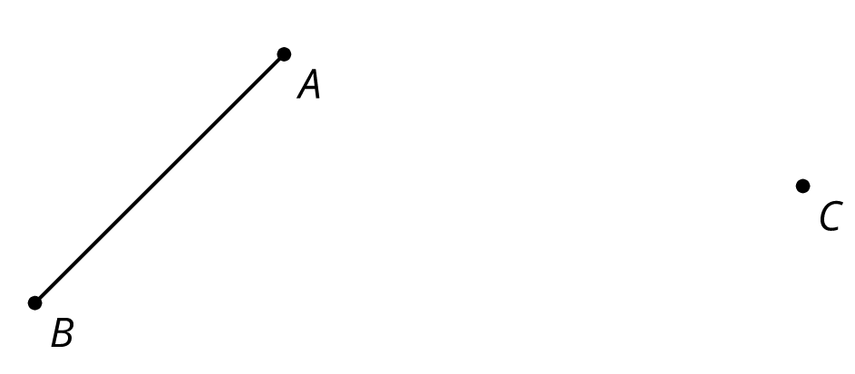
Build It
Here is segment AB and a point C:
Create a circle centered at C whose radius is the length of AB. Mark a point on the circle and label it D. Draw line CD and label its other intersection with the circle as point E.
Unit 1 ● Lesson 1 ● Activity 4

Slide 14
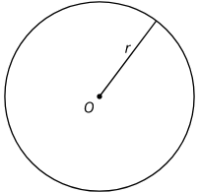
circle
A circle of radius r with center O is the set of all points that are a distance r units from O.
To draw a circle of radius 3 and center O, use a compass to draw all the points at a distance 3 from O.
Unit 1 ● Lesson 1

Slide 15
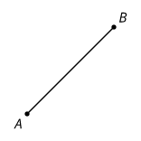
line segment
A set of points on a line with two endpoints.
Unit 1 ● Lesson 1

Slide 16
This slide deck is copyright 2020 by Kendall Hunt Publishing, https://im.kendallhunt.com/, and is licensed under the Creative Commons Attribution-NonCommercial 4.0 International License (CC BY-NC 4.0), https://creativecommons.org/licenses/by-nc/4.0/.This slide deck is copyright 2020 by Kendall Hunt Publishing, https://im.kendallhunt.com/, and is licensed under the Creative Commons Attribution-NonCommercial 4.0 International License (CC BY-NC 4.0), https://creativecommons.org/licenses/by-nc/4.0/.
All curriculum excerpts are under the following licenses:
IM 9–12 Math is copyright 2019 by Illustrative Mathematics. It is licensed under the Creative Commons Attribution 4.0 International License (CC BY 4.0).
This material includes public domain images or openly licensed images that are copyrighted by their respective owners. Openly licensed images remain under the terms of their respective licenses. See the image attribution section for more information.
The Illustrative Mathematics name and logo are not subject to the Creative Commons license and may not be used without the prior and express written consent of Illustrative Mathematics.

Slide 17
Unit 1
Constructing Patterns
Constructions and Rigid Transformations
Lesson 2
Notes:
For quick access to the presentation from your own drive, go to File > Add shortcut to Drive.
To customize for your students, go to File > Make a copy to make a copy of the slide deck in your Google Drive that you can edit.
Report a Typo

Slide 18
Let’s use compass and straightedge constructions to make patterns.
Unit 1 ● Lesson 2

Slide 19
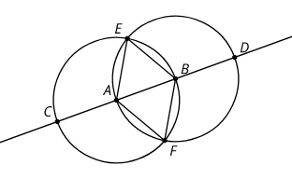
Why Is That True?
Here are 2 circles with centers A and B .
Based on the diagram, explain how you know each statement is true.
The length of segment EA is equal to the length of segment EB.
Triangle ABF is equilateral.
Unit 1 ● Lesson 2 ● Activity 1

Slide 20
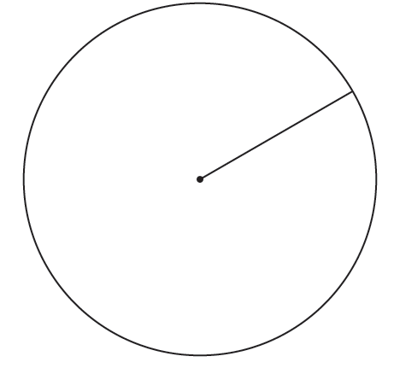
Make Your Own
Use straightedge and compass moves to build your own pattern using the circle and radius as a place to start. As you make your pattern, record each move on a separate sheet of blank paper. Use precise vocabulary so someone can make a perfect copy without seeing the original. Include instructions about how to shade or color your pattern.
Unit 1 ● Lesson 2 ● Activity 2

Slide 21
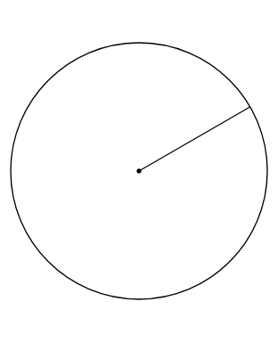
Make Your Own
Follow the instructions precisely to recreate the pattern.
Unit 1 ● Lesson 2 ● Activity 3

Slide 22
Constructing Patterns
What was difficult about following someone’s instructions?
What changes would you make about the way you wrote your instructions to describe figures in geometry?
Were there any shapes or patterns that you were surprised could be made with straightedge and compass moves?
Unit 1 ● Lesson 2

Slide 23
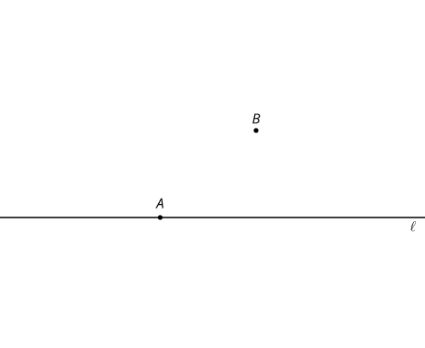
Constructing a Parallel Line
Here is point A on line l and point B that is not on l.
Use these straightedge and compass moves to create a line parallel to the given line that goes through point :
Create a line through A and B extending in both directions. Label this line p.
Create a circle centered at B with radius AB. This circle intersects with line l in 2 places. Label the intersection point to the right of A as C.
Unit 1 ● Lesson 2 ● Activity 4

Slide 24
Constructing a Parallel Line
Here is point A on line l and point B that is not on l.
Create a circle centered at B with radius BA . This circle intersects with line p at A and 1 other point. Label the new intersection point as D.
Create a circle centered at D with a radius of length BC. This circle intersects with the circle centered at B in 2 places. Label the intersection point to the right of B as E.
Using a different colored pencil, create a line through B and E extending in both directions.
Unit 1 ● Lesson 2 ● Activity 4

Slide 25
circle
A circle of radius r with center O is the set of all points that are a distance r units from O.
To draw a circle of radius 3 and center O, use a compass to draw all the points at a distance 3 from O.
Unit 1 ● Lesson 2

Slide 26
line segment
A set of points on a line with two endpoints.
Unit 1 ● Lesson 2

Slide 27
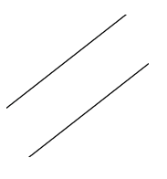
parallel
Two lines that don't intersect are called parallel. We can also call segments parallel if they extend into parallel lines.
Unit 1 ● Lesson 2

Slide 28
Unit 1 ● Lesson 2
I can follow instructions to create a construction.
I can use precise mathematical language to describe a construction.

Slide 29
This slide deck is copyright 2020 by Kendall Hunt Publishing, https://im.kendallhunt.com/, and is licensed under the Creative Commons Attribution-NonCommercial 4.0 International License (CC BY-NC 4.0), https://creativecommons.org/licenses/by-nc/4.0/.This slide deck is copyright 2020 by Kendall Hunt Publishing, https://im.kendallhunt.com/, and is licensed under the Creative Commons Attribution-NonCommercial 4.0 International License (CC BY-NC 4.0), https://creativecommons.org/licenses/by-nc/4.0/.
All curriculum excerpts are under the following licenses:
IM 9–12 Math is copyright 2019 by Illustrative Mathematics. It is licensed under the Creative Commons Attribution 4.0 International License (CC BY 4.0).
This material includes public domain images or openly licensed images that are copyrighted by their respective owners. Openly licensed images remain under the terms of their respective licenses. See the image attribution section for more information.
The Illustrative Mathematics name and logo are not subject to the Creative Commons license and may not be used without the prior and express written consent of Illustrative Mathematics.

