Slide 1
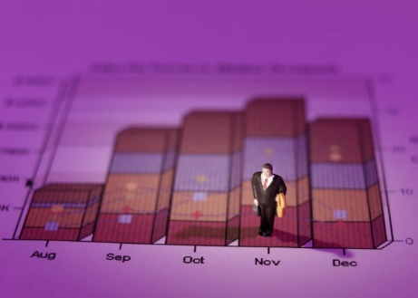




















STAT 110
Stats Starts Here
Chapter 1
Jobs
Sports Teams
The Role of Statistics and the Data Analysis Process
Hobbies

Slide 2


Stats Starts Here
Over 99% of people surveyed said this is the greatest class ever offered at Loyola University.
List of people surveyed: ME

Slide 3

What is Statistics?

Slide 4

The Exam (FICTIONAL DATA)
The class average last semester was a 94 on the final exam.
It was out of 500 points!!!!
A group of individuals averaged a 78% on an algebra exam……
The group of individuals were 7 year olds…
Or…the group of individuals were Algebra teachers!

Slide 5

Dream Job
The average salary at a company that has 25 employees is $8,500,000 per year.
Would you like to be hired by this company?
The CEO makes
$212,400,000 per year…
The other 24 employees
Average $4,166.67 per/year

Slide 6

The “W’s”
To provide context we need the W’s
  Who
  What (and in what units)
  When
  Where
  Why (if possible)
  and How
  of the data.
Note: the answers to “who” and “what” are essential.

Slide 7
The Data Analysis Process
Understand the nature of the problem
Decide what to measure and how to measure it
Collect data
Summarize data and perform preliminary analysis
Perform formal analysis
Interpret results
It is important to have a clear direction before gathering data.
It is important to select and apply the appropriate inferential statistical methods
It is important to carefully define the variables to be studied and to develop appropriate methods for determining their values.
This step often leads to the formulation of new research questions.
It is important to understand how data is collected because the type of analysis that is appropriate depends on how the data was collected!
This initial analysis provides insight into important characteristics of the data.

Slide 8
Graphs Exercise
Your options are as follows:
A) The months all OMHS students were born
B) The distribution of GPA’s at Harvard
C) The distribution of SAT scores in Maryland
D) The distribution of salaries for students right out of college

Slide 9
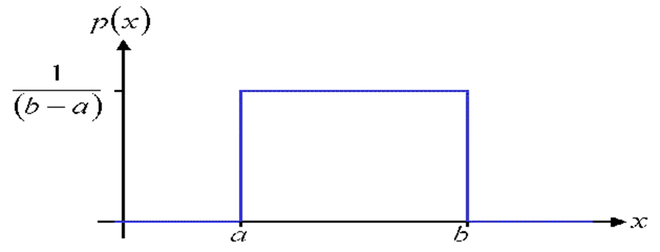
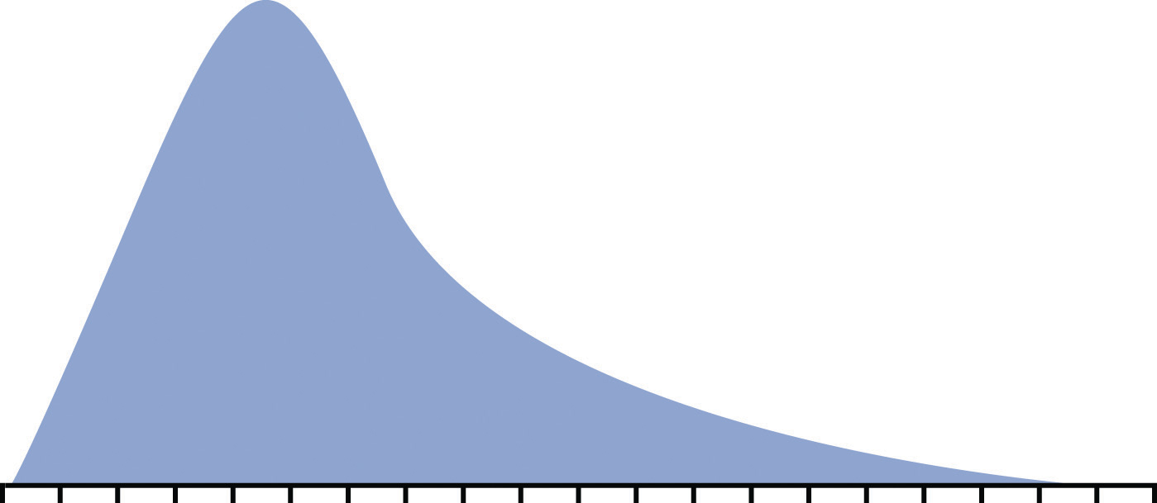
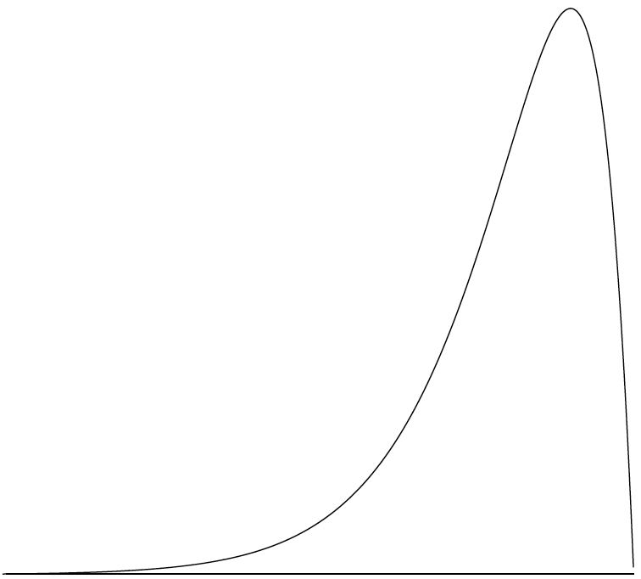
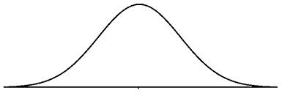
A) The months all Loyola students were born
B) The distribution of GPAs at Harvard Law School
C) The distribution of SAT scores in the U.S
D) The distribution of salaries for students right out of college
1.
2.
3.
4.

Slide 10
Descriptive statistics
If the sample of high school GPAs contained 1,000 numbers, how could the data be organized or summarized?
Create a graph
State the range of GPAs
Calculate the average GPA
the methods of organizing & summarizing data

Slide 11
Variable
Is this a variable . . .
The number of wrecks per week at the intersection outside school?
The variable of interest is the GPA of high school graduates
YES
any characteristic whose value may change from one individual to another
Suppose we wanted to know the average GPA of high school graduates in the nation this year. Define the variable of interest.
Notes:
Give several examples of different variables

Slide 12
Data
For this variable . . .
The number of wrecks per week at the intersection outside . . . What could observations be?
0, 1, 2, …
The values for a variable from individual observations

Slide 13

Two types of variables
categorical
numerical

Slide 14

What and Why (cont.)
A categorical (or qualitative) variable names categories and answers questions about how cases fall into those categories.
  Categorical examples: sex, race, ethnicity
A numerical (or quantitative) variable is a measured variable (with units) that answers questions about the quantity of what is being measured.
  Quantitative examples: income ($), height (inches), weight (pounds)

Slide 15
Numerical variables
quantitative
observations or measurements take on numerical values
makes sense to average these values
Can you name any numerical variables?

Slide 16
Examples
Time it takes to get to school in minutes
Height in inches
Number of shoes owned
Gender
Hair color
Age of Oscar winners in years
Temperature of a cup of coffee in Cº
Type of pain medication
Jellybean flavors
Hours spent on Social Media
N
N
N
C
C
N
N
C
C
N

Slide 17
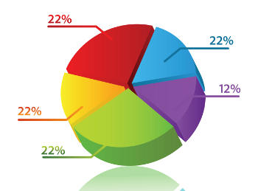
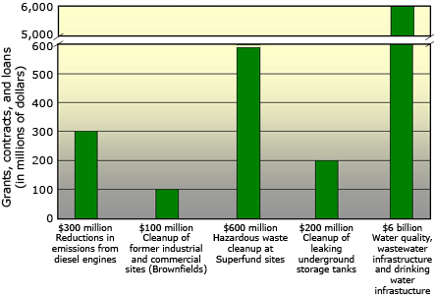
Displaying and Describing
Data

Slide 18
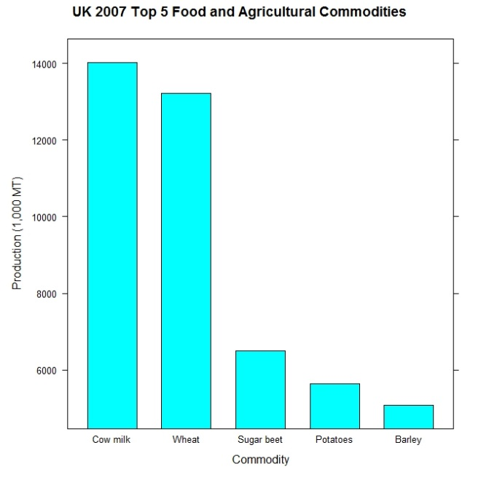
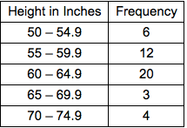
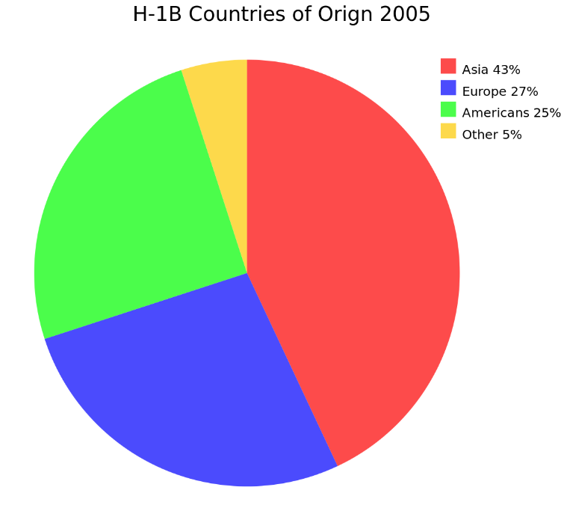
Types of Graphs for Categorical Data
Bar Charts
Pie Charts
Frequency Table (Two-Way Table)

Slide 19
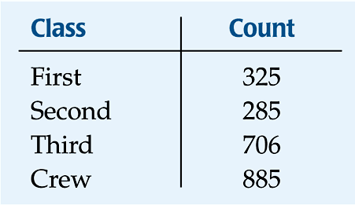
Frequency Tables: Making Piles
We can “pile” the data by counting the number of data values in each category of interest.
We can organize these counts into a frequency table, which records the totals and the category names.

Slide 20
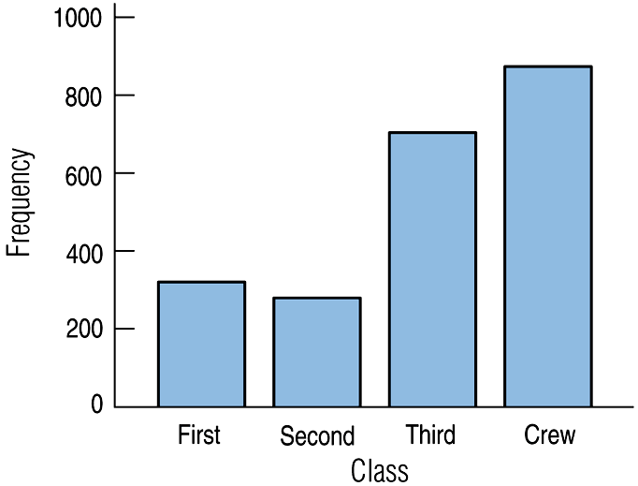
Bar Charts
A bar chart displays the distribution of a categorical variable, showing the counts for each category next to each other for easy comparison.
A bar chart stays true to the area principle.
Thus, a better display for the ship data is:

Slide 21
Bar Chart
When to Use Categorical data
How to construct
  Draw a horizontal line; write the categories or labels below the line at regularly spaced intervals
  Draw a vertical line; label the scale using frequency or relative frequency
  Place equal-width rectangular bars above each category label with a height determined by its frequency or relative frequency

Slide 22
Bar Chart (continued)
What to Look For
Frequently or infrequently occurring categories
Collect the following data and then display the data in a bar chart:
What is your favorite ice cream flavor?
Vanilla, chocolate, strawberry, or other

Slide 23
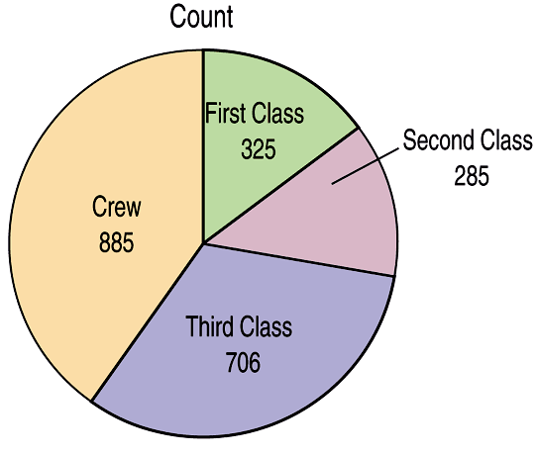
Pie Charts
When you are interested in parts of the whole, a pie chart might be your display of choice.
Pie charts show the whole group of cases as a circle.
They slice the circle into pieces whose size is proportional to the fraction of the whole in each category.

