Slide 1
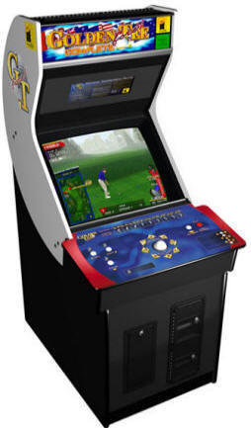
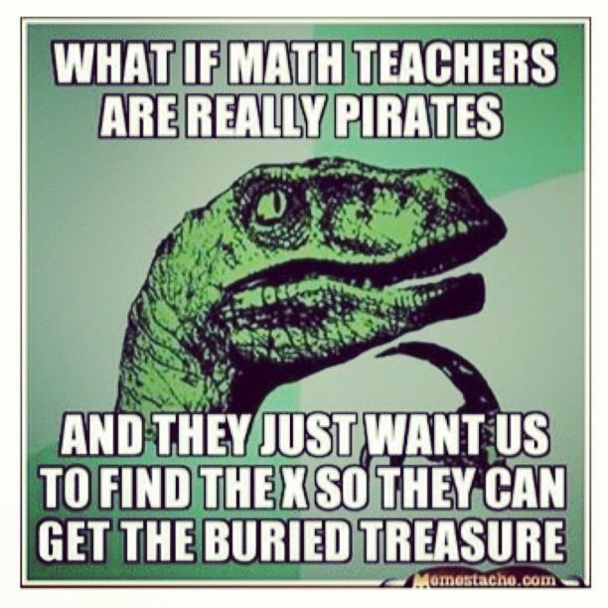
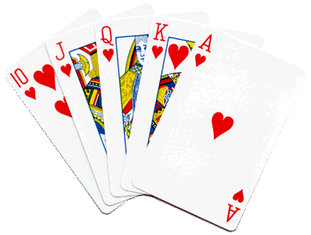
Mr. Calise
Welcome Back!
I have been teaching High School for 23 years
I love ALL TYPES of SPORTS and ALL TYPES of MUSIC
I also teach Math and Statistics at Johns Hopkins University, CCBC, AACC and Loyola University
I have two children ages 12 and 15.

Slide 2
conjecture
A reasonable guess that you are trying to either prove or disprove.
Unit 1 ● Lesson 3

Slide 3
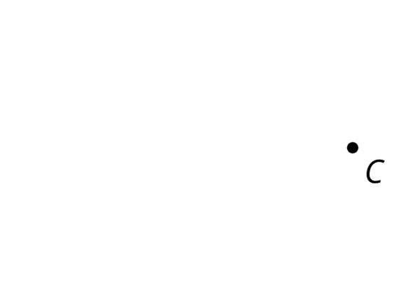
point
A point has NO SIZE, and is represented by a dot.
Named with a capital letter.
Unit 1 ● Lesson 3

Slide 4
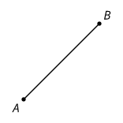
line segment
A set of points on a line with two endpoints.
Unit 1 ● Lesson 1

Slide 5
line
A line has NO thickness and goes on forever in both directions.
Named by using any TWO points on the line.
Unit 1 ● Lesson 1

Slide 6
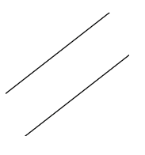
parallel
Two lines that don't intersect are called parallel. We can also call segments parallel if they extend into parallel lines.
Unit 1 ● Lesson 2

Slide 7
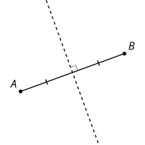
perpendicular
Perpendicular means two lines (segments) that intersect to create a right (90 degree) angle.
Unit 1 ● Lesson 3

Slide 8
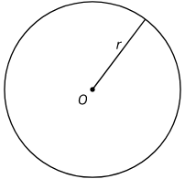
circle
A circle of radius r with center O is the set of all points that are a distance r units from O.
To draw a circle of radius 3 and center O, use a compass to draw all the points at a distance 3 from O.
Unit 1 ● Lesson 1

Slide 9
midpoint
A midpoint is a point that divides/cuts a segment in half.
midpoint
Unit 1 ● Lesson 1

Slide 10
perpendicular bisector
The perpendicular bisector of a segment is a line through the midpoint of the segment that is perpendicular to it.
Unit 1 ● Lesson 3

Slide 11
Illegal Construction Moves
Create a circle centered at A with radius AB.
Estimate the midpoint of segment AB and label it C.
Create a circle centered at B with radius BC. This creates 2 intersection points. Label the one toward the top of the page as D and the one toward the bottom as E.
Use your straightedge to connect points A, D, and E to make triangle ADE and lightly shade it in with your pencil.
Unit 1 ● Lesson 1 ● Activity 2

Slide 12
Build It
Here is segment AB and a point C:
Create a circle centered at C whose radius is the length of AB. Mark a point on the circle and label it D. Draw line CD and label its other intersection with the circle as point E.
Unit 1 ● Lesson 1 ● Activity 4

Slide 13
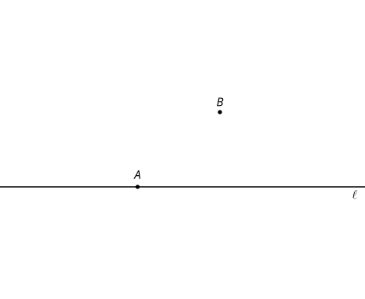
Constructing a Parallel Line
Here is point A on line l and point B that is not on l.
Use these straightedge and compass moves to create a line parallel to the given line that goes through point :
Create a line through A and B extending in both directions. Label this line p.
Create a circle centered at B with radius AB. This circle intersects with line l in 2 places. Label the intersection point to the right of A as C.
Unit 1 ● Lesson 2 ● Activity 4

Slide 14
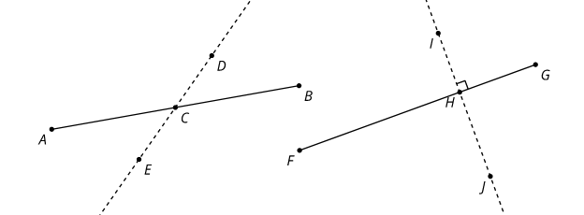
How Well Can You Slice It?
Perpendicular bisector - a line through the midpoint of a segment that is perpendicular to that segment.
Unit 1 ● Lesson 3 ● Activity 3

Slide 15
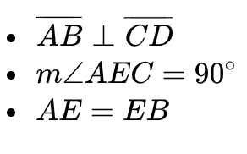
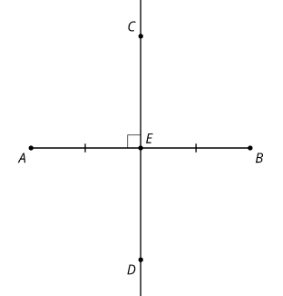
Construction Techniques 1: Perpendicular Bisectors
How did we know that a point was the same distance away from the two given points without measuring with a ruler?
What exactly is a circle? How do we use circles to reason about distance without using a ruler?
Unit 1 ● Lesson 3

Slide 16
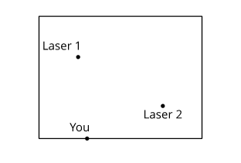
Walk the Line
Here is a hallway with lasers:
Imagine that you must cross the hallway while staying an equal distance from each laser. If you get closer to one laser than the other, it will blast you. Use a compass and straightedge to draw a safe path through the hallway.
Unit 1 ● Lesson 3 ● Activity 4

