Slide 1
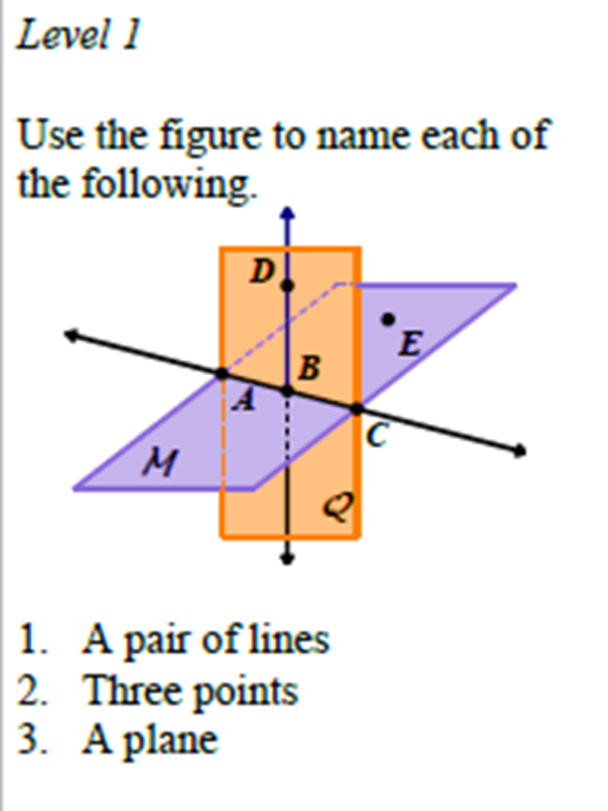
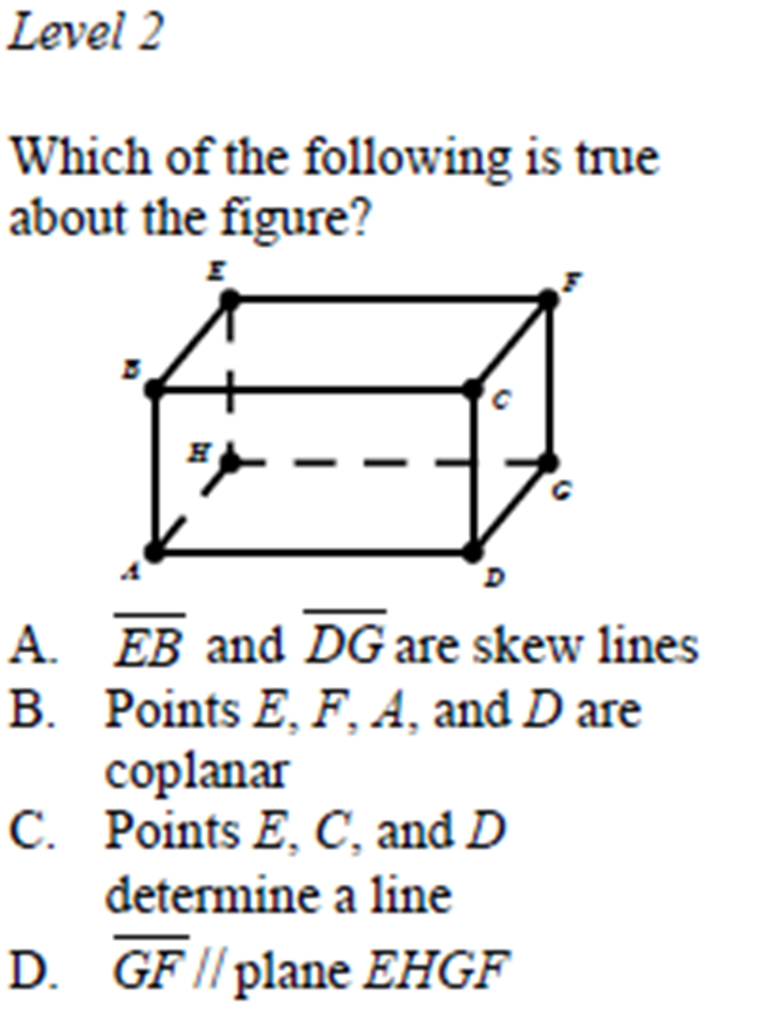
DRILL (9/2)

Slide 2
Geometry Lesson
Continuation of Lesson 1.1

Slide 3
Angles
* An angle is made up of two rays that share the same endpoint.
To name an angle we either can use the one point where the vertex is located if there is only one angle, otherwise we must use three points making sure the vertex is in the middle.
A
B
C

Slide 4
Naming Angles
E
D
A
C
B

Slide 5
What is a postulate?
A postulate, or axiom, is a statement that is accepted as true without proof. Postulates about points, lines, and planes help describe geometric properties.
Notes:
In traditional logic, an axiom or postulate is a proposition that is not proved or demonstrated but considered to be either self-evident, or subject to necessary decision. Therefore, its truth is taken for granted, and serves as a starting point for deducing and inferring other (theory dependent) truths.

Slide 6
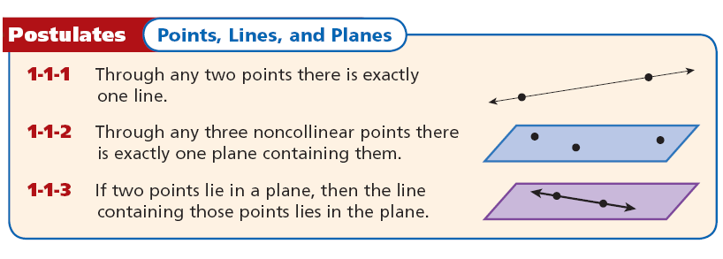
Points, Lines, and Planes Postulates

Slide 7
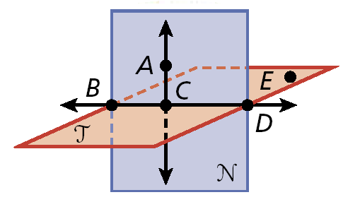
Wrap-Up (PRACTICE)
Lesson Quiz: Part I
1. Two opposite rays.
CB and CD
2. A point on BC.
Possible answer: D
3. The intersection of plane N and plane T.
Possible answer: BD
4. A plane containing E, D, and B.
Plane T
5. a ray with endpoint P that passes through Q

Slide 8
Honors Geometry Lesson A2

Slide 9
The distance between any two points is the absolute value of the difference of the coordinates. If the coordinates of points A and B are a and b, then the distance between A and B is |a – b| or |b – a|. The distance between A and B is also called the length of AB, or AB.
A
B
AB = |a – b| or |b - a|
a
b

Slide 10
Example 1: Finding the Length of a Segment
Find each length.
A. BC
B. AC
BC = |1 – 3|
AC = |–2 – 3|
= |1 – 3|
= |– 5|
= 2
= 5

Slide 11
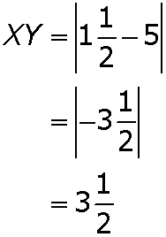
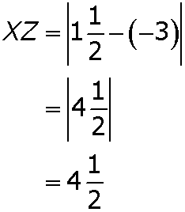
Check It Out! Example 1
Find each length.
a. XY
b. XZ

Slide 12
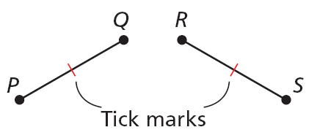
Congruent segments are segments that have the same length. In the diagram, PQ = RS, so you can write PQ ≅ RS. This is read as “segment PQ is congruent to segment RS.” Tick marks are used in a figure to show congruent segments.

Slide 13
In order for you to say that a point B is between two points A and C, all three points must lie on the same line, and AB + BC = AC.

Slide 14
Example 3A: Using the Segment Addition Postulate
G is between F and H, FG = 6, and GH = 11. Find FH.
FH = FG + GH
Seg. Add. Postulate
FH = 6 + 11
Substitute 6 for FG and 11 for FH.
Subtract 6 from both sides.
FH = 17
Simplify.

Slide 15
Check It Out! Example 3a
Y is between X and Z, XZ = 8, and XY = 3 . Find YZ.
XZ = XY + YZ
Seg. Add. Postulate
8 = 3 + YZ
Substitute the given values.
YZ = 5
Subtract 3 from both sides.

Slide 16
Example 3B: Using the Segment Addition Postulate
M is between N and O. Find NO.
NM + MO = NO
Seg. Add. Postulate
17 + (3x – 5) = 5x + 2
Substitute the given values
3x + 12 = 5x + 2
Simplify.
Subtract 2 from both sides.
3x + 10 = 5x
Simplify.
Subtract 3x from both sides.
10 = 2x
Divide both sides by 2.
5 = x

Slide 17
Example 3B Continued
M is between N and O. Find NO.
NO = 5x + 2
= 5(5) + 2
Substitute 5 for x.
= 27
Simplify.

Slide 18
Check It Out! Example 3b
E is between D and F. Find DF.
DE + EF = DF
Seg. Add. Postulate
(3x – 1) + 13 = 6x
Substitute the given values
3x + 12 = 6x
Subtract 3x from both sides.
12 = 3x
Simplify.
Divide both sides by 3.
4 = x

Slide 19
Check It Out! Example 3b Continued
E is between D and F. Find DF.
DF = 6x
= 6(4)
Substitute 4 for x.
= 24
Simplify.

Slide 20
The midpoint M of AB is the point that bisects, or divides, the segment into two congruent segments. If M is the midpoint of AB, then AM = MB.
So if AB = 6, then AM = 3 and MB = 3.

Slide 21
Example 4: Recreation Application
The map shows the route for a race. You are at X, 6000 ft from the first checkpoint C. The second checkpoint D is located at the midpoint between C and the end of the race Y. The total race is 3 miles. How far apart are the 2 checkpoints?
XY = 3(5280 ft)
Convert race distance to feet.
= 15,840 ft

Slide 22
Example 4 Continued
XC + CY = XY
Seg. Add. Post.
Substitute 6000 for XC and 15,840 for XY.
6000 + CY = 15,840
Subtract 6000 from both sides.
CY = 9840
Simplify.
D is the mdpt. of CY, so CD = CY.
= 4920 ft
The checkpoints are 4920 ft apart.

Slide 23
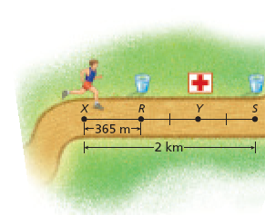
Check It Out! Example 4
You are 1182.5 m from the first-aid station. What is the distance to a drink station located at the midpoint between your current location and the first-aid station?
The distance XY is 1182.5 m. The midpoint would be
.

Slide 24
Example 5: Using Midpoints to Find Lengths
D is the midpoint of EF, ED = 4x + 6, and DF = 7x – 9. Find ED, DF, and EF.
E
4x + 6
D
7x – 9
F
Step 1 Solve for x.
ED = DF
D is the mdpt. of EF.
4x + 6 = 7x – 9
Substitute 4x + 6 for ED and 7x – 9 for DF.
Subtract 4x from both sides.
6 = 3x – 9
Simplify.
Add 9 to both sides.
15 = 3x
Simplify.

Slide 25
Example 5 Continued
D is the midpoint of EF, ED = 4x + 6, and DF = 7x – 9. Find ED, DF, and EF.
E
4x + 6
D
7x – 9
F
15 3x
=
Divide both sides by 3.
x = 5
Simplify.

Slide 26
Example 5 Continued
D is the midpoint of EF, ED = 4x + 6, and DF = 7x – 9. Find ED, DF, and EF.
E
4x + 6
D
7x – 9
F
Step 2 Find ED, DF, and EF.
ED = 4x + 6
DF = 7x – 9
EF = ED + DF
= 4(5) + 6
= 7(5) – 9
= 26 + 26
= 26
= 26
= 52

Slide 27
Check It Out! Example 5
S is the midpoint of RT, RS = –2x, and
ST = –3x – 2. Find RS, ST, and RT.
R
S
T
–2x
–3x – 2
Step 1 Solve for x.
RS = ST
S is the mdpt. of RT.
–2x = –3x – 2
Substitute –2x for RS and –3x – 2 for ST.
Add 3x to both sides.
x = –2
Simplify.

Slide 28
Check It Out! Example 5 Continued
S is the midpoint of RT, RS = –2x, and
ST = –3x – 2. Find RS, ST, and RT.
R
S
T
–2x
–3x – 2
Step 2 Find RS, ST, and RT.
RS = –2x
ST = –3x – 2
RT = RS + ST
= –2(–2)
= –3(–2) – 2
= 4 + 4
= 4
= 4
= 8

Slide 29
Lesson Quiz: Part I
1. M is between N and O. MO = 15, and MN = 7.6. Find NO.
22.6
2. S is the midpoint of TV, TS = 4x – 7, and
SV = 5x – 15. Find TS, SV, and TV.
25, 25, 50

Slide 30
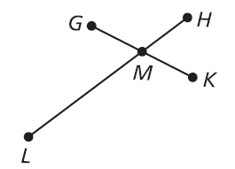
Lesson Quiz: Part II
3. LH bisects GK at M. GM = 2x + 6, and
GK = 24. Find x.
3

