Slide 1
Section 2.1
Introduction
to Functions

Slide 2
Relation
Definition of a Relation
A relation is any set of ordered pairs.
The set of all first components of the ordered pairs is called the domain of the relation
and the set of all second components is called the range of the relation.

Slide 3
Objective 1
Find the domain and range of a relation.

Slide 4
Objective 1: Example
Find the domain and range of the relation:
The domain is the set of all first components. Domain:
The range is the set of all second components. Range:

Slide 5
Objective 2
Determine whether a relation is a function.

Slide 6
Functions
Definition of a Function
A function is a correspondence from a first set, called the domain, to a second set, called the range, such that each element in the domain corresponds to exactly one element in the range.
(Each x corresponds to exactly one y in a function. However, a y value may be the image of more than one x.)
For example, the following relation is a function:
Note that the y value 3 is the image of two x values.

Slide 7
Example
Determine whether the following is a function.
Yes, because none of the members of the domain correspond to more than one member of the range.
1
drums
2
guitar
violin
3
flute
4
Domain
Range

Slide 8
Example
Determine whether the following is a function.
No, because one of the members of the domain, 9, corresponds to more than one member of the range.
3
ants
8
beetles
crickets
5
moths
9
Domain
Range

Slide 9
Example
Determine whether each relation is a function:
(a)
Yes – a function
(b)
No – not a function since 1 is mapped to 2 and 10
(c)
Yes – a function

Slide 10
Objective 2: Example
2a. Determine whether the relation is a function:
5 corresponds to both 6 and 7. If any element in the domain corresponds to more than one element in the range, the relation is not a function.
Thus, the relation is not a function.

Slide 11
Objective 2: Example
2b. Determine whether the relation is a function:
Every element in the domain corresponds to exactly one element in the range. No two ordered pairs in the given relation have the same first component and different second components.
Thus, the relation is a function.

Slide 12
Objective 3
Evaluate a function.

Slide 13
Functions as Equations
Functions are usually given in terms of equations rather than as sets of ordered pairs.
For example, consider the function
For each value of x, there is one and only one value of y.
The variable x is called the independent variable and the variable y is called the dependent variable.

Slide 14
Function Notation
If an equation in x and y gives only one value of y for each value of x, then the variable y is a function of the variable x.
When an equation represents a function, the function is often named by a letter such as f, g, h, F, G, or H.
The output value, the y value, is often denoted by f(x), read “f of x” or “f at x”
The notation does not mean “f times x”. The notation describes the value of the function f at x.

Slide 15
Example
Find the indicated function value:
for
Replace x with 3
Evaluate the exponent
Multiply
Add and Subtract

Slide 16
Example
Find the indicated function value: for
Replace z with −4
Evaluate the exponent
Multiply
Add

Slide 17
Objective 3: Example
3a. Find for

Slide 18
Objective 3: Example
3b. Find for

Slide 19
Objective 3: Example
3c. Find for

Slide 20
Objective 3: Example
3d. Find for

Slide 21
Objective 3: Example
3e. Function g is defined by the following table:
Find

Slide 22
Objective 3: Example (cont)
To find locate 1 in the x-column.
When the input is 1, the output is 0.
Thus

Slide 23
Objective 3: Example
3f. Function g is defined by the following table:
Find

Slide 24
Objective 3: Example (cont)
Locate 3 in the column. Note that it occurs twice, when and when
Thus, or

Slide 25
Section 2.2
Graphs
of Functions

Slide 26
Objective 1
Graph functions by plotting points.

Slide 27
Graphs of Functions
The graph of a function is the graph of its ordered pairs.
For example, the graph of is the set of points satisfying

Slide 28
Example
Graph the function
x |  | Ordered Pair
−2
−1
0
1
2

Slide 29
Example (cont)

Slide 30
Objective 1: Example
1. Graph the functions and in the same rectangular coordinate system. Select integers for x, starting with and ending with 2. How is the graph of g related to the graph of f ?

Slide 31
Objective 1: Example (cont)
Make a table for

Slide 32
Objective 1: Example (cont)
Make a table for

Slide 33
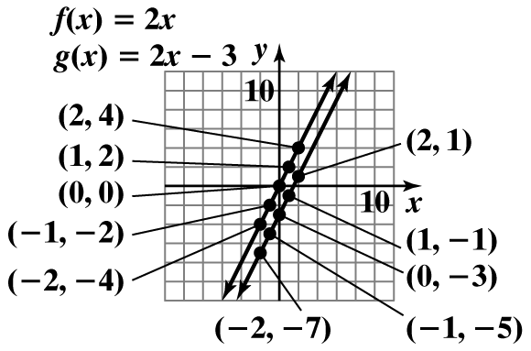
Objective 1: Example (cont)
Plot the points and draw the lines that pass through them.
The graph of g is the graph of f shifted down by 3 units.

Slide 34
Objective 2
Use the vertical line test to identify functions.

Slide 35
The Vertical Line Test for Functions
If any vertical line intersects a graph in more than one point, the graph does not define y as a function of x.

Slide 36
Example
Use the vertical line test to identify graphs in which y is a function of x.
(a)
(b)
(c)

Slide 37
Example (cont)
(a)
(b)
(c)
y is a function of x
y is not a function of x
y is a function of x

Slide 38
Example (cont)
This graph is not a function since the blue vertical line indicated, intersected three points of the graph. Here, three values of y correspond to one value of x. For example, the points indicated might have been and . The x value of then mapped to three distinct y values and not just one.
The vertical line test is just a quick visual method for determining whether you have a function.
(b)
y is not a function of x

Slide 39
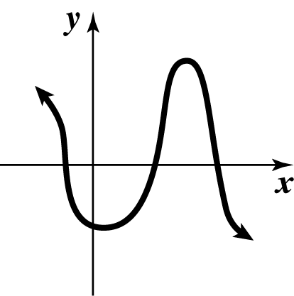
Objective 2: Example
2. Use the vertical line test to determine if the graph represents y as a function of x.
The graph passes the vertical line test and thus y is a function of x.

Slide 40
Objective 3
Obtain information about a function from its graph.

Slide 41
Graphs of Functions
Obtaining Information from Graphs
A closed dot indicates that the graph does not extend beyond this point and the point belongs to the graph.
An open dot indicates that the graph does not extend beyond this point and the point does not belong to the graph.
An arrow indicates that the graph extends indefinitely in the direction in which the arrow points.

Slide 42
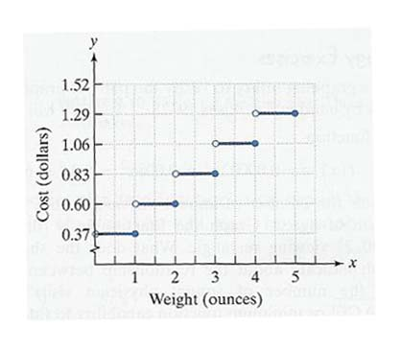
Example
The figure shows the cost of mailing a first-class letter, as a function of its weight, x, in ounces. Use the graph to answer the following questions.

Slide 43
Example (cont)
(a) Find What does this mean in terms of the variables in this situation?
(b) Find What does this mean in terms of the variables in this situation?
(c) What is the cost of mailing a letter that weighs 1.5 ounces?
(d) What is the cost of mailing a letter that weighs 1.8 ounces?

Slide 44
Example (cont)
(a) Find What does this mean in terms of the variables in this situation?
This means that when a first-class letter weighs 3 ounces, postage costs 83 cents.

Slide 45
Example (cont)
(b) Find What does this mean in terms of the variables in this situation?
This means that when a first-class letter weighs 4 ounces, postage costs $1.06.

Slide 46
Example (cont)
(c) What is the cost of mailing a letter that weighs 1.5 ounces?
This means that when a first-class letter weighs 1.5 ounces, postage costs $0.60.

Slide 47
Example (cont)
(d) What is the cost of mailing a letter that weighs 1.8 ounces?
This means that when a first-class letter weighs 1.8 ounces, postage costs $0.60.

Slide 48
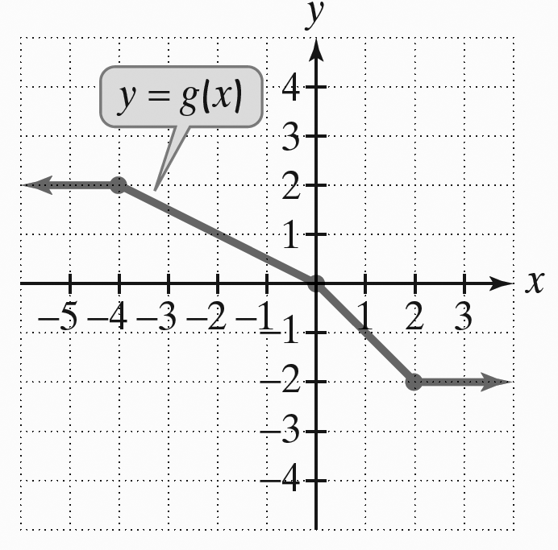
Objective 3: Example
3a. The following is the graph of g.
Use the graph to find
The graph indicates that to the left of the graph is at a constant height of 2.
Thus,

Slide 49
Objective 3: Example
3b. Use the graph from Problem 3a to find the value of x for which
The height of the graph is when

Slide 50
Objective 4
Identify the domain and range of a function from its graph.

Slide 51
Domain and Range
The graph of a function can be used to determine the function’s domain and range.
Domain: set of inputs (found on the x axis – the collection of all x values in the graph)
Range: set of outputs (found on the y axis – the collection of all y values in the graph)

Slide 52
Example
Use the graph of the function to identify its domain and range.

Slide 53
Example (cont)
To identify the domain, we look from the far left to the far right, identifying all the x values used. There is not a first (smallest) and there is not a last (largest) x value (indicated by the arrows). Therefore, x takes on all values.

Slide 54
Example (cont)
To identify the range, we look from the bottom of the graph to the top, identifying all the y values used. There is not a lowest, (as indicated again by the arrows) but there is a highest. y takes on all values up to and including approximately 3.6.

Slide 55
Example (cont)
Domain is a real number
Range

Slide 56
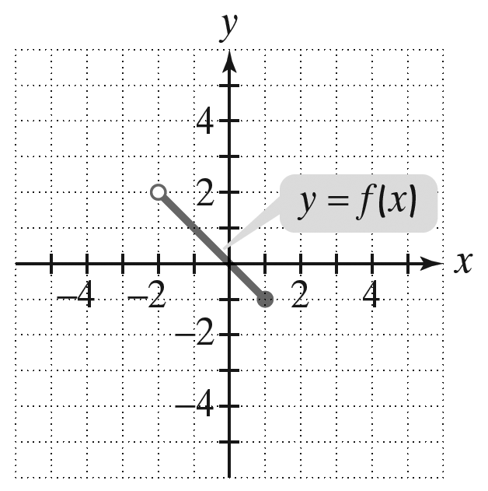
Objective 4: Example
4. Use the graph of the function to identify its domain and its range.
Inputs on the x-axis extend from excluding to 1, including 1. The domain is
Outputs on the y-axis extend from including to 2, excluding 2.
The range is

