Slide 1
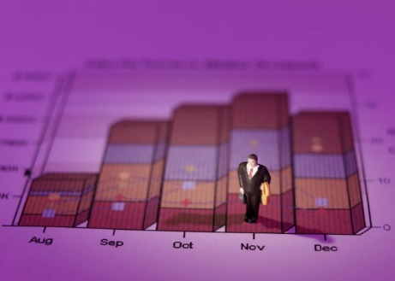





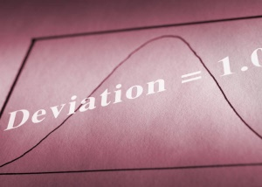














STAT 210
Stats Starts Here
Chapter 1
Jobs
Sports Teams
The Role of Statistics and the Data Analysis Process
Hobbies

Slide 2


Stats Starts Here
According to 100% of people surveyed, this is the greatest class ever offered in college.
List of people surveyed: ME

Slide 3
What Is (Are?) Statistics?
Statistics (the discipline) is a way of reasoning, a collection of tools and methods, designed to help us understand the world.
Statistics (plural) are particular calculations made from a sample of data.
Data are values with a context.
What is Statistics About?
Statistics is about variation.
All measurements are imperfect, since there is variation that we cannot see.
Statistics helps us to understand the real, imperfect world in which we live.

Slide 4
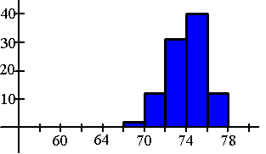
Why should one study statistics?
Can dogs help patients with heart failure by reducing stress and anxiety?
To be informed . . .
  Extract information from tables, charts and graphs
  Follow numerical arguments
  Understand the basics of how data should be gathered, summarized, and analyzed to draw statistical conclusions
When people take a vacation do they really leave work behind?
Notes:
Examples come from page 2 & 3.

Slide 5
Why should one study statistics? (continued)
Many companies now require drug screening as a condition of employment. With these screening tests there is a risk of a false-positive reading. Is the risk of a false result acceptable?
To make informed judgments
To evaluate decisions that affect your life
If you choose a particular major, what are your chances of finding a job when you graduate?
Notes:
Examples come from page 2 & 3.

Slide 6

What is variability?
Suppose you went into a convenience store to purchase a soft drink. Does every can on the shelf contain exactly 12 ounces?
NO – there may be a little more or less in the various cans due to the variability that is inherent in the filling process.
In fact, variability is almost universal!
It is variability that makes life interesting!!
Notes:
Discuss the fact that variability exist in almost everything – provide several examples.

Slide 7

The Exam (FICTIONAL DATA)
The class average last semester was a 94 on the final exam.
It was out of 500 points!!!!
A group of individuals averaged a 78% on an algebra exam……
The group of individuals were 7 year olds…
Or…the group of individuals were Algebra teachers!

Slide 8

Dream Job
The average salary at a company that has 25 employees is $8,500,000 per year.
Would you like to be hired by this company?
The CEO makes
$212,400,000 per year…
The other 24 employees
Average $4,166.67 per/year

Slide 9

The “W’s”
To provide context we need the W’s
  Who
  What (and in what units)
  When
  Where
  Why (if possible)
  and How
  of the data.
Note: the answers to “who” and “what” are essential.

Slide 10
The Data Analysis Process
Understand the nature of the problem
Decide what to measure and how to measure it
Collect data
Summarize data and perform preliminary analysis
Perform formal analysis
Interpret results
It is important to have a clear direction before gathering data.
It is important to select and apply the appropriate inferential statistical methods
It is important to carefully define the variables to be studied and to develop appropriate methods for determining their values.
This step often leads to the formulation of new research questions.
It is important to understand how data is collected because the type of analysis that is appropriate depends on how the data was collected!
This initial analysis provides insight into important characteristics of the data.

Slide 11
Suppose we wanted to know the average GPA of high school graduates in the nation this year.
We could collect data from all high schools in the nation.
What term would be used to describe “all high school graduates”?
Notes:
population

Slide 12
Population
What do you call it when you collect data about the entire population?
The entire collection of individuals or objects about which information is desired
A census is performed to gather about the entire population

Slide 13
GPA Continued:
Suppose we wanted to know the average GPA of high school graduates in the nation this year.
We could collect data from all high schools in the nation.
Why might we not want to use a census here?
If we didn’t perform a census, what would we do?
Notes:
Discuss some problems associated with performing a census:
Takes a lot of time
Inaccurate data
Missing data
costly

Slide 14

Sample
A subset of the population, selected for study in some prescribed manner
What would a sample of all high school graduates across the nation look like?
High school graduates from each state (region), ethnicity, gender, etc.

Slide 15
GPA Continued:
Suppose we wanted to know the average GPA of high school graduates in the nation this year.
We could collect data from a sample of high schools in the nation.
Once we have collected the data, what would we do with it?
Notes:
Organize it – graph & make some calculations etc.

Slide 16
Descriptive statistics
If the sample of high school GPAs contained 1,000 numbers, how could the data be organized or summarized?
Create a graph
State the range of GPAs
Calculate the average GPA
the methods of organizing & summarizing data

Slide 17
GPA Continued:
Suppose we wanted to know the average GPA of high school graduates in the nation this year.
We could collect data from a sample of high schools in the nation.
Could we use the data from our sample to answer this question?
Notes:
Organize it – graph & make some calculations etc.

Slide 18
Inferential statistics
Based on the sample, if the average GPA for high school graduates was 3.0, what generalization could be made?
The average national GPA for this year’s high school graduate is approximately 3.0.
Could someone claim that the average GPA for graduates in your local school district is 3.0?
Be sure to sample from the population of interest!!
No. Generalizations based on the results of a sample can only be made back to the population from which the sample came from.
involves making generalizations from a sample to a population

Slide 19
Variable
Is this a variable . . .
The number of wrecks per week at the intersection outside school?
The variable of interest is the GPA of high school graduates
YES
any characteristic whose value may change from one individual to another
Suppose we wanted to know the average GPA of high school graduates in the nation this year. Define the variable of interest.
Notes:
Give several examples of different variables

Slide 20
Data
For this variable . . .
The number of wrecks per week at the intersection outside . . . What could observations be?
0, 1, 2, …
The values for a variable from individual observations

Slide 21
Two types of variables
categorical
numerical
discrete
continuous

Slide 22

What and Why (cont.)
A categorical (or qualitative) variable names categories and answers questions about how cases fall into those categories.
  Categorical examples: sex, race, ethnicity
A numerical (or quantitative) variable is a measured variable (with units) that answers questions about the quantity of what is being measured.
  Quantitative examples: income ($), height (inches), weight (pounds)

Slide 23
What and Why (cont.)
Example: In a student evaluation of instruction at a large university, one question asks students to evaluate the statement “The instructor was generally interested in teaching” on the following scale: 1 = Disagree Strongly; 2 = Disagree; 3 = Neutral; 4 = Agree; 5 = Agree Strongly.
Question: Is interest in teaching categorical or quantitative?

Slide 24
Examples
Time it takes to get to school in minutes
Height in inches
Number of shoes owned
Gender
Hair color
Age of Oscar winners in years
Temperature of a cup of coffee in Cº
Type of pain medication
Jellybean flavors
Hours spent on Social Media
N
N
N
C
C
N
N
C
C
N

Slide 25
Numerical variables
quantitative
observations or measurements take on numerical values
makes sense to average these values
two types - discrete & continuous
Can you name any numerical variables?

Slide 26
Discrete (numerical)
Isolated points along a number line
usually counts of items

Slide 27

Continuous (numerical)
Variable that can be any value in a given interval
usually measurements of something

Slide 28
Identify the following variables:
the color of cars in the teacher’s lot
the number of calculators owned by students at your school
the zip code of an individual
the amount of time it takes students to drive to school
the appraised value of homes in your city
Categorical
Discrete numerical
Categorical
Is money a measurement or a count?
Continuous numerical
discrete numerical

Slide 29
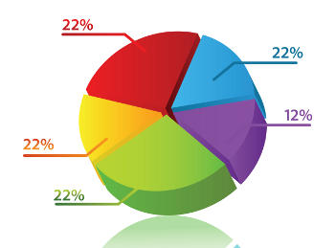
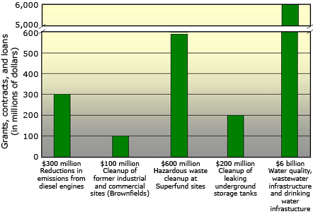
Displaying and Describing
Categorical Data

Slide 30
Classifying variables by the number of variables in a data set
Suppose that the PE coach records the height of each student in his class.
Univariate - data that describes a single characteristic of the population
This is an example of a univariate data

Slide 31
Classifying variables by the number of variables in a data set
Suppose that the PE coach records the height and weight of each student in his class.
Bivariate - data that describes two characteristics of the population
This is an example of a bivariate data

Slide 32
Classifying variables by the number of variables in a data set
Suppose that the PE coach records the height, weight, number of sit-ups, and number of push-ups for each student in his class.
Multivariate - data that describes more than two characteristics (beyond the scope of this course)
This is an example of a multivariate data

Slide 33
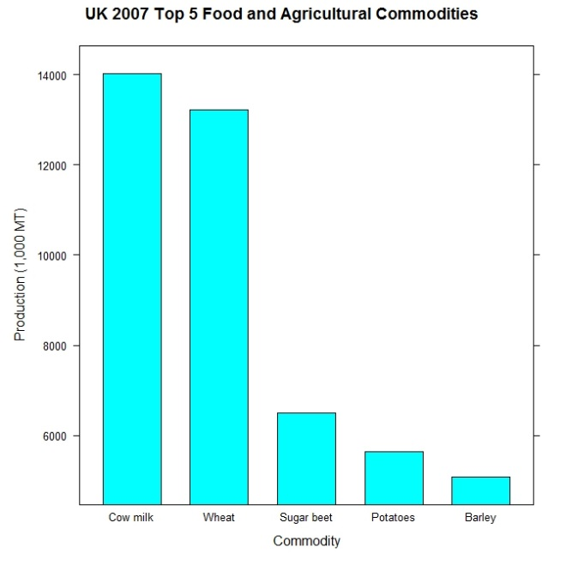
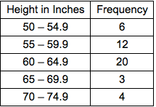
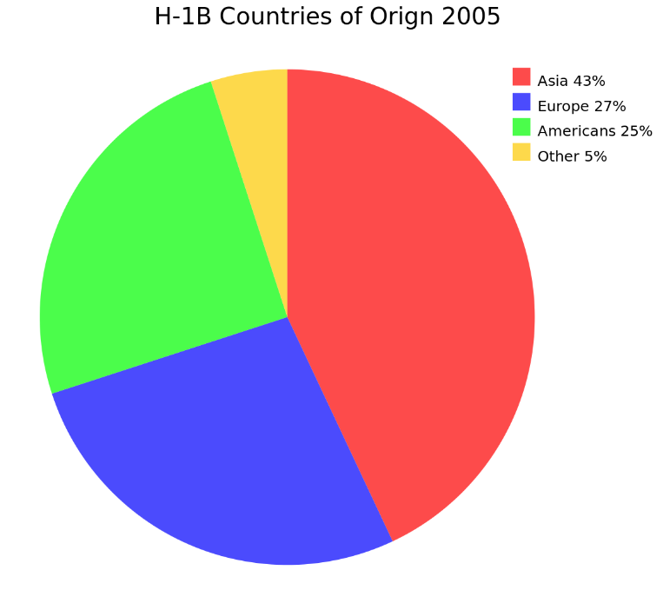
Types of Graphs for Categorical Data
Bar Charts
Pie Charts
Frequency Table (Two-Way Table)

Slide 34
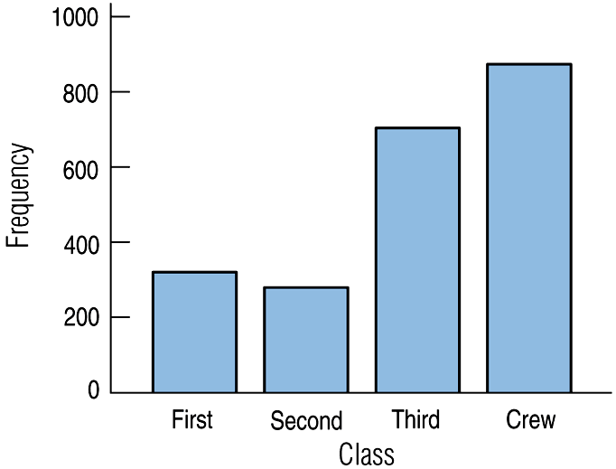
Bar Charts
A bar chart displays the distribution of a categorical variable, showing the counts for each category next to each other for easy comparison.
A bar chart stays true to the area principle.
Thus, a better display for the ship data is:

Slide 35
Bar Chart
When to Use Categorical data
How to construct
  Draw a horizontal line; write the categories or labels below the line at regularly spaced intervals
  Draw a vertical line; label the scale using frequency or relative frequency
  Place equal-width rectangular bars above each category label with a height determined by its frequency or relative frequency

Slide 36
Bar Chart (continued)
What to Look For
Frequently or infrequently occurring categories
Collect the following data and then display the data in a bar chart:
What is your favorite ice cream flavor?
Vanilla, chocolate, strawberry, or other

Slide 37
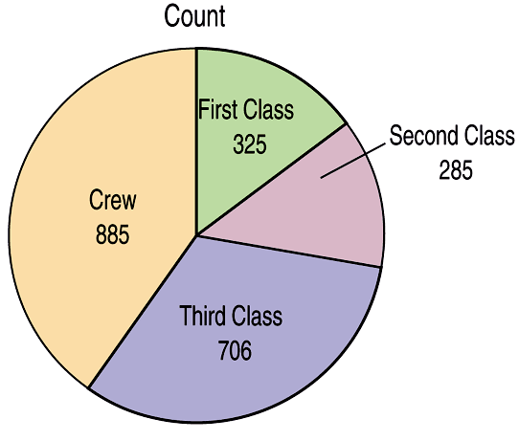
Pie Charts
When you are interested in parts of the whole, a pie chart might be your display of choice.
Pie charts show the whole group of cases as a circle.
They slice the circle into pieces whose size is proportional to the fraction of the whole in each category.

Slide 38
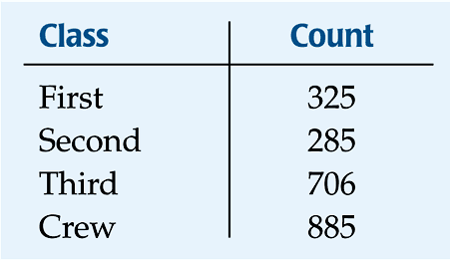
Frequency Tables: Making Piles
We can “pile” the data by counting the number of data values in each category of interest.
We can organize these counts into a frequency table, which records the totals and the category names.

