Slide 1
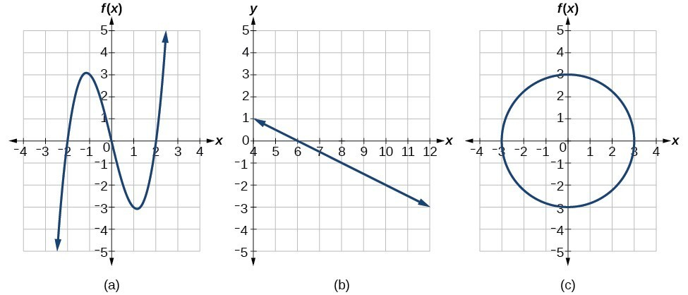
Day 3
Say if each graph is a function. (Yes or No)

Slide 2
Visualizing domain of

Slide 3
Visualizing range of

Slide 4
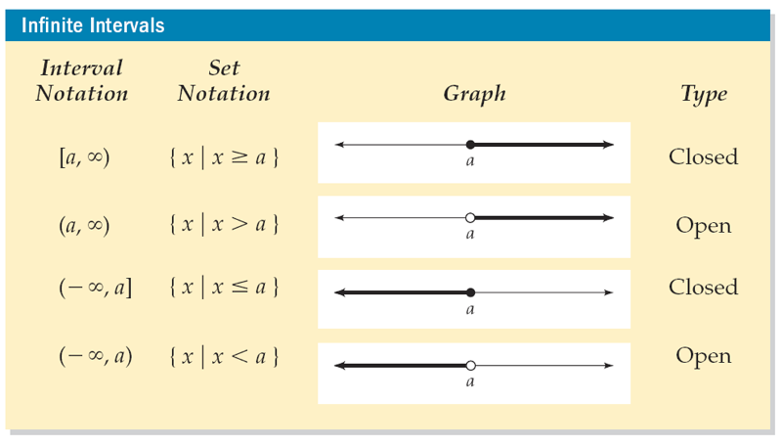
Interval Notation
Parentheses (, ) mean the same as less than or greater than.
Square brackets [, ] are used for less than or equal to and greater than or equal to.

Slide 5
Interval notation

Slide 6
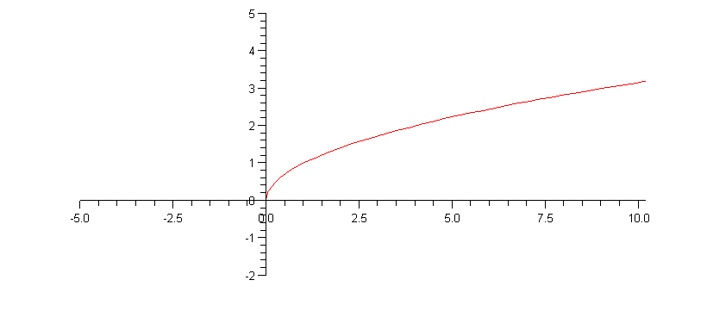
Domain = [0, ∞) Range = [0, ∞)

Slide 7
Domain and Range
y
Example:
Find the domain and range of the function graphed to the right. Use interval notation.
Domain
x
Range
Domain is [–3, 4]
Range is [–4, 2]

Slide 8
Domain and Range
y
Example:
Find the domain and range of the function graphed to the right. Use interval notation.
Range
x
Domain is (– ∞, ∞)
Range is [– 2, ∞)
Domain

Slide 9
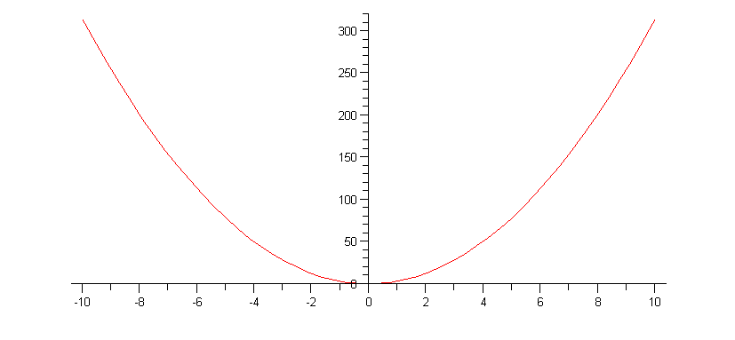
Graph of A(r) = πr²
A(r)
r
What is the Domain and Range of this function?

Slide 10
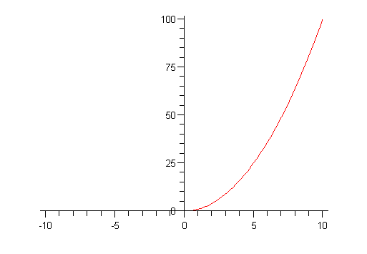
Domain and Range of A(r) = πr²
Domain = (0, ∞) Range = (0, ∞)

