Slide 1
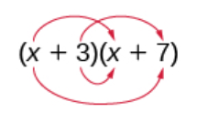
Drill
Recall how to multiply two binomials like the example below and finish multiplying these two binomials.

Slide 2
Objective
Students will be able to use the product rule for radicals in order to multiply radicals.

Slide 4
Steps for multiplying binomials with radicals
Step 1: Multiply the binomials
Step 2: Combine like terms if possible
Step 3: Simplify all radicals

Slide 5

Example 1:
$$(1−\sqrt{3})(2+\sqrt{6})$$

Slide 6

Example 2:
$$(3\sqrt{7}−5)(2\sqrt{5}−6)$$

Slide 7
Example 3:
$${(4+\sqrt{11})}^{2}$$

Slide 8
You Try:
$$(3+2\sqrt{5})(2+4\sqrt{5})$$
$$(4+2\sqrt{5})^{2}$$

