Slide 1
Section 2.4
Linear
Functions
and Slope

Slide 2
Objective 1
Use intercepts to graph a linear function in standard form.

Slide 3
Linear Functions
All equations of the form are straight lines when graphed, as long as A and B are not both zero.
Such an equation is called the standard form of the equation of the line.
To graph equations of this form, two very important points are used – the intercepts.

Slide 4
Translating Phrases into Expressions
Using Intercepts to Graph
Find the x-intercept. Let and solve for x.
Find the y-intercept. Let and solve for y.
Find a checkpoint, a third ordered-pair solution.
Graph the equation by drawing a line through the three points.

Slide 5
Example
Graph the equation using intercepts.
Find the x-intercept. Let and then solve for x.
Replace y with 0
Multiply and simplify
Divide by
The x-intercept is so the line passes through

Slide 6
Example (cont)
Find the y-intercept. Let and then solve for y.
Replace x with 0
Multiply and simplify
Divide by 4
The y-intercept is 3, so the line passes through

Slide 7
Example (cont)
Find a checkpoint, a third ordered-pair solution. For our checkpoint, we will let (because is not the x-intercept) and find the corresponding value for y.
Replace x with 1
Multiply
Add 2 to both sides
Divide by 4 and simplify
The checkpoint is the ordered pair

Slide 8
Example (cont)
Graph the equation by drawing a line through the three points. The three points in the figure below lie along the same line. Drawing a line through the three points results in the graph of
(0,3)
(1,3.5)
(−6,0)

Slide 9
Objective 1: Example
1. Graph:
Find the x − intercept setting
Find the y − intercept by setting

Slide 10
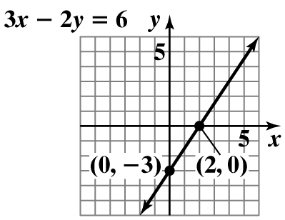
Objective 1: Example (cont)
Plot the points and draw the line that passes through them.

Slide 11
Objective 2
Compute a line’s slope.

Slide 12
Slope
The change in the y values is the vertical change or the “Rise”.
The change in the x values is the horizontal change or the “Run.”
m is commonly used to denote the slope of a line. The slope of a line is related to its steepness.
When the slope is positive, the line rises from left to right.
When the slope is negative, the line falls from left to right.

Slide 13
Slope of a Line
The slope m of the line through the two distinct points and is m, where
where
Note that you may call either point
However, don’t subtract in one order in the numerator and use another order for subtraction in the denominator or the sign of your slope will be wrong.

Slide 14
Slopes of Lines
Possibilities for a Line’s Slope
Positive Slope | Negative Slope
Zero Slope | Undefined Slope

Slide 15
Example
Find the slope of the line passing through the pair of points. Then explain what the slope means. and
Let and
Remember, the slope is obtained as follows:
This means that for every six units that the line (that passes through both points) travels up, it also travels 11 units to the right.

Slide 16
Objective 2: Example
2. Find the slope of the line passing through and

Slide 17
Objective 3
Find a line’s slope and y-intercept from its equation.

Slide 18
Slopes of Lines
Slope-Intercept Form of the Equation of a Line
with slope m, and y-intercept b
Examples

Slide 19
Example
Give the slope and y-intercept for the line whose equation is:
Subtract 3x from both sides
Simplify
Divide both sides by
Simplify
Therefore, the slope is and the y-intercept is

Slide 20
Objective 3: Example
3. Give the slope and the y-intercept for the line whose equation is
First, convert the equation to slope-intercept form by solving the equation for y.

Slide 21
Objective 3: Example (cont)
In this form, the coefficient of x is the line’s slope and the constant term is the y-intercept.
The slope is 2 and the y-intercept is

Slide 22
Objective 4
Graph linear functions in slope-intercept form.

Slide 23
Slopes of Lines
Graphing Using the Slope and y-Intercept
Plot the point containing the y-intercept on the y-axis. This is the point
Obtain a second point using the slope, m. Write m as a fraction, and use rise-over-run, starting at the point on the y-axis, to plot this point.
Use a straightedge to draw a line through the two points. Draw arrowheads at the ends of the line to show that the line continues indefinitely in both directions.

Slide 24
Example
Graph the line whose equation is
The equation is in the form
The slope is 2 and the y-intercept is 3.
Now that we have identified the slope and the y-intercept, we use the three steps in the box to graph the equation.

Slide 25
Example (cont)
Plot the point containing the y-intercept on the y-axis. The y-intercept is 3. We plot the point shown below.
(0,3)

Slide 26
Example (cont)
Obtain a second point using the slope, m. Write m as a fraction, and use rise over run, starting at the point containing the y-intercept, to plot this point. We express the slope, 2, as a fraction.
We plot the second point on the line by starting at the first point. Based on the slope, we move 2 units up (the rise) and 1 unit to the right (the run). This puts us at a second point on the line, shown on the graph.
(1,5)
(0,3)

Slide 27
Example (cont)
Use a straightedge to draw a line through the two points. The graph of is shown below.
(1,5)
(0,3)

Slide 28
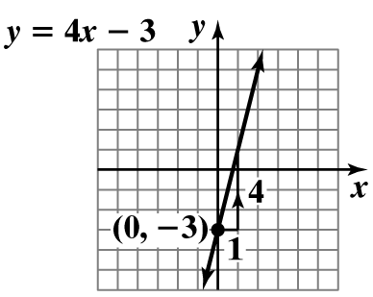
Objective 4: Example
Graph the line whose equation is
Begin by plotting the y-intercept of
Then use the slope of 4 to plot more points.

Slide 29
Objective 5
Graph horizontal or vertical lines.

Slide 30
Horizontal and Vertical Lines
Horizontal and Vertical Lines
Equation of a Horizontal Line
A horizontal line is given by an equation of the form where b is the y-intercept.
Equation of a Vertical Line
A vertical line is given by an equation of the form where a is the x-intercept.
(0,b)
(a,0)

Slide 31
Example
Graph the linear equation:
All ordered pairs that are solutions of have a value of y that is always Any value can be used for x. Let’s select three of the possible values for x:
x | y = − 4 | (x,y)
−3 | −4 | (−3, −4)
1 | −4 | (1, −4)
6 | −4 | (6, −4)

Slide 32
Example
Upon plotting the three resultant points and connecting the points with a line, the graph is the solution.
(1, $−$4)
($−$3, $−$4)
(6, $−$4)

Slide 33
Example
Graph the linear equation:
All ordered pairs that are solutions of have a value of y that is always 5. Any value can be used for x. Let’s select three of the possible values for y:
x = 5 | y | (x,y)
5 | −3 | (5, −3)
5 | 1 | (5, 1)
5 | 5 | (5, 5)

Slide 34
Example
Upon plotting the three resultant points and connecting the points with a line, the graph is the solution.
(5,5)
(5,1)
(5,−3)

Slide 35
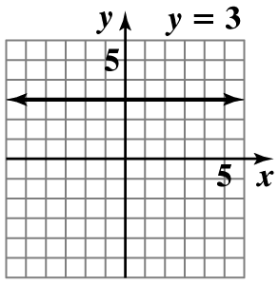
Objective 5: Example
5a. Graph in the rectangular coordinate system.
is a horizontal line.

Slide 36
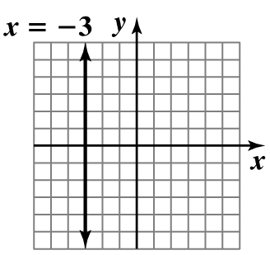
Objective 5: Example
5b. Graph in the rectangular coordinate system.
is a horizontal line.

Slide 37
Objective 6
Interpret a slope as rate of change.

Slide 38
Slope as Rate of Change
Slope is defined as the ratio of a change in y to a corresponding change in x. For a linear function, slope may be interpreted as the rate of change of the dependent variable per unit change in the independent variable.
Our next example shows how slope can be interpreted as a rate of change in an applied situation. When calculating slope in applied problems, keep track of the units in the numerator and denominator.

Slide 39
Example
A linear function that models data is described. Find the slope of each model. Then describe what this means in terms of the rate of change of the dependent variable y per unit change in the independent variable x.
The linear function models the average cost in dollars of a retail drug prescription in the United States, y, x years after 1991.
The slope of the linear model is 2. This means that every year (since 1991) the average cost in dollars of a retail drug prescription in the U.S. has increased approximately $2.

Slide 40
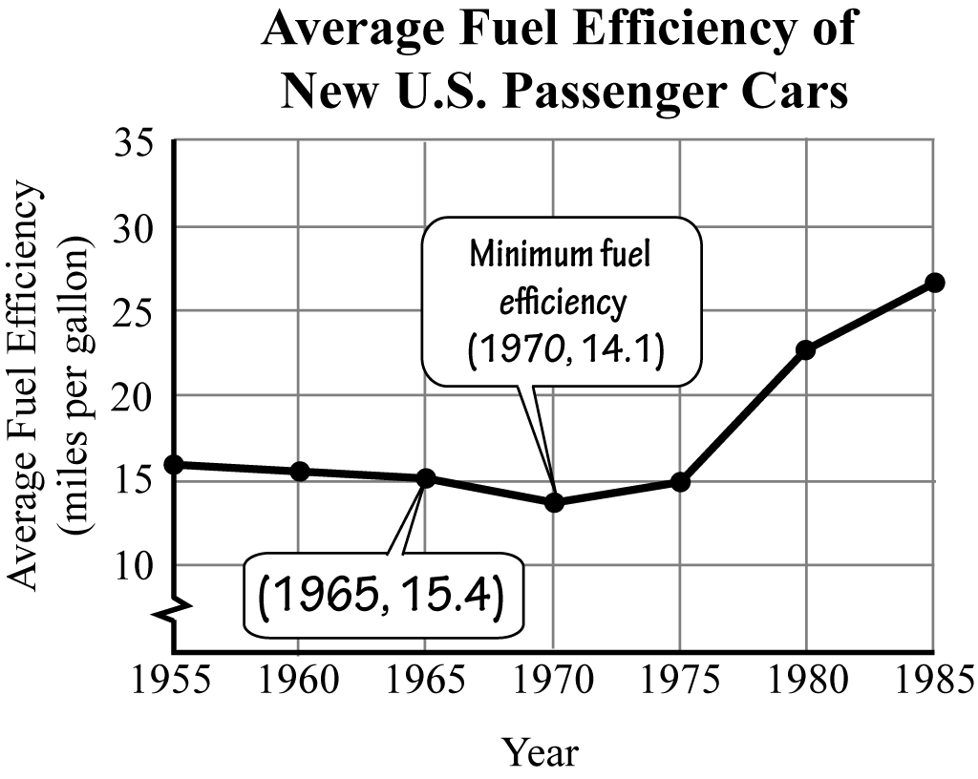
Objective 6: Example
6. Use the graph to find the slope of the line segment for the period from 1965 through 1970.

Slide 41
Objective 7
Find a function’s average rate of change.

Slide 42
Average Rate of Change
If the graph of a function is not a straight line, the average rate of change between any two points is the slope of the line containing the two points.

Slide 43
Objective 7: Example
7. When a person receives a drug injected into a muscle, the concentration of the drug in the body, measured in milligrams per 100 milliliters, is a function of the time elapsed after the injection, measured in hours. The graph below represents such a function, where x represents hours after the injection and is the drug’s concentration at time x. Find the average rate of change in the drug’s concentration between 1 hour and 3 hours.

Slide 44
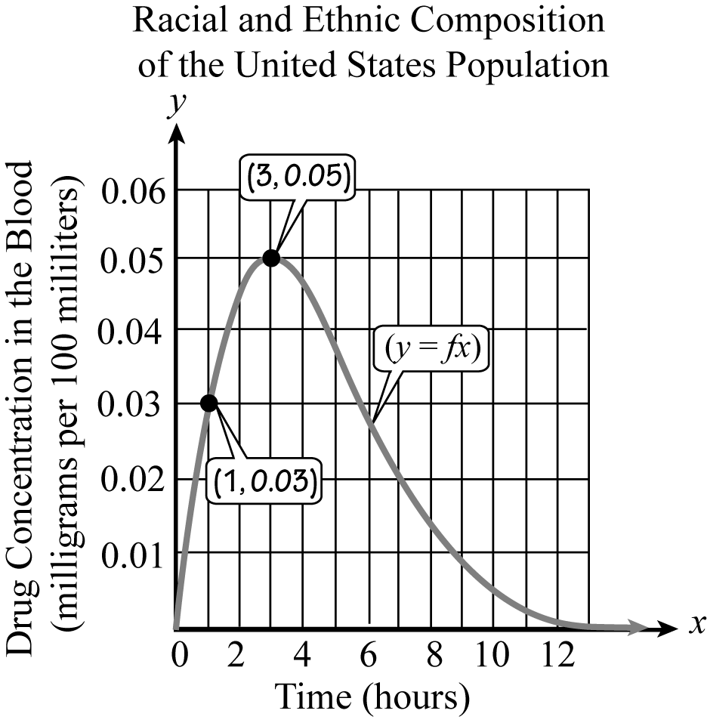
Objective 7: Example (cont)

Slide 45
Objective 7: Example (cont)
The average rate of change between 1 hour and 3 hours is 0.01. This means that the drug’s concentration is increasing at an average rate of 0.01 milligram per 100 milliliters per hour.

Slide 46
Objective 8
Use slope and y-intercept to model data.

Slide 47
Linear Modeling
Linear functions are useful for modeling data that fall on or near a line. The next example will illustrate how we can use the equation to obtain a model for the data and make predictions about the future.

Slide 48
Example
Find a linear function, in slope-intercept form or a constant function that models the given description. Describe what each variable in your model represents. Then use the model to make a prediction.
In 1998, there were 84 million Internet users in the United States and this number has increased at a rate of 21 million users per year since then.

Slide 49
Example (cont)
where is the number of U.S. Internet users (in millions) x years after 1998. We predict in 2018, there will be million U.S. Internet users.

Slide 50
Objective 8: Example
8. The amount of carbon dioxide in the atmosphere, measured in parts per million, has been increasing as a result of the burning of oil and coal. The buildup of gases and particles is believed to trap heat and raise the planet’s temperature. The pre-industrial concentration of atmospheric carbon dioxide was 280 parts per million. The scatter plot shows the average atmospheric concentration of carbon dioxide, in parts per million, for selected years from 1950 through 2009.

Slide 51
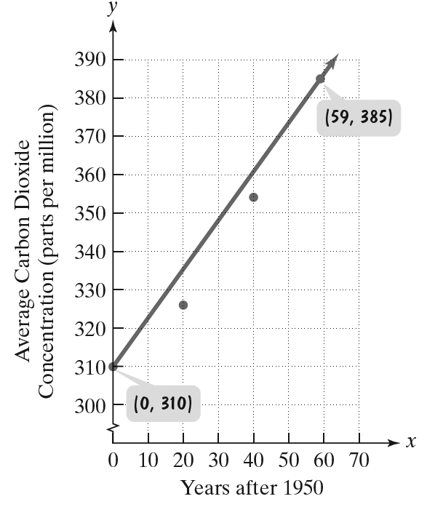
Objective 8: Example (cont)
Use the line in the scatter plot to find a function in the form that models average atmospheric concentration of carbon dioxide, in parts per million, x years after 1950. Round m to two decimal places.
Use the line segment passing through (59, 385) and (0, 310) to obtain a model.

Slide 52
Objective 8: Example (cont)
We need values for m, the slope, and b, the y-intercept.
The point (0, 310) gives us the y-intercept of 310.
Thus,

Slide 53
Section 2.5
The Point-Slope
Form of the
Equation of
a Line

Slide 54
Point-Slope Form
Point-Slope Form of the Equation of a Line
The point-slope equation of a nonvertical line with slope m that passes through the point is

Slide 55
Objective 1
Use the point-slope form to write equations of a line.

Slide 56
Example
Write the point-slope form and then the slope-intercept form of the equation of the line with slope that passes through the point
Substitute the given values
Simplify
This is the equation of the line in point-slope form.
Distribute
Subtract 4 from both sides
This is the equation of the line in slope-intercept form.

Slide 57
Example
Write the point-slope form and then the slope-intercept form of the equation of the line that passes through the points and .
First we must find the slope of the line. That is done as follows:
Now find the two forms of the equation of the line. To find the point-slope form of the line, use either point provided. Use .

Slide 58
Example (cont)
Substitute the given values
Simplify
This is the equation of the line in point-slope form.
Distribute
Subtract 4 from both sides
This is the equation of the line in slope-intercept form.

Slide 59
Equations of Lines
Equations of Lines
Standard Form
Slope-intercept Form
Horizontal line
Vertical line
Point-slope Form

Slide 60
Deciding which form to use:
Begin with slope-intercept form if you know: | Begin with point-slope form if you know:
The slope of the line and the y-intercept or two points on the line, one of which is the y-intercept. | The slope of the line and the y-intercept and a point on the line other than the y-intercept or two points on the line, neither of which is the y-intercept.

Slide 61
Objective 1: Example
Write the point-slope form and the slope-intercept form of the equation of the line with slope that passes through the point
Point-Slope Form:

Slide 62
Objective 1: Example
Now we solve , the point- slope form, for y and write an equivalent equation in slope-intercept form
Slope-Intercept Form

Slide 63
Objective 2
Model data with linear functions and make predictions.

Slide 64
Example
Drugs are an increasingly common way to treat depressed and hyperactive kids. The line graphs represent models that show users per 1000 U.S. children, ages 9 through 17.
Stimulants like Ritalin
(2001,34.2)
30
(1995,24)
Users Per 1000 Children
20
(2001,16.4)
10
Antidepressants like Prozac
(1995,8)
1995
1996
1997
1998
1999
2000
2001
Y E A R

Slide 65
Example (cont)
(a) Find the slope of the blue line segment for children using stimulants. Describe what this means in terms of rate of change.
(b) Find the slope of the red line segment for children using antidepressants. Describe what this means in terms of rate of change.
(c) Do the blue and red line segments lie on parallel lines? What does this mean in terms of the rate of change for children using stimulants and children using antidepressants?

Slide 66
Example (cont)
(a) Find the slope of the blue line segment for children using stimulants. Describe what this means in terms of rate of change.
This means that every year (since 1995), approximately 1.7 more children (per 1000) use stimulants like Ritalin.

Slide 67
Example (cont)
(b) Find the slope of the red line segment for children using antidepressants. Describe what this means in terms of rate of change.
This means that every year (since 1995), approximately 1.4 more children (per 1000) use antidepressants like Prozac.

Slide 68
Example (cont)
(c) Do the blue and red line segments lie on parallel lines? What does this mean in terms of the rate of change for children using stimulants and children using antidepressants?
The blue and red lines do not lie on parallel lines. This means that the number of child users for stimulants like Ritalin is increasing faster than the number of child users for antidepressants like Prozac.

Slide 69
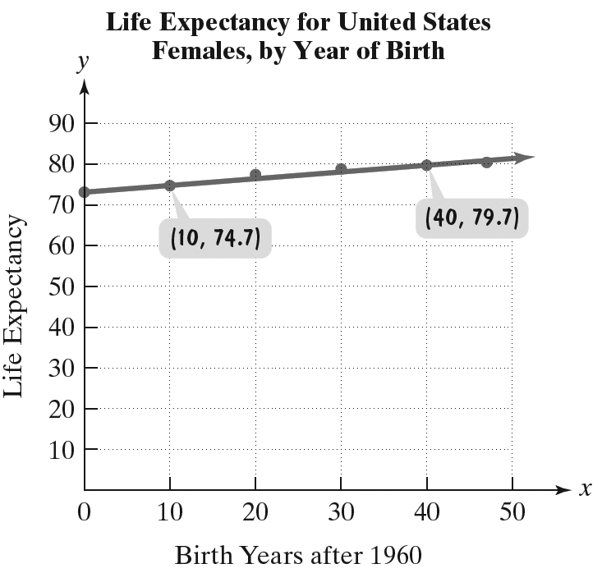
Objective 2: Example
The data for the life expectancy for American women are displayed as a set of six points in the scatter plot. Also shown is a line that passes through or near the six points.

Slide 70
Objective 2: Example (cont)
Use the data points labeled by the voice balloons to write the slope-intercept form of the equation of this line. Round the slope to two decimal places. Then use the linear function to predict the life expectancy of an American woman born in 2020.

Slide 71
Objective 2: Example (cont)
First, find the slope.
Then use the slope and one of the points to write the equation in point-slope form.
Using the point

Slide 72
Objective 2: Example (cont)
Next, since 2020 is 60 years after 1960, substitute 60 into the function:
This means that the life expectancy of American women in 2020 is predicted to be 83.2 years.
Answers vary due to rounding and choice of point. If point is chosen, and the life expectancy of American women in 2020 is predicted to be 83.1 years.

Slide 73
Objective 3
Find slopes and equations of parallel and perpendicular lines.

Slide 74
Parallel and Perpendicular Lines
Slope and Parallel Lines
If two nonvertical lines are parallel, then they have the same slope.
If two distinct nonvertical lines have the same slope, then they are parallel.
Two distinct vertical lines, both with undefined slopes, are parallel.

Slide 75
Parallel and Perpendicular Lines
Two lines are parallel if they have the same slope.
The following lines are parallel:
and are parallel.
and are parallel.

Slide 76
Parallel and Perpendicular Lines
Slope and Perpendicular Lines
If two nonvertical lines are perpendicular, then the product of their slopes is .
If the product of the slopes of two lines is, , then the lines are perpendicular.
A horizontal line having zero slope is perpendicular to a vertical line having undefined slope.

Slide 77
Parallel and Perpendicular Lines
One line is perpendicular to another line if its slope is the negative reciprocal of the slope of the other line.
The following lines are perpendicular:
and are perpendicular.
and are perpendicular.

Slide 78
Example
Write an equation of the line passing through and parallel to the line whose equation is
Since the desired line to represent is parallel to the given line, they have the same slope. Therefore the slope of the new line is also . Therefore, the equation of the new line is:
Substitute the given values
Simplify
Distribute
Subtract 4 from both sides

Slide 79
Example
Write an equation of the line passing through and perpendicular to the line whose equation is
The slope of the given equation is . Therefore, the slope of the new line is , since Therefore, the using the slope and the point , the equation of the line is as follows:

Slide 80
Example (cont)
Substitute the given values
Simplify
Distribute
Subtract 4 from both sides

Slide 81
Example (cont)
Common Denominators
Common Denominators
Simplify

Slide 82
Objective 3: Example
3a. Write an equation of the line passing through and parallel to the line whose equation is Express the equation in point-slope form and slope-intercept form.
Since the line is parallel to we know it will have slope
We are given that it passes through . We use the slope and point to write the equation in point-slope form.

Slide 83
Objective 3: Example (cont)
Point-Slope form:
Solve for y to obtain slope-intercept form.
Slope-Intercept form:

Slide 84
Objective 3: Example
3b. Write an equation of the line passing through and perpendicular to the line whose equation is Express the equation in point-slope form and slope-intercept form.
First, find the slope of the line
Solve the given equation for y to obtain slope-intercept form.

Slide 85
Objective 3: Example (cont)
Since the slope of the given line is the slope of any line perpendicular to the given line is 3.
We use the slope of 3 and the point to write the equation in point-slope form.

Slide 86
Objective 3: Example (cont)
Solve for y to obtain slope-intercept form.

