Slide 1
Summary (Week 1)
Categorical vs. Quantitative Variables
Types of Graphs for Categorical and Quantitative Data
Describe a Distribution: (Shape, Center, Spread)
Shape: Symmetric vs. Skewed
Center: Mean vs. Median
Spread: IQR vs. Standard Deviation
Checking for Outliers: Q1 – 1.5(IQR)
Q3 + 1.5(IQR)

Slide 2
Summary: Shape, Center, and Spread
Mean and Standard Deviation always go together
Median and IQR always go together.
Use MEAN and STANDARD DEVIATION when the distribution is symmetric and there are NO Outliers!
Otherwise use Median and IQR.

Slide 3
Review
Given the 5-Number summary determine if any numbers are outliers.
Min = 6 Q1 = 16 Med = 25 Q3 = 24 Max = 36
* If it is also know that the mean of the distribution is 28, then what would the shape of the distribution look like?
* What would be the best measure of center?

Slide 4
Chapter 6
The Standard Deviation as a Ruler and the Normal Model

Slide 5
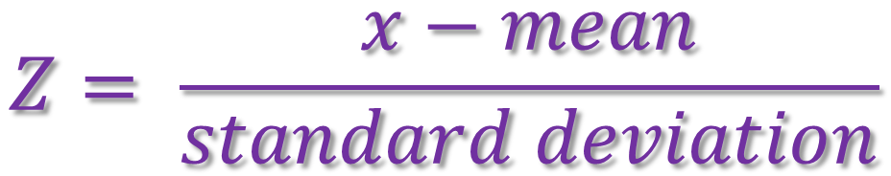
Standardizing with z-scores
We compare individual data values to their mean, relative to their standard deviation using the following formula:
We call the resulting values standardized values, denoted as z. They can also be called z-scores.
$$Z= \frac{x−mean}{standard deviation}$$

Slide 6

Standardizing with z-scores (cont.)
Standardized values have no units.
z-scores measure how many standard deviations away from the mean a specific data value falls.
A negative z-score tells us that the data value is below the mean, while a positive z-score tells us that the data value is above the mean.

Slide 7
Benefits of Standardizing
Standardized values have been converted from their original units to the standard statistical unit of standard deviations from the mean.
Thus, we can compare values that are measured on different scales, with different units, or from different populations.

Slide 8
Shifting Data
  Adding or subtracting a constant to every data value adds or subtracts the same constant to measures of position: center, percentiles, max/min.
  Its shape and spread - range, IQR, standard deviation - remain unchanged.

Slide 9
Rescaling Data
  * When we multiply (or divide) all the data values by any constant, all measures of position (such as the mean, median, and percentiles) and measures of spread (such as the range, the IQR, and the standard deviation) are multiplied (or divided) by that same constant.

Slide 10
Back to z-scores
Standardizing data into z-scores shifts the data by subtracting the mean and rescales the values by dividing by their standard deviation.
  Standardizing into z-scores does not change the shape of the distribution.
  Standardizing into z-scores changes the center by making the mean 0.
  Standardizing into z-scores changes the spread by making the standard deviation 1.

Slide 11
When Is a z-score BIG?
A z-score gives us an indication of how unusual a value is because it tells us how far it is from the mean.
Remember that a negative z-score tells us that the data value is below the mean, while a positive z-score tells us that the data value is above the mean.
The larger a z-score is (negative or positive), the more unusual it is.

Slide 12
When Is a z-score Big? (cont.)
There is no universal standard for z-scores, but there is a model that shows up over and over in Statistics.
This model is called the Normal model (You may have heard of “bell-shaped curves.”).
Normal models are appropriate for distributions whose shapes are unimodal and roughly symmetric.
These distributions provide a measure of how extreme a z-score is.

Slide 13
When Is a z-score Big? (cont.)
There is a Normal model for every possible combination of mean and standard deviation.
  We write N(μ,σ) to represent a Normal model with a mean of μ and a standard deviation of σ.
We use Greek letters because this mean and standard deviation do not come from data—they are numbers (called parameters) that specify the model.

Slide 14
When Is a z-score Big? (cont.)
Summaries of data, like the sample mean and standard deviation, are written with Latin letters. Such summaries of data are called statistics.
When we standardize Normal data, we still call the standardized value a z-score, and we write

Slide 15
When Is a z-score Big? (cont.)
When we use the Normal model, we are assuming the distribution is Normal.
We cannot check this assumption in practice, so we check the following condition:
  Nearly Normal Condition: The shape of the data’s distribution is unimodal and symmetric.
  This condition can be checked by making a histogram or a Normal probability plot (to be explained later!).

Slide 16
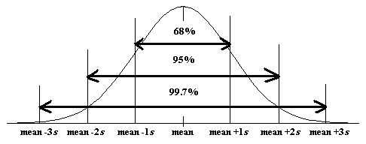
The 68-95-99.7 Rule (Empirical Rule)
Normal models give us an idea of how extreme a value is by telling us how likely it is to find one that far from the mean.
We can find these numbers precisely, but until then we will use a simple rule that tells us a lot about the Normal model…

Slide 17
The 68-95-99.7 Rule (cont.)
It turns out that in a Normal model:
  about 68% of the values fall within one standard deviation of the mean;
  about 95% of the values fall within two standard deviations of the mean; and,
  about 99.7% of the values fall within three standard deviations of the mean.

Slide 18
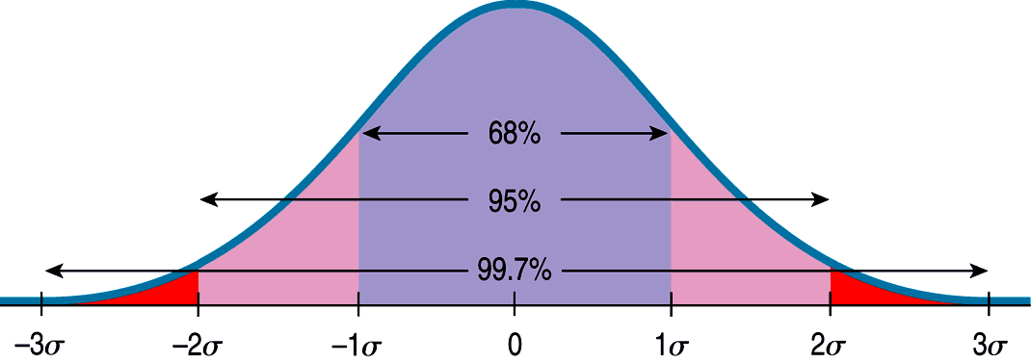
The 68-95-99.7 Rule (cont.)
The following shows what the 68-95-99.7 Rule tells us:

Slide 19
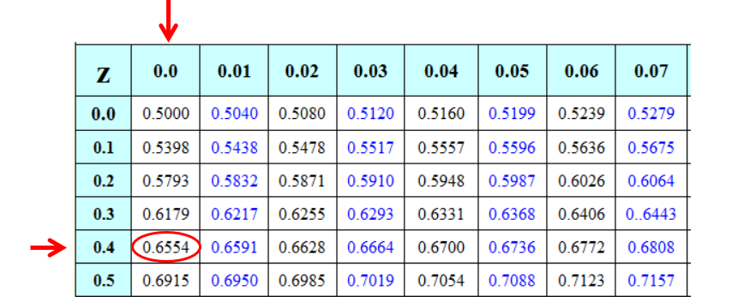
Finding Normal Percentiles by Hand
When a data value doesn’t fall exactly 1, 2, or 3 standard deviations from the mean, we can look it up in a table of Normal percentiles.
(Extra Z-Score Charts are on my website!)

Slide 20
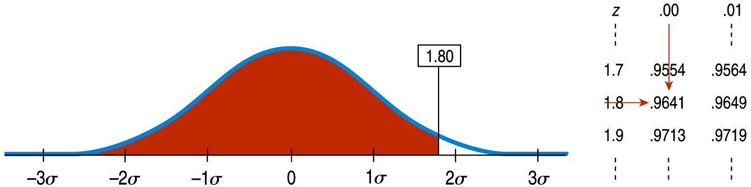
Finding Normal Percentiles by Hand (cont.)
Table Z is the standard Normal table. We have to convert our data to z-scores before using the table.
The figure shows us how to find the area to the left when we have a z-score of 1.80:

Slide 21
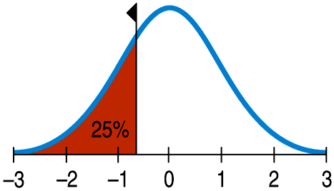
From Percentiles to Scores: z in Reverse
Sometimes we start with areas and need to find the corresponding z-score or even the original data value.
Example: What z-score represents the first quartile in a Normal model?

Slide 22
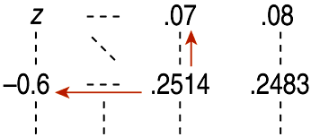
From Percentiles to Scores: z in Reverse
Look in Table Z for an area of 0.2500.
The exact area is not there, but 0.2514 is pretty close.
This figure is associated with z = -0.67, so the first quartile is 0.67 standard deviations below the mean.

Slide 23
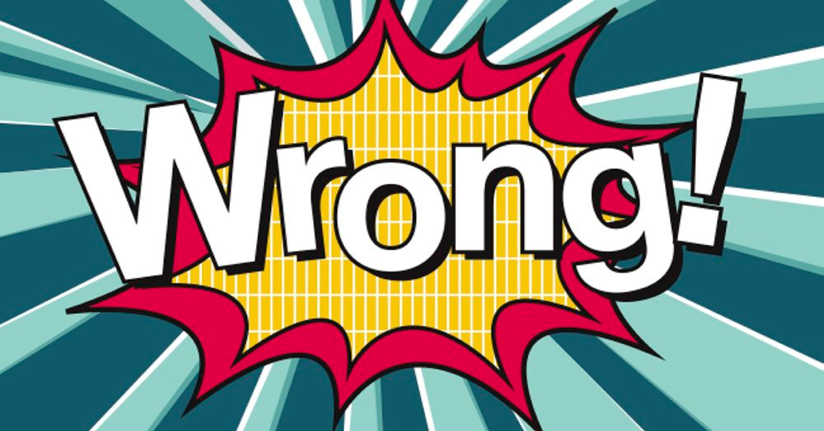
What Can Go Wrong? (cont.)
Don’t use the mean and standard deviation when outliers are present—the mean and standard deviation can both be distorted by outliers.
Don’t round your results in the middle of a calculation.
Don’t worry about minor differences in results.

Slide 24
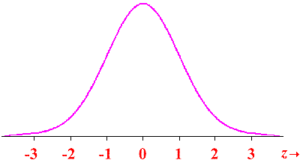
1. A normal distribution of scores has a standard deviation of 10. Find the z-scores corresponding to each of the following values:
a) A score of 60, where the mean score of the sample data values is 40.
b) A score that is 30 points below the mean.
c) A score of 80, where the mean score of the sample data values is 30.
d) A score of 20, where the mean score of the sample data values is 50.

Slide 25
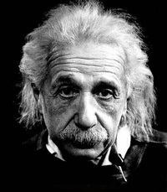
2. IQ scores have a mean of 100 and a standard deviation of 16. Albert Einstein reportedly had an IQ of 160.
a. What is the difference between Einstein's IQ and the mean?
b. How many standard deviations is that?
c. Convert Einstein’s IQ score to a z score.
d. If we consider “usual IQ scores to be those that convert z scores between -2 and 2, is Einstein’s IQ usual or unusual?

Slide 26
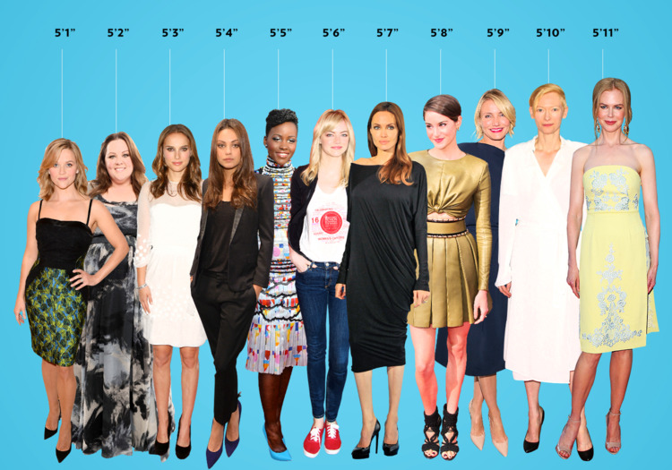
3. Women's heights have a mean of 63.6 in. and a standard deviation of 2.5 inches.
Find the z score corresponding to a woman with a height of 70 inches and determine whether the height is unusual.
What percent of women have a height higher than 70 inches?

Slide 27
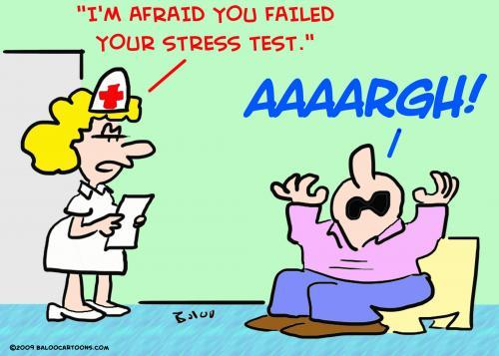
4. Three students take equivalent stress tests. Which is the highest relative score (meaning which has the largest z score value)?
a. A score of 144 on a test with a mean of 128 and a standard deviation of 34.
b. A score of 90 on a test with a mean of 86 and a standard deviation of 18.
c. A score of 18 on a test with a mean of 15 and a standard deviation of 5.

Slide 28
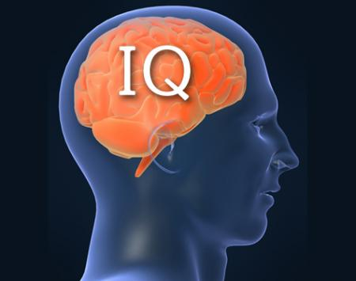
5. As mentioned above, IQ scores are normally distributed with mean 100 and std deviation of 16.
What percent of people have an IQ of less than 100?
What percent of people have an IQ between 84 and 100?
What percent of people have an IQ higher than 140?
What percent of people have an IQ less than 80?

