Slide 1
PRACTICE
A normal distribution of scores has a standard deviation of 10. Find the z-scores corresponding to each of the following values:
a) A score of 60, where the mean score of the sample data values is 40.
b) A score that is 30 points below the mean.
c) A score of 55, where the mean score of the sample data values is 30.
d) A score of 28, where the mean score of the sample data values is 40.

Slide 2
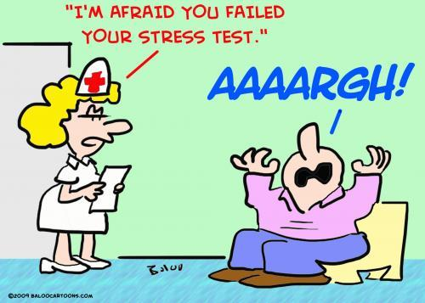
3. Three students take equivalent stress tests. Which is the highest relative score (meaning which has the largest z score value)?
a. A score of 144 on a test with a mean of 128 and a standard deviation of 34.
b. A score of 90 on a test with a mean of 86 and a standard deviation of 18.
c. A score of 18 on a test with a mean of 15 and a standard deviation of 5.

Slide 3
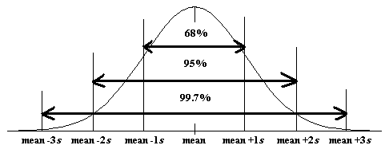
The 68-95-99.7 Rule (Empirical Rule)
Normal models give us an idea of how extreme a value is by telling us how likely it is to find one that far from the mean.
We can find these numbers precisely, but until then we will use a simple rule that tells us a lot about the Normal model…

Slide 4
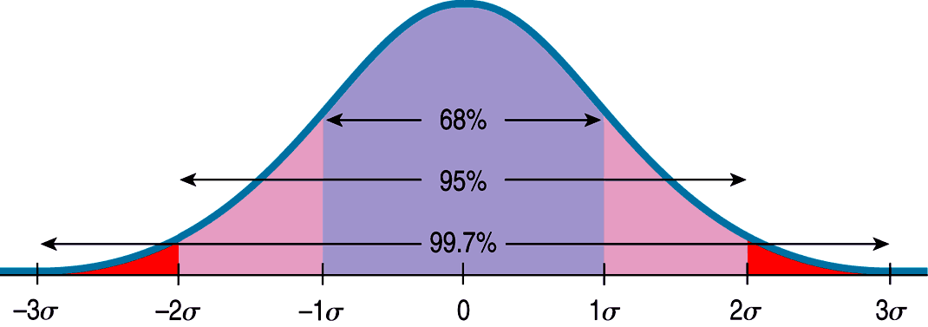
The 68-95-99.7 Rule (cont.)
The following shows what the 68-95-99.7 Rule tells us:

Slide 5
The 68-95-99.7 Rule (cont.)
It turns out that in a Normal model:
about 68% of the values fall within one standard deviation of the mean;
about 95% of the values fall within two standard deviations of the mean; and,
about 99.7% of the values fall within three standard deviations of the mean.

Slide 6
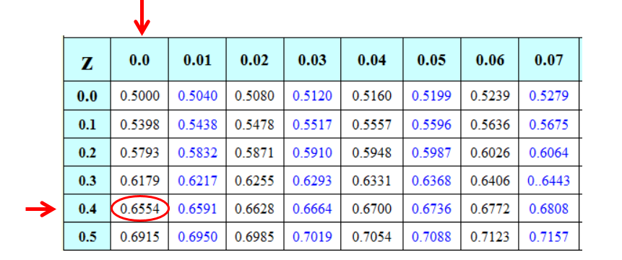
Finding Normal Percentiles by Hand
When a data value doesn’t fall exactly 1, 2, or 3 standard deviations from the mean, we can look it up in a table of Normal percentiles.
(Extra Z-Score Charts are on my website!)

Slide 7
Finding Normal Percentiles by Hand (cont.)
Table Z is the standard Normal table. We have to convert our data to z-scores before using the table.
The figure shows us how to find the area to the left when we have a z-score of 1.80:

Slide 8
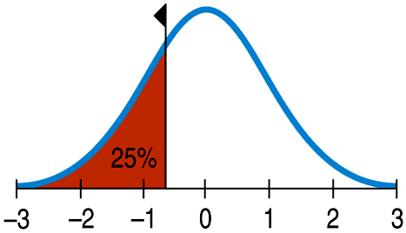
From Percentiles to Scores: z in Reverse
Sometimes we start with areas and need to find the corresponding z-score or even the original data value.
Example: What z-score represents the first quartile in a Normal model?

Slide 9
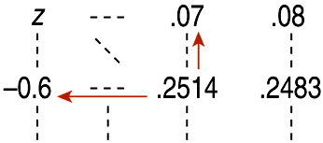
From Percentiles to Scores: z in Reverse
Look in Table Z for an area of 0.2500.
The exact area is not there, but 0.2514 is pretty close.
This figure is associated with z = -0.67, so the first quartile is 0.67 standard deviations below the mean.

Slide 10
4. Women's heights have a mean of 63.6 in. and a standard deviation of 2.5 inches.
Find the z score corresponding to a woman with a height of 70 inches and determine whether the height is unusual.
What percent of women have a height higher than 70 inches?
What would be the height of a women in the 18th percentile?

Slide 11
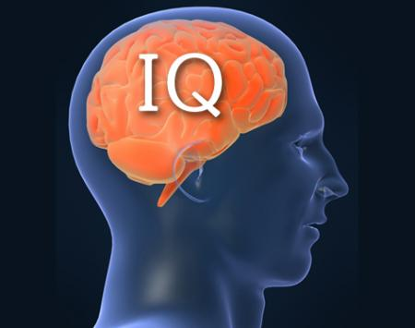
5. As mentioned above, IQ scores are normally distributed with mean 100 and std. deviation of 16.
What percent of people have an IQ of less than 90?
What percent of people have an IQ higher than 140?
What percent of people have an IQ between 70 and 110?
What would be the IQ of someone in the 73rd percentile?

