Slide 1
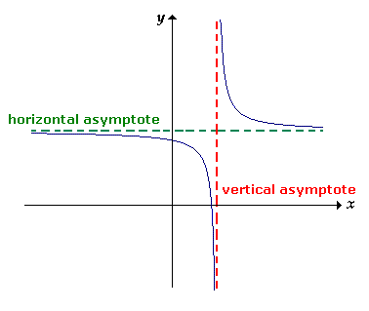
Horizontal Asymptotes
Should be written as y= because they are a flat horizontal line going through a y-value on the y-axis.
There are two ways to determine the horizontal asymptote (see next slide)

Slide 3
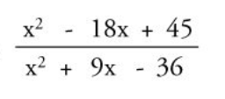
Example 1:
Degree of the numerator:
Degree of the denominator:
H.A. :

Slide 4
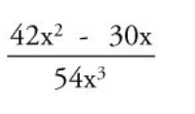
Example 2:
Degree of the numerator:
Degree of the denominator:
H.A. :

Slide 5
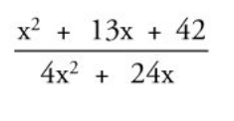
Example 3:
Degree of the numerator:
Degree of the denominator:
H.A. :

Slide 6
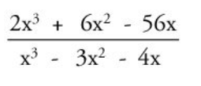
Example 4:
Degree of the numerator:
Degree of the denominator:
H.A. :

Slide 7

Check – Vertical and Horizontal
$$f\left(x\right)=\frac{2x−1}{x−5}$$
Vertical Asymptote:
Horizontal Asymptote:
*Use Desmos to check answer

Slide 8
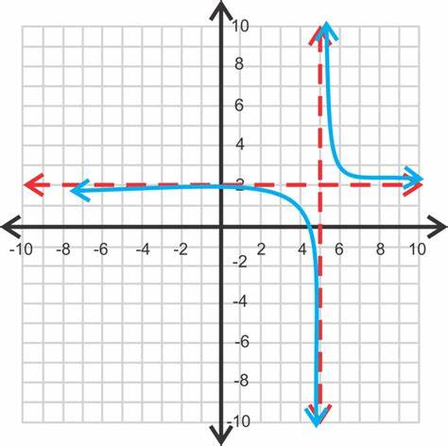
Check – Vertical and Horizontal
Vertical Asymptote:
Horizontal Asymptote:

