Slide 1
DRILL
Factor the following
$x^{2}−8x+15$
$x^{2}−36$
$2x^{2}−18x−44$

Slide 2
Welcome to Algebra 2 Class
Make sure you have pencil and paper handy.
Open your Schoology.

Slide 3
Attendance & Opening Task
Type your name in the chat box for attendance.
Share in the chat box.
Do you see a vase of two people facing each other?

Slide 4
Attendance & Opening Task
If you see the vase first, you are seeing the bigger picture with less focus on the details, so you are likely a "bigger picture" thinker.
If you see the two people in profile first, your eyes are picking up on the details of each silhouette, so you are likely someone who zeroes in easily on particulars and senses the steps that must be accomplished to reach a goal.

Slide 5
Outcomes
Students will be able to apply factoring techniques in order to determine the “hole” in the rational function.
Agenda:
Check-In
Think About It
Learn About It
Try It – Desmos
Show What You Know
What are we learning today?
How are we going to learn our lesson today?

Slide 6
Unit 2 Topic C: Rational Functions Lesson: Holes (in Graphs of Rational Functions)

Slide 7
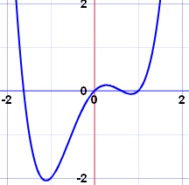
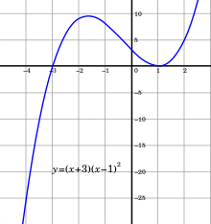
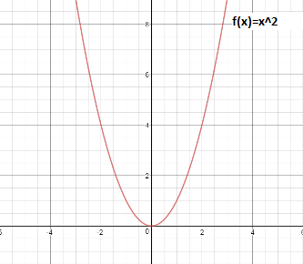
Learn About It
Continuous – a function is continuous if we can draw its graph without lifting the pencil.

Slide 8
Learn About It
Asymptotes and holes are discontinuities. We need to lift the pencil and start drawing again at those points.
Asymptotes – a vertical or horizontal line that a curve gets really close to but does not touch.

Slide 9
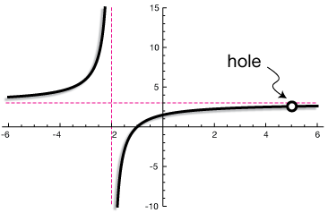
Learn About It
A hole is a single point in the graph of a rational function that cannot exist. The function is not continuous at a hole.

Slide 10
Learn About It
Steps to identify hole(s) in rational functions.
Factor numerator and denominator
If there is the same factor in the numerator and denominator, then there is a hole. (More than one factor cancels $→$ More than one hole)
Set this factor equal to zero and solve for x.
Simplify the rational function.
Find the ordered pair (x, y) by substituting x into the simplified equation to get the value of y.
Identify the coordinates of the hole(s) for which the following rational functions will be discontinuous.
a. $f\left(x\right)=\frac{x^{2}−4}{x−2}$

Slide 11
Try It
Steps to identify hole(s) in rational functions.
Factor numerator and denominator
If there is the same factor in the numerator and denominator, then there is a hole. (More than one factor cancels $→$ More than one hole)
Set this factor equal to zero and solve for x.
Simplify the rational function.
Find the ordered pair (x, y) by substituting x into the simplified equation to get the value of y.
Identify the coordinates of the hole(s) for which the following rational functions will be discontinuous.
a. $f\left(x\right)=\frac{x^{2}−16}{x+4}$

Slide 12
Learn About It
Steps to identify hole(s) in rational functions.
Factor numerator and denominator
If there is the same factor in the numerator and denominator, then there is a hole. (More than one factor cancels $→$ More than one hole)
Set this factor equal to zero and solve for x.
Simplify the rational function.
Find the ordered pair (x, y) by substituting x into the simplified equation to get the value of y.
Identify the coordinates of the hole(s) for which the following rational functions will be discontinuous.
b. $f\left(x\right)=\frac{x^{2}−4x−5}{x^{2}−3x−10}$

Slide 13
Try It
Steps to identify hole(s) in rational functions.
Factor numerator and denominator
If there is the same factor in the numerator and denominator, then there is a hole. (More than one factor cancels $→$ More than one hole)
Set this factor equal to zero and solve for x.
Simplify the rational function.
Find the ordered pair (x, y) by substituting x into the simplified equation to get the value of y.
Identify the coordinates of the hole(s) for which the following rational functions will be discontinuous.
b. $f\left(x\right)=\frac{x^{2}−9x+18}{x^{2}−11x+30}$

Slide 14
Learn About It
Steps to identify hole(s) in rational functions.
Factor numerator and denominator
If there is the same factor in the numerator and denominator, then there is a hole. (More than one factor cancels $→$ More than one hole)
Set this factor equal to zero and solve for x.
Simplify the rational function.
Find the ordered pair (x, y) by substituting x into the simplified equation to get the value of y.
Identify the coordinates of the hole(s) for which the following rational functions will be discontinuous.
c. $f\left(x\right)=\frac{x^{2}−3x−4}{x^{2}+6x+5}$

Slide 15
Try It
Steps to identify hole(s) in rational functions.
Factor numerator and denominator
If there is the same factor in the numerator and denominator, then there is a hole. (More than one factor cancels $→$ More than one hole)
Set this factor equal to zero and solve for x.
Simplify the rational function.
Find the ordered pair (x, y) by substituting x into the simplified equation to get the value of y.
Identify the coordinates of the hole(s) for which the following rational functions will be discontinuous.
c. $f\left(x\right)=\frac{x^{2}+12x+20}{x^{2}−4x−12}$

Slide 16
Outcomes
Students will be able to apply factoring techniques in order to determine the “hole” in the rational function.
Let us revisit our Outcome again

Slide 17
Try It – More Practice
Open Schoology
Go Try It: Desmos Activity
Enter code:

Slide 18
Show What You Know
Go to your Schoology for Algebra 2
Show What You Know: Equivalent Expressions

Slide 19
Outcomes Debrief
Students will be able to apply factoring techniques in order to determine the “hole” in the rational function.
Did we accomplish our objective?

