Slide 1
Section 5.3
Greatest
Common
Factors and
Factoring by
Grouping

Slide 2
Factoring
Factoring a polynomial means finding an equivalent expression that is a product. For example, when we take the polynomial
and write it as
we say that we have factored the polynomial. In factoring, we write a sum as a product.

Slide 3
Objective 1
Factoring out the greatest common factor of a polynomial.

Slide 4
Factoring
Factoring a Monomial from a Polynomial
Determine the greatest common factor of all terms in the polynomial.
Express each term as the product of the GCF and its other factor.
Use the distributive property to factor out the GCF.

Slide 5
Example
Factor:
First, determine the greatest common factor of the three terms.
Notice that the greatest integer that divides into 49, 70 and 35 (the coefficients of the terms) is 7. The variables raised to the smallest exponents are
x³, y³ and z^{3.}
The GCF is

Slide 6
Example (cont)
Express each term as the product of the GCF and its other factor
Factor out the GCF

Slide 7
Objective 1: Example
1a. Factor:
Factor out the GCF.
GCF GCF

Slide 8
Objective 1: Example
1b. Factor:
Factor out the GCF.
GCF GCF

Slide 9
Objective 1: Example
1c. Factor:
Factor out the GCF.
GCF GCF

Slide 10
Objective 1: Example
1d. Factor:
Factor out the GCF.
GCF GCF GCF

Slide 11
Objective 2
Factor out a common factor with a negative coefficient.

Slide 12
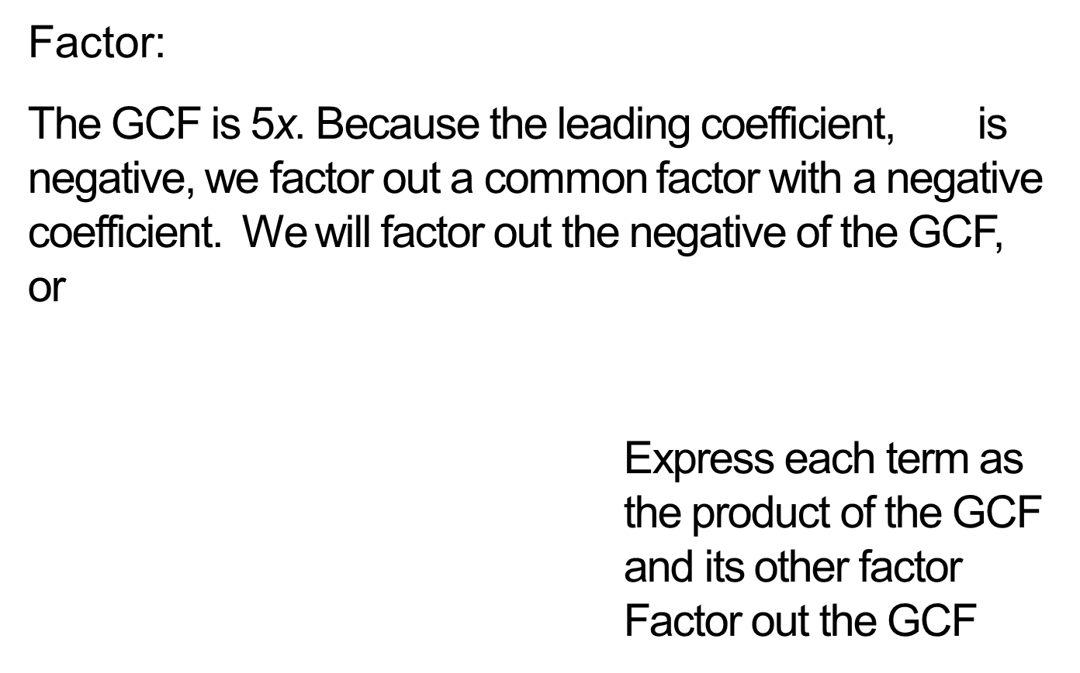
Example
Factor:
The GCF is 5x. Because the leading coefficient, is negative, we factor out a common factor with a negative coefficient. We will factor out the negative of the GCF, or
Express each term as the product of the GCF and its other factor Factor out the GCF

Slide 13
Objective 2: Example
2. Factor out a common factor with a negative coefficient:
Factor out the GCF.
GCF GCF GCF

Slide 14
Objective 3
Factor by grouping.

Slide 15
Example
Factor:
Identify the common binomial factor in each part of the problem.
The GCF, a binomial, is
The GCF, a binomial, is

Slide 16
Example (cont)
Factor out the common binomial factor as follows.
This step, usually omitted, shows each term as the product of the GCF and its other factor, in that order. Factor out the GCF

Slide 17
Factoring by Grouping
Factoring by Grouping
Group terms that have a common monomial factor. There will usually be two groups. Sometimes the terms must be rearranged.
Factor out the common monomial factor from each group.
Factor out the remaining common binomial factor (if one exists).

Slide 18
Example
Factor:
There is no factor other than 1 common to all terms. However, we can group terms that have a common factor:
Common factor is:
Use , rather than 2b, as the common factor:
In this way, the common binomial factor, , appears.

Slide 19
Example (cont)
We see that it is sometimes necessary to use a factor with a negative coefficient to obtain a common binomial factor for the two groupings. We now factor the given polynomial as follows:
Group terms with common factors
Factor out the common factors from the grouped terms
Factor out the GCF

Slide 20
Example
Your local electronics store is having an end-of-the-year sale. The price on a large-screen television had been reduced by 30%. Now the sale price is reduced by another 30%. If x is the television’s original price, the sale price can be represented by

Slide 21
Example (cont)
(a) Factor out from each term. Then simplify the resulting expression.
(b) Use the simplified expression from part (a) to answer these questions. With a 30% reduction followed by a 30% reduction, is the television selling at 40% of its original price? If not, at what percentage of the original price is it selling?

Slide 22
Example (cont)
This step, usually omitted, shows each term as the product of the GCF and its other factor, in that order.
Factor out the GCF
Subtract
Distribute
Subtract

Slide 23
Example (cont)
(b) With a 30% reduction, followed by another 30% reduction, the expression that represents the reduced price of the television simplifies to 0.49x.
Therefore, this series of price reductions effectively gives a new price for the television at 49% its original price, not 40%.

Slide 24
Objective 3: Example
3a. Factor:
common factor common factor is is 5

Slide 25
Objective 3: Example
3b. Factor:
common factor common factor is 4x is

Slide 26
Section 5.4
Factoring
Trinomials

Slide 27
Objective 1
Factor a trinomial whose leading
coefficient is 1.

Slide 28
Factoring Trinomials
In the previous section we factored certain polynomials having four terms using the method of grouping.
Now, we will use trial and error and a problem solving process to factor trinomials.
The polynomials we will begin with will have leading coefficients of one. We will begin by trying to factor these trinomials into a product of two binomials. Polynomials that cannot be factored over a given number set are said to be prime.

Slide 29
Factoring Trinomials
A Strategy for Factoring
Enter x as the first term of each factor.
List pairs of factors of the constant c.
Try various combinations of these factors. Select the combination in which the sum of the Outside and Inside products is equal to bx.
I
Sum of O + I
O

Slide 30
Factoring Trinomials (cont)
A Strategy for Factoring
Check your work by multiplying the factors using the FOIL method. You should obtain the original trinomial.
If none of the possible combinations yield an Outside product and an Inside product who sum is equal to bx, the trinomial cannot be factored using integers and is called prime over the set of integers.

Slide 31
Example
Factor:
Enter x as the first term of each factor.
To find the second term of each factor, we must find two integers whose product is 24 and whose sum is 11.
2. List pairs of factors of the constant, 24.
Factors of 24 | 24, 1 | 24, 1 | 12, 2 | 12, 2
8, 3 | 8, 3 | 6, 4 | 6, 4

Slide 32
Example (cont)
3. Try various combinations of these factors. The correct factorization of is the one in which the sum of the Outside and Inside products is equal to 11x. Here is a list of the possible factorizations.
Possible Factorizations of | Sum of Outside and Inside Products (Should Equal 11x)

Slide 33
Example (cont)
Possible Factorizations of | Sum of Outside and Inside Products (Should Equal 11x)
This is the required middle term.

Slide 34
Example (cont)
Thus,
Check this result by multiplying the right side using the FOIL method. You should obtain the original trinomial. Because of the commutative property, the factorization can also be expressed as

Slide 35
Example
Factor:
The GCF of the three terms of the polynomial is 4y. Therefore, we begin by factoring out 4y. Then we factor the remaining trinomial.

Slide 36
Example (cont)
Factor out the GCF. Begin factoring Find two integers whose product is and whose sum is 3. The integers are and 6.
Thus,

Slide 37
Objective 1: Example
1a. Factor:
Find a factor pair of 8 that has a sum of 6.
factor pair:
sum:

Slide 38
Objective 1: Example
1b. Factor:
Find a factor pair of 20 that has a sum of
factor pair:
sum:

Slide 39
Objective 1: Example
1c. Factor:
Find a factor pair of 6 that has a sum of
factor pair:
sum:

Slide 40
Objective 1: Example
1d. Factor:
First, factor out the GCF.
Next, factor the trinomial.

Slide 41
Objective 2
Factor using a substitution.

Slide 42
Factoring Trinomials using Substitution
In some trinomials, the highest power is greater than 2, and the exponent in one of the terms is half of the other term. By letting u equal the variable to the smaller power, the trinomial can be written in a form that makes its possible factorization more obvious.
If a factorization is found, we replace all occurrences of u in the factorization with the original substitution.

Slide 43
Objective 2: Example
2. Factor using substitution:
Let
Now substitute for u.

Slide 44
Objective 3
Factor a trinomial whose leading
coefficient is not 1.

Slide 45
Factoring Trinomials
A Strategy for Factoring
Assume, for the moment, that there is no greatest common factor.
Find two First terms whose product is
Find two Last terms whose product is c:

Slide 46
Factoring Trinomials (cont)
If no such combinations exist, the polynomial is prime.
A Strategy for Factoring
Assume, for the moment, that there is no greatest common factor.
By trial and error, perform steps 1 and 2 until the sum of the Outside product and Inside product is bx: Sum of O + I
I
O

Slide 47
Example
Factor:
Find two First terms whose product is There is more than one choice for our two First terms. Those choices are cataloged below.

Slide 48
Example (cont)
Find two Last terms whose product is 15. There is more than one choice for our two Last terms. Those choices are cataloged below.

Slide 49
Example (cont)
3. Try various combinations of these factors. The correct factorization of is the one in which the sum of the Outside and Inside products is equal to 19x. Here is a list of the possible factorizations.
Possible Factorizations of | Sum of Outside and Inside Products (Should Equal 19x)

Slide 50
Example (cont)
Therefore, the factorization of is:
Possible Factorizations of | Sum of Outside and Inside Products (Should Equal 19x)
This is the required middle term.

Slide 51
Example
Factor:
The GCF of the three terms of the polynomial is We begin by factoring out
Find two First terms whose product is

Slide 52
Example (cont)
Find two Last terms whose product is 3. The only possible factorization is since the sum of the Outside and Inside products must be , having a negative coefficient.
Try various combinations of these factors. The correct factorization of is the one in which the sum of the Outside and Inside products is equal to . A list of the possible factorizations can be found on the next page.

Slide 53
Example (cont)
Possible Factorizations of | Sum of Outside and Inside Products (Should Equal )
This is the required middle term.

Slide 54
Example (cont)
The factorization of is . Now we include the GCF in the complete factorization of the given polynomial. Thus,

Slide 55
Example
Factor:
Notice that the exponent on is half that of the exponent on We will let u equal the variable to the power that is half of 6. Thus, let

Slide 56
Example (cont)
This is the given polynomial, with written as
Let Rewrite the trinomial in terms of u.
Factor the trinomial.
Now substitute for u.
Therefore,

Slide 57
Objective 3: Example
3a. Factor:

Slide 58
Objective 3: Example
3b. Factor:
First, factor out the GCF.
Next, factor the trinomial.

Slide 59
Objective 3: Example
3c. Factor:
Let
Now substitute for u.

Slide 60
Objective 4
Factor trinomials by grouping.

Slide 61
Factoring Trinomials
Factoring Using Grouping
Multiply the leading coefficient, a, and the constant, c.
Find the factors of ac whose sum is b.
Rewrite the middle term, bx, as a sum or difference using the factors from step 2.
Factor by grouping.

Slide 62
Example
Factor by grouping:
The trinomial is of the form
Multiply the leading coefficient, a, and the constant, c. Using and .

Slide 63
Example (cont)
Find the factors of ac whose sum is b. We want the factors of whose sum is b, or 1. The factors of whose sum is 1 are 4 and
Rewrite the middle term, a, as a sum or difference using the factors from step 2: 4 and

Slide 64
Example (cont)
Factor by grouping.
Group terms
Factor from each group
Factor out , the common binomial factor
Thus,

Slide 65
Objective 4: Example
4. Factor:
a b c
Multiply a and c.
Find the factors of ac whose sum is b.
Product:
Sum:

Slide 66
Objective 4: Example (cont)
Rewrite the middle term using the factors of and
Find GCF Find GCF

