Slide 1
Section 6.1
Rational
Expressions
and Functions:
Multiplying
and Dividing

Slide 2
Rational Expressions
A rational expression consists of a polynomial divided by a nonzero polynomial (denominator cannot be equal to 0).

Slide 3
Objective 1
Evaluate rational functions.

Slide 4
Rational Functions
A rational function is a function defined by a formula that is a rational expression. For example, the following is a rational function:

Slide 5
Example
The rational function
models the cost, in millions of dollars, to inoculate x% of the population against a particular strain of flu. The graph of the rational function is shown. Use the function’s equation to solve the following problem.
Find and interpret Identify your solution as a point on the graph.

Slide 6
Example (cont)

Slide 7
Example (cont)
We use substitution to evaluate a rational function, just as we did to evaluate other functions.
This is the given rational function.
Replace each occurrence of x with 60.
Perform the indicated operations.

Slide 8
Example (cont)
Thus, This means that the cost to inoculate 60% of the population against a particular strain of the flu is $195 million. The figure below illustrates the solution by the point on the graph of the rational function.

Slide 9
Objective 1: Example
1. The rational function
models the cost, in thousands of dollars, to remove x% of the pollutants that a city has discharged into a lake. Find and interpret

Slide 10
Objective 1: Example (cont)
The cost to remove 40% of the lake’s pollutants is
$80 thousand.

Slide 11
Objective 2
Find the domain of a rational function.

Slide 12
Example
Find the domain of f if
The domain of f is the set of all real numbers except those for which the denominator is zero. We can identify such numbers by setting the denominator equal to zero and solving for x.

Slide 13
Example (cont)
Set the denominator equal to 0.
Factor.
or Set each factor equal to 0.
Solve the resulting equations.

Slide 14
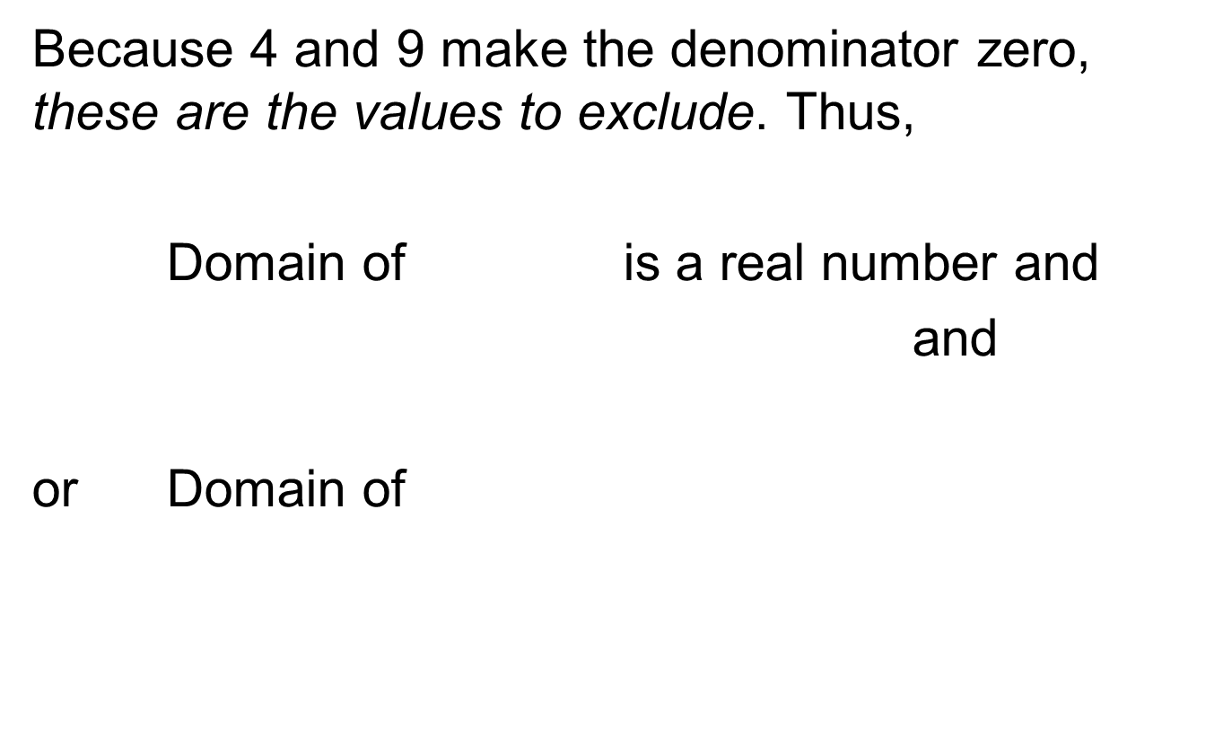
Example (cont)
Because 4 and 9 make the denominator zero, these are the values to exclude. Thus,
Domain of is a real number and
and
or $\text{Domain} \text{of}$

Slide 15
Example (cont)
Domain of
In this example, we excluded 4 and 9 from the domain. Unlike the graph of a polynomial which is continuous, this graph has two breaks in it − one at each of the excluded values. Since x cannot be 4 or 9, there is not a function value corresponding to either of those x values. At 4 and at 9, there will be dashed vertical lines called vertical asymptotes.

Slide 16
Example (cont)
The graph of the function will approach these vertical lines on each side as the x values draw closer and closer to each of them, but will not touch (cross) the vertical lines. The lines and each represent vertical asymptotes for this particular function.

Slide 17
Objective 2: Example
2. Find the domain of f if
The domain is all real numbers except those which make the denominator zero. Set the denominator equal to zero and solve.
or
Domain of

Slide 18
Objective 3
Interpret information given by the graph of a rational function.

Slide 19
Rational Expressions
Asymptotes
Vertical Asymptotes | A vertical line that the graph of a function approaches, but does not touch.
Horizontal Asymptotes | A horizontal line that the graph of a function approaches as x gets very large or very small. The graph of a function may touch/cross its horizontal asymptote.

Slide 20
Objective 3: Example
3. Fill in the blank: A vertical line that the graph of a function approaches, but does not touch, is said to be a vertical asymptote of the graph.

Slide 21
Objective 4
Simplify rational expressions.

Slide 22
Rational Expressions
Simplifying Rational Expressions
Factor the numerator and the denominator completely.
Divide both the numerator and the denominator by any common factors.

Slide 23
Example
Simplify:
Factor the numerator and denominator.
Divide out the common factor,
Simplify.

Slide 24
Objective 4: Example
4a. Simplify:

Slide 25
Objective 4: Example
4b. Simplify:

Slide 26
Objective 5
Multiply rational expressions.

Slide 27
Multiplying Rational Expressions
Multiplying Rational Expressions
Factor all numerators and denominators completely.
Divide numerators and denominators by common factors.
Multiply the remaining factors in the numerators and multiply the remaining factors in the denominators.

Slide 28
Multiplying Rational Expressions
Simplifying Rational Expressions with Opposite Factors in the Numerator and Denominator
The quotient of two polynomials that have opposite signs and are additive inverses is

Slide 29
Example
Multiply:
This is the original expression.
Factor the numerators and denominators completely.

Slide 30
Example (cont)
Divide numerators and denominators by common factors.
Multiply the remaining factors in the numerators and in the denominators.

Slide 31
Example
Multiply:
This is the original expression.
Factor the numerators
and denominators completely.

Slide 32
Example (cont)
Divide numerators and denominators by common factors. Because and are opposite, their quotient is
or

Slide 33
Objective 5: Example
5a. Multiply:

Slide 34
Objective 5: Example
5b. Multiply:

Slide 35
Objective 6
Divide rational expressions.

Slide 36
Dividing Rational Expressions
Dividing Rational Expressions
If P, Q, R, and S are polynomials, where then
Replace with its reciprocal by interchanging its numerator and denominator.
Change division to multiplication.

Slide 37
Example
Divide:
This is the original expression.
Invert the divisor and multiply. Factor.

Slide 38
Example (cont)
Divide numerators and denominators by common factors.
Multiply the remaining factors in the numerators and in the denominators.

Slide 39
Objective 6: Example
6. Divide:

Slide 40
Objective 6: Example (cont)

Slide 41
Section 6.2
Adding and
Subtracting
Rational
Expressions

Slide 42
Objective 1
Add rational expressions with the same denominator.

Slide 43
Adding Rational Expressions
Adding Rational Expressions With Common Denominators
If $\text{and}$ are rational expressions, then To add rational expressions with the same denominator, add numerators and place the sum over the common denominator. If possible, factor and simplify the result.

Slide 44
Example
Add:
This is the original expression.
Add numerators. Place this sum over the common denominator.
Combine like terms.

Slide 45
Example (cont)
Factor.
Factor and simplify by dividing out the common factor, x.
Simplify.

Slide 46
Objective 1: Example
1. Add:

Slide 47
Objective 2
Subtract rational expressions with the same denominator.

Slide 48
Subtracting Rational Expressions
Subtracting Rational Expressions With Common Denominators
If and are rational expressions, then To subtract rational expressions with the same denominator, subtract numerators and place the difference over the common denominator. If possible, factor and simplify the result.

Slide 49
Example
Subtract:
This is the original expression.
Subtract numerators. Place this difference over the common denominator.
Remove the parentheses and distribute.

Slide 50
Example (cont)
Combine like terms.
Factor.
Factor and simplify by dividing out the common factor,
Simplify.

Slide 51
Objective 2: Example
2. Subtract:

Slide 52
Objective 3
Find the least common denominator.

Slide 53
Least Common Denominators
Finding the Least Common Denominator (LCD)
Factor each denominator completely.
List the factors of the first denominator.
Add to the list in step 2 any factors of the second denominator that do not appear in the list.
Form the product of each different factor from the list in step 3. This product is the least common denominator.

Slide 54
Example
Find the LCD of:
1. Factor each denominator completely.
2. List the factors of the first denominator.

Slide 55
Example (cont)
3. Add any unlisted factors from the second denominator. The second denominator is One factor of is already in our list, but the factor is not. We add the factor to our list.
4. The least common denominator is the product of all factors in the final list. Thus,
is the least common denominator.

Slide 56
Objective 3: Example
3a. Find the LCD of
Factor each denominator:
List the factors of the first denominator:
Add any unlisted factors from the second denominator:

Slide 57
Objective 3: Example (cont)
The LCD is the product of all the factors in the final list:
The LCD is

Slide 58
Objective 3: Example
3b. Find the LCD of and
Factor each denominator:
List the factors of the first denominator:
Add any unlisted factors from the second denominator:

Slide 59
Objective 3: Example (cont)
The LCD is the product of all the factors in the final list:
The LCD is or

Slide 60
Objective 4
Add and subtract rational expressions with different denominators.

Slide 61
Add & Subtract Fractions
Adding and Subtracting Rational Expressions That Have Different Denominators
Find the LCD of the rational expressions.
Rewrite each rational expression as an equivalent expression whose denominator is the LCD. To do so, multiply the numerator and denominator of each rational expression by any factor(s) needed to convert the denominator into the LCD.

Slide 62
Add & Subtract Fractions (cont)
Adding and Subtracting Rational Expressions That Have Different Denominators
Add or subtract numerators, placing the resulting expression over the LCD.
If possible, simplify the resulting rational expressions.

Slide 63
Example
Add:
1. Find the least common denominator. Begin by factoring the denominators.
The factors of the first denominator are and The only factor from the second denominator that is unlisted is Thus, the least common denominator is,

Slide 64
Example (cont)
2. Write equivalent expressions with the LCD as denominators.
This is the original expression.
Factored denominators.
Multiply each numerator and denominator by the extra factor required to form the LCD.

Slide 65
Example (cont)
3. & 4. Add numerators, putting this sum over the LCD. Simplify, if possible.
Add numerators.
Perform the multiplications using the distributive property.
Combine like terms.

Slide 66
Example (cont)
Since the numerator does not factor, there are clearly no common factors in the numerator and the denominator. Therefore, the final solution is,

Slide 67
Example
Subtract:
1. Find the least common denominator. Begin by factoring the denominators.
The factors of the first denominator are and The only factor from the second denominator that is unlisted is Thus, the least common denominator is,

Slide 68
Example (cont)
2. Write equivalent expressions with the LCD as denominators.
This is the original expression.
Factored denominators.
Multiply each numerator and denominator by the extra factor required to form the LCD.

Slide 69
Example (cont)
3 & 4. Add numerators, putting this sum over the LCD. Simplify, if possible.
Subtract numerators.
Perform the multiplications using the distributive property and FOIL.

Slide 70
Example (cont)
Remove parentheses.
Combine like terms in the numerator.
Since the numerator does not factor, there are clearly no common factors betwixt the numerator and the denominator. Therefore, the final
solution is,

Slide 71
Example
Perform the indicated operations:
1. Find the least common denominator. Begin by factoring the denominators.

Slide 72
Example (cont)
The factors of the first denominator are 1 and The only factor from the second denominator that is unlisted is We have already listed all factors from the third denominator. Thus, the least common denominator is,
or
2. Write equivalent expressions with the LCD as denominators.

Slide 73
Example (cont)
This is the original expression.
Factor the second denominators.
Multiply each numerator and denominator by the extra factor required to form the LCD.

Slide 74
Example (cont)
3 & 4. Add numerators, putting this sum over the LCD. Simplify, if possible.
Add and subtract numerators.
Perform the multiplications using the distributive property.
Combine like terms in the numerator.

Slide 75
Example (cont)
Since the numerator does not factor, there are clearly no common factors in the numerator and the denominator. Therefore, the final solution is,

Slide 76
Objective 4: Example
4a. Add:
The LCD is
Rewrite each rational expression with the LCD as the denominator.

Slide 77
Objective 4: Example
4b. Add:
The LCD is
Rewrite each rational expression with the LCD as the denominator.

Slide 78
Objective 4: Example
4c. Subtract:
The LCD is
Rewrite each rational expression with the LCD as the denominator.

Slide 79
Objective 4: Example (cont)

Slide 80
Objective 4: Example
4d. Perform the indicated operations:
The LCD is
Rewrite each rational expression with the LCD as the denominator.

Slide 81
Objective 4: Example (cont)

Slide 82
Objective 5
Add and subtract rational expressions with opposite denominators.

Slide 83
Example
Add:
This is the original expression.
Factor the first denominator.
Multiply the numerator and the denominator of the second rational expression by

Slide 84
Example (cont)
Multiply by
Rewrite as
Notice the LCD is
Multiply the second numerator and denominator by the extra factor required to form the LCD.

Slide 85
Example (cont)
Perform the multiplications using the distributive property.
Add and subtract numerators.
Remove parentheses and distribute.

Slide 86
Example (cont)
Combine like terms in the numerator.
Since the numerator does not factor, there are clearly no common factors betwixt the numerator and the denominator. Therefore, the final solution is,

Slide 87
Objective 5: Example
5. Add:
Since the denominators are opposites, multiply the numerator and denominator of the second rational expression by

