Slide 1
Drill: Tues, 1/3
1. Identify CL and its relationship to triangle ABC.
2. Find the midpoint and slope of the segment that passes through (2, 8) and (–4, 6).
OBJ: SWBAT prove and apply theorems about perpendicular bisectors.
Notes:
Materials: Patty Paper, Poster Paper, F1 Graphic Org, HW: Are You Ready

Slide 2
When a point is the same distance from two or more objects, the point is said to be equidistant from the objects. Triangle congruence theorems can be used to prove theorems about equidistant points.

Slide 4
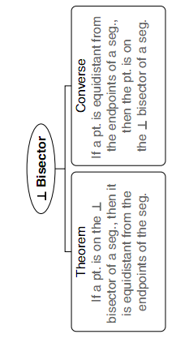

Slide 5
So… can you prove it?
Get into groups of 2 – 4
Reason Bank: Dfn of Perpendicular, Given (3 times), Dfn of Midpoint, Reflexive Prop. of Congruence, CPCTC, SAS, and Dfn of Congruent Segments
Notes:
Fix this reason bank!!

Slide 6
Remember that the distance between a point and a line is the length of the perpendicular segment from the point to the line.

Slide 7
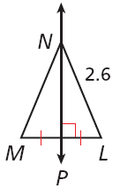
Example 1A: Applying the Perpendicular Bisector Theorem and Its Converse
Find each measure.
MN
MN = LN
⊥ Bisector Thm.
MN = 2.6
Substitute 2.6 for LN.

Slide 8
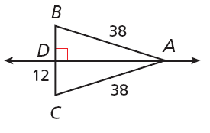
Example 1B: Applying the Perpendicular Bisector Theorem and Its Converse
Find each measure.
BC
Since AB = AC and , is the perpendicular bisector of by the Converse of the Perpendicular Bisector Theorem.
BC = 2CD
Def. of seg. bisector.
BC = 2(12) = 24
Substitute 12 for CD.

Slide 9
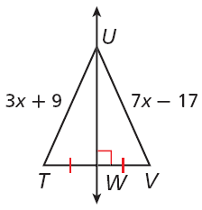
Example 1C: Applying the Perpendicular Bisector Theorem and Its Converse
Find each measure.
TU
TU = UV
⊥ Bisector Thm.
3x + 9 = 7x – 17
Substitute the given values.
9 = 4x – 17
Subtract 3x from both sides.
26 = 4x
Add 17 to both sides.
6.5 = x
Divide both sides by 4.
So TU = 3(6.5) + 9 = 28.5.

Slide 10
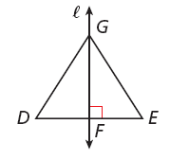
Check It Out! Example 1a
Find the measure.
Given that line ℓ is the perpendicular bisector of DE and EG = 14.6, find DG.
DG = EG
⊥ Bisector Thm.
DG = 14.6
Substitute 14.6 for EG.

Slide 11
A locus is a set of points that satisfies a given condition. The perpendicular bisector of a segment can be defined as the locus of points in a plane that are equidistant from the endpoints of the segment.

