Slide 1
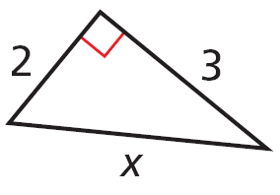
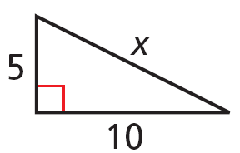
Drill: Tuesday, 1/13
For Exercises 1 and 2, find the value of x. Give your answer in simplest radical form.
1. 2.
Simplify each expression.
3. 4.
SWBAT: Justify and apply properties of 45°-45°-90° triangles and 30°-60°-90° triangles.

Slide 2
5.8 Special Right Triangles
SWBAT: Justify and apply properties of 45°-45°-90° triangles and 30°-60°-90° triangles.

Slide 3
Special Triangle #1
Start with a colored piece of paper and cut it into a square.
Fold the square in half on a diagonal.
What type of triangle have you folded from the square? (Label the measures for each angle)
Label the two legs of the triangle “x”
On a separate sheet of paper find the length of the hypotenuse in terms of “x”.
SWBAT: Justify and apply properties of 45°-45°-90° triangles and 30°-60°-90° triangles.

Slide 4
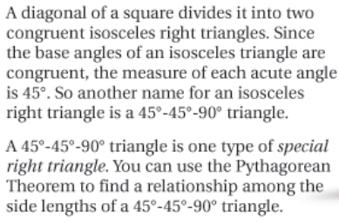

Slide 5
SWBAT: Justify and apply properties of 45°-45°-90° triangles and 30°-60°-90° triangles.

Slide 6
SWBAT: Justify and apply properties of 45°-45°-90° triangles and 30°-60°-90° triangles.

Slide 7
SWBAT: Justify and apply properties of 45°-45°-90° triangles and 30°-60°-90° triangles.

Slide 8
SWBAT: Justify and apply properties of 45°-45°-90° triangles and 30°-60°-90° triangles.

Slide 9
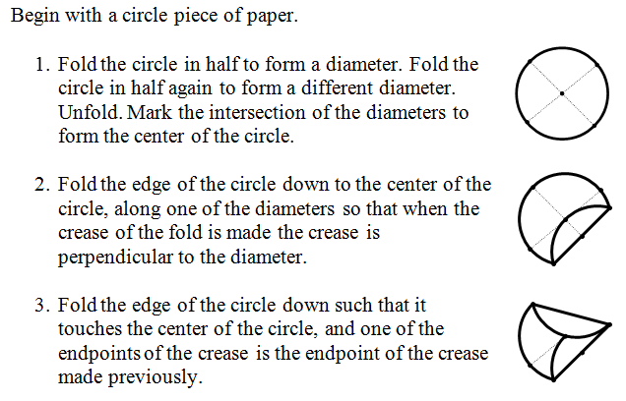
Special Right Triangle #2
SWBAT: Justify and apply properties of 45°-45°-90° triangles and 30°-60°-90° triangles.

Slide 10
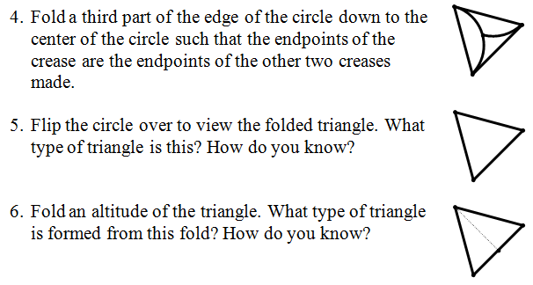
Special Right Triangle #2
SWBAT: Justify and apply properties of 45°-45°-90° triangles and 30°-60°-90° triangles.

Slide 11
SWBAT: Justify and apply properties of 45°-45°-90° triangles and 30°-60°-90° triangles.

Slide 12
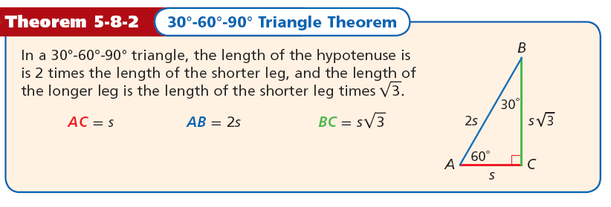
SWBAT: Justify and apply properties of 45°-45°-90° triangles and 30°-60°-90° triangles.

Slide 13
SWBAT: Justify and apply properties of 45°-45°-90° triangles and 30°-60°-90° triangles.

Slide 14
SWBAT: Justify and apply properties of 45°-45°-90° triangles and 30°-60°-90° triangles.

Slide 15
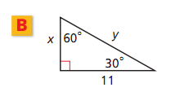
SWBAT: Justify and apply properties of 45°-45°-90° triangles and 30°-60°-90° triangles.

Slide 16
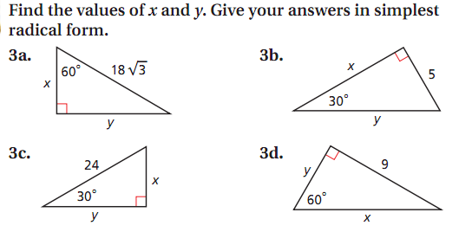
In Pairs…
SWBAT: Justify and apply properties of 45°-45°-90° triangles and 30°-60°-90° triangles.

Slide 17
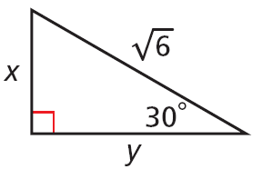
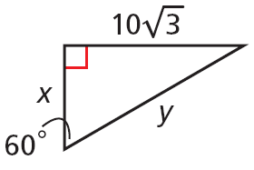
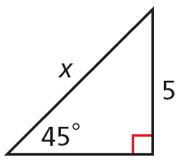
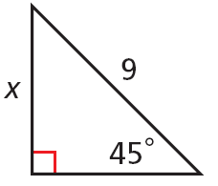
Lesson Quiz: Part I Name: ______________
Find the values of the variables. Give your answers in simplest radical form.
1. 2.
3. 4.
SWBAT: Justify and apply properties of 45°-45°-90° triangles and 30°-60°-90° triangles.

Slide 18
Find the perimeter and area of each figure. Give your answers in simplest radical form.
5. a square with diagonal length 20 cm
6. an equilateral triangle with height 24 in.
SWBAT: Justify and apply properties of 45°-45°-90° triangles and 30°-60°-90° triangles.

