Slide 1
Algebra II Final Exam Review
Part I

Slide 2
Rational Functions
Simplify the expression $\frac{x^{2}−6x+5}{x−1}$ given that $x≠1.$

Slide 3
Rational Functions
Determine the following about the rational function $f\left(x\right)=\frac{1}{x−4}$
Vertical Asymptote
Y-intercept
Is this graph a continuous function? Why or why not?

Slide 4
Logs
What is the value of x in the equation $\log_{7}\left(x\right)=3?$

Slide 5

Logs
Which of the following is equivalent to
$x=\frac{log⁡(249)}{log⁡(3)}$ C. $x=\frac{log⁡(249)}{log⁡(6)}$
$x=\frac{log⁡(243)}{log⁡(3)}$ $x=\frac{log⁡(243)}{log⁡(6)}$
$$3^{x}+6=249$$

Slide 6
Systems
Determine the x-values for which the functions $f\left(x\right)=x^{2}−x−12$ and $g\left(x\right)=−2x−8$.

Slide 7

Radical Equations
Solve for x: $\sqrt{4x−1}=9$

Slide 8

Inverses
Determine the inverse of $f\left(x\right)=−3x+5$

Slide 9
Trig
Match the angles with their correct sine value from looking at the unit circle.
A. $180°$ B. $45°$ C. $225°$ D. $150°$
1) $−\frac{\sqrt{2}}{2}$ 2) $0$ 3) $\frac{1}{2}$ 4) $\frac{\sqrt{2}}{2}$

Slide 10

Trig
Convert to radians
Convert to degrees
$$315°$$
$$\frac{3π}{5}$$

Slide 11
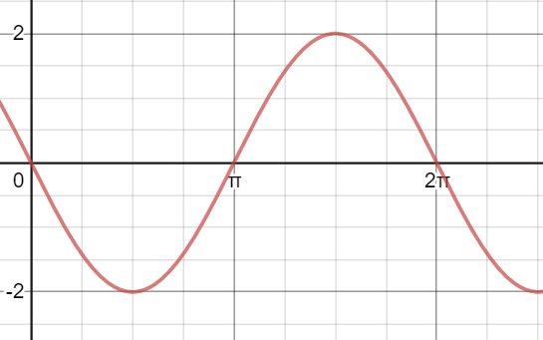
Trig
Which of the following is the equation that matches the graph below?
$f\left(x\right)=2sin⁡(x)$ c) $f\left(x\right)=−2sin⁡(x)$
$f\left(x\right)=\frac{1}{2}sin⁡(x)$ d) $f\left(x\right)=sin⁡(x)$

Slide 12
Imaginary Numbers (i) Simplify the expression of complex numbers
(5i – 3)4i
(4 – 2i)(3 + 4i)
6i – 4 + 3i² – 4i

Slide 13
Solving Quadratics with non-real Solutions
$x^{2}+5x+10=0$
$x^{2}+5x+10=0$

