Slide 1
Algebra 2 Final Exam Review
Part 2

Slide 2
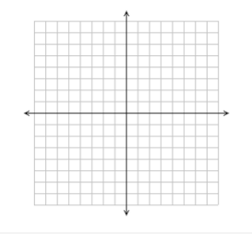
1. Sketch a graph that meets the given requirements listed below.
An Absolute function with Imaginary Roots (Non-Real)
A quadratic function with exactly 1 unique real roots.

Slide 3
525, 840, 1344, 2150.4, 3440.64,….
2. Consider the above sequence:
Is the sequence arithmetic or geometric? Explain your reasoning.

Slide 4


Real, Imaginary, or Complex numbers
Please simplify the expression and decide if it is a Real Number or a Complex Number
$\left(5\right)\left(i^{2}\right)$
$\left(4i\right)\left(3\right)$
$(4i)(3+3i)$
4. $\left(6\right)\left(4−13i\right)$
5. $\left(2i−3\right)\left(3i+4\right)$
6. $(i−5)(3i)$

Slide 5
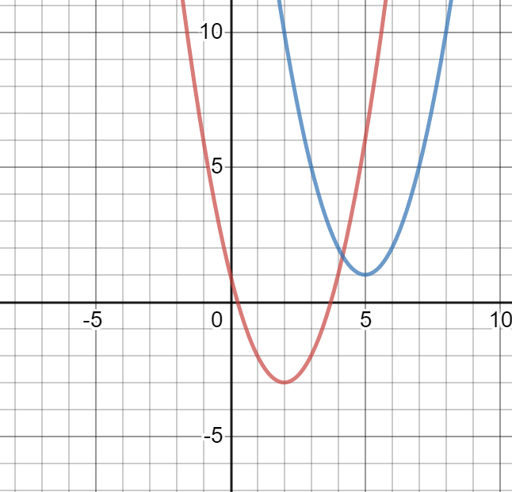
The graph for the functions $f\left(x\right)={(x−2)}^{2}−3$ (red) and $g\left(x\right)= {(x−5)}^{2}+1$ (Blue) are shown in the graph to the right. Describe the transformations of a parent function to obtain the graphs of f(x) and g(x).

Slide 6
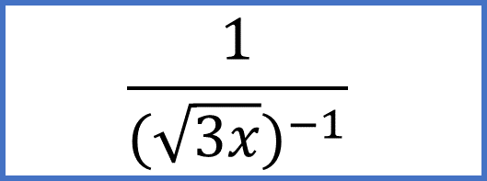
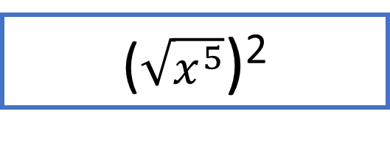
Match each expression on the left with an equivalent expression from the list on the right.
$$\sqrt[4]{x^{3}}$$
$$x^{−\frac{7}{8}}$$
$$\frac{1}{\sqrt[8]{x^{7}}}$$
$$x^{\frac{3}{4}}$$
($\sqrt{x^{5}}$)²
$$x^{5}; x≥0$$
$$\frac{1}{(\sqrt{3x})^{−1}}$$
$$\sqrt{3x}$$

Slide 7
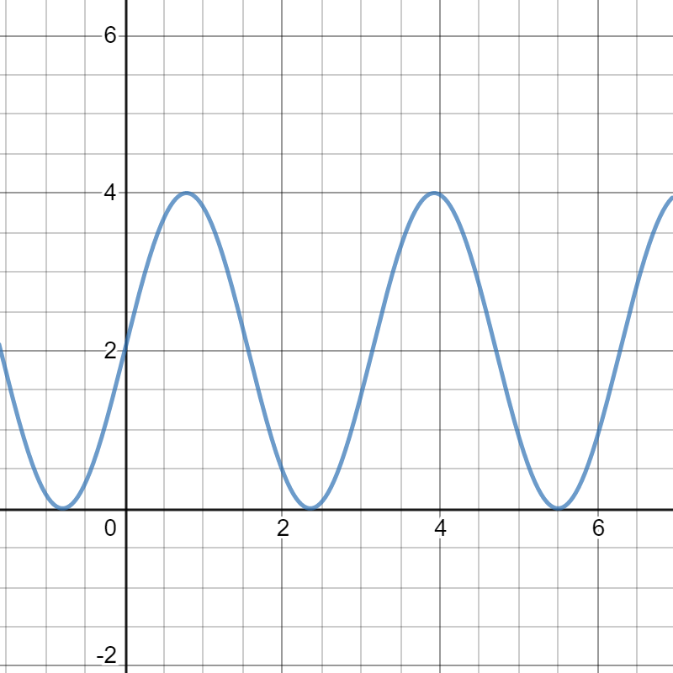
The graph to the left is a based on the equation y = 2sin 2x +2. Select all the statements that are true. A. The amplitude of the function is 2. B. The period of the function is $π$ C. The midline of the function is y = 4 D. The function increases over the interval 4 < x < 6

