Slide 1
G2a Parallelograms

Slide 2
Drill: Mon, 2/28
OBJ: SWBAT prove and apply properties of parallelograms.

Slide 3
What is a quadrilateral??
Notes:
What makes them special? What are some special quads? What are properties that some have but others do not?

Slide 4
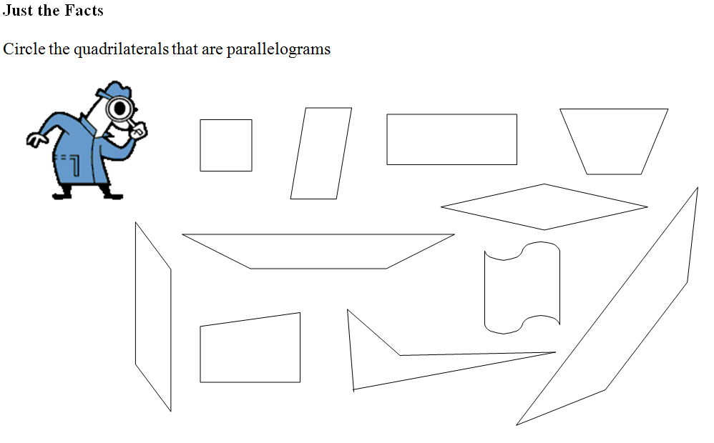

Slide 5
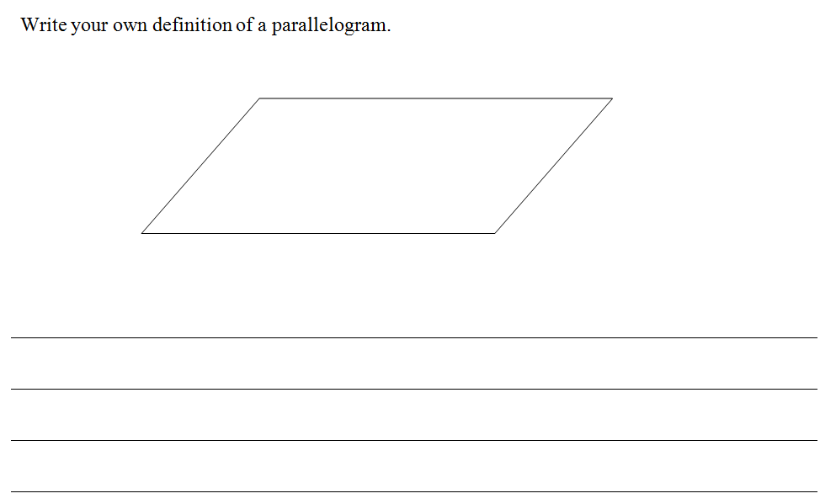

Slide 6
Formal Definition

Slide 7
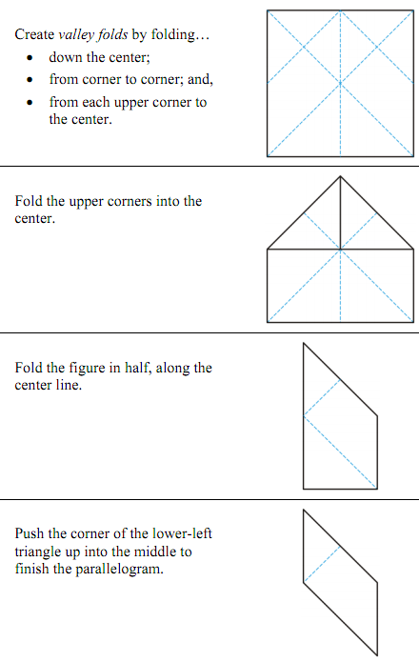
Parallelogram Foldable
With one piece of colored paper, follow the instructions at right…
Notes:
Mark congruent opposite angles and sides, and bisecting diagonals

Slide 8
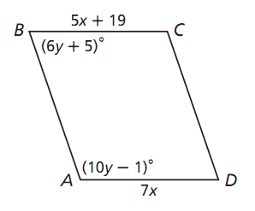
ABCD is a parallelogram
Find AD
Find angle B

Slide 9
In pairs…

Slide 10
Summary: Properties of Parallelograms
Property | Parallelogram | Rectangle | Rhombus | Square | Trapezoid | Kite
Opposite sides are parallel
Opposite sides are congruent
Opposite angles are congruent
Diagonals are congruent
Diagonals are perpendicular
Diagonals bisect each other
All angles are right angles.
All sides are congruent.

Slide 11
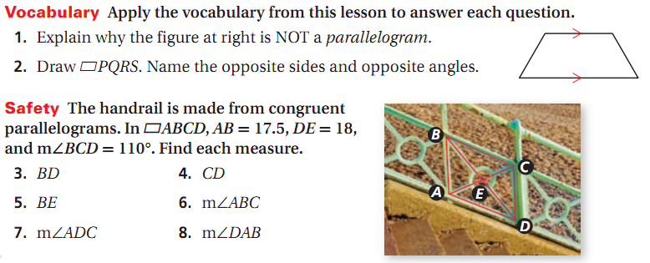
G2a Exit Ticket Name: ___________

Slide 12
G2a Exit Ticket Name: ___________

