Slide 1
G2b Parallelograms

Slide 2
Drill: Wed, 3/2
OBJ: SWBAT prove and apply properties of parallelograms.

Slide 3
Intro: Properties of Parallelograms
Property | Parallelogram | Rectangle | Rhombus | Square | Trapezoid | Kite
Opposite sides are parallel
Opposite sides are congruent
Opposite angles are congruent
Diagonals are congruent
Diagonals are perpendicular
Diagonals bisect each other
All angles are right angles.
All sides are congruent.

Slide 4
Parallelogram Proofs
What do we know about parallelograms??

Slide 5
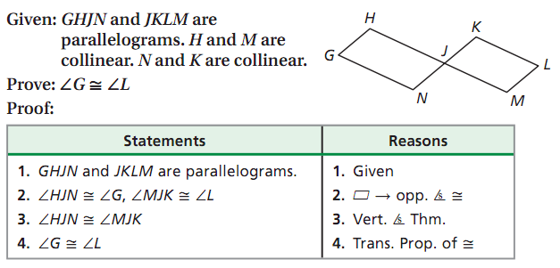
Example Proof

Slide 6
Proof Solution

