Slide 1
Wednesday, October 7, 2020
VOTING
CONNECTED, ACCEPTED, RESPECTED
Notes:
TEACHERS: TURN ON YOUR COMPUTER’S AUDIO THROUGHOUT THE PRESENTATION

Slide 2
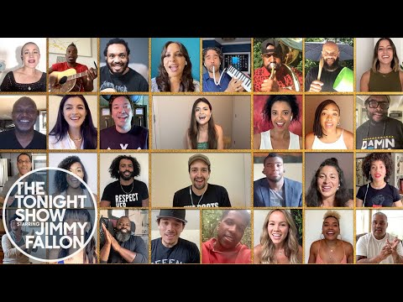
CONNECTED, ACCEPTED, RESPECTED
Notes:
Helpless from the play Hamilton
Video ends at 4 minutes 3 seconds
ENCOURAGE STUDENTS TO GET UP, MOVE, AND SING-A-LONG!!!
Here’s the link to the video in case it doesn’t display in the presentation: https://youtu.be/vo_s6PsVogI?t=18

Slide 3
VOTING
What’
CONNECTED, ACCEPTED, RESPECTED
Notes:
INTRO SLIDE
NO AUDIO

Slide 4
Voting in the United States
November 3rd
United States Citizens
Students will be able to explain:
why it’s important for U. S. citizens to exercise their right to vote
the voting process
CONNECTED, ACCEPTED, RESPECTED
Notes:
TEACHER: Ask students to read the slide aloud.
TEACHER SAY: “Tuesday, November 3rd is the date for the General Election for President of the United States. In order to vote, a person must be a United States citizen and be 18 years old on election day. How many of you are eligible to vote? How many of the people in your household are eligible or registered to vote? How many of them exercise their right to vote?” Pause for student responses to each question.

Slide 5
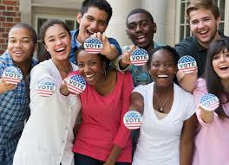
Why is it important for millennials to vote? What is the voting process?
Click on the picture to view the video
CONNECTED, ACCEPTED, RESPECTED
Notes:
TEACHERS SAY: “Why is it important for young citizens to vote? What is the voting process in the United States?” Pause for student responses. Then SAY: “The video will answer each of these questions.”
Teacher: Remind students to take notes in order to answer the questions at the end of the lesson for GRIT@OMHS GAMIFIED!
Click on the picture to access the video that is located on a website. Here’s the URL in case it doesn’t load from the presentation: https://www.wevideo.com/view/1857514441
Click play on the video to start it.
Video ends at 15 minutes 32 seconds

Slide 6
Let’s Discuss!
What does voting mean to you and your family?
What are some responsibilities associated with having the right to vote?
Why is the millennial vote so important? Do you think it’s more important than the baby boomer votes? Explain.
What are the steps necessary to register to vote?
CONNECTED, ACCEPTED, RESPECTED
Notes:
Teacher: Lead the collaborative discussion. Allow students to provide authentic, open-ended responses, and allow them to ask questions. Cultivate the environment of listening to every student voice.
TEACHER SAY:
“What does voting mean to you and your family?
What are some responsibilities associated with having the right to vote?
Why is the millennial vote so important? Do you think it’s more important than baby boomer voters? Explain.
What are the steps necessary to register to vote?”

Slide 7
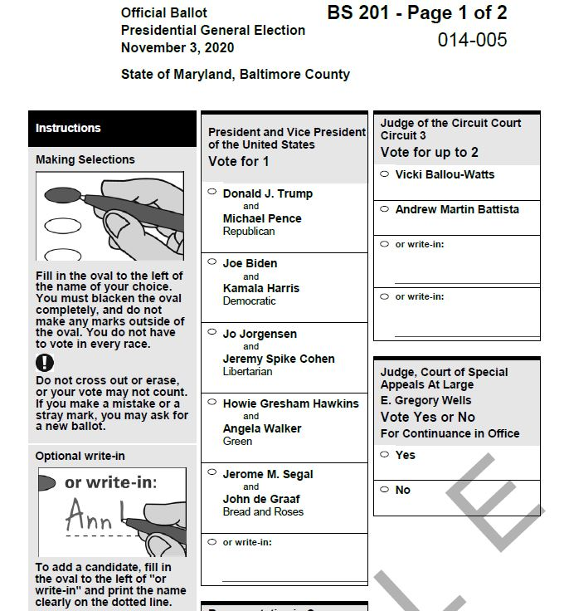
Let’s View A Sample Ballot
What do you recognize?
What’s unfamiliar?
What questions arise?
CONNECTED, ACCEPTED, RESPECTED
Notes:
TEACHER SAY: “Let’s view a sample ballot.” Click on the ballot to view the entire ballot as a pdf file.
TEACHER SAY: “What do you recognize? What’s unfamiliar?”
Lead the discussion extension and encourage students to participate. Share your experience as a voter and how it is your voice in the political arena. BE MOTIVATED so students will want to be motivated as well ☺

Slide 8
Voting Resources
After Voting Info
How Maryland Votes
Methods for Voting
How Can I Register to Vote?
Voter Registration Application – English
Voter Registration Application – Spanish
Tips to Protect Your Vote and Registration
CONNECTED, ACCEPTED, RESPECTED
Notes:
Teacher: Highlight a few of the voting resource links by clicking on them to open the document. Have a discussion with students about the content of the documents and how they and their family members can benefit from the information.

Slide 9
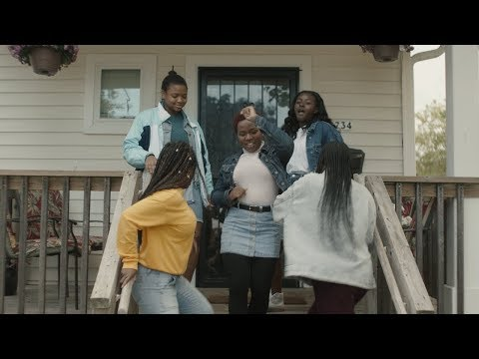
YOUR VOICE IS AWESOME!!! USE IT TO VOTE ON NOVEMBER 3RD
CONNECTED, ACCEPTED, RESPECTED
Notes:
TEACHER SAY: “YOUR VOICE IS AWESOME!!! USE IT TO VOTE ON NOVEMBER 3RD”
RESPECT: An anthem for young voters
Video begins automatically
Video ends at 1 minutes 30 seconds
Here’s the URL in case it doesn’t load from the presentation: https://youtu.be/N4Xzz4vPjAU
ENCOURAGE STUDENTS TO GET UP, MOVE, AND SING-A-LONG!!!

Slide 10
GRIT@OMHS Gamified
Are you competitive?
Love winning games?
Want to win a cool prize?
Click on the Google Form in the chat to enter GRIT@OMHS Gamified!
CONNECTED, ACCEPTED, RESPECTED
Notes:
TEACHER SAY: “Students who click on the purple Google Form icon can enter GRIT@OMHS GAMIFIED!!! Students will earn points by completing the Google Form! The student(s) who earns the highest points at the end of the semester will get a really cool prize!”
TEACHER SAY: “This presentation and all supporting documents will be posted for students in Schoology today.”
Paste the link to the Google Form in the chat: https://forms.office.com/Pages/ResponsePage.aspx?id=3cPDSRs_g0GOdLONSDpa_ZJlulQu2ItLmYbAp-8BfhNUMTIxWlY2UFJUU1RQWEE3M1g3MkoyWDJMRC4u

Slide 11
Thank you!
Ms. Campbell
Ms. Dillard
Mr. Blumenauer
Ms. Caffyn
Ms. Lubold and her dedicated students
GRIT Committee Members
Ms. Filosa
Period 1 Teachers
Most of all, thank you students! You are the reason our OMHS community is connected, accepted, and respected.
CONNECTED, ACCEPTED, RESPECTED
Notes:
TEACHER SAY: THANK YOU STUDENTS! You are the reason our OMHS community is connected, accepted, and respected.

