Slide 1
Medians and Altitudes
of Triangles
5-3
Warm Up
Lesson Presentation
Lesson Quiz
Holt McDougal Geometry
Holt Geometry

Slide 2
Warm Up
1. What is the name of the point where the angle bisectors of a triangle intersect?
Find the midpoint of the segment with the given endpoints.
2. (–1, 6) and (3, 0)
3. (–7, 2) and (–3, –8)
4. Write an equation of the line containing the points (3, 1) and (2, 10) in point-slope form.
incenter
(1, 3)
(–5, –3)
y – 1 = –9(x – 3)

Slide 3
Objectives
Apply properties of medians of a triangle.
Apply properties of altitudes of a triangle.

Slide 4
Vocabulary
median of a triangle
centroid of a triangle
altitude of a triangle
orthocenter of a triangle

Slide 5
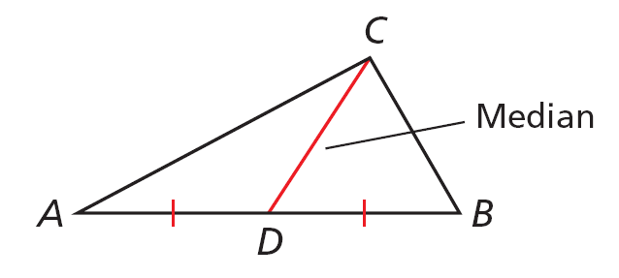
A median of a triangle is a segment whose endpoints are a vertex of the triangle and the midpoint of the opposite side.
Every triangle has three medians, and the medians are concurrent.

Slide 6
The point of concurrency of the medians of a triangle is the centroid of the triangle . The centroid is always inside the triangle. The centroid is also called
the center of gravity because it is the point where a triangular region will balance.

Slide 7
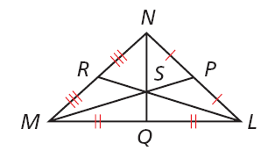
Example 1A: Using the Centroid to Find Segment Lengths
In ∆LMN, RL = 21 and SQ =4. Find LS.
Centroid Thm.
Substitute 21 for RL.
LS = 14
Simplify.

Slide 8
Example 1B: Using the Centroid to Find Segment Lengths
In ∆LMN, RL = 21 and SQ =4. Find NQ.
Centroid Thm.
NS + SQ = NQ
Seg. Add. Post.
Substitute NQ for NS.
Subtract from both sides.
Substitute 4 for SQ.
12 = NQ
Multiply both sides by 3.

Slide 9
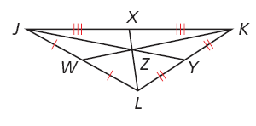
Check It Out! Example 1a
In ∆JKL, ZW = 7, and LX = 8.1. Find KW.
Centroid Thm.
Substitute 7 for ZW.
KW = 21
Multiply both sides by 3.

Slide 10
Check It Out! Example 1b
In ∆JKL, ZW = 7, and LX = 8.1. Find LZ.
Centroid Thm.
Substitute 8.1 for LX.
LZ = 5.4
Simplify.

Slide 11
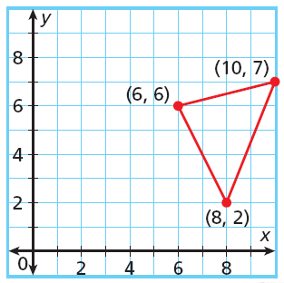
Example 2: Problem-Solving Application
A sculptor is shaping a triangular piece of iron that will balance on the point of a cone. At what coordinates will the triangular region balance?

Slide 12
Example 2 Continued
1
Understand the Problem
The answer will be the coordinates of the centroid of the triangle. The important information is the location of the vertices, A(6, 6), B(10, 7), and C(8, 2).
2
Make a Plan
The centroid of the triangle is the point of intersection of the three medians. So write the equations for two medians and find their point of intersection.

Slide 13
Example 2 Continued
3
Solve
Let M be the midpoint of AB and N be the midpoint of AC.
CM is vertical. Its equation is x = 8. BN has slope 1. Its equation is y = x – 3. The coordinates of the centroid are D(8, 5).

Slide 14
Example 2 Continued
4
Look Back
Let L be the midpoint of BC. The equation for AL is , which intersects x = 8 at D(8, 5).

Slide 15
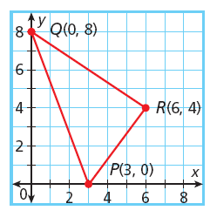
Check It Out! Example 2
Find the average of the x-coordinates and the average of the y-coordinates of the vertices of ∆PQR. Make a conjecture about the centroid of a triangle.

Slide 16
Check It Out! Example 2 Continued
The x-coordinates are 0, 6 and 3. The average is 3.
The y-coordinates are 8, 4 and 0. The average is 4.
The x-coordinate of the centroid is the average of the x-coordinates of the vertices of the ∆, and the y-coordinate of the centroid is the average of the y-coordinates of the vertices of the ∆.

Slide 17
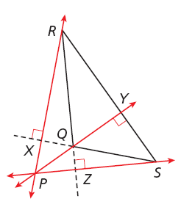
An altitude of a triangle is a perpendicular segment from a vertex to the line containing the opposite side.
Every triangle has three altitudes. An altitude can be inside, outside, or on the triangle.

Slide 18
In ΔQRS, altitude QY is inside the triangle, but RX and SZ are not. Notice that the lines containing the altitudes are concurrent at P. This point of concurrency is the orthocenter of the triangle.

Slide 19
Helpful Hint
The height of a triangle is the length of an altitude.

Slide 20
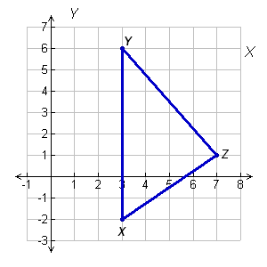
Example 3: Finding the Orthocenter
Find the orthocenter of ∆XYZ with vertices X(3, –2), Y(3, 6), and Z(7, 1).
Step 1 Graph the triangle.
X

Slide 21
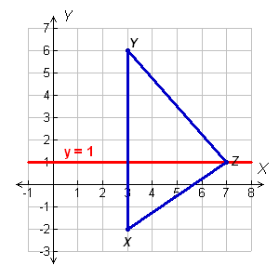
Example 3 Continued
Step 2 Find an equation of the line containing the altitude from Z to XY.
Since XY is vertical, the altitude is horizontal. The line containing it must pass through Z(7, 1) so the equation of the line is y = 1.

Slide 22
Example 3 Continued
Step 3 Find an equation of the line containing the altitude from Y to XZ.
The slope of a line perpendicular to XZ is . This line must pass through Y(3, 6).
Point-slope form.
Substitute 6 for y₁, for m, and 3 for x₁.
Distribute .
Add 6 to both sides.

Slide 23
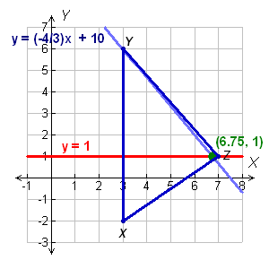
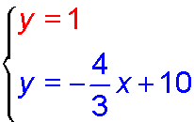
Example 3 Continued
Step 4 Solve the system to find the coordinates of the orthocenter.
Substitute 1 for y.
Subtract 10 from both sides.
6.75 = x
Multiply both sides by
The coordinates of the orthocenter are (6.75, 1).

Slide 24
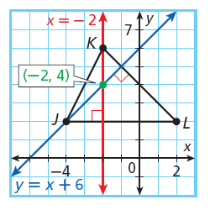
Check It Out! Example 3
Show that the altitude to JK passes through the orthocenter of ∆JKL.
An equation of the altitude to JK is
4 = 1 + 3
4 = 4 ✓
Therefore, this altitude passes through the orthocenter.

Slide 25
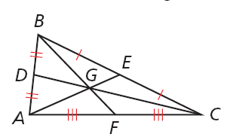
Lesson Quiz
Use the figure for Items 1–3. In ∆ABC, AE = 12, DG = 7, and BG = 9. Find each length.
1. AG
2. GC
3. GF
8
14
13.5
For Items 4 and 5, use ∆MNP with vertices M (–4, –2), N (6, –2) , and P (–2, 10). Find the coordinates of each point.
4. the centroid
5. the orthocenter
(0, 2)

