Slide 1
Inverse of a Function
Unit 3 (Algebra II)

Slide 2
Goals:
Find inverses of relations
Explore inverses of functions
An Inverse relation switches the input and output values of the original relation.
Original ordered pair is (a, b), the inverse is. (b, a)
Example: apples in; lemons out to lemons in; apples out

Slide 3
Finding Inverses of Relations/Functions
* When you have a set of points or points on a graph if you want to find the inverse of the relation/function you simply SWITCH the “x” and the “y” coordinates. (EXAMPLE BELOW)
Original set of points:
Inverse set of points:

Slide 4
Example 8-1a
Geometry The ordered pairs of the relation {(1, 3), (6, 3), (6, 0), (1, 0)} are the coordinates of the vertices of a rectangle. Find the inverse of this relation and determine whether the resulting ordered pairs are also the coordinates of the vertices of a rectangle.
To find the inverse of this relation, reverse the coordinates of the ordered pairs. The inverse of the relation is {(3, 1), (3, 6), (0, 6), (0, 1)}.

Slide 5
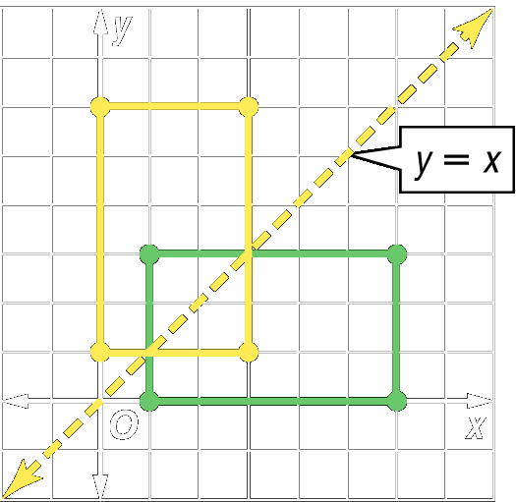
Example 8-1b
Graphs of the Function and its Inverse: Plotting the points shows that the ordered pairs also describe the vertices of a rectangle.
Notice that the graph of the relation and the inverse are reflections over the graph of y = x.

Slide 6
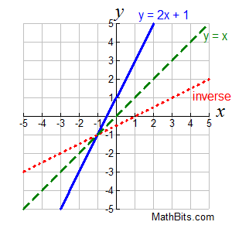
Graph the function and its inverse
x | f(x)
-2 | -3
-1 | -1
0 | 1
1 | 3
2 | 5
x | f ⁻¹ (x)
-3 | -2
-1 | -1
1 | 0
3 | 1
5 | 2
Function
Inverse Function

Slide 7
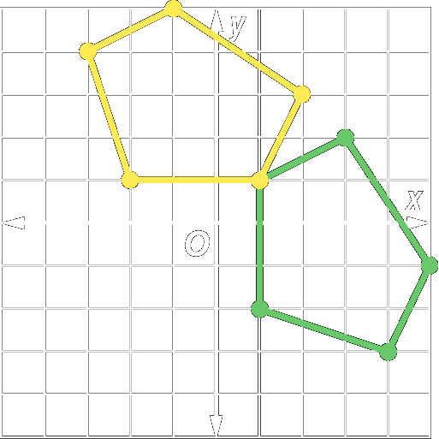
Example 8-1c
Geometry The ordered pairs of the relation {(–3, 4), (–1, 5), (2, 3), (1, 1), (–2, 1)} are the coordinates of the vertices of a pentagon. Find the inverse of this relation and determine whether the resulting ordered pairs are also the coordinates of the vertices of a pentagon.
Answer: {(4, –3), (5, –1), (3, 2), (1, 1), (1, –2)} These ordered pairs also describe the vertices of a pentagon.

