Slide 1
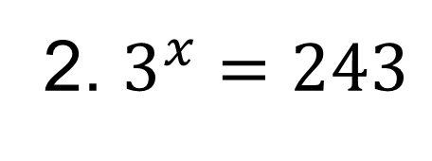
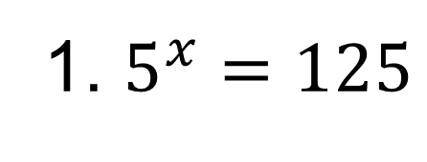
Drill
Find the x-value for each of the following that would make the equations true.
1. $5^{x}=125$
2. $3^{x}=243$

Slide 2
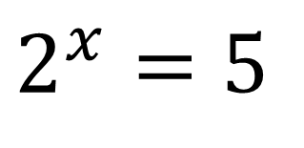
What about this one?
$$2^{x}=5$$
In order to solve problems like that we must use logarithms. Logarithms are the inverses of exponential functions.

Slide 3
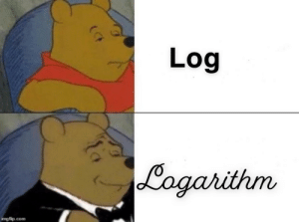
Today we will be able to rewrite exponential equations as logarithms and vice versa

Slide 4








Can you find the pattern used to rewrite each of the problems on the left as logs?
$$3^{2}=9$$
$$\log_{3}{9}=2$$
$$4^{1/2}=2$$
$$\log_{4}{2}=\frac{1}{2}$$
$$2^{3}=8$$
$$\log_{2}{8}=3$$
$$3^{−4}=\frac{1}{81}$$
$$\log_{3}{\frac{1}{81}}=−4$$

Slide 5

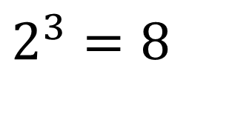
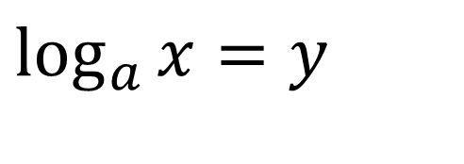
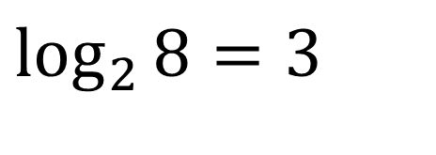
Logarithms
Logarithmic Form
Exponential Form
$$\log_{2}{8}=3$$
$$2^{3}=8$$
$$\log_{a}{x}=y$$
$$a^{y}=x$$
READ “log base a of x is y”

Slide 6


COMPLETE THE TABLE
Logarithmic Form
Exponential Form
$$\log_{4}{16}=2$$
$$64^{1/2}=8$$
$$\log_{5}{\frac{1}{25}}=−2$$

Slide 7



COMPLETE THE TABLE
Logarithmic Form
Exponential Form
$${\frac{1}{4}}^{−4}=256$$
$$\log_{6}{216}=3$$
$$c^{4}=h$$

