Slide 1
9-5
Effects of Changing
Dimensions Proportionally
Warm Up
Lesson Presentation
Lesson Quiz
Holt McDougal Geometry
Holt Geometry

Slide 2
Warm Up
Find the area of each figure. Give exact answers, using π if necessary.
1. a square in which s = 4 m
2. a circle in which r = 2 ft
3. ABC with vertices A(–3, 1), B(2, 4), and C(5, 1)
16 m²
4π ft²
12 units²

Slide 3
Objectives
Describe the effect on perimeter and area when one or more dimensions of a figure are changed.
Apply the relationship between perimeter and area in problem solving.

Slide 4
In the graph, the height of each DVD is used to represent the number of DVDs shipped per year.
However as the height of each DVD increases, the width also increases, which can create a misleading effect.

Slide 6
Effects of Changing One Dimension
Effects of Changing Dimensions Proportionally
Effects of Changing Area

Slide 7
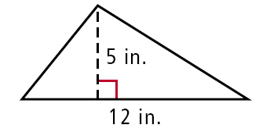
Example 1: Effects of Changing One Dimension
Describe the effect of each change on the area of the given figure.
The height of the triangle is multiplied by 6.
original dimensions: multiply the height by 6:
= 30 in² = 180 in²
Notice that 180 = 6(30). If the height is multiplied by 6, the area is also multiplied by 6.

Slide 8
Example 1B: Effects of Changing One Dimension
The diagonal SU of the kite with vertices R(2, 2), S(4, 0), T(2, –2), and U(–5,0) is multiplied by .
original dimensions:

Slide 9
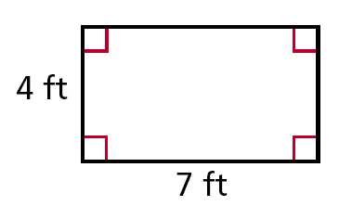
Check It Out! Example 1
The height of the rectangle is tripled. Describe the effect on the area.
original dimensions:
A = bh = (7)(4)
= 28 ft²
triple the height:
Notice that 84 = 3(28). If the height is multiplied by 3, the area is tripled.
A = bh = (7)(12)
= 84 ft²

Slide 10
Helpful Hint
If the radius of a circle or the side length of a square is changed, the size of the entire figure changes proportionally.

Slide 11
Example 2A: Effects of Changing Dimensions Proportionally
Describe the effect of each change on the perimeter or circumference and the area of the given figures.
The base and height of a rectangle with base 4 ft and height 5 ft are both doubled.

Slide 12
Example 2A Continued
original dimensions:
P = 2(4) + 2(5) = 18 ft
P = 2b + 2h
A = (4)(5) = 20 ft²
A = bh
dimensions doubled:
P = 2(8) + 2(10) = 36 ft
2(4) = 8; 2(5) = 10
A = (8)(10) = 80 ft²
The perimeter is multiplied by 2.
2(18) = 38
The area is multiplied by 2², or 4.
4(20) = 80

Slide 13
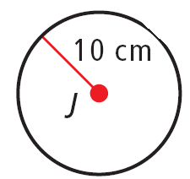
Example 2B: Effects of Changing Dimensions Proportionally
The radius of J is multiplied by .
original dimensions:
C = 2π(10) = 20π cm
C = 2πr
A = π(10)² = 100π cm²
A = πr²
dimensions multiplied by .
C = 2π(2) = 4π cm
A = π(2)² = 4π cm²

Slide 14
Example 2B Continued
The circumference is multiplied by .
The area is multiplied by

Slide 15
Check It Out! Example 2
The base and height of the triangle with vertices P(2, 5), Q(2, 1), and R(7, 1) are tripled. Describe the effect on its area and perimeter.
original dimensions:
The perimeter is tripled, and the area is multiplied by 9.
dimensions tripled:

Slide 16
When the dimensions of a figure are changed proportionally, the figure will be similar to the original figure.

Slide 18
Business Application Using Tiles

Slide 19
Example 3A: Effects of Changing Area
A circle has a circumference of 32π in. If the area is multiplied by 4, what happens to the radius?
The original radius is
and the area is A = πr² = 256π in². If the area is multiplied by 4, the new area is 1024π in².
πr² = 1024π
Set the new area equal to πr².
r² = 1024
Divide both sides by π.
Take the square root of both sides and simplify.
r = √1024 = 32
Notice that 32π = 2(16π). The radius is multiplied by 2.

Slide 20
Example 3B: Effects of Changing Area
An equilateral triangle has a perimeter of 21m. If the area is multiplied by , what happens to the side length?
Let s be a side length of an equilateral triangle. Draw a segment that bisects the top angle and the base to form a 30-60-90 triangle.
.

Slide 21
Example 3B Continued
The length of each side is , and the area
of the equilateral triangle is
If the area is multiplied by , the new area is

Slide 22
Example 3B Continued

Slide 23
Check It Out! Example 3
A square has a perimeter of 36 mm. If the area is multiplied by , what happens to the side length?

Slide 24
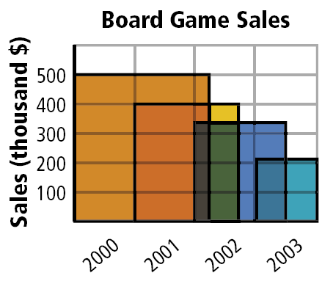
Example 4: Entertainment Application
Explain why the graph is misleading.
The height of the bar representing sales in 2000 is about 2.5 times the height of the bar representing sales in 2003.

Slide 25
Example 4 Continued
This means that the area of the bar multiplied by about 2.5², or 6.25, so the area of the larger bar is about 6.25 times the area of the smaller bar.
The graph gives the misleading impression that the number of sales in 2003 decreased by 6 times the sales in 2000, but the decrease was actually closer to 2.5 times.

Slide 26
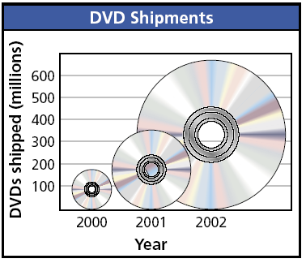
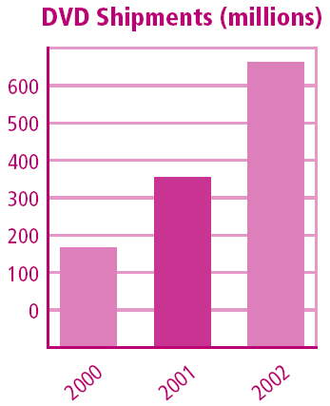
Check It Out! Example 4
Use the information in example 4 to create a version of the graph that is not misleading.

Slide 27
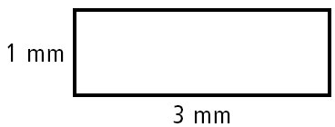
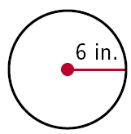
Lesson Quiz: Part I
Describe the effect of each change on the area of the given figure.
1. The base length of the rectangle is multiplied by 8.
The area is multiplied by 8.
2. The radius of the circle is tripled.
The area is multiplied by 9.

Slide 28
Lesson Quiz: Part II
3. A square has an area of 49 cm². If the area is quadrupled, what happens to the side length?
The side length is doubled.
4. Rob had a 10 ft by 12 ft wall painted. For a wall twice as wide, the painter charged him twice as much. Is this reasonable? Explain.
Yes; the second wall has twice the area of the first wall.

