Slide 1

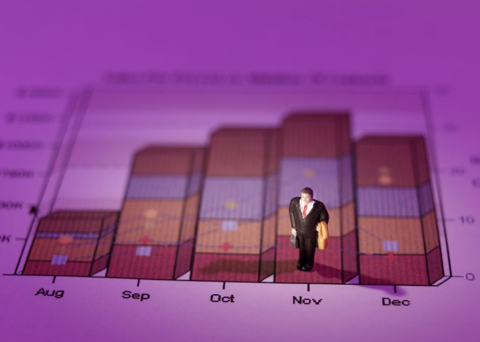


Math 125
Stats Starts Here

Slide 2



Stats Starts Here
According to 100% of people surveyed, this is the greatest class ever offered in college.
List of people surveyed: ME

Slide 3
What Are Data?
Data can be numbers, record names, or other labels.
Not all data represented by numbers are numerical data (e.g., 1=male, 2=female).
Data are useless without their context…

Slide 4

The Exam (FICTIONAL DATA)
The class average last semester was a 94 on the final exam.
It was out of 500 points!!!!
A group of individuals averaged a 78% on an algebra exam……
The group of individuals were 7 year olds…
Or…the group of individuals were Algebra teachers!

Slide 5

Dream Job
The average salary at a company that has 25 employees is $8,500,000 per year.
Would you like to be hired by this company?
The CEO makes
$212,400,000 per year…
The other 24 employees
Average $4,166.67 per/year

Slide 6
What and Why (cont.)
A categorical (or qualitative) variable names categories and answers questions about how cases fall into those categories.
  Categorical examples: sex, race, ethnicity
A quantitative variable is a measured variable (with units) that answers questions about the quantity of what is being measured.
  Quantitative examples: income ($), height (inches), weight (pounds)

Slide 7
What and Why (cont.)
Example: In a student evaluation of instruction at a large university, one question asks students to evaluate the statement “The instructor was generally interested in teaching” on the following scale: 1 = Disagree Strongly; 2 = Disagree; 3 = Neutral; 4 = Agree; 5 = Agree Strongly.
Question: Is interest in teaching categorical or quantitative?

Slide 8
Examples
Q
Q
Q
C
C
Q
Q
C
C
Q
Time it takes to get to school
Height in inches
Number of shoes owned
Gender
Hair color
Age of Oscar winners
Temperature of a cup of coffee
Type of pain medication
Jellybean flavors
Hours on Social Media

Slide 9
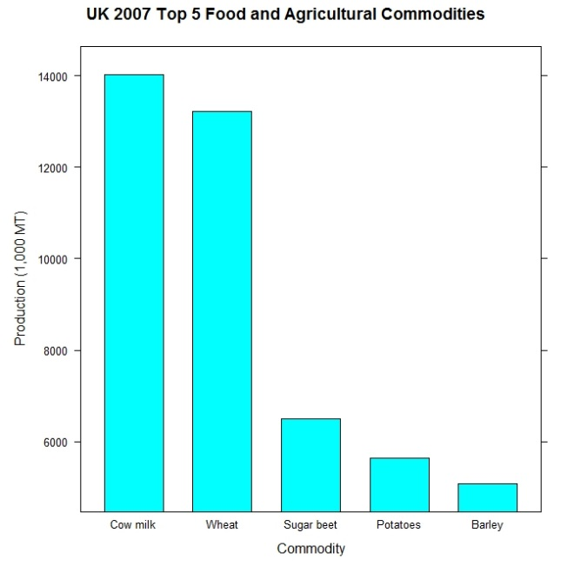
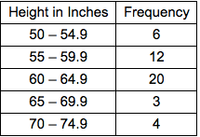
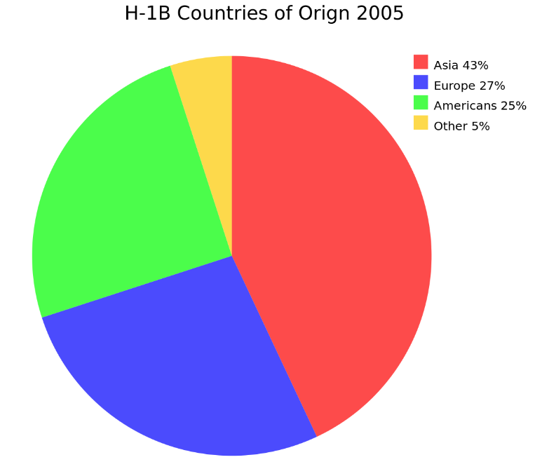
Types of Graphs for Categorical Data
Bar Charts
Pie Charts
Frequency Table (Two-Way Table)

Slide 10
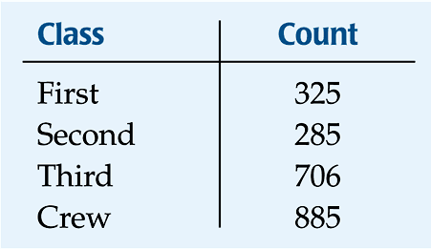
Frequency Tables: Making Piles
We can “pile” the data by counting the number of data values in each category of interest.
We can organize these counts into a frequency table, which records the totals and the category names.

Slide 11
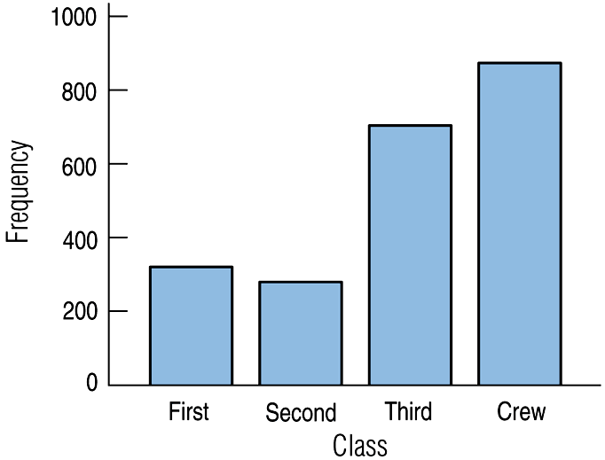
Bar Charts
A bar chart displays the distribution of a categorical variable, showing the counts for each category next to each other for easy comparison.
A bar chart stays true to the area principle.
Thus, a better display for the ship data is:

Slide 12
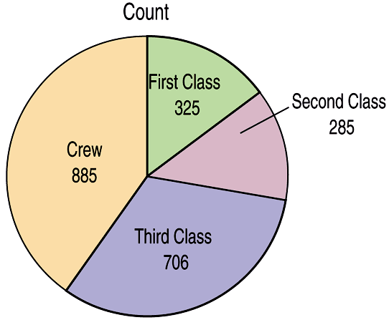
Pie Charts
When you are interested in parts of the whole, a pie chart might be your display of choice.
Pie charts show the whole group of cases as a circle.
They slice the circle into pieces whose size is proportional to the fraction of the whole in each category.

Slide 13
Types of Graphs (Quantitative Data)
Histograms
Class Intervals
Frequency Polygon

Slide 14
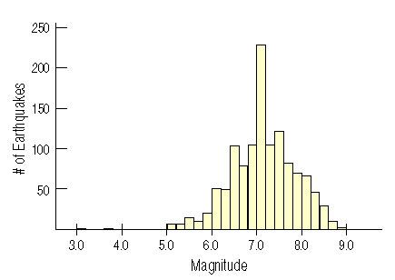
Histograms: Earthquake Magnitudes
A histogram breaks up the entire span of values covered by the quantitative variable into equal-width piles called bins.
A histogram plots the bin counts as the heights of bars. (like a bar chart)
Here is a histogram of earthquake magnitudes

Slide 15
Class
Intervals

Slide 16
Frequency Polygon

