Slide 1

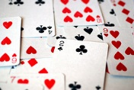

Basic Concepts of Probability (2.2)

Slide 2
Dealing with Random Phenomena
A random phenomenon is a situation in which we know what outcomes could happen, but we don’t know which particular outcome did or will happen.
In general, each occasion upon which we observe a random phenomenon is called a trial.
At each trial, we note the value of the random phenomenon, and call it an outcome.
When we combine outcomes, the resulting combination is an event.
The collection of all possible outcomes is called the sample space.

Slide 3
The Law of Large Numbers
First a definition . . .
When thinking about what happens with combinations of outcomes, things are simplified if the individual trials are independent.
  Roughly speaking, this means that the outcome of one trial doesn’t influence or change the outcome of another.
  For example, coin flips are independent.

Slide 4
The Law of Large Numbers (cont.)
The Law of Large Numbers (LLN) says that the long-run relative frequency of repeated independent events gets closer and closer to a single value.
We call the single value the probability of the event.
Because this definition is based on repeatedly observing the event’s outcome, this definition of probability is often called empirical probability.

Slide 5
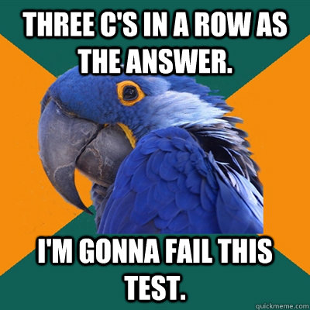
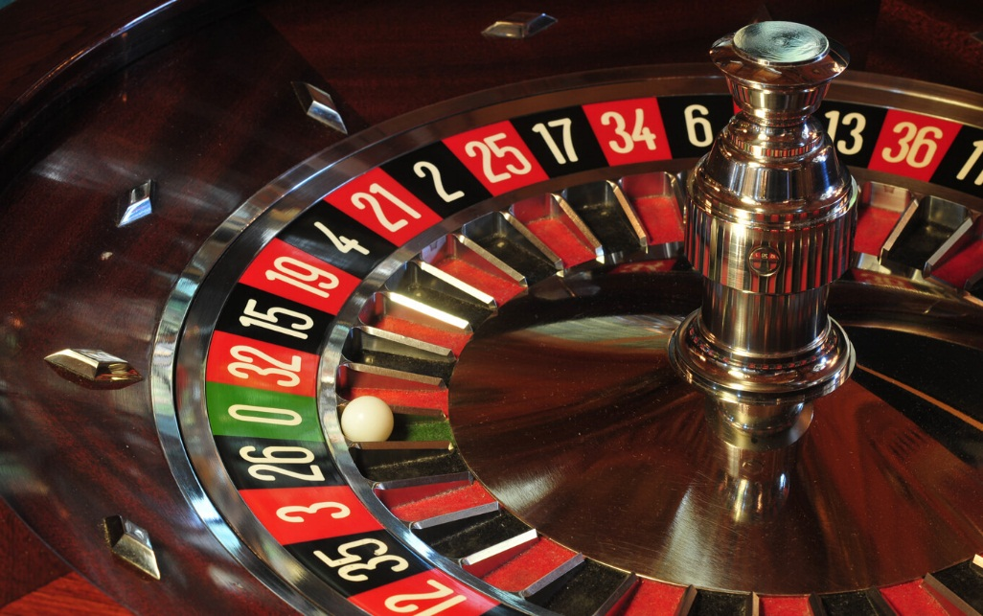
The Nonexistent Law of Averages
The LLN says nothing about short-run behavior.
Relative frequencies even out only in the long run, and this long run is really long (infinitely long, in fact).
The so called Law of Averages (that an outcome of a random event that hasn’t occurred in many trials is “due” to occur) doesn’t exist at all.

Slide 6
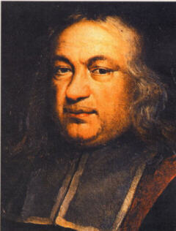
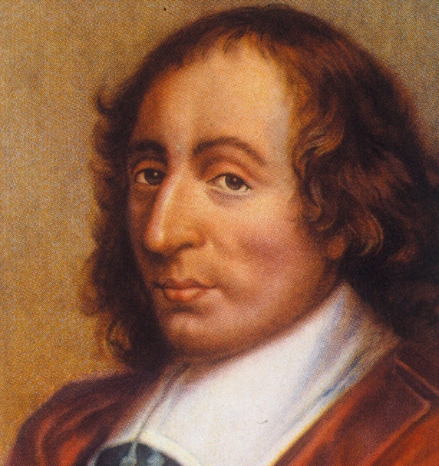
Foundation of Probability
The onset of probability as a useful science is primarily attributed to Blaise Pascal (1623-1662) and Pierre de Fermat (1601-1665). While contemplating a gambling problem posed by Chevalier de Mere in 1654, Blaise Pascal and Pierre de Fermat laid the fundamental groundwork of probability theory, and are thereby accredited the fathers of probability.
Chances of a Lifetime
(16 minutes in)

Slide 7

Modeling Probability (cont.)
The probability of an event is the number of outcomes in the event divided by the total number of possible outcomes.
P(A) =
# of outcomes in A
# of possible outcomes

Slide 8
Example
A bag contains 5 red, 4 blue, 3 green and 8 orange marbles.
What is the probability of selecting a green marble?

Slide 9
Formal Probability
Two requirements for a probability:
  A probability is a number between 0 and 1.
  For any event A, 0 ≤ P(A) ≤ 1.
Probability Assignment Rule:
  The probability of the set of all possible outcomes of a trial must be 1.
  P(S) = 1 (S represents the set of all possible outcomes.)

Slide 10
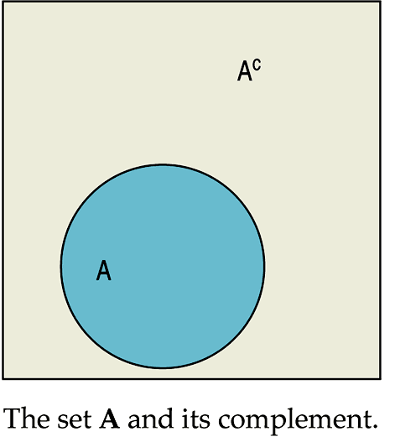
Formal Probability (cont.)
Complement Rule:
  The set of outcomes that are not in the event A is called the complement of A, denoted A^{C}.
  The probability of an event occurring is 1 minus the probability that it doesn’t occur: P(A) = 1 – P(A^{C})

Slide 11
Example
A bag contains 5 red, 4 blue, 3 green and 8 orange marbles.
What is the probability of selecting a green, blue or red marble?

Slide 12
Formal Probability
Multiplication Rule:
  For two independent events A and B, the probability that both A and B occur is the product of the probabilities of the two events.
  P(A and B) = P(A) x P(B), provided that A and B are independent.

Slide 13
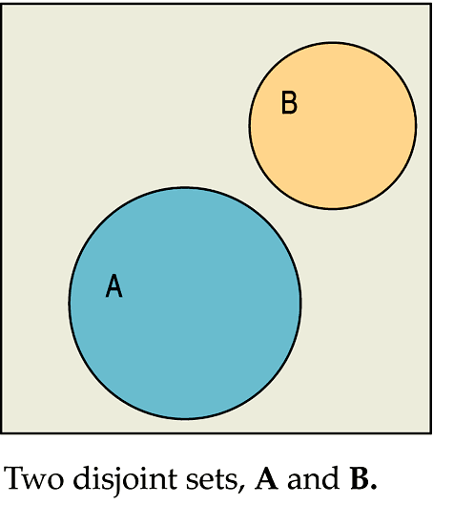
Formal Probability (cont.)
Addition Rule:
  Events that have no outcomes in common (and, thus, cannot occur together) are called disjoint (or mutually exclusive).

Slide 14
Formal Probability (cont.)
Addition Rule (cont.):
  For two disjoint events A and B, the probability that one or the other occurs is the sum of the probabilities of the two events.
  P(A or B) = P(A) + P(B), provided that A and B are disjoint.

Slide 15
Example
Using the whole numbers from 1 – 20.
What is the probability of selecting a number less than 7 OR greater than 15?

Slide 16
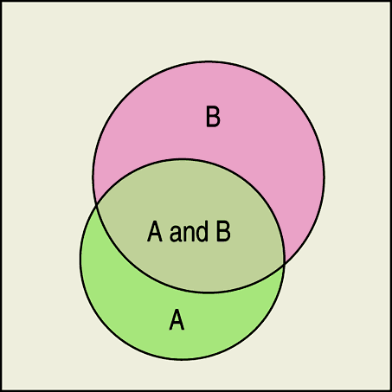
General Addition Rule:
  For any two events A and B,
  P(A or B) = P(A) + P(B) – P(A and B)
  (On the Formula Sheet)
The following Venn diagram shows a situation in which we would use the general addition rule:

Slide 17
Conditional Probabilities
To find the probability of the event B given the event A, we restrict our attention to the outcomes in A. We then find in what fraction of those outcomes B also occurred.
(On the Formula Sheet)
Note: P(A) cannot equal 0, since we know that A has occurred.

Slide 18
The General Multiplication Rule
When two events A and B are independent, we can use the multiplication rule for independent events:
P(A and B) = P(A) x P(B)
However, when our events are not independent, this earlier multiplication rule does not work. Thus, we need the General Multiplication Rule.

Slide 19
The General Multiplication Rule (cont.)
We encountered the general multiplication rule in the form of conditional probability.
Rearranging the equation in the definition for conditional probability, we get the General Multiplication Rule:
  For any two events A and B,
  P(A and B) = P(A) x P(B|A)
  or
  P(A and B) = P(B) x P(A|B)

Slide 21
For example – a fair coin is spun twice
1st
2nd
H
HH
H
T
HT
Possible Outcomes
H
TH
T
T
TT

Slide 22
Attach probabilities
1st
2nd
H
HH
P(H,H)=½x½=¼
½
½
H
½
T
HT
P(H,T)=½x½=¼
½
H
TH
P(T,H)=½x½=¼
½
T
½
T
TT
P(T,T)=½x½=¼
INDEPENDENT EVENTS – 1st spin has no effect on the 2nd spin

Slide 23
Calculate probabilities
1st
2nd
*
H
HH
P(H,H)=½x½=¼
½
½
H
½
*
T
HT
P(H,T)=½x½=¼
½
H
TH
*
P(T,H)=½x½=¼
½
T
½
T
TT
P(T,T)=½x½=¼
Probability of at least one Head?

Slide 24
For example – 10 coloured beads in a bag – 3 Red, 2 Blue, 5 Green. One taken, colour noted, returned to bag, then a second taken.
1st
2nd
R
RR
B
RB
R
G
RG
R
BR
INDEPENDENT EVENTS
B
B
BB
G
BG
R
GR
G
B
GB
G
GG

Slide 25
Probabilities
1st
2nd
R
RR
P(RR) = 0.3x0.3 = 0.09
0.3
0.2
B
RB
P(RB) = 0.3x0.2 = 0.06
R
0.3
0.5
G
RG
P(RG) = 0.3x0.5 = 0.15
R
BR
P(BR) = 0.2x0.3 = 0.06
0.3
0.2
0.2
B
B
BB
P(BB) = 0.2x0.2 = 0.04
0.5
G
BG
P(BG) = 0.2x0.5 = 0.10
0.3
R
GR
P(GR) = 0.5x0.3 = 0.15
0.5
G
0.2
B
GB
P(GB) = 0.5x0.2 = 0.10
0.5
G
GG
P(GG) = 0.5x0.5 = 0.25
All ADD UP to 1.0

Slide 26
Choose a meal
Pudding
Ice Cream 0.45
Apple Pie 0.55
Main course
Salad 0.2
Egg & Chips 0.5
Pizza 0.3
IC
P(S,IC) = 0.2 x 0.45 = 0.09
0.45
S
0.55
0.2
AP
P(S,AP) = 0.2 x 0.55 = 0.110
0.45
IC
P(E,IC) = 0.5 x 0.45 = 0.225
0.5
E
0.55
AP
P(E,AP) = 0.5 x 0.55 = 0.275
0.3
IC
P(P,IC) = 0.3 x 0.45 = 0.135
P
0.45
0.55
AP
P(P,AP) = 0.3 x 0.55 = 0.165

Slide 27
Basic Counting Rule
Example: If you have 5 Shirts, 4 Pairs of Pants and 3 Pairs of Shoes. You can make (5)(4)(3) = 60 different outfits.

Slide 28
Factorial
Factorial means you multiply by all the whole numbers less than that number down to one.

Slide 29
Permutations
Example: I have 9 paintings and have room to display 4 of them at a time on my wall. How many different ways can I do this?

Slide 30
Combinations

Slide 31
Definition
Let’s say that a game gives payoffs
a₁, a₂,…, a_{n} with probabilities
p₁, p₂,… p_{n}.
* The expected value (or expectation) E of this game is
E = a₁p₁ + a₂p₂ + … + a_{n}p_{n}.
Think of expected value as a long term average.

Slide 32
American Roulette
At a roulette table in Las Vegas, you will find the following numbers 1 – 36, 0, 00. There are 38 total numbers.
We place a $1 chip on 7. If the ball lands in the 7 slot we win $35 (net winnings). If the ball lands on any other number we lose our $1 chip.
What is the expectation of this bet?
To answer this question we need to know the probability of winning and losing.
The probability of winning is 1/38. The probability of losing is 37/38.
So the expectation is E = $35(1/38) + (-$1)(37/38) =
(35-37)/38 = -2/38 = -$0.053
What this tells us is that over a long time for every $1 we bet we will lose $0.053.
This is an example of a game with a negative expectation. One should not play games when the expectation is negative.

Slide 33
Example 2
On the basis of previous experience a librarian knows that the number of books checked out by a person visiting the library has the following probabilities:
# of books | 0 | 1 | 2 | 3 | 4 | 5
Probability | 0.15 | 0.35 | 0.25 | 0.15 | 0.05 | 0.05
Find the expected number of books checked out
by a person.
E = 0(0.15)+1(0.35)+2(0.25)+3(0.15)+4(0.05)+5(0.05)
E = 0 + 0.35 + 0.50 + 0.45 + 0.20 + 0.25
E = 1.75

