Slide 1
Order of operations
CCBC Math 081
Lesson 1.2

Slide 2
In our lives and in MATH, we need to do things in a certain order to make sure they turn out right.
That is where the ORDER OF OPERATIONS come into play!

Slide 3
There is a lot going on here…where do we begin?
Left to Right
10 + 8 x 6 ÷ 2²
Order of Operations
10 + 8 x 6 ÷ 2²

Slide 4
Why use Order of Operations?
When an expression has more than one operation, you must know which order to solve them in to arrive at the correct answer.
To make sure everyone gets the same answer, we use the order of operations.

Slide 5
Order of Operations
Definition
The order of operations are a specific set of steps to follow in multi-step problems to ensure that everyone gets the same final answer.

Slide 6
Important Vocabulary
A numerical expression is a mathematical phrase that includes only numbers and operation symbols.
When you simplify a numerical expression, you are finding its value.
Numerical Expressions | 4 + 8 ÷ 2 × 6 | 371 – 203 + 2 | 5,006 × 19

Slide 7
Four Rules for Order of Operations
1. Perform calculations inside parentheses first
2. Solve Exponents
3. Perform all multiplication & division from left to right…
Multiplication and Division are married ☺
4. Perform all addition and subtraction from left to right
Addition and Subtraction are married ☺

Slide 8
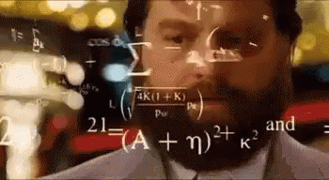
Please Excuse My Dear Aunt Sally
P
Parentheses ( )
E
Exponents 4³
M
D
Multiply x
Divide ÷
A
S
Add +
Subtract -

Slide 9
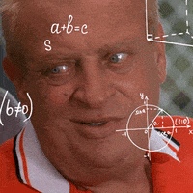
Please Excuse My Dear Aunt Sally
Parentheses ( )
Always do parentheses 1st.

Slide 10
Please Excuse My Dear Aunt Sally
Exponents 4³
Always do Exponents 2nd.

Slide 11
Exponential Expressions
Power
Exponent
Exponential Expression
Base
Base: The number that is repeatedly multiplied.
Exponent: A symbol written to the upper right of a base number that indicates how many times to use the base as a factor.
Evaluate:
Find the value.

Slide 12

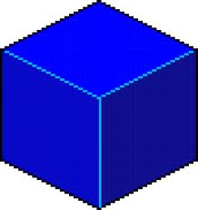
Exponential Expressions
5 squared
5
= 25
5
5 cubed
= 125
5
5
5

Slide 13
Exponential Expressions
 | Base | Exponent | Evaluate
Opposite of
Parentheses are important!!
No difference
Watch for negative numbers raised to an EVEN power!!!

Slide 14
Please Excuse My Dear Aunt Sally
Multiply x
Divide ÷
Next, solve all multiplication & division from left to right

Slide 15
Please Excuse My Dear Aunt Sally
Add +
Subtract -
Finally, end your problem with addition and subtraction 4th, from left to right.

Slide 16
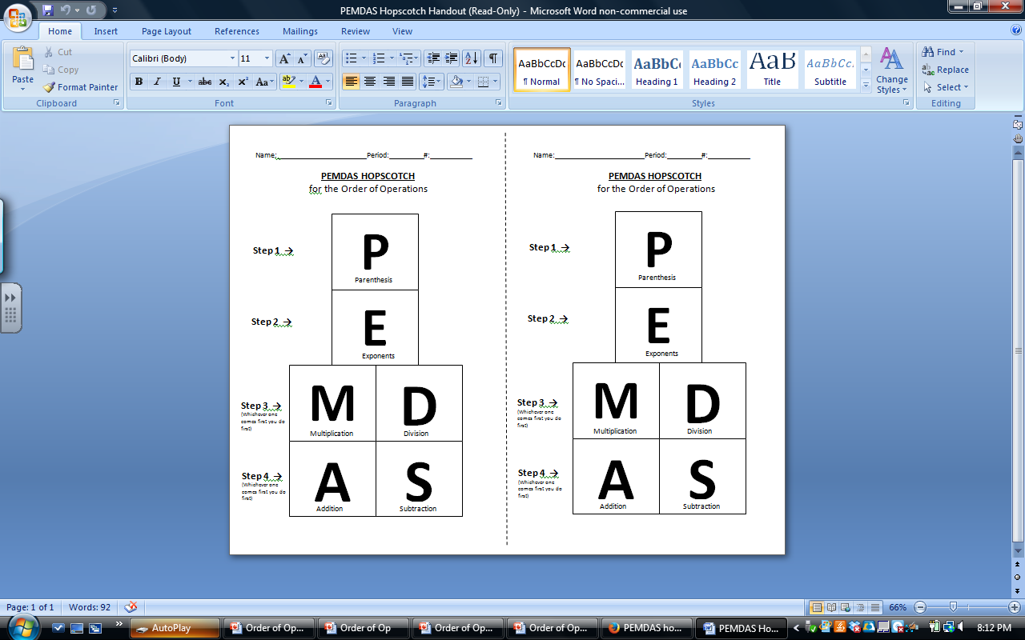
PEMDAS HOPSCOTCH

Slide 17
COMMON ERROR!
Be Careful!
PEMDAS is only FOUR STEPS!
P – E – MD – AS
It is NOT six steps!
P – E – M – D – A – S

Slide 18
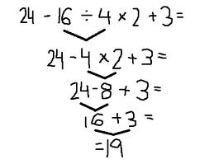
IMPORTANT!!
ALWAYS UNDERLINE the portion of the problem you are solving and BRING DOWN the remaining parts of the problem!
Your problem should look like an upside down triangle!!

Slide 19
Example 1
11 + (15 - 3) x 2

Slide 20
Example 1
11 + (15 - 3) x 2

Slide 21
Example 2
6² - 13 + 5 x 2

Slide 22
Example 3
50 – ( 16 ÷ 2² ) + 3

Slide 23
Example 4
60 ÷12 + 4⁰ x ( 3 x 5)

Slide 24
Try on your own…
5 + 18 ÷ 3² - 1
3 x ( 12÷ 4) - 5⁰

Slide 25
Two More on Your Own
4² + 48 ÷ (10 – 4)
9 ÷ 3 + 6 x 2³

Slide 26
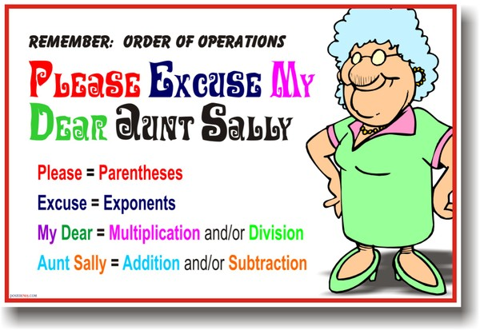
Order of Operations
PEMDAS
Also roots
Left to right!!!
Parentheses = Grouping Symbols
Grouping Symbols???
No
( )
[ ]
Yes

Slide 27
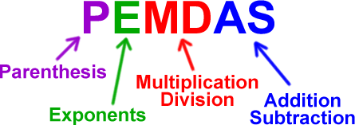

Slide 28
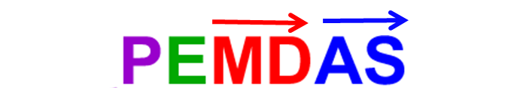

Slide 31
Undefined

Slide 33
Simplify using order of operations.
a) − 18
b) 6
c) 30
d) 36
1.5

Slide 34
Simplify using order of operations.
a) − 18
b) 6
c) 30
d) 36
1.5

Slide 35
Simplify using order of operations.
a)
b)
c)
d) undefined
1.5

Slide 36
Simplify using order of operations.
a)
b)
c)
d) undefined
1.5

