Slide 1
What is a quadrilateral??
Notes:
What makes them special? What are some special quads? What are properties that some have but others do not?

Slide 2
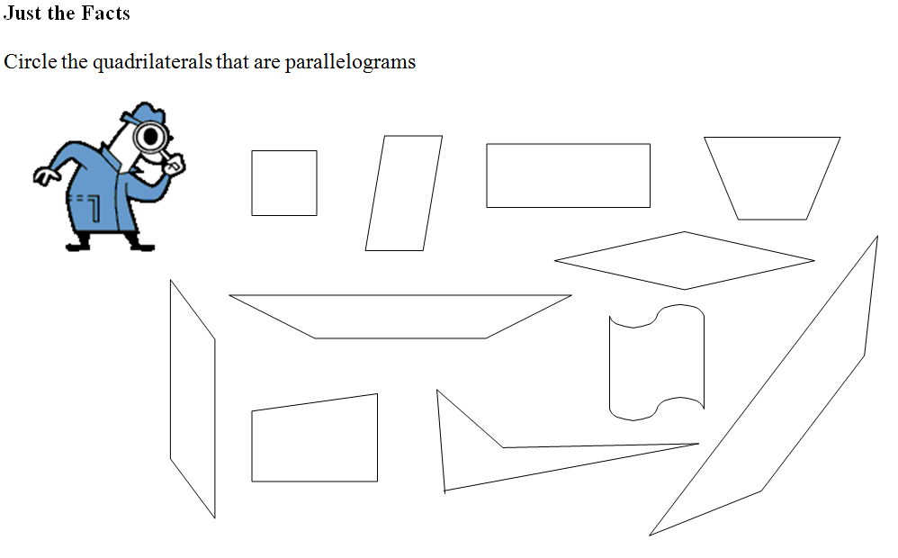

Slide 3
Formal Definition

Slide 4
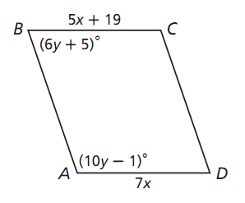
ABCD is a parallelogram
Find AD
Find angle B

Slide 5
In pairs…

Slide 6
Summary: Properties of Parallelograms
Property | Parallelogram | Rectangle | Rhombus | Square | Trapezoid | Kite
Opposite sides are parallel
Opposite sides are congruent
Opposite angles are congruent
Diagonals are congruent
Diagonals are perpendicular
Diagonals bisect each other
All angles are right angles.
All sides are congruent.

Slide 9
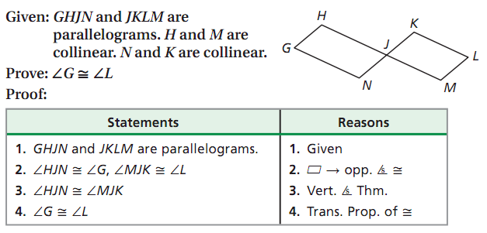
Example Proof

Slide 10
Proof Solution

