Slide 1
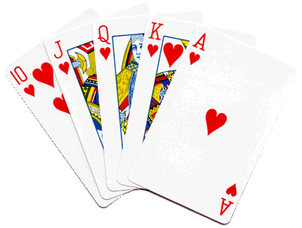
Mr. Calise
Welcome Back!
Hope you had a
Great summer!
I have been teaching High School for 24 years
I love ALL TYPES of SPORTS and ALL TYPES of MUSIC
I also teach Math and Statistics at Johns Hopkins University, CCBC, AACC and Loyola University
I have two children ages 12 and 16.

Slide 2
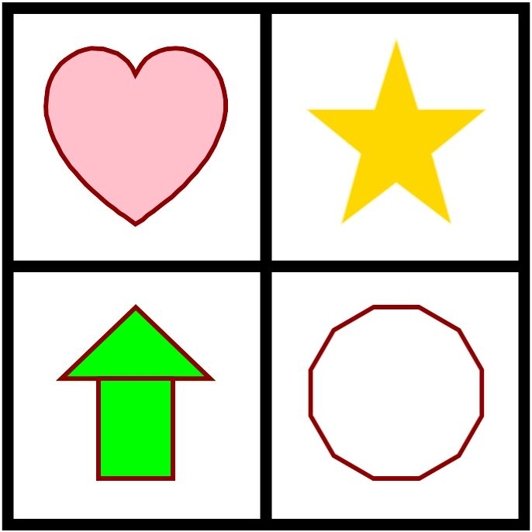
Which Picture is different?

Slide 3
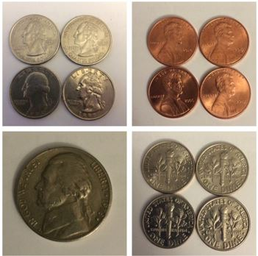
Which Picture is different?

Slide 4
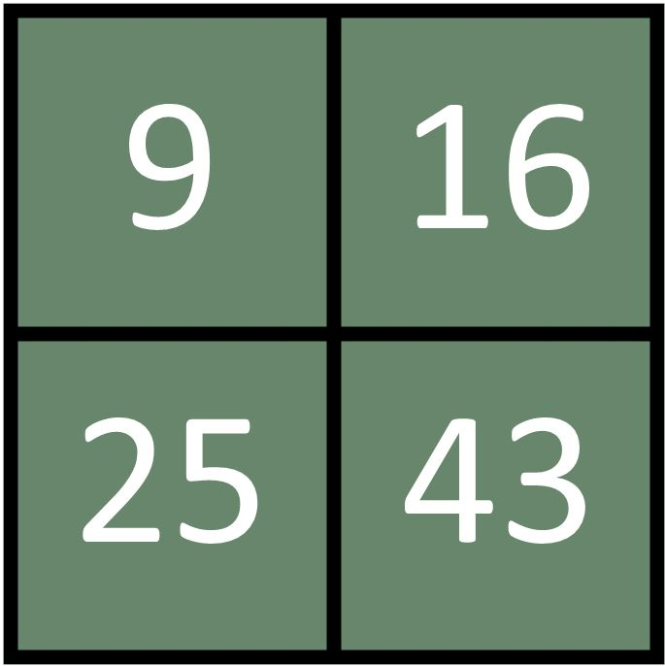
Which Picture is different?

Slide 5
Why should I do well ?
Investigate and Discover why doing well in this course could be very beneficial!

Slide 6
Syllabus and Textbook
www.mrcalise.com
Desmos
www.student.desmos.com

Slide 7
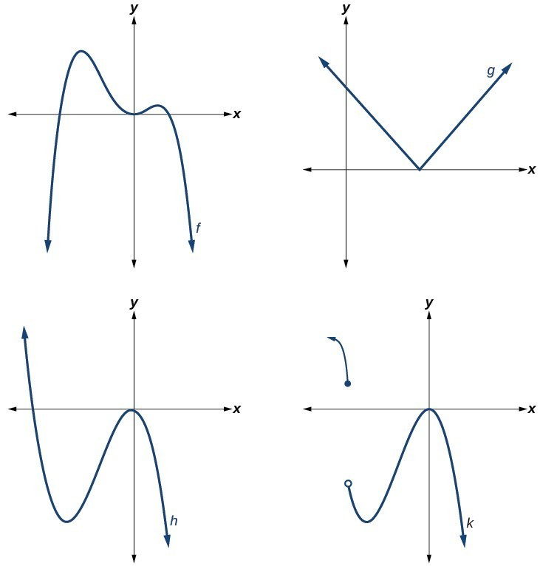
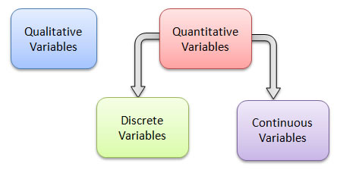
Day 1 Family Functions Discrete vs. Continuous

Slide 8
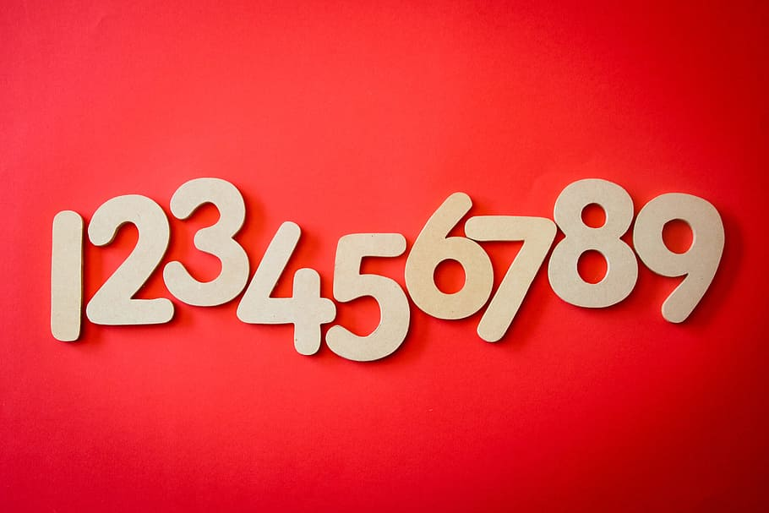
Discrete
A discrete function/graph only consists of certain distinct points – points that can be counted or listed.
For instance, the number of students in my classes throughout the day is a discrete function (can’t have half of a student).
What are some other examples of discrete functions?

Slide 9
Continuous
A continuous function/graph consists of all points within a given interval (including up to infinity).
For instance, the height of someone throughout their life day is a continuous function. (can have decimal answers).
Another way to think of continuous is “did I have to pick up my pencil in the drawing of the graph?
What are some other examples of discrete functions?

Slide 10
Neither
A graph/function can also be “neither” discrete or continuous.
This occurs when our graph “jumps” points which makes it not continuous, but also has an infinite number of points (uncountable) which makes is not discrete.

Slide 11
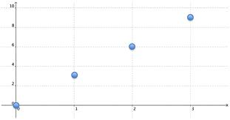
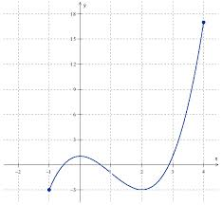
Classify Each Graph
Continuous
Discrete

Slide 12
Classify Each Graph
Neither!

Slide 13
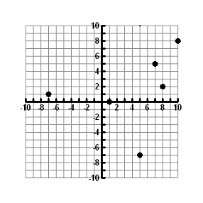
Is the following function discrete or continuous? What is the Domain? What is the Range?
Discrete

Slide 14
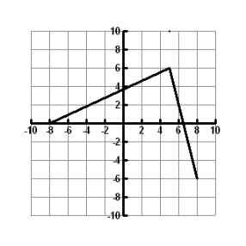
Is the following function discrete or continuous?
What is the Domain? What is the Range?
Continuous

Slide 15
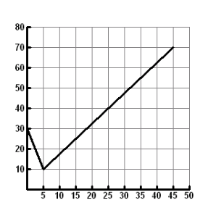
Is the following function discrete or continuous? What is the Domain? What is the Range?
Continuous

Slide 16
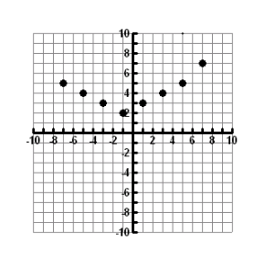
Is the following function discrete or continuous? What is the Domain? What is the Range?
Discrete

Slide 17
Fil. (Submit in Schoology)

