Slide 1
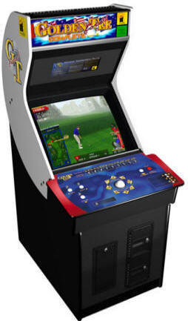
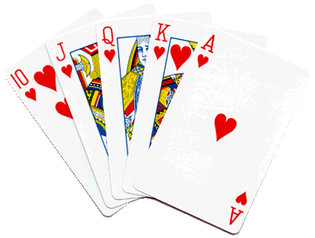
Mr. Calise
Welcome Back!
Hope you had a
Great 1st Semester
I have been teaching High School for 23 years
I love ALL TYPES of SPORTS and ALL TYPES of MUSIC
I also teach Math and Statistics at Johns Hopkins University and CCBC
I have two children ages 13 and 16.

Slide 2
Unit 1
A Towering Sequence
Sequences and Functions
Lesson 1
Notes:
For quick access to the presentation from your own drive, go to File > Add shortcut to Drive.
To customize for your students, go to File > Make a copy to make a copy of the slide deck in your Google Drive that you can edit.
Report a Typo

Slide 3
Let’s explore the Tower of Hanoi.
Unit 1 ● Lesson 1

Slide 4
What’s Next?
Here is a rule for making a list of numbers:
Each number is 1 less than twice the previous number.
Pick a number to start with, then follow the rule to build a list of 5 numbers.
Unit 1 ● Lesson 1 ● Activity 1

Slide 5
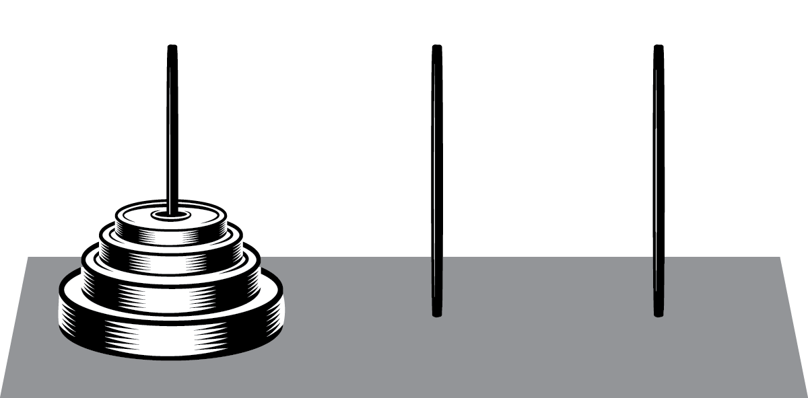
The Tower of Hanoi
In the Tower of Hanoi puzzle, a set of discs sits on a peg, while there are 2 other empty pegs.
A move in the Tower of Hanoi puzzle involves taking a disc and moving it to another peg. There are two rules:
Only move 1 disc at a time.
Never put a larger disc on top of a smaller one.
You complete the puzzle by building the complete tower on a different peg than the starting peg.
Using 2 discs, complete the puzzle. What is the smallest number of moves you can find?
Using 3 discs, complete the puzzle. What is the smallest number of moves you can find?
Using 4 discs, complete the puzzle. What is the smallest number of moves you can find?
Jada says she used the solution for 3 discs to help her solve the puzzle for 4 discs. Describe how this might happen.
How many moves do you think it will take to complete a puzzle with 5 discs? Explain or show your reasoning.
How many moves do you think it will take to complete a puzzle with 7 discs?
Unit 1 ● Lesson 1 ● Activity 2

Slide 6
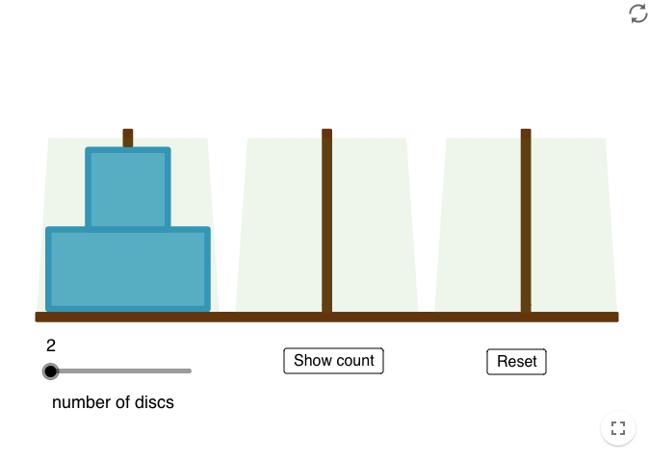
The Tower of Hanoi
Unit 1 ● Lesson 1 ● Activity 2

Slide 7
The Tower of Hanoi
number of discs | 1 | 2 | 3 | 4 | 5 | 6 | 7
number of moves
Unit 1 ● Lesson 1 ● Activity 2

Slide 8
Checker Jumping Puzzle
Some checkers are lined up, with blue on one side, red on the other, with one empty space between them. A move in this checker game pushes any checker forward 1 space, or jumps over any 1 checker of the other color. Jumping the same color is not allowed, moving backwards is not allowed, and 2 checkers cannot occupy the same space.
You complete the puzzle by switching the colors completely: ending up with blue on the right, red on the left, with 1 empty space between them.
Using 1 checker on each side, complete the puzzle. What is the smallest number of moves needed?
Using 3 checkers on each side, complete the puzzle. What is the smallest number of moves needed?
Estimate the number of moves needed if there are 2 or 4 checkers on each side, then test your guesses.
Noah says he used the solution for 3 checkers on each side to help him solve the puzzle for 4 checkers. Describe how this might happen.
How many moves do you think it will take to complete a puzzle with 7 checkers on each side?
Unit 1 ● Lesson 1 ● Activity 3

Slide 9
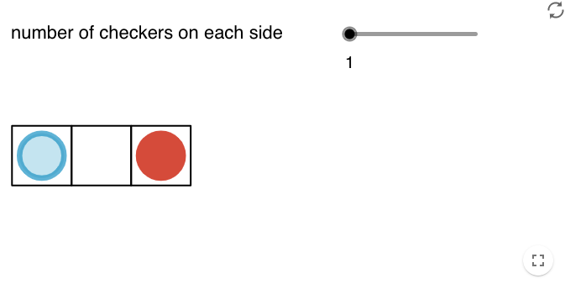
Checker Jumping Puzzle
Unit 1 ● Lesson 1 ● Activity 3

Slide 10
Checker Jumping Puzzle
number of checkers on each side | 1 | 2 | 3 | 4 | 5 | 6 | 7
number of moves | 3
Unit 1 ● Lesson 1 ● Activity 3

Slide 11
A Towering Sequence
Create a sequence of 5 numbers that follows some rule and write it down on a piece of paper.
Exchange papers with your partners and then try to find the next term in your partner's sequence along with the rule they used.
Unit 1 ● Lesson 1

Slide 12
Unit 1 ● Lesson 1
I can give an example of a sequence.

Slide 13
Next?
A sequence starts 3, 6, . . .
Give a rule the sequence could follow, and list the next 3 terms.
Give a different rule the sequence could follow, and list the next 3 terms.
Unit 1 ● Lesson 1 ● Activity 4

Slide 14
sequence
A list of numbers, possibly going on forever, such as all the odd positive integers arranged in order: 1, 3, 5, 7, . . . .
Unit 1 ● Lesson 1

Slide 15
term (of a sequence)
One of the numbers in a sequence.
Unit 1 ● Lesson 1

Slide 16
This slide deck is copyright 2020 by Kendall Hunt Publishing, https://im.kendallhunt.com/, and is licensed under the Creative Commons Attribution-NonCommercial 4.0 International License (CC BY-NC 4.0), https://creativecommons.org/licenses/by-nc/4.0/.This slide deck is copyright 2020 by Kendall Hunt Publishing, https://im.kendallhunt.com/, and is licensed under the Creative Commons Attribution-NonCommercial 4.0 International License (CC BY-NC 4.0), https://creativecommons.org/licenses/by-nc/4.0/.
All curriculum excerpts are under the following licenses:
IM 9–12 Math is copyright 2019 by Illustrative Mathematics. It is licensed under the Creative Commons Attribution 4.0 International License (CC BY 4.0).
This material includes public domain images or openly licensed images that are copyrighted by their respective owners. Openly licensed images remain under the terms of their respective licenses. See the image attribution section for more information.
The Illustrative Mathematics name and logo are not subject to the Creative Commons license and may not be used without the prior and express written consent of Illustrative Mathematics.

Slide 17
Unit 1
Introducing Geometric Sequences
Sequences and Functions
Lesson 2
Notes:
For quick access to the presentation from your own drive, go to File > Add shortcut to Drive.
To customize for your students, go to File > Make a copy to make a copy of the slide deck in your Google Drive that you can edit.
Report a Typo

Slide 18
Let’s explore growing and shrinking patterns.
Unit 1 ● Lesson 2

Slide 19
A Pattern in Lists
What do you notice? What do you wonder?
40, 120, 360, 1080, 3240
2, 8, 32, 128, 512
1000, 500, 250, 125, 62.5
256, 192, 144, 108, 81
Unit 1 ● Lesson 2 ● Activity 1

Slide 20
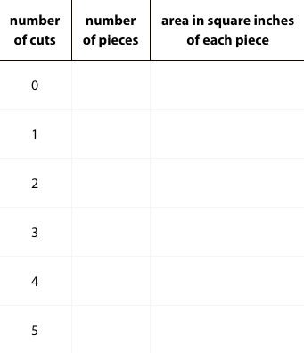
Paper Slicing
Clare takes a piece of paper, cuts it in half, then stacks the pieces. She takes the stack of two pieces, then cuts in half again to form four pieces, stacking them. She keeps repeating the process.
The original piece of paper has length 8 inches and width 10 inches. Complete the table.
Describe in words how you can use the results after 5 cuts to find the results after 6 cuts.
Unit 1 ● Lesson 2 ● Activity 2

Slide 21
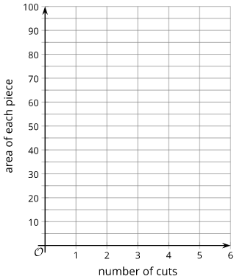
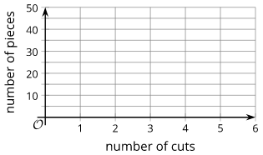
Paper Slicing
On the given axes, sketch a graph of the number of pieces as a function of the number of cuts. How can you see on the graph how the number of pieces is changing with each cut?
On the given axes, sketch a graph of the area of each piece as a function of the number of cuts. How can you see how the area of each piece is changing with each cut?
Unit 1 ● Lesson 2 ● Activity 2

Slide 22
Complete the Sequence
Complete each geometric sequence.
1.5, 3, 6, ___, 24, ___
40, 120, 360, ___, ___
200, 20, 2, ___, 0.02, ___
, ___, , , ___
24, 12, 6, ___, ___
For each sequence, find its growth factor.
Unit 1 ● Lesson 2 ● Activity 3

Slide 23
Introducing Geometric Sequences
In your group of 2, come up with a new geometric sequence and be prepared to explain why it is a geometric sequence.
Unit 1 ● Lesson 2

Slide 24
Unit 1 ● Lesson 2
I can find missing terms in a geometric sequence.

Slide 25
A Possible Geometric Sequence
Here is a sequence: 500, 100, 20, . . .
Explain why this sequence could be a geometric sequence.
What is the next term? Explain how you know.
Unit 1 ● Lesson 2 ● Activity 4

Slide 26
geometric sequence
A sequence in which each term is a constant times the previous term.
Unit 1 ● Lesson 2

Slide 27
This slide deck is copyright 2020 by Kendall Hunt Publishing, https://im.kendallhunt.com/, and is licensed under the Creative Commons Attribution-NonCommercial 4.0 International License (CC BY-NC 4.0), https://creativecommons.org/licenses/by-nc/4.0/.This slide deck is copyright 2020 by Kendall Hunt Publishing, https://im.kendallhunt.com/, and is licensed under the Creative Commons Attribution-NonCommercial 4.0 International License (CC BY-NC 4.0), https://creativecommons.org/licenses/by-nc/4.0/.
All curriculum excerpts are under the following licenses:
IM 9–12 Math is copyright 2019 by Illustrative Mathematics. It is licensed under the Creative Commons Attribution 4.0 International License (CC BY 4.0).
This material includes public domain images or openly licensed images that are copyrighted by their respective owners. Openly licensed images remain under the terms of their respective licenses. See the image attribution section for more information.
The Illustrative Mathematics name and logo are not subject to the Creative Commons license and may not be used without the prior and express written consent of Illustrative Mathematics.

