Slide 1
Unit 1
Sequences are Functions
Sequences and Functions
Lesson 5
Notes:
For quick access to the presentation from your own drive, go to File > Add shortcut to Drive.
To customize for your students, go to File > Make a copy to make a copy of the slide deck in your Google Drive that you can edit.
Report a Typo

Slide 2
Let's learn how to define a sequence recursively.
Unit 1 ● Lesson 5

Slide 3
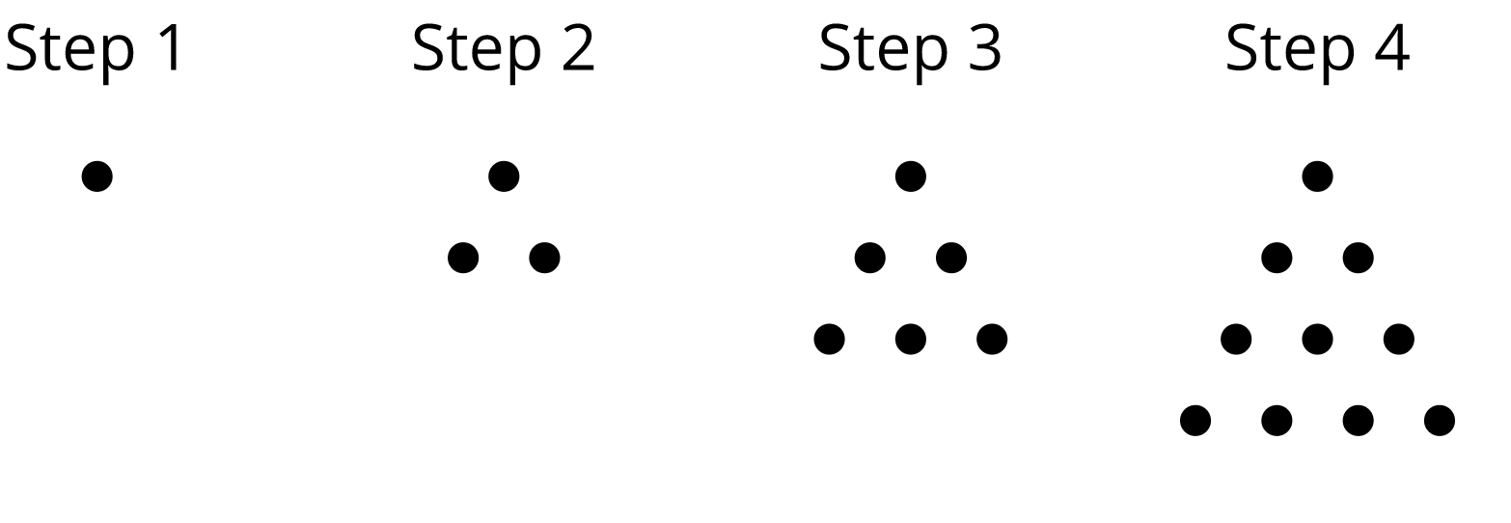
Bowling for Triangles
Describe how to produce one step of the pattern from the previous step.
Unit 1 ● Lesson 5 ● Activity 1

Slide 4
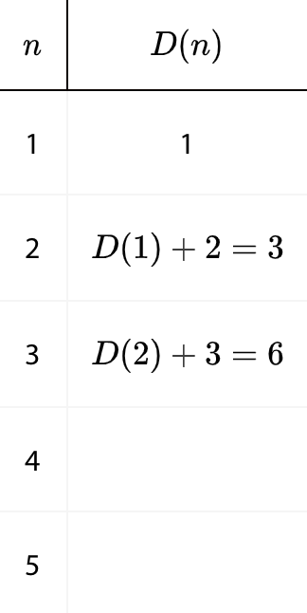
Bowling for Triangles (Part 2)
Here is a visual pattern of dots. The number D(n) of dots is a function of the step number n.
What values make sense for n in this situation? What values don't make sense for n?
Complete the table for Steps 1 to 5.
Following the pattern in the table, write an equation for in terms of the previous step. Be prepared to explain your reasoning.
Unit 1 ● Lesson 5 ● Activity 2

Slide 5
Let's Define Some Sequences
Use the first 5 terms of each sequence to state if the sequence is arithmetic, geometric, or neither. Next, define the sequence recursively using function notation.
A: 30, 40, 50, 60, 70, . . .
B: 80, 40, 20, 10, 5, 2.5, . . .
C: 1, 2, 4, 8, 16, 32, . . .
D:
E: 20, 13, 6, -1, -8, . . .
F: 1, 3, 7, 15, 31, . . .
Unit 1 ● Lesson 5 ● Activity 3

Slide 6
Sequences are Functions
Sequence: A List of Numbers
Geometric (exponential function)
Multiply each term by the growth factor.
Example sequence: 2, 6, 18, 54, . . .
Growth factor: 3
Recursive:
Example sequence: 160, 40, 10, 2.5, . . .
Growth factor:
Recursive:
Arithmetic (linear function)
Add to each term the rate of change.
Example sequence: 2, 7, 12, 17, . . .
Rate of change: 5
Recursive:
Example sequence: 9, 5, 1, -3, . . .
Rate of change: -4
Recursive:
Unit 1 ● Lesson 5

Slide 7
Unit 1 ● Lesson 5
I can define arithmetic and geometric sequences recursively using function notation.

Slide 8
Define This Sequence
Use the first five terms of sequence H to define the sequence recursively using function notation.
2.5, 7.5, 22.5, 67.5, 202.5, . . .
Unit 1 ● Lesson 5 ● Activity 4

Slide 9
arithmetic sequence
A sequence in which each term is the previous term plus a constant.
Unit 1 ● Lesson 5

Slide 10
geometric sequence
A sequence in which each term is a constant times the previous term.
Unit 1 ● Lesson 5

Slide 11
This slide deck is copyright 2020 by Kendall Hunt Publishing, https://im.kendallhunt.com/, and is licensed under the Creative Commons Attribution-NonCommercial 4.0 International License (CC BY-NC 4.0), https://creativecommons.org/licenses/by-nc/4.0/.This slide deck is copyright 2020 by Kendall Hunt Publishing, https://im.kendallhunt.com/, and is licensed under the Creative Commons Attribution-NonCommercial 4.0 International License (CC BY-NC 4.0), https://creativecommons.org/licenses/by-nc/4.0/.
All curriculum excerpts are under the following licenses:
IM 9–12 Math is copyright 2019 by Illustrative Mathematics. It is licensed under the Creative Commons Attribution 4.0 International License (CC BY 4.0).
This material includes public domain images or openly licensed images that are copyrighted by their respective owners. Openly licensed images remain under the terms of their respective licenses. See the image attribution section for more information.
The Illustrative Mathematics name and logo are not subject to the Creative Commons license and may not be used without the prior and express written consent of Illustrative Mathematics.

Slide 12
Unit 1
Representing Sequences
Sequences and Functions
Lesson 6
Notes:
For quick access to the presentation from your own drive, go to File > Add shortcut to Drive.
To customize for your students, go to File > Make a copy to make a copy of the slide deck in your Google Drive that you can edit.
Report a Typo

Slide 13
Let’s look at different ways to represent a sequence.
Unit 1 ● Lesson 6

Slide 14
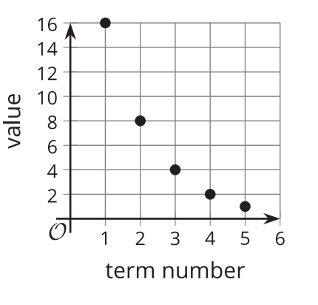
Reading Representations
For each sequence shown, find either the growth factor or rate of change. Be prepared to explain your reasoning.
5, 15, 25, 35, 45, . . .
Starting at 10, each new term is less than the previous term.
5.
Unit 1 ● Lesson 6 ● Activity 1

Slide 15
Matching Recursive Definitions
Take turns with your partner to match a sequence with a recursive definition. It may help to first figure out if the sequence is arithmetic or geometric.
For each match that you find, explain to your partner how you know it’s a match.
For each match that your partner finds, listen carefully to their explanation. If you disagree, discuss your thinking and work to reach an agreement.
There is one sequence and one definition that do not have matches. Create their corresponding match.
Sequences:
3, 6, 12, 24
18, 36, 72, 144
3, 8, 13, 18
18, 13, 8, 3
18, 9, 4.5, 2.25
18, 20, 22, 24
Definitions:
.
.
.
.
.
.
Unit 1 ● Lesson 6 ● Activity 2

Slide 16
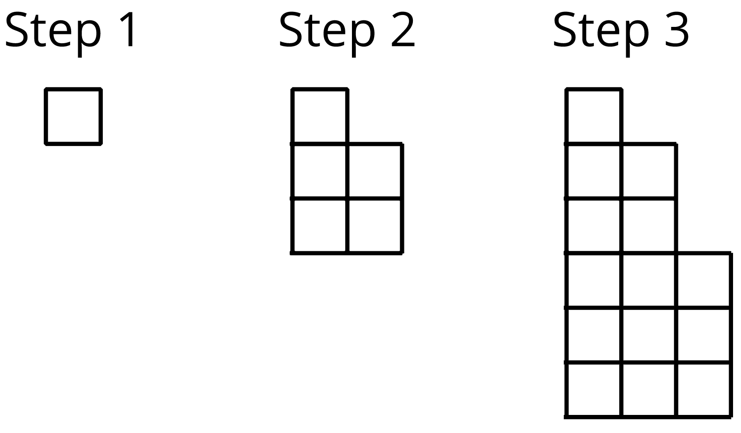
Squares of Squares
Here is a pattern where the number of small squares increases with each new step.
Write a recursive definition for the total number of small squares S(n) in Step n.
Sketch a graph of S that shows Steps 1 to 7.
Is this sequence geometric, arithmetic, or neither? Be prepared to explain how you know.
Unit 1 ● Lesson 6 ● Activity 3

Slide 17
Representing Sequences
Each group will be assigned one of the example sequences.
Groups will create a graph and visual pattern showing the first five values of their sequence.
Unit 1 ● Lesson 6

Slide 18
Unit 1 ● Lesson 6
I can represent a sequence in different ways.

Slide 19
Represent this Sequence
A sequence has the recursive definition for
Write the first five terms of the sequence.
Sketch a graph of the first five terms of the sequence.
Unit 1 ● Lesson 6 ● Activity 4

Slide 20
arithmetic sequence
A sequence in which each term is the previous term plus a constant.
Unit 1 ● Lesson 6

Slide 21
geometric sequence
A sequence in which each term is a constant times the previous term.
Unit 1 ● Lesson 6

Slide 22
This slide deck is copyright 2020 by Kendall Hunt Publishing, https://im.kendallhunt.com/, and is licensed under the Creative Commons Attribution-NonCommercial 4.0 International License (CC BY-NC 4.0), https://creativecommons.org/licenses/by-nc/4.0/.This slide deck is copyright 2020 by Kendall Hunt Publishing, https://im.kendallhunt.com/, and is licensed under the Creative Commons Attribution-NonCommercial 4.0 International License (CC BY-NC 4.0), https://creativecommons.org/licenses/by-nc/4.0/.
All curriculum excerpts are under the following licenses:
IM 9–12 Math is copyright 2019 by Illustrative Mathematics. It is licensed under the Creative Commons Attribution 4.0 International License (CC BY 4.0).
This material includes public domain images or openly licensed images that are copyrighted by their respective owners. Openly licensed images remain under the terms of their respective licenses. See the image attribution section for more information.
The Illustrative Mathematics name and logo are not subject to the Creative Commons license and may not be used without the prior and express written consent of Illustrative Mathematics.

