Slide 1
Unit 2
Let’s Make a Box
Polynomials and Rational Functions
Lesson 1
Notes:
For quick access to the presentation from your own drive, go to File > Add shortcut to Drive.
To customize for your students, go to File > Make a copy to make a copy of the slide deck in your Google Drive that you can edit.
Report a Typo

Slide 2
Let’s investigate volumes of different boxes.
Unit 2 ● Lesson 1

Slide 3
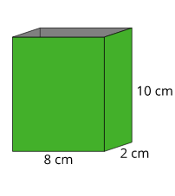
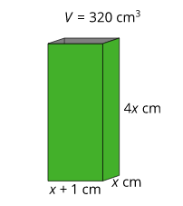
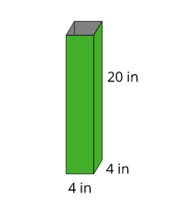
Boxes
Which one doesn’t belong?
length: 4 cm
width: 8 cm
height: 10 cm
B.
D.
Unit 2 ● Lesson 1 ● Activity 1

Slide 4
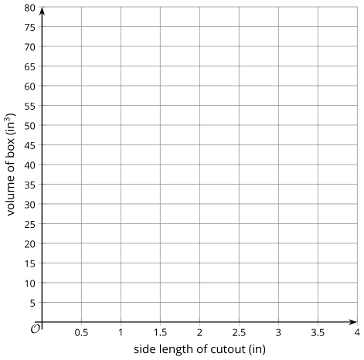
Building Boxes
Your teacher will give you some supplies.
Construct an open-top box from a sheet of paper by cutting out a square from each corner and then folding up the sides.
Calculate the volume of your box, and complete the table with your information.
Unit 2 ● Lesson 1 ● Activity 2

Slide 5
Building the Biggest Box
The volume V(x) in cubic inches of the open-top box is a function of the side length x in inches of the square cutouts. Make a plan to figure out how to construct the box with the largest volume.
Pause here so your teacher can review your plan.
Write an expression for V(x).
Use graphing technology to create a graph representing V(x). Approximate the value of x that would allow you to construct an open-top box with the largest volume possible from one piece of paper.
Unit 2 ● Lesson 1 ● Activity 3

Slide 6
Let’s Make a Box
What strategy did you use to answer the question?
What are some side lengths for the square cutouts that don’t make sense?
Unit 2 ● Lesson 1

Slide 7
Unit 2 ● Lesson 1
I can create and interpret a polynomial that models the volume of a box.

Slide 8
A Box’s Domain
Outside of the United States, the common paper size is called A4 and measures 21 by 29.7 centimeters. Let V(x) = (21 - 2x)(29.7 - 2x)(x) be the volume in cubic centimeters of a box made from A4 paper by cutting out squares of side length x in centimeters from each corner and then folding up the sides.
What is a reasonable domain for V in this context? Explain or show your reasoning.
Unit 2 ● Lesson 1 ● Activity 4

Slide 9
polynomial
A polynomial function of x is a function given by a sum of terms, each of which is a constant times a whole number power of x. The word polynomial is used to refer both to the function and to the expression defining it.
Unit 2 ● Lesson 1

Slide 10
This slide deck is copyright 2020 by Kendall Hunt Publishing, https://im.kendallhunt.com/, and is licensed under the Creative Commons Attribution-NonCommercial 4.0 International License (CC BY-NC 4.0), https://creativecommons.org/licenses/by-nc/4.0/.This slide deck is copyright 2020 by Kendall Hunt Publishing, https://im.kendallhunt.com/, and is licensed under the Creative Commons Attribution-NonCommercial 4.0 International License (CC BY-NC 4.0), https://creativecommons.org/licenses/by-nc/4.0/.
All curriculum excerpts are under the following licenses:
IM 9–12 Math is copyright 2019 by Illustrative Mathematics. It is licensed under the Creative Commons Attribution 4.0 International License (CC BY 4.0).
This material includes public domain images or openly licensed images that are copyrighted by their respective owners. Openly licensed images remain under the terms of their respective licenses. See the image attribution section for more information.
The Illustrative Mathematics name and logo are not subject to the Creative Commons license and may not be used without the prior and express written consent of Illustrative Mathematics.

Slide 11
Unit 2
Funding the Future
Polynomials and Rational Functions
Lesson 2
Notes:
For quick access to the presentation from your own drive, go to File > Add shortcut to Drive.
To customize for your students, go to File > Make a copy to make a copy of the slide deck in your Google Drive that you can edit.
Report a Typo

Slide 12
Let’s look at some other things that polynomials can model.
Unit 2 ● Lesson 2

Slide 13
Writing Numbers
What do you notice? What do you wonder?
300 + 20 + 9
3 100s, 2 10s, 9 1s
3(10²) + 2(10¹) + 9(10⁰)
Unit 2 ● Lesson 2 ● Activity 1

Slide 14
Polynomials in the Integers
Consider the polynomial function p given by
p(x) = 5x³ + 6x² + 4x.
Evaluate the function at x = -5 and x = 15.
How does knowing that 5,000 + 600 + 40 = 5,640 help you solve the equation 5x³ + 6x² + 4x = 5,640?
Unit 2 ● Lesson 2 ● Activity 2

Slide 15
A Yearly Gift
At the end of 12th grade, Clare’s aunt started investing money for her to use after graduating from college four years later. The first deposit was $300. If r is the annual interest rate of the account, then at the end of each school year the balance in the account is multiplied by a growth factor of x = 1 + r.
After one year, the total value is 300x. After two years, the total value is
300x ⦁ x = 300x². Write an expression for the total value after graduation in terms of x.
If Clare’s aunt had invested another $500 at the end of her freshman year, what would the expression be for the total value after graduation in terms of x?
Pause here for a whole-class discussion.
Suppose that $250 was invested at the end of sophomore year, and $400 at the end of junior year in addition to the original $300 and the $500 invested at the end of freshman year. Write an expression for the total value after graduation in terms of x.
The total amount y, in dollars, after four years is a function y = C(x) of the growth factor x. If the total Clare receives after graduation is C(x) = 1,580, use a graph to find the interest rate that the account earned.
Unit 2 ● Lesson 2 ● Activity 3

Slide 16
Funding the Future
C(x) = 200x¹⁵ + 100x¹⁴ + 500x⁵ + 300x²
How long ago did the account open? How can you tell?
How can you tell that the last time money was put into the account was $300 2 years ago?
Suppose that $300 was deposited into the account 8 years ago. How would you need to change the equation?
Let’s say the interest rate is 5%, and we want to know what C(x) is. When we’re putting values into a calculator to find C(x), what might go wrong?
Unit 2 ● Lesson 2

Slide 17
Unit 2 ● Lesson 2
I can use polynomials to understand different kinds of situations.

Slide 18
A Different Account
An account grows at an annual interest rate of r, so it grows by a factor of x = 1 + r each year. The function
A(x) = 800x⁴ + 350x³ + 500x² + 600x gives the amount in the account after 4 years when the growth factor is x.
What is the total amount in the account if the interest rate for the account is 3% each year?
How much money was put into the account at the beginning?
After 5 years, $200 is added to the account. Use the expression for A(x) to write a new expression B(x) that represents how much is in the account after 5 years.
Unit 2 ● Lesson 2 ● Activity 4

Slide 19
polynomial
A polynomial function of x is a function given by a sum of terms, each of which is a constant times a whole number power of x. The word polynomial is used to refer both to the function and to the expression defining it.
Unit 2 ● Lesson 2

Slide 20
This slide deck is copyright 2020 by Kendall Hunt Publishing, https://im.kendallhunt.com/, and is licensed under the Creative Commons Attribution-NonCommercial 4.0 International License (CC BY-NC 4.0), https://creativecommons.org/licenses/by-nc/4.0/.This slide deck is copyright 2020 by Kendall Hunt Publishing, https://im.kendallhunt.com/, and is licensed under the Creative Commons Attribution-NonCommercial 4.0 International License (CC BY-NC 4.0), https://creativecommons.org/licenses/by-nc/4.0/.
All curriculum excerpts are under the following licenses:
IM 9–12 Math is copyright 2019 by Illustrative Mathematics. It is licensed under the Creative Commons Attribution 4.0 International License (CC BY 4.0).
This material includes public domain images or openly licensed images that are copyrighted by their respective owners. Openly licensed images remain under the terms of their respective licenses. See the image attribution section for more information.
The Illustrative Mathematics name and logo are not subject to the Creative Commons license and may not be used without the prior and express written consent of Illustrative Mathematics.

