Slide 1
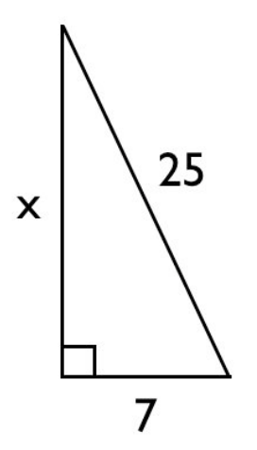
Drill:
Using the Pythagorean Theorem, find the length of the missing side of the right triangle on the right.
Convert 240 degrees into radians.

Slide 2
Outcomes
Students will be able to actively participate in a review in order to recall concepts learned in Unit 4 in preparation for the unit assessment.
Agenda:
Check-In
Think About It
Learn About It
Try It
How are we going to learn our lesson today?
What are we learning today?

Slide 3
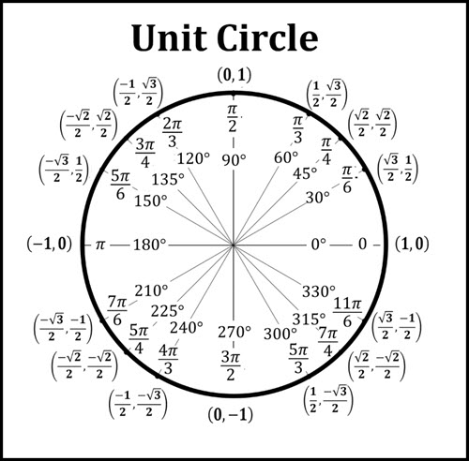
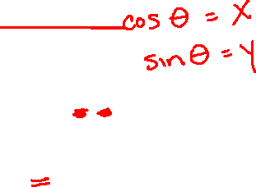

Slide 4
May 27th 2021
Unit 4
Assessment Review

Slide 5
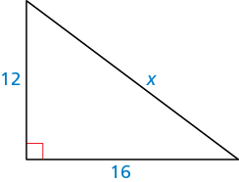
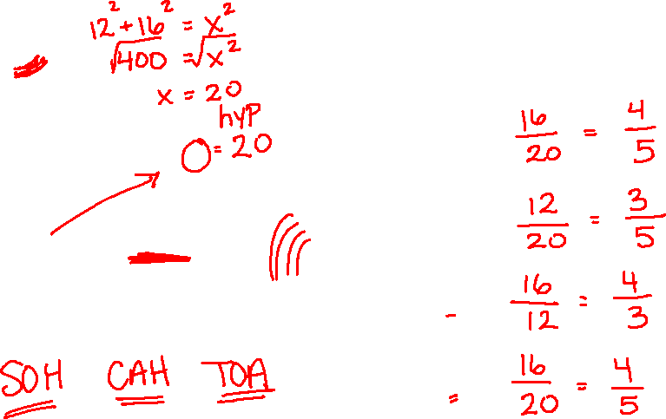

Learn About It
Review
Find each trig ratio:
Sin A =
Cos A =
Tan A =
Cos B =

Slide 6
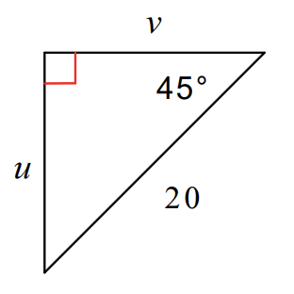
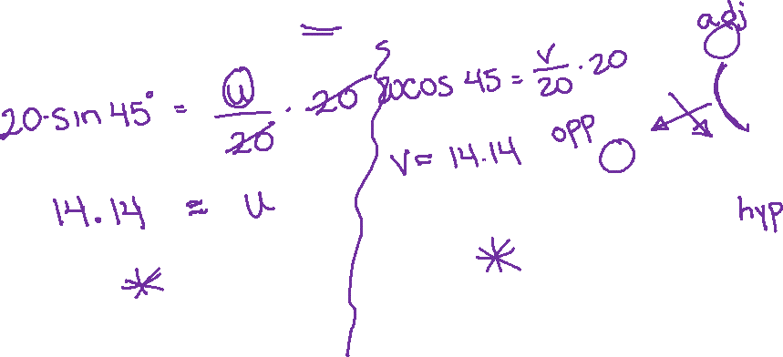
Learn About It
Review
Determine the length of one of the two sides of the right triangle on the right.

Slide 7
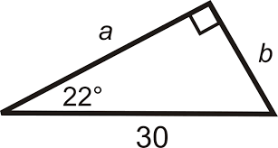
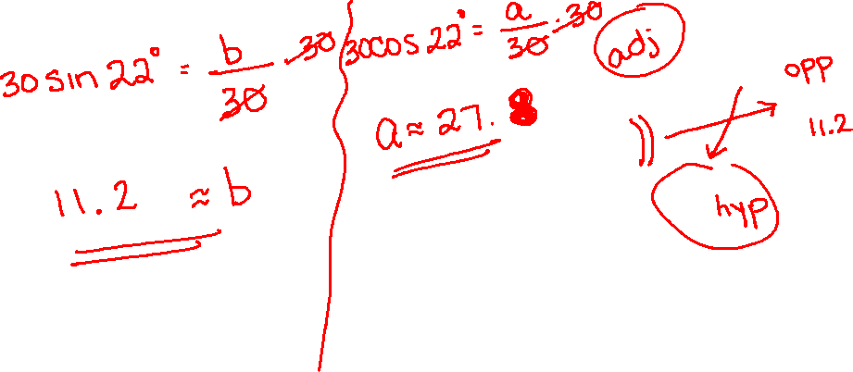
Learn About It
Review
Determine the length of the two sides of the right triangle on the right.

Slide 8
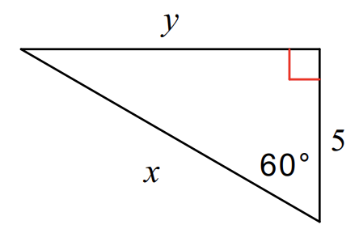

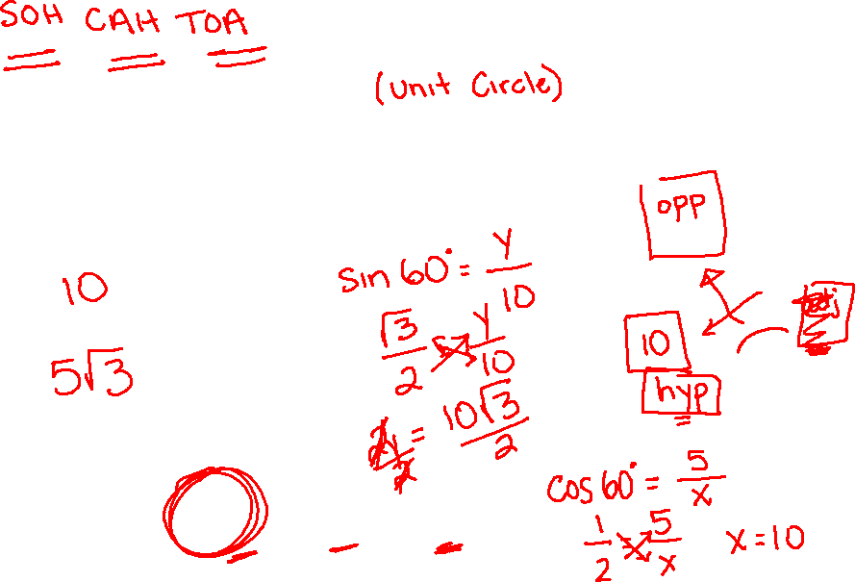
Learn About It
Review
Match the correct values for x and y in the right triangle on the right. Note: There are more values than needed.
x =
y =
$5$ $10$ $5\sqrt{3}$ $10\sqrt{3}$ $5\sqrt{2}$

Slide 9

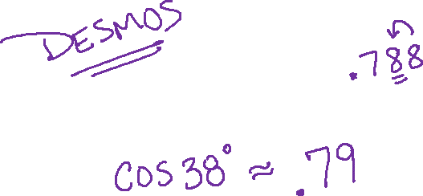
Learn About It
Review
Write the value of $\cos{38°}$ to the nearest hundredths place.

Slide 10
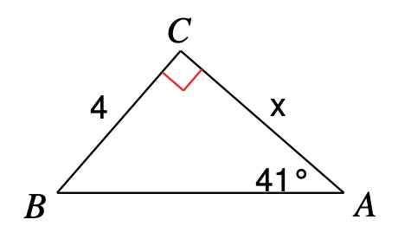
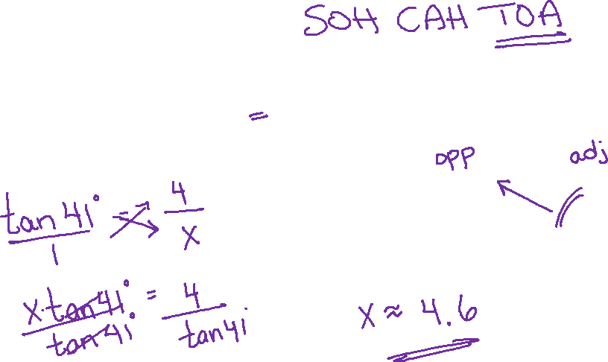
Learn About It
Review
Write the trigonometric ratio to represent and correctly solve the length of x in the triangle on the right.

Slide 11

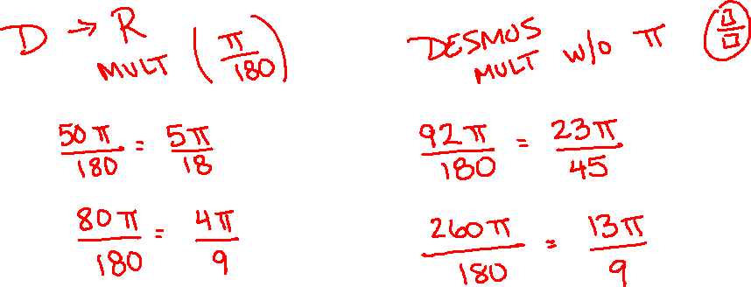
Learn About It
Review
Match each angle measure with its corresponding radian measure.
50^{O} = 92^{O} =
80^{O} = 260^{O} =
$\frac{4π}{9}$ $\frac{5π}{18}$ $\frac{13π}{9}$ $\frac{23π}{45}$

Slide 12
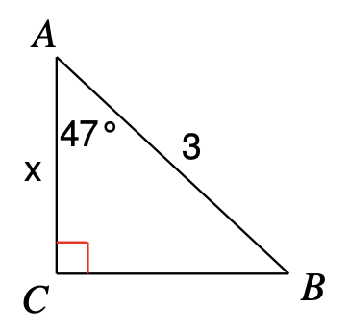
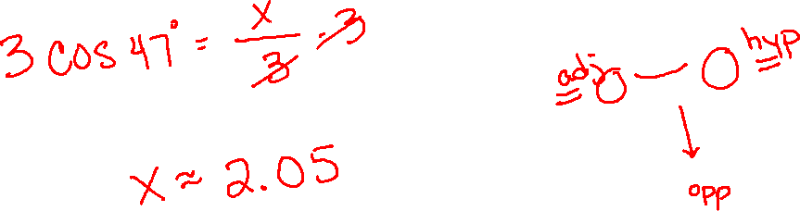
Learn About It
Review
Determine the value of x in the right triangle on the right.

Slide 13
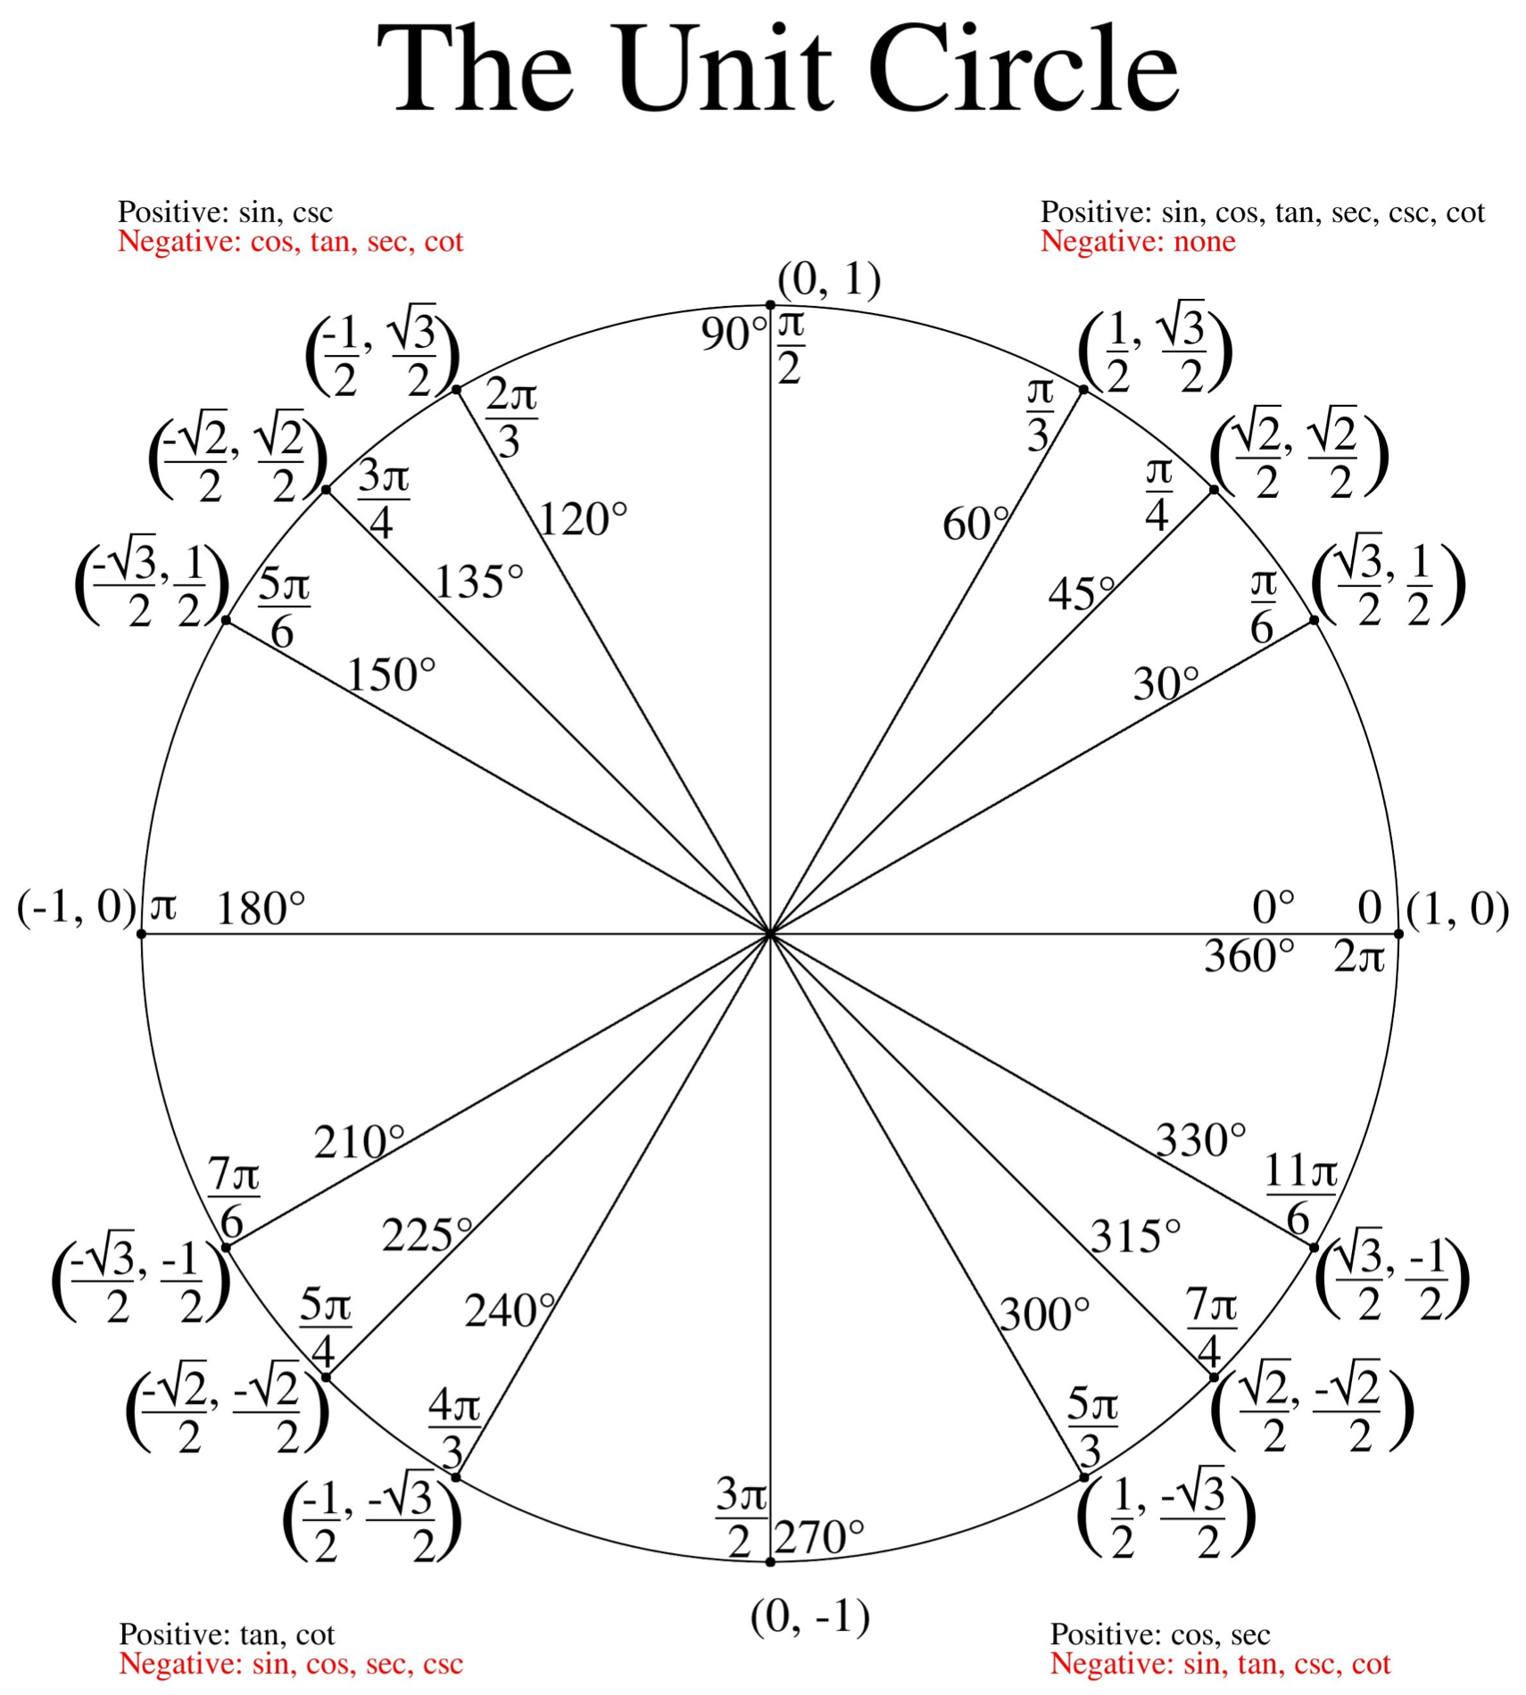
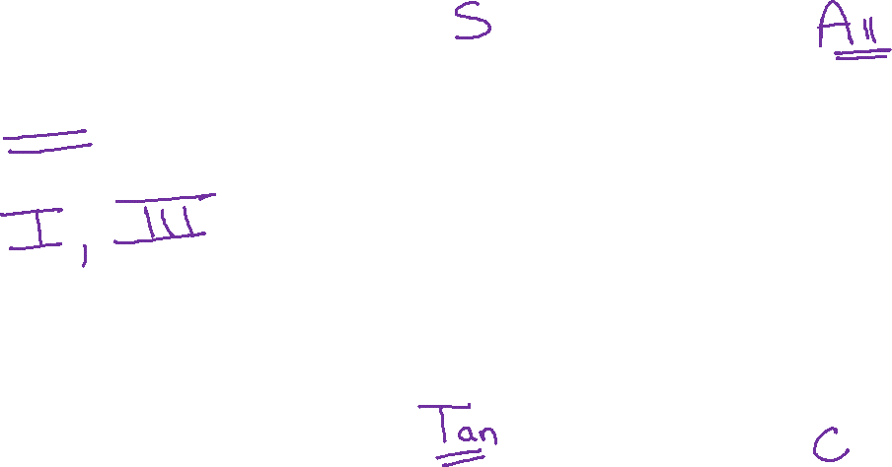
Learn About It
Review
In which quadrants is the value of tan positive?

Slide 14
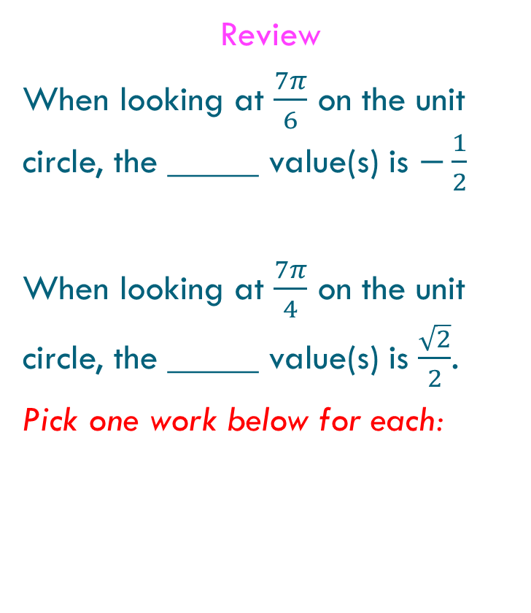
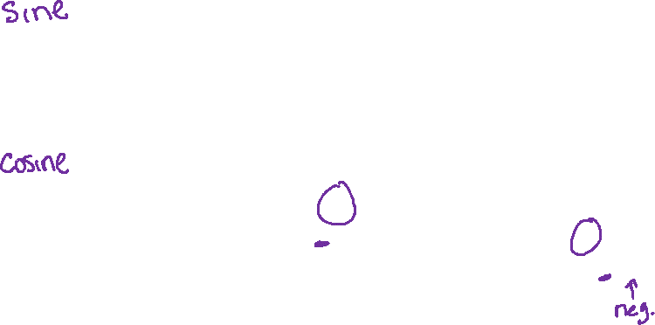
Learn About It
Review
When looking at $\frac{7π}{6}$ on the unit circle, the _____ value(s) is $−\frac{1}{2}$
When looking at $\frac{7π}{4}$ on the unit circle, the _____ value(s) is $\frac{\sqrt{2}}{2}$.
Pick one work below for each:
sine cosine both

Slide 15

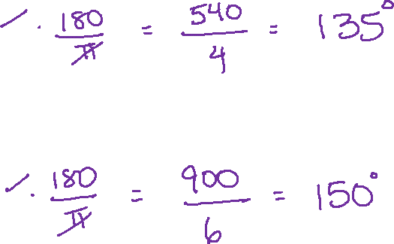
Learn About It
Convert each angle into degrees:
$\frac{3π}{4}$
$\frac{5π}{6}$

Slide 16
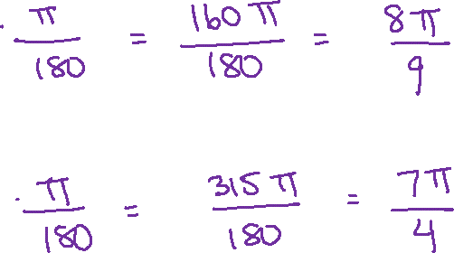
Learn About It
Convert each angle into radians:
160º
315º

