Slide 1
Chapter 1
Data Analysis
Section 1.1
Analyzing Categorical Data

Slide 2
Data Analysis
MAKE and INTERPRET bar graphs for categorical data.
IDENTIFY what makes some graphs of categorical data misleading.
CALCULATE marginal and joint relative frequencies from a two-way table.
CALCULATE conditional relative frequencies from a two-way table.
Use bar graphs to COMPARE distributions of categorical data.
DESCRIBE the nature of the association between two categorical variables.

Slide 3
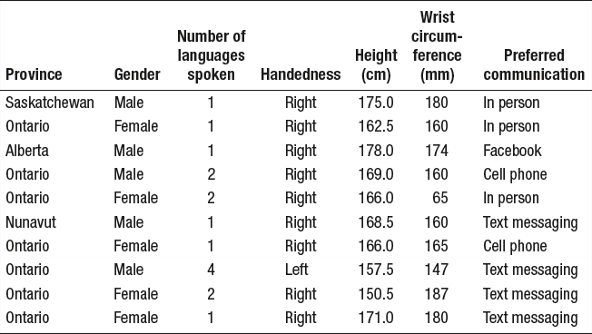
Organizing Categorical Data
Categorical variable
Values (These are the data)

Slide 4
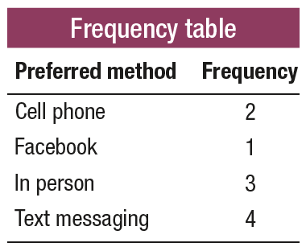
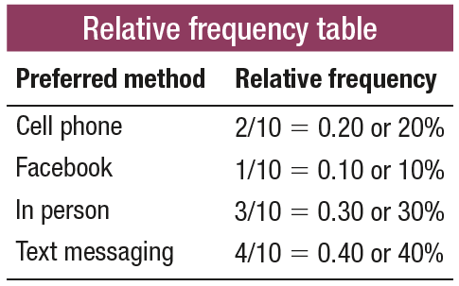
Organizing Categorical Data
Count
Proportion
Percent

Slide 5
Displaying Categorical Data
To display the distribution of categorical data, make a bar graph
Count
Proportion
Percent

Slide 6
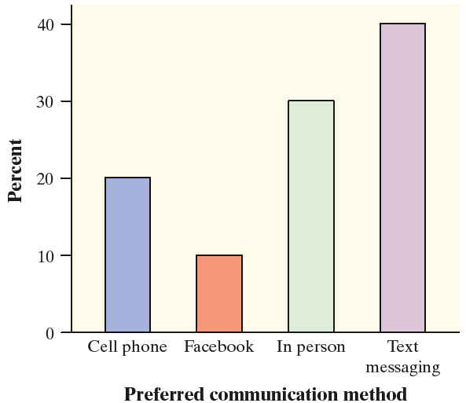
Displaying Categorical Data
To display the distribution of categorical data, make a bar graph
Proportion
Percent

Slide 7
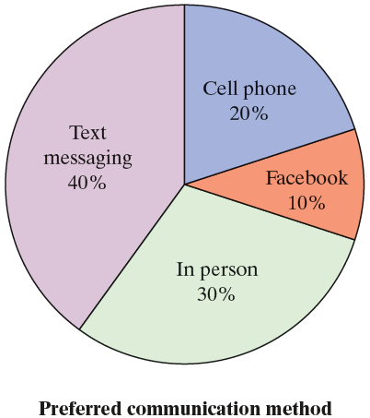
Displaying Categorical Data
To display the distribution of categorical data, make a bar graph or a pie chart.

Slide 8
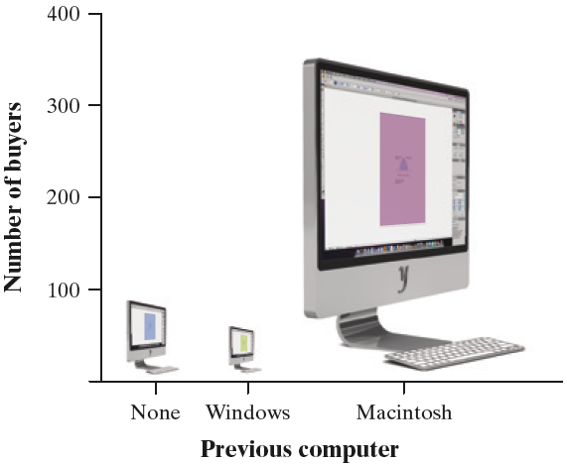
Graphs: Good and Bad
Bar graphs are a bit dull to look at. It is tempting to replace the bars with pictures or to use special 3-D effects to make the graphs seem more interesting.
Don’t do it!
CAUTION:
beware the pictograph
watch those scales

Slide 9
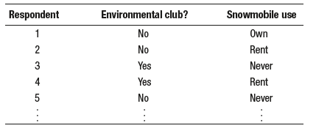
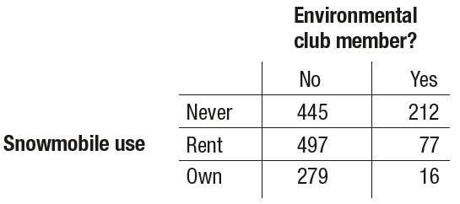
Analyzing Data on Two Categorical Variables
How do you analyze data do when a data set involves two categorical variables?
A two-way table is a table of counts that summarizes data on the relationship between two categorical variables for some group of individuals.
We can include row and column totals

Slide 10
Analyzing Data on Two Categorical Variables
A marginal relative frequency gives the percent or proportion of individuals that
have a specific value for one categorical variable.

Slide 11
Analyzing Data on Two Categorical Variables
A marginal relative frequency gives the percent or proportion of individuals that
have a specific value for one categorical variable.

Slide 12
Analyzing Data on Two Categorical Variables
A marginal relative frequency gives the percent or proportion of individuals that
have a specific value for one categorical variable.

Slide 13
Analyzing Data on Two Categorical Variables
A marginal relative frequency gives the percent or proportion of individuals that
have a specific value for one categorical variable.

Slide 14
Analyzing Data on Two Categorical Variables
A marginal relative frequency gives the percent or proportion of individuals that
have a specific value for one categorical variable.

Slide 15
Analyzing Data on Two Categorical Variables
A marginal relative frequency gives the percent or proportion of individuals that
have a specific value for one categorical variable.

Slide 16
Analyzing Data on Two Categorical Variables
A marginal relative frequency gives the percent or proportion of individuals that
have a specific value for one categorical variable.
A marginal relative frequency tells you about only one of the variables in a two-way table.

Slide 17
Analyzing Data on Two Categorical Variables
A joint relative frequency gives the percent or proportion of individuals that have a specific value for one categorical variable and a specific value for another categorical variable.

Slide 18
Analyzing Data on Two Categorical Variables
A joint relative frequency gives the percent or proportion of individuals that have a specific value for one categorical variable and a specific value for another categorical variable.
A joint relative frequency helps answer questions involving both of the variables in a two-way table.

Slide 19
Analyzing Data on Two Categorical Variables
A joint relative frequency gives the percent or proportion of individuals that have a specific value for one categorical variable and a specific value for another categorical variable.
What percent of people in the sample are environmental club members and own snowmobiles?
A joint relative frequency helps answer questions involving both of the variables in a two-way table.

Slide 20
Analyzing Data on Two Categorical Variables
A joint relative frequency gives the percent or proportion of individuals that have a specific value for one categorical variable and a specific value for another categorical variable.
What percent of people in the sample are environmental club members and own snowmobiles?
A joint relative frequency helps answer questions involving both of the variables in a two-way table.

Slide 21
Analyzing Data on Two Categorical Variables
A joint relative frequency gives the percent or proportion of individuals that have a specific value for one categorical variable and a specific value for another categorical variable.
What percent of people in the sample are environmental club members and own snowmobiles?
A joint relative frequency helps answer questions involving both of the variables in a two-way table.
What proportion of people in the sample are not environmental club members and never use snowmobiles?

Slide 22
Analyzing Data on Two Categorical Variables
A joint relative frequency gives the percent or proportion of individuals that have a specific value for one categorical variable and a specific value for another categorical variable.
What percent of people in the sample are environmental club members and own snowmobiles?
A joint relative frequency helps answer questions involving both of the variables in a two-way table.
What proportion of people in the sample are not environmental club members and never use snowmobiles?

Slide 23
Relationships Between Two Categorical Variables
Marginal and joint relative frequencies do not tell us much about the relationship between environmental club membership and snowmobile use for the people in the sample.

Slide 24
Relationships Between Two Categorical Variables
Marginal and joint relative frequencies do not tell us much about the relationship between environmental club membership and snowmobile use for the people in the sample.
A conditional relative frequency gives the percent or proportion of individuals that have a specific value for one categorical variable among individuals who
share the same value of another categorical variable (the condition).

Slide 25
Relationships Between Two Categorical Variables
Marginal and joint relative frequencies do not tell us much about the relationship between environmental club membership and snowmobile use for the people in the sample.
A conditional relative frequency gives the percent or proportion of individuals that have a specific value for one categorical variable among individuals who
share the same value of another categorical variable (the condition).
What percent of environmental club members in the sample are snowmobile owners?

Slide 26
Relationships Between Two Categorical Variables
Marginal and joint relative frequencies do not tell us much about the relationship between environmental club membership and snowmobile use for the people in the sample.
A conditional relative frequency gives the percent or proportion of individuals that have a specific value for one categorical variable among individuals who
share the same value of another categorical variable (the condition).
What percent of environmental club members in the sample are snowmobile owners?

Slide 27
Relationships Between Two Categorical Variables
Marginal and joint relative frequencies do not tell us much about the relationship between environmental club membership and snowmobile use for the people in the sample.
A conditional relative frequency gives the percent or proportion of individuals that have a specific value for one categorical variable among individuals who
share the same value of another categorical variable (the condition).
What percent of environmental club members in the sample are snowmobile owners?

Slide 28
Relationships Between Two Categorical Variables
The distribution of snowmobile use among environmental club members is called the conditional distribution of snowmobile use among environmental club members.

Slide 29
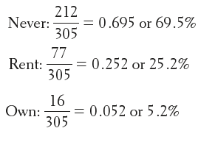
Relationships Between Two Categorical Variables
The distribution of snowmobile use among environmental club members is called the conditional distribution of snowmobile use among environmental club members.

Slide 30
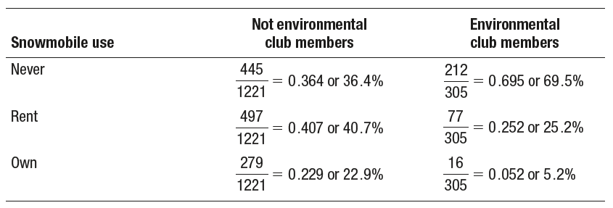
Relationships Between Two Categorical Variables
We can find the distribution of snowmobile use among the survey respondents who are not environmental club members in a similar way.

Slide 31
Relationships Between Two Categorical Variables
When comparing groups of different sizes, be sure to use relative frequencies (percents or proportions) instead of frequencies (counts) when analyzing categorical data.
Make sure to avoid statements like “More club members never use snowmobiles” when you mean “A greater percentage of club members never use snowmobiles.”

Slide 32
Relationships Between Two Categorical Variables
A side-by-side bar graph displays the distribution of a categorical variable for each value of another categorical variable. The bars are grouped together based
on the values of one of the categorical variables and placed side by side.
A segmented bar graph displays the distribution of a categorical variable as segments of a rectangle, with the area of each segment proportional to the
percent of individuals in the corresponding category.

Slide 33
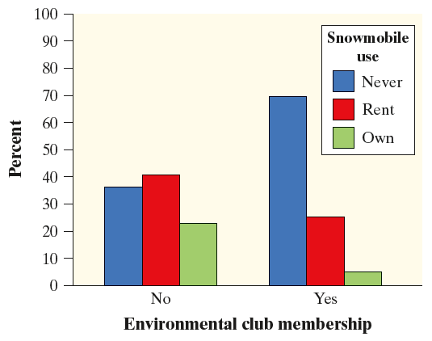
Relationships Between Two Categorical Variables
Side-by-side Bar Graph
A segmented bar graph displays the distribution of a categorical variable as segments of a rectangle, with the area of each segment proportional to the
percent of individuals in the corresponding category.

Slide 34
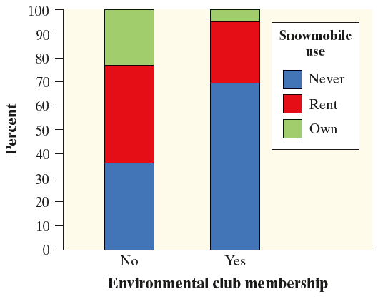
Relationships Between Two Categorical Variables
Side-by-side Bar Graph
Segmented Bar Graph

Slide 35
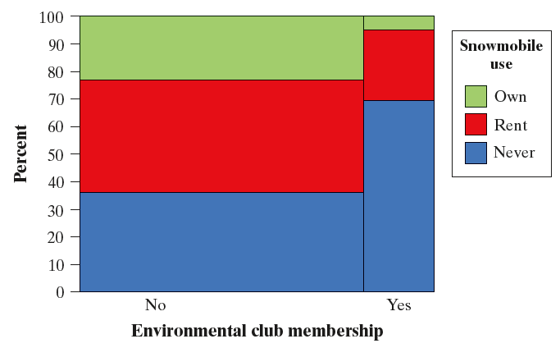
Relationships Between Two Categorical Variables
A mosaic plot is a modified segmented bar graph in which the width of each rectangle is proportional to the number of individuals in the corresponding category.
Mosaic Plot

Slide 36
Relationships Between Two Categorical Variables
There is an association between two variables if knowing the value of one variable helps us predict the value of the other.

Slide 37
Relationships Between Two Categorical Variables
There is an association between two variables if knowing the value of one variable helps us predict the value of the other.

Slide 38
Relationships Between Two Categorical Variables
There is an association between two variables if knowing the value of one variable helps us predict the value of the other.
If knowing the value of one variable does not help us predict the value of the other, then there is no association between the variables.

Slide 39
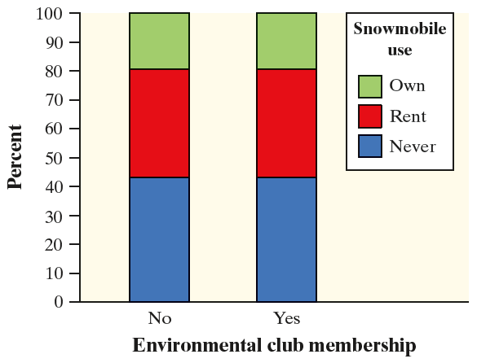
Relationships Between Two Categorical Variables
There is an association between two variables if knowing the value of one variable helps us predict the value of the other.
If knowing the value of one variable does not help us predict the value of the other, then there is no association between the variables.

Slide 40
Relationships Between Two Categorical Variables
There is an association between two variables if knowing the value of one variable helps us predict the value of the other.
CAUTION: Association does not necessarily imply causation!
If knowing the value of one variable does not help us predict the value of the other, then there is no association between the variables.

Slide 41
Section Summary
MAKE and INTERPRET bar graphs for categorical data.
IDENTIFY what makes some graphs of categorical data misleading.
CALCULATE marginal and joint relative frequencies from a two-way table.
CALCULATE conditional relative frequencies from a two-way table.
Use bar graphs to COMPARE distributions of categorical data.
DESCRIBE the nature of the association between two categorical variables.

